Slide 1
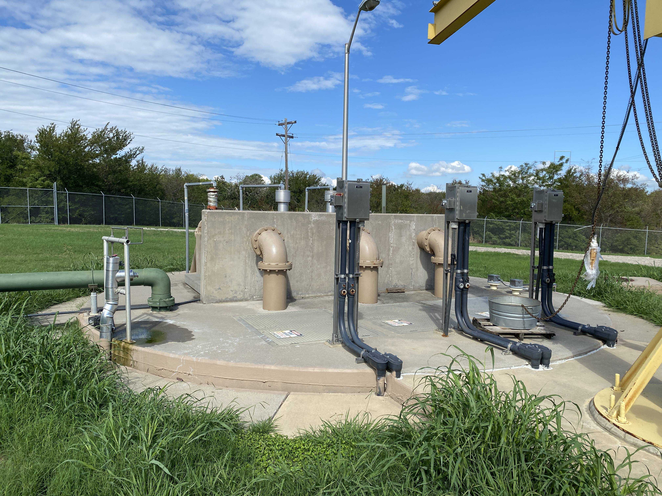
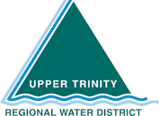
Reducing Risk at the District’s Riverbend WWTP Influent
Lift Station
Paul Banschbach, PE

Slide 2
Over the next 20 minutes, we will discuss the following..
Existing Lift Station Capacity & Condition Concerns
Alternatives Overview
Bidding Update

Slide 3

Existing Lift Station Capacity & Condition Concerns

Slide 4
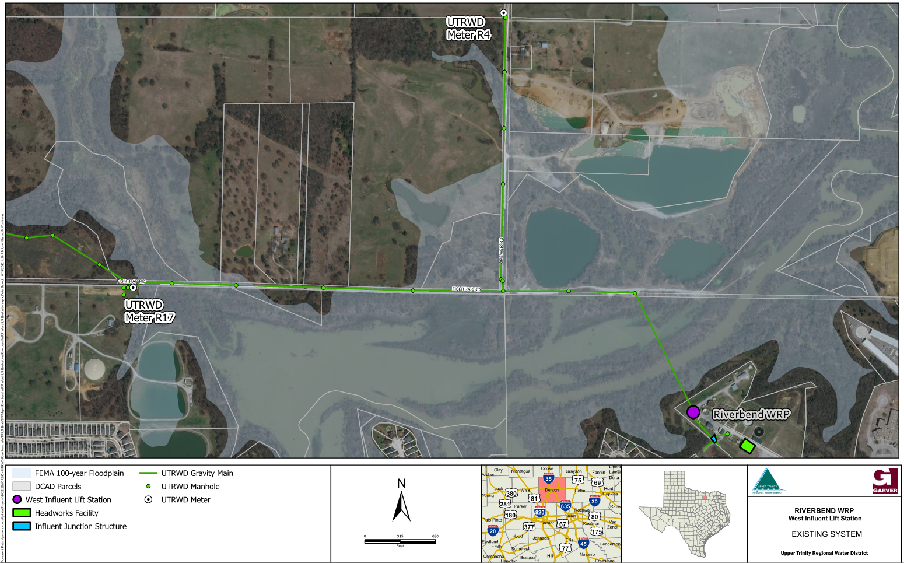
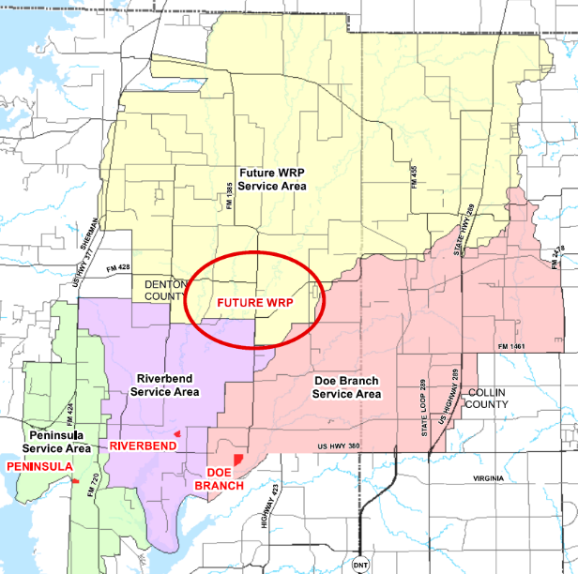
The existing west influent lift station serves the area north of Lewisville Lake in the Riverbend WRP service area.
36” inverted siphon

Slide 5
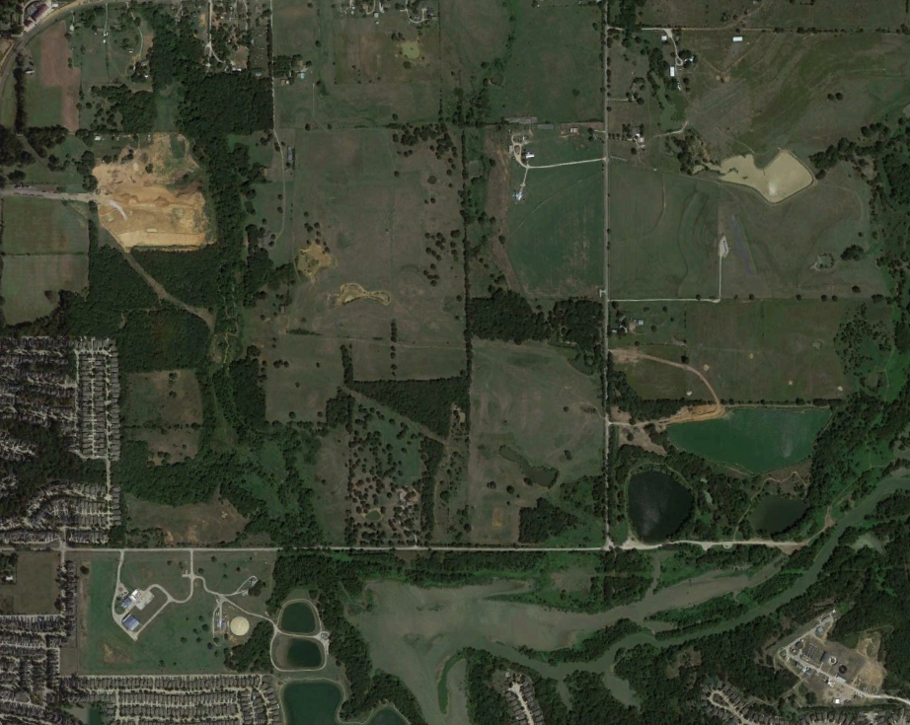
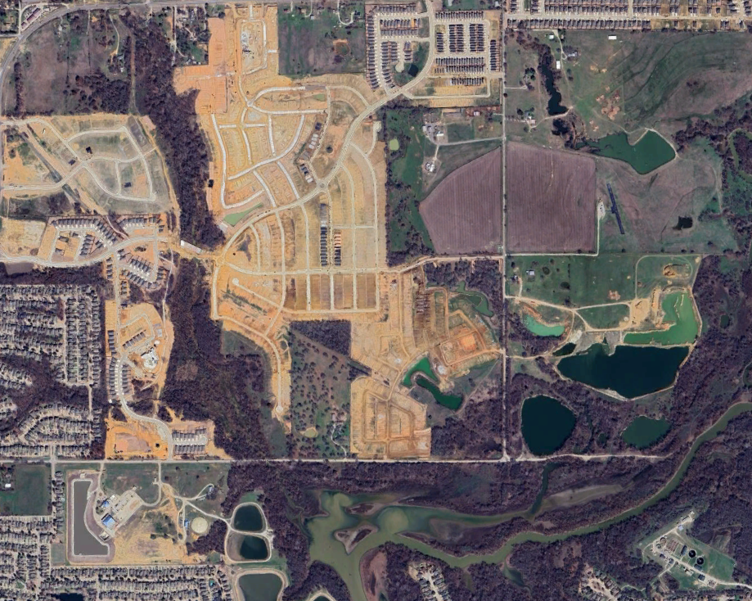
Fast moving developments required urgent capacity upgrades at the lift station.
2019
2025

Slide 6
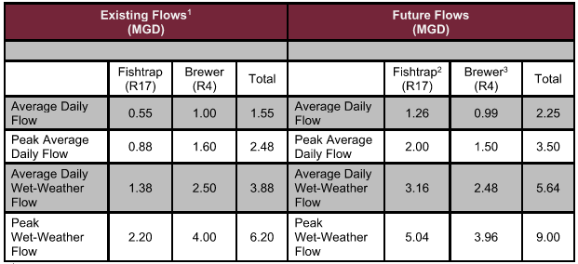
Based on system modeling and pending developments, the WILS needed to be upgraded from 6.2 MGD to 9 MGD with buildout flows exceeding 17 MGD.
Existing Flows¹ (MGD) |  |  |  | Future Flows (MGD)
 | Fishtrap (R17) | Brewer (R4) | Total |  | Fishtrap² (R17) | Brewer³ (R4) | Total
Average Daily Flow | 0.55 | 1.00 | 1.55 | Average Daily Flow | 1.26 | 0.99 | 2.25
Peak Average Daily Flow | 0.88 | 1.60 | 2.48 | Peak Average Daily Flow | 2.00 | 1.50 | 3.50
Average Daily Wet-Weather Flow | 1.38 | 2.50 | 3.88 | Average Daily Wet-Weather Flow | 3.16 | 2.48 | 5.64
Peak Wet-Weather Flow | 2.20 | 4.00 | 6.20 | Peak Wet Weather Flow | 5.04 | 3.96 | 9.00

Slide 7
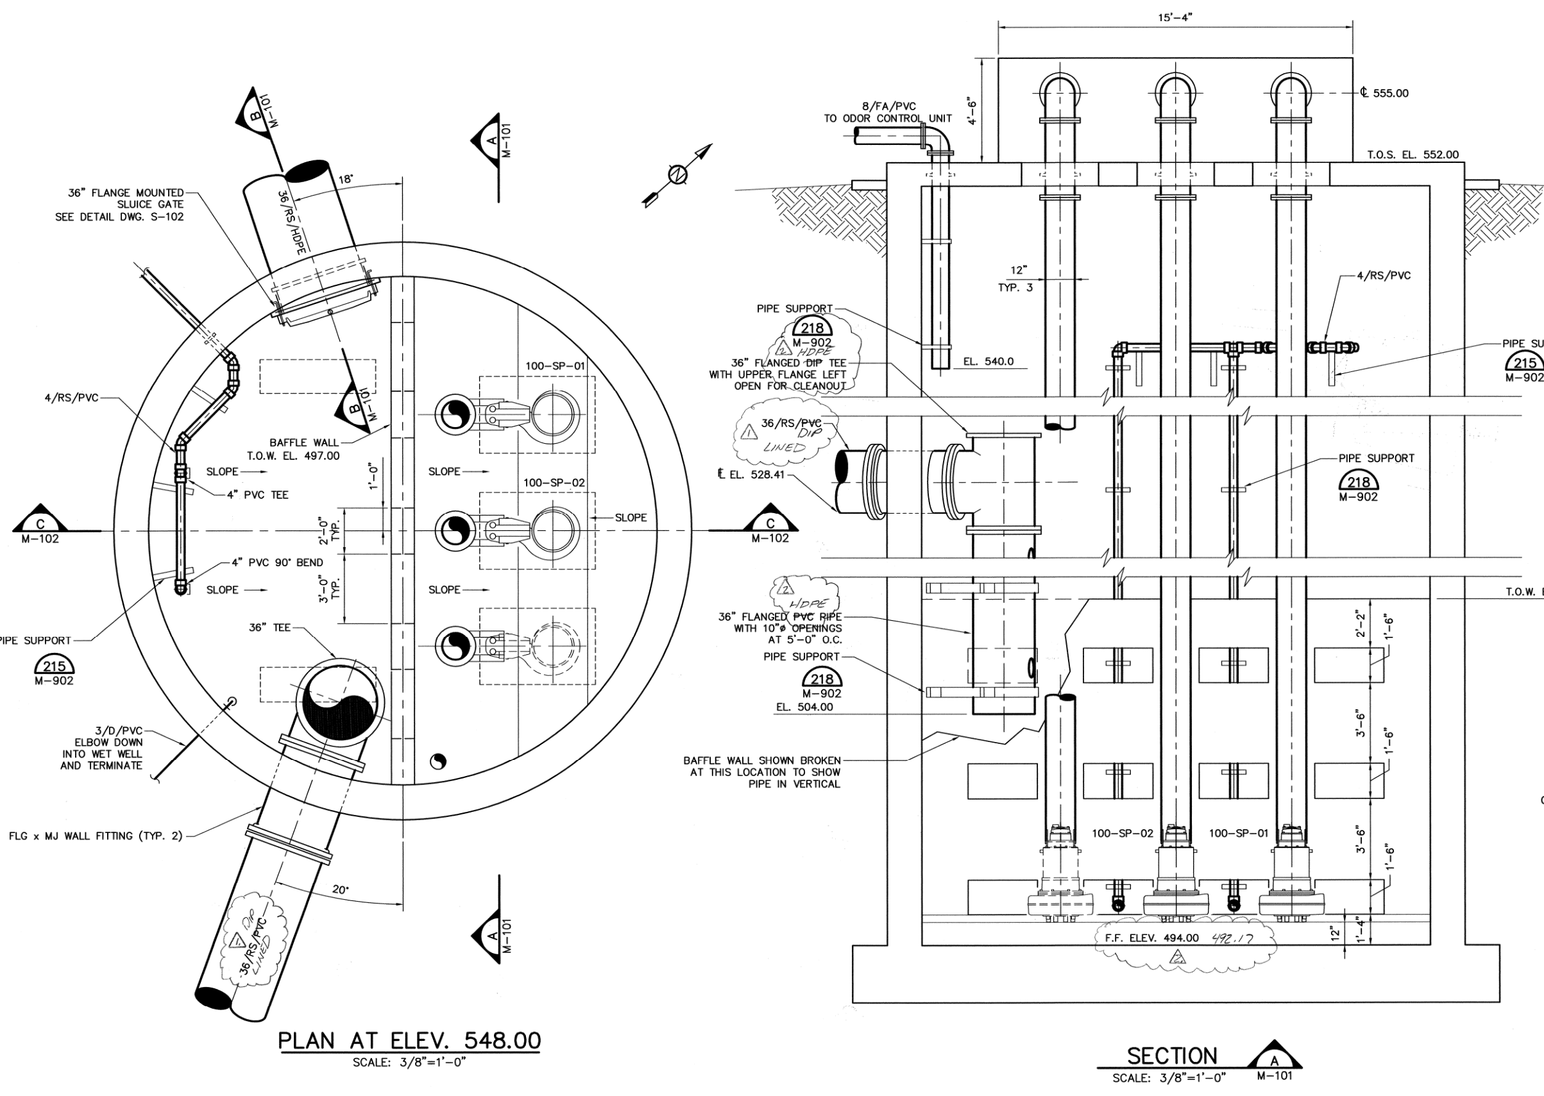
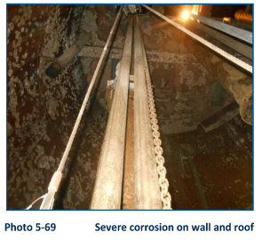
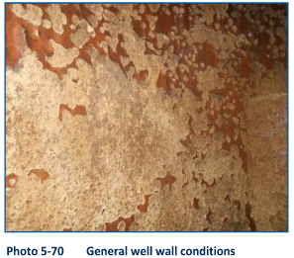
With the existing wet well depth and configuration, regular maintenance is challenging resulting in severe condition issues.
60’
Pump guiderails are corroded

Slide 8
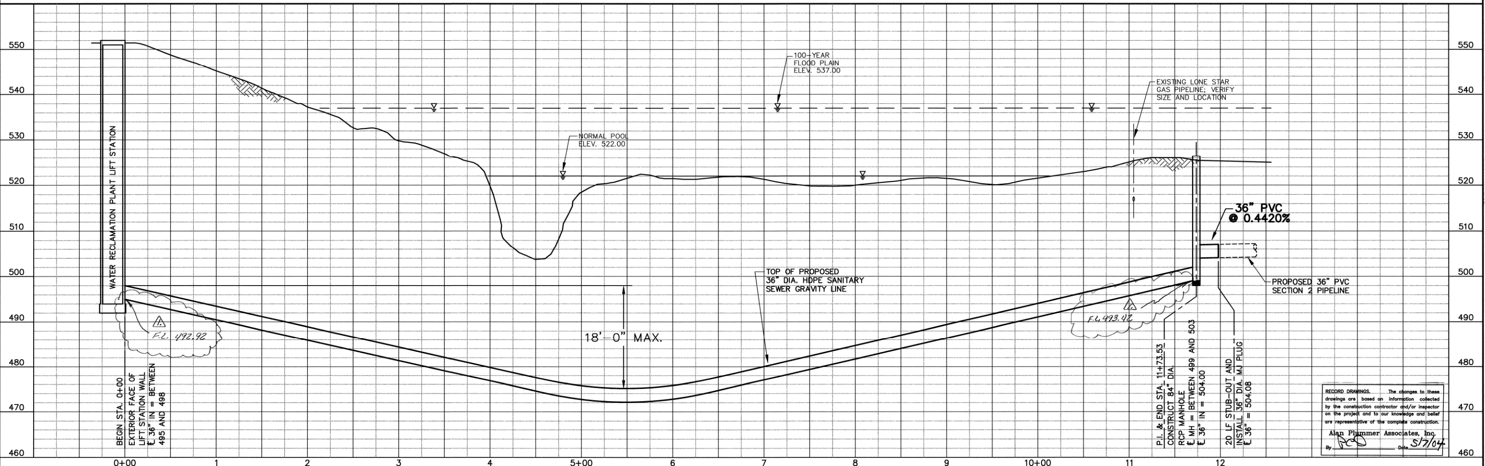
Velocities through the existing inverted siphon are below 2 FPS causing sediment deposition creating issues at the lift station during flushing events

Slide 9
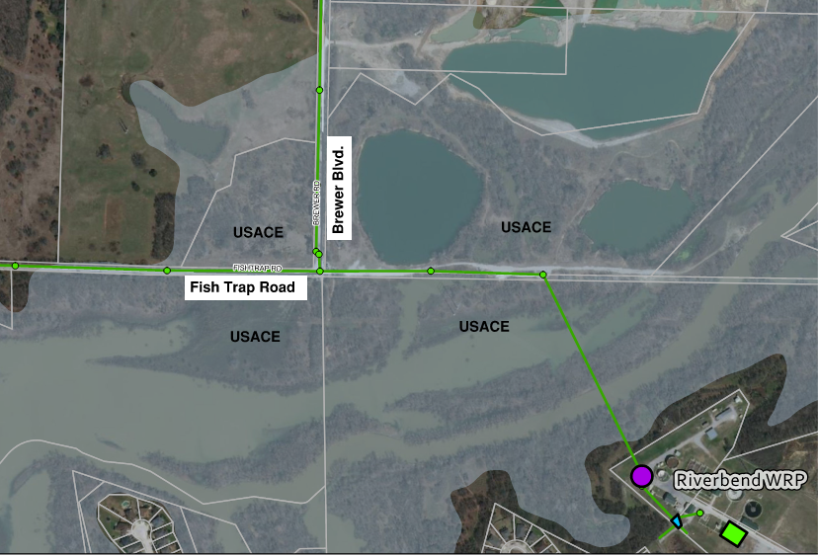

The USACE is the primary external stakeholder, and any new easement requests come with lengthy permitting efforts.
Brewer Blvd.
Fish Trap Road

Slide 10

Alternatives Overview

Slide 11

We initially investigated rehabilitating the existing lift station but identified multiple high-risk concerns
11

Slide 12
The nearest manhole is on the north side of the lake limiting bypass pumping options for the lift station rehab.

Slide 13
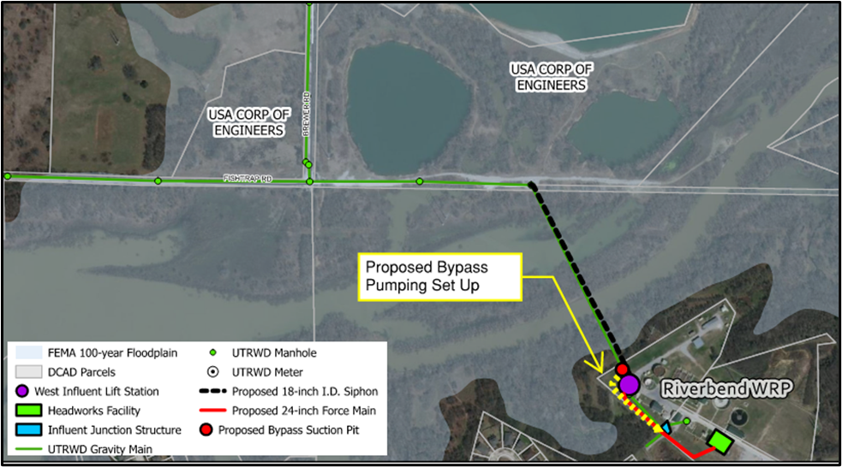
To bypass the wet well for rehabilitation, a second 60’+ suction pit would need to be installed on the south side of the Lake requiring high risk construction
Bypass pumping was estimated to be $2.5M+

Slide 14
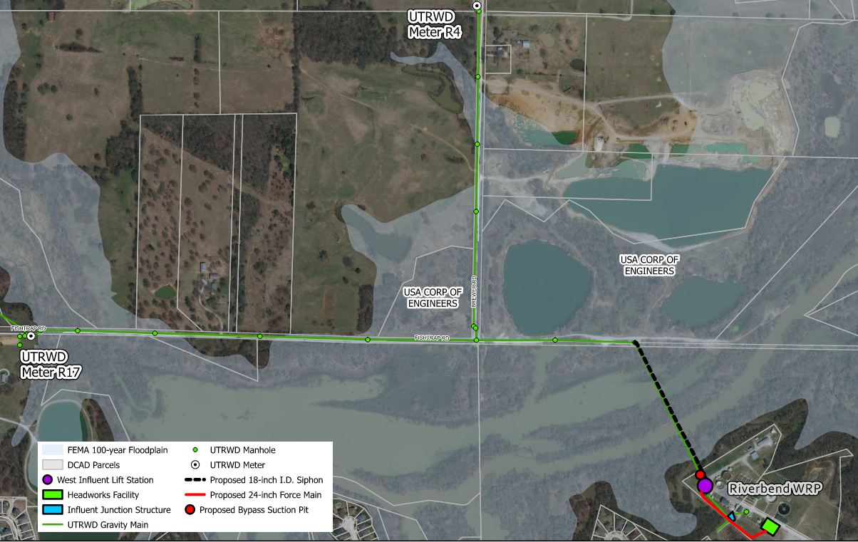
An 18-inch dry weather flow siphon could be installed to increase scouring velocities, but the existing siphon would still be utilized for peak events

Slide 15
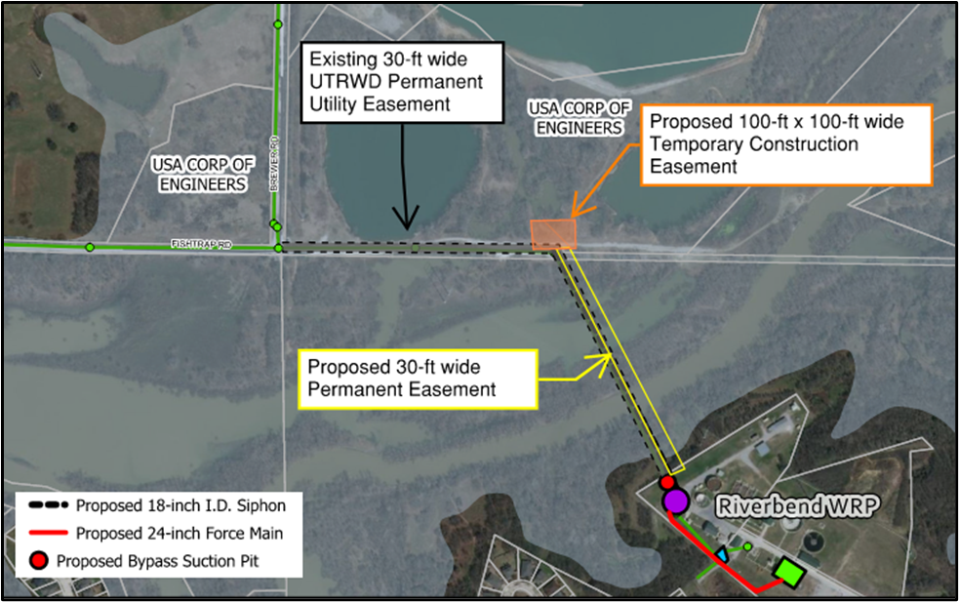
Additional easements from the USACE would be needed for installation of the dry weather siphon adding schedule risk

Slide 16
The 60’ deep wet well would remain a challenge to maintain with limited operational flexibility
60’

Slide 17
Replacing the pumps in the wet well would increase capacity; however, full build out flows would not be achieved resulting in a second future lift station.
Improvements identified in Lift Stations Condition Assessments Report (August 2022)
Recoat surfaces within wet well and associated site manholes
Replace pump guide rails in the wet well
Replace 10-inch ductile iron discharge piping in the wet well
Replace VFD for Pump No. 3
Perform electrical maintenance work on electrical and I/C assets, including level transducer and pump pressure gauges
Replace submersible pump
Garver recommends replacing all pumps to 7.5 MGD for total pumping capacity of 15 MGD

Slide 18



The rehabilitation alternative could be implemented quickly but came with significant cons
Pros
Cons
Lowest Cost
WILS wet well remains at 60’ deep
Quickest to implement
Two siphon barrels to maintain and operate
Immediate capacity relief with bypass
pumping operations
Additional gravity infrastructure in USACE property
WILS can be upgraded to pump 15 MGD
Further expansion of WILS (>15 MGD) will be challenging
ADF siphon barrel should improve
sediment and rag issues
High-risk bypass operation
Significant cost spent on bypass and not on infrastructure

Slide 19
We identified major risks associated with the upgrading the existing lift station
High risk bypass pumping
Limited ability to fix the sediment issues in the inverted siphon
The 60-foot-deep wet well is not maintainable
The full buildout flows would likely require a second lift station
Potential permitting delays with the USACE

Slide 20
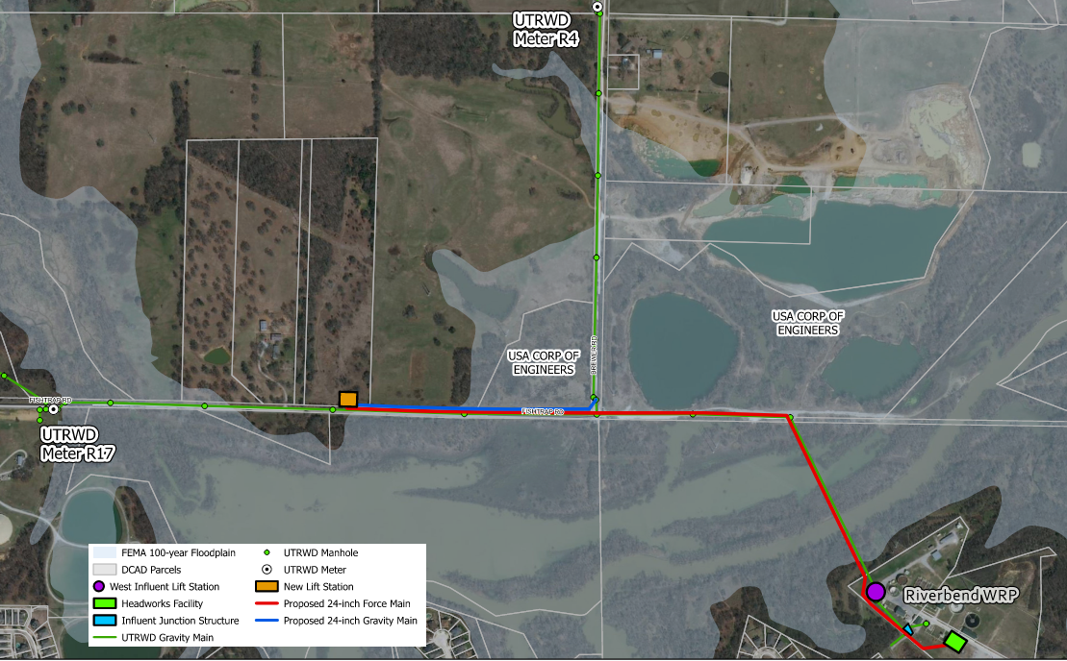
To mitigate the rehabilitation risks, we proposed relocating the lift station to the north side of the lake
New 10 MGD lift station
New 24-inch force main
Decommission WILS
Bypass pumping eliminated!

Slide 21
The lake crossing was designed as a force main with increased velocities to limit sediment deposition
21

Slide 22
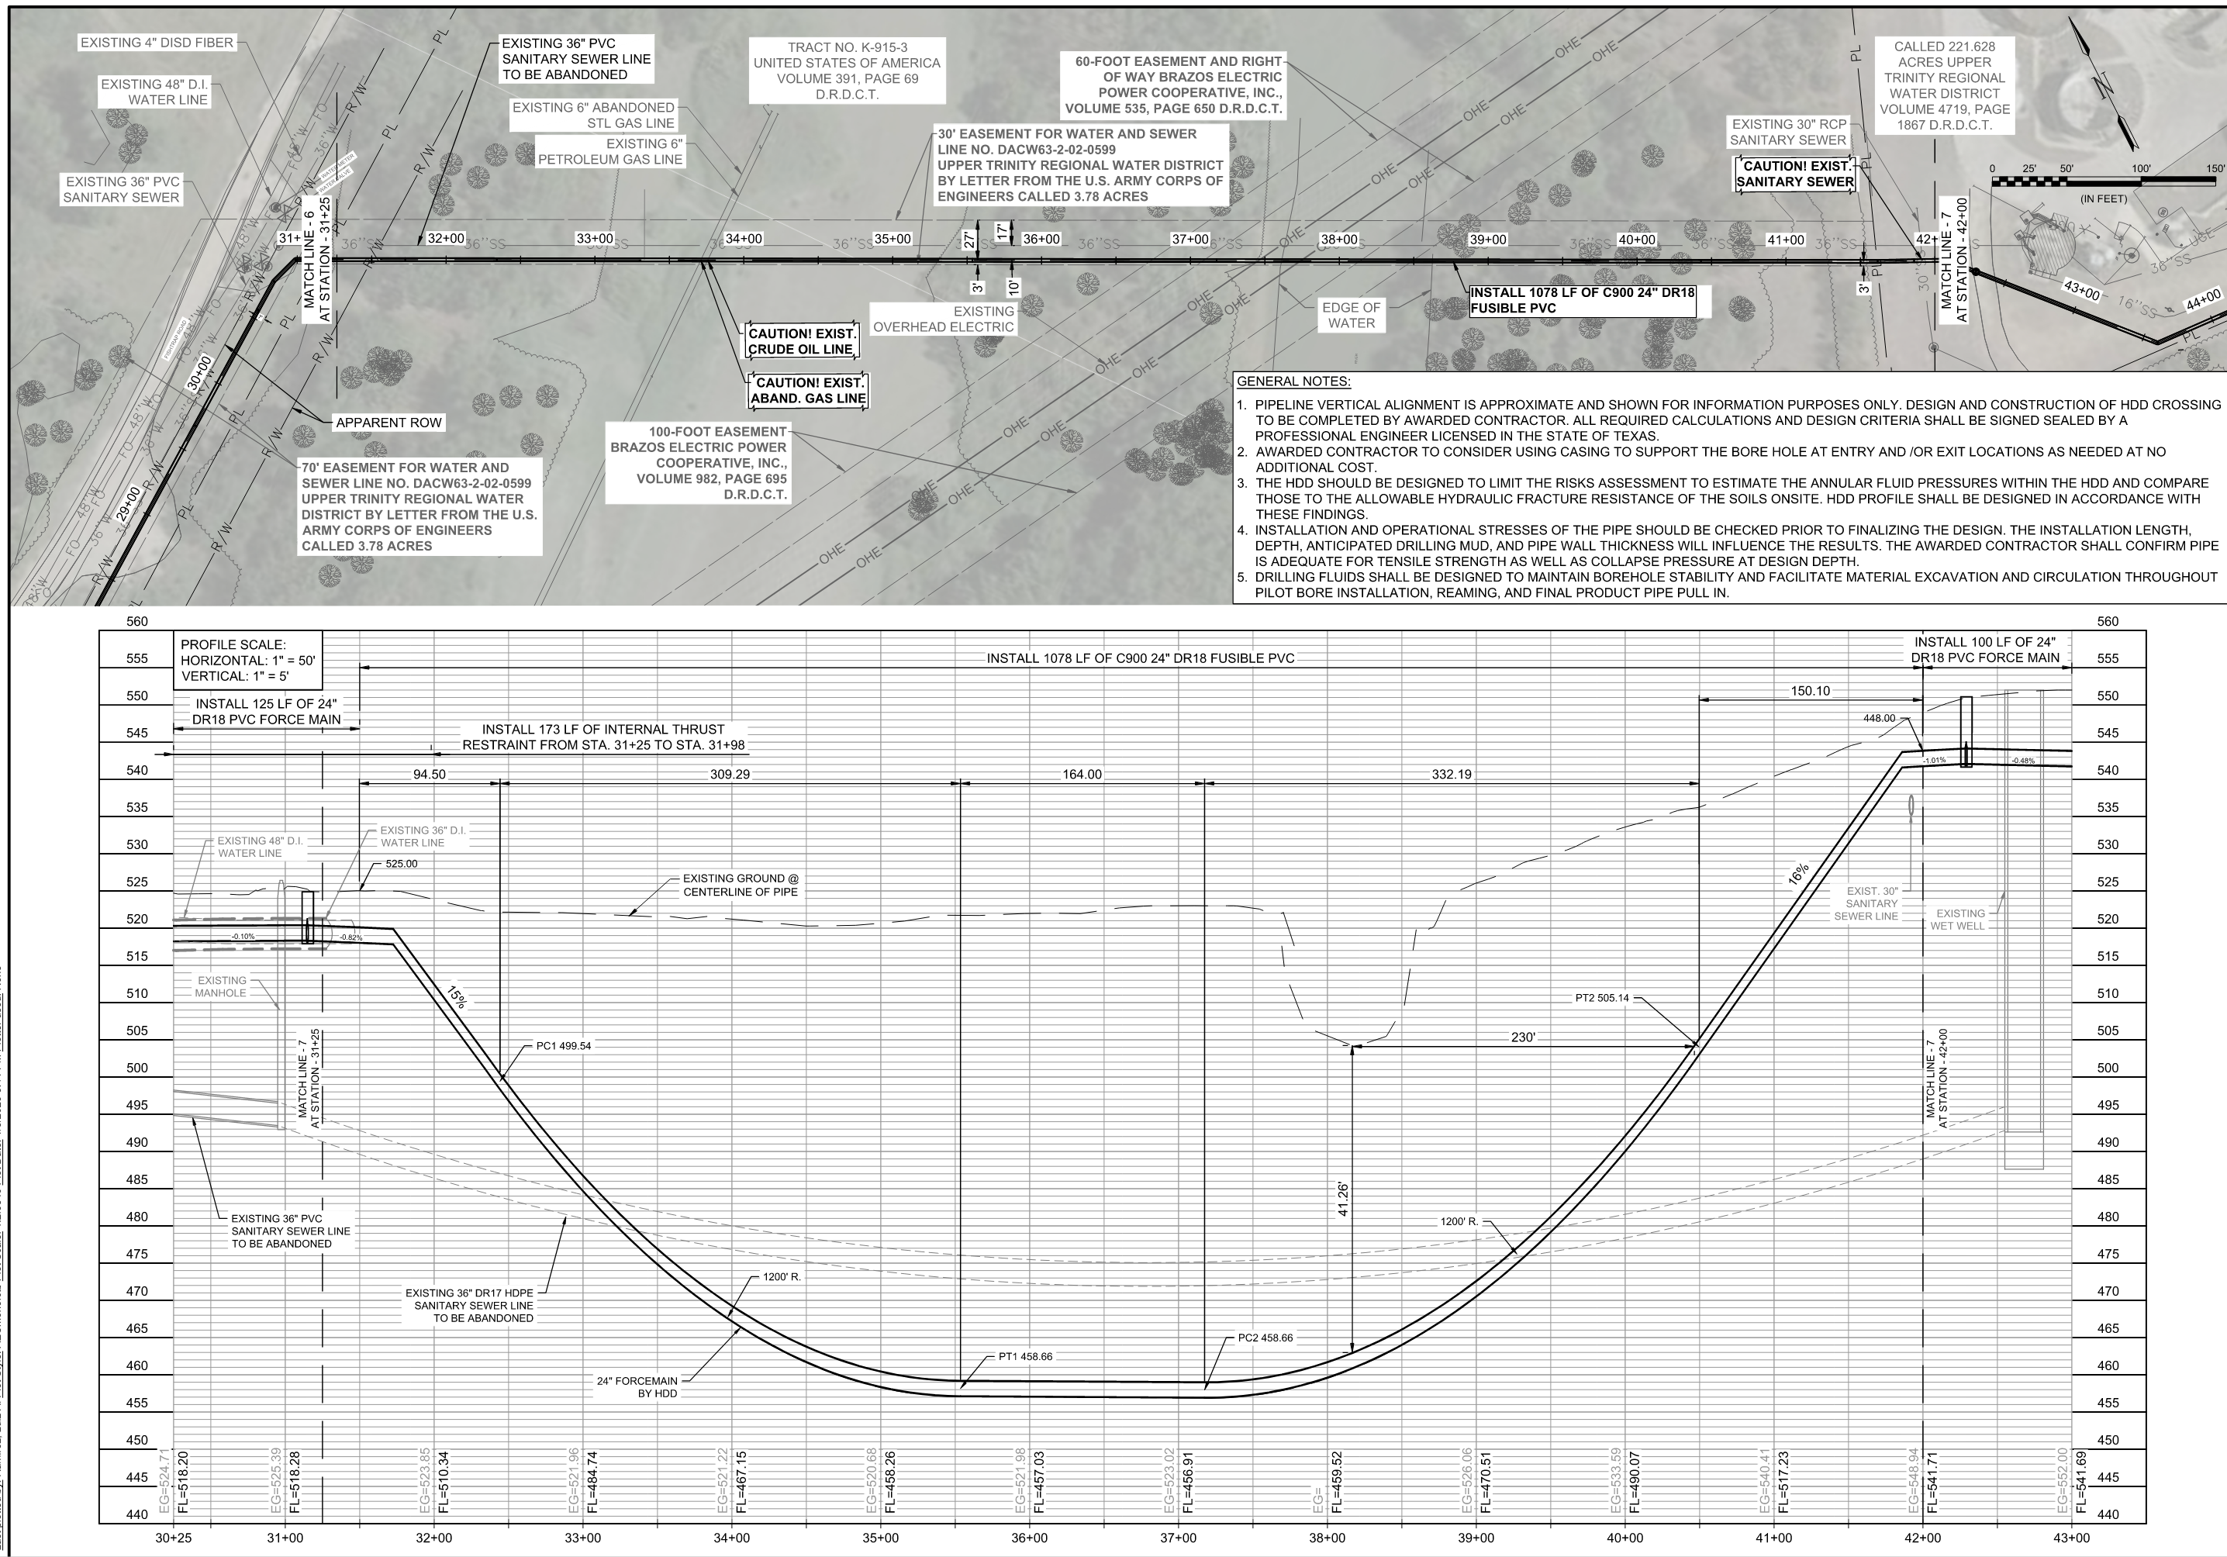
To minimize USACE permitting, the lake crossing was proposed to be installed by HDD to limit deep pits in the floodplain and additional permitting needs.

Slide 23
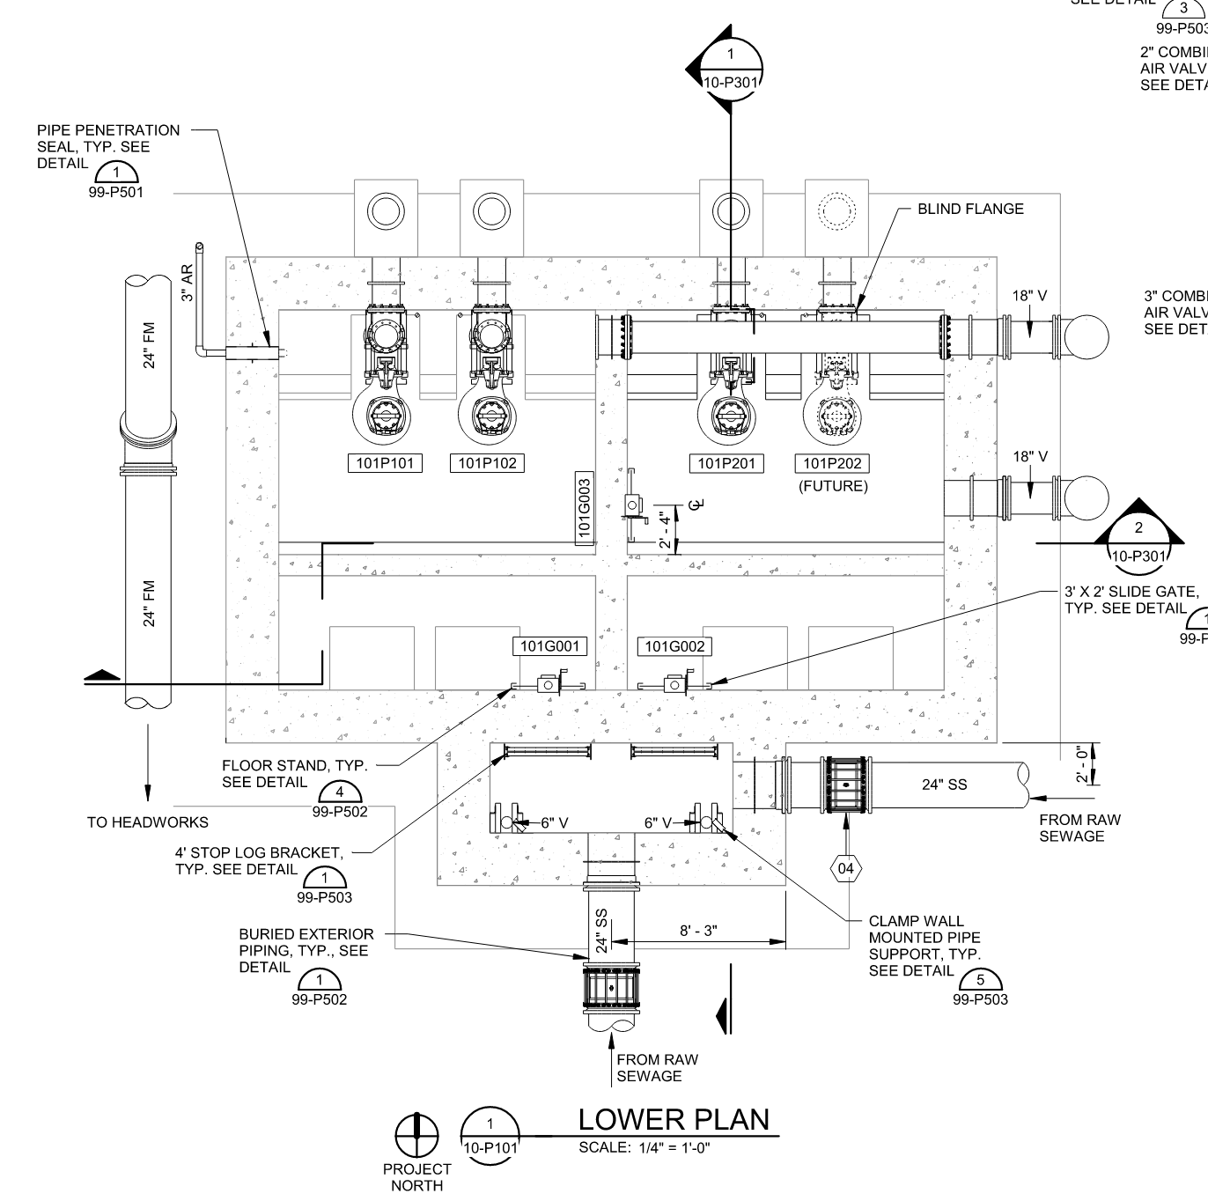
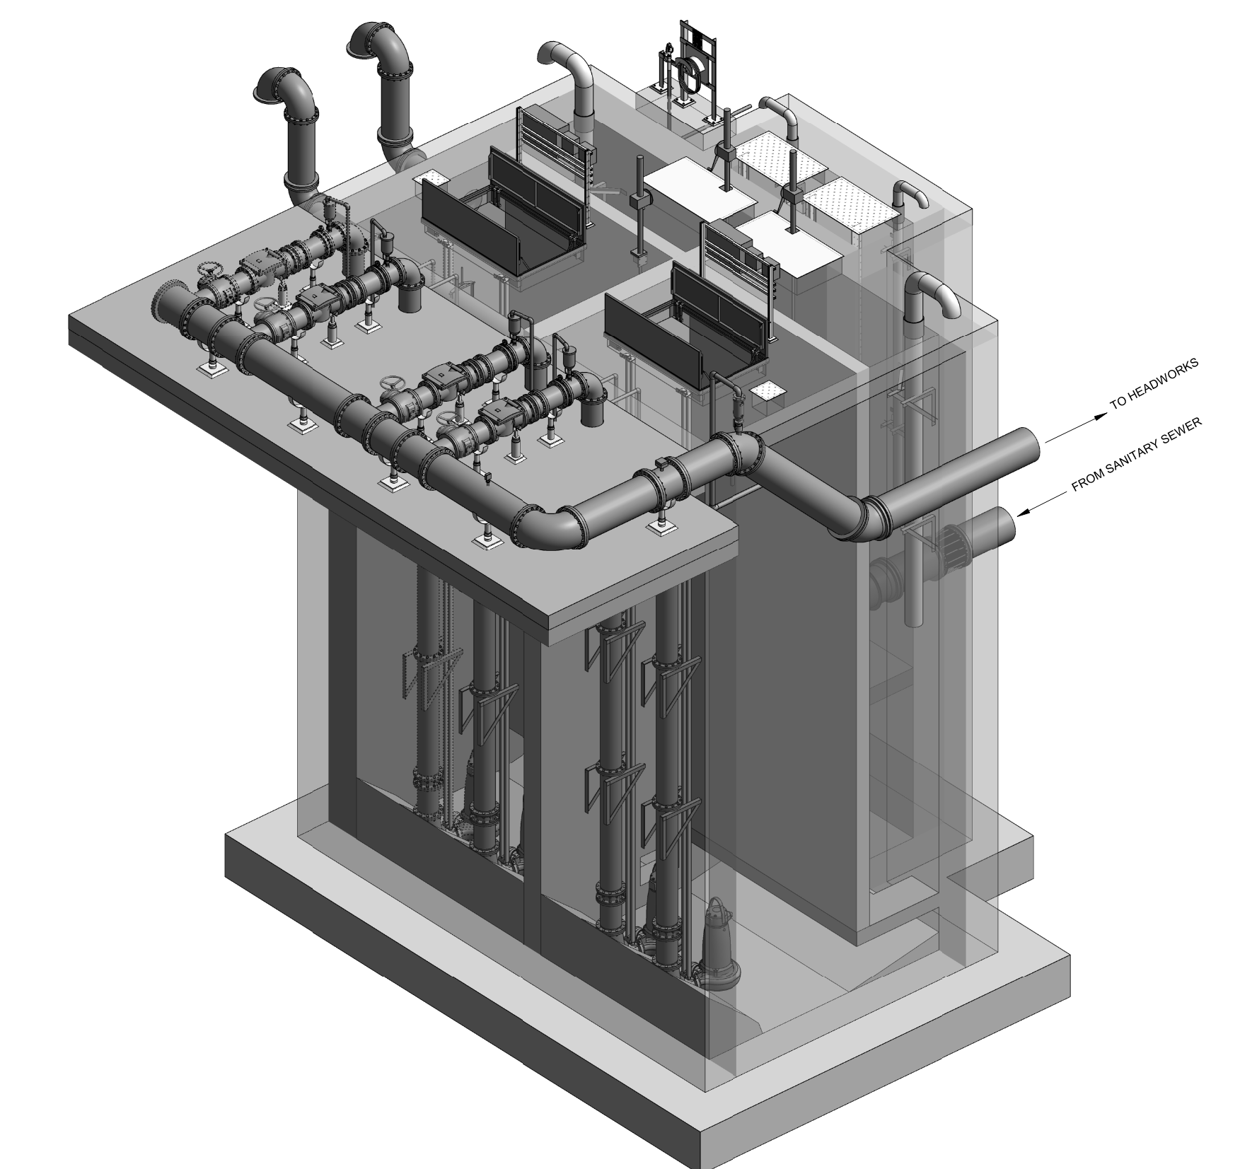
A new lift station wet well provided the opportunity to design for ease of maintenance and to reduce downtime risks.

Slide 24
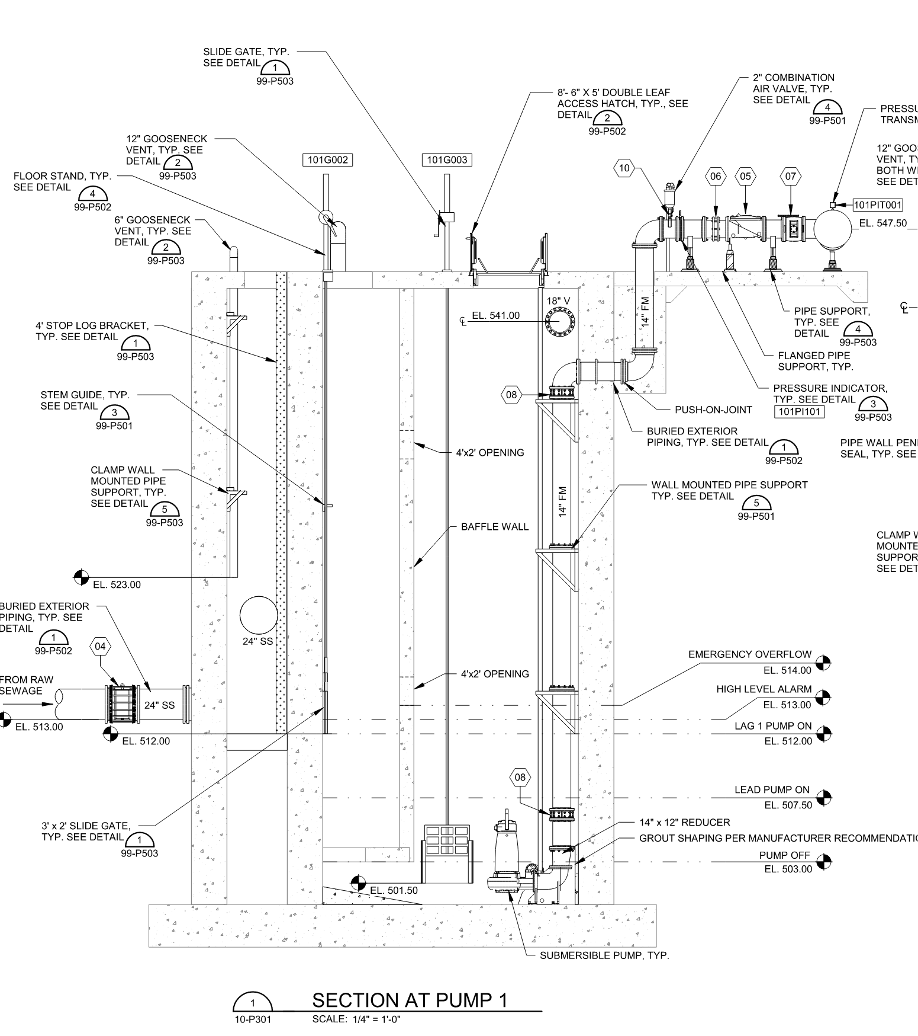
With fewer gravity pipe restrictions, the wet well depth could be reduced for safer operator access.
The 60’ deep wet well would remain a challenge to maintain with limited operational flexibility
45’

Slide 25
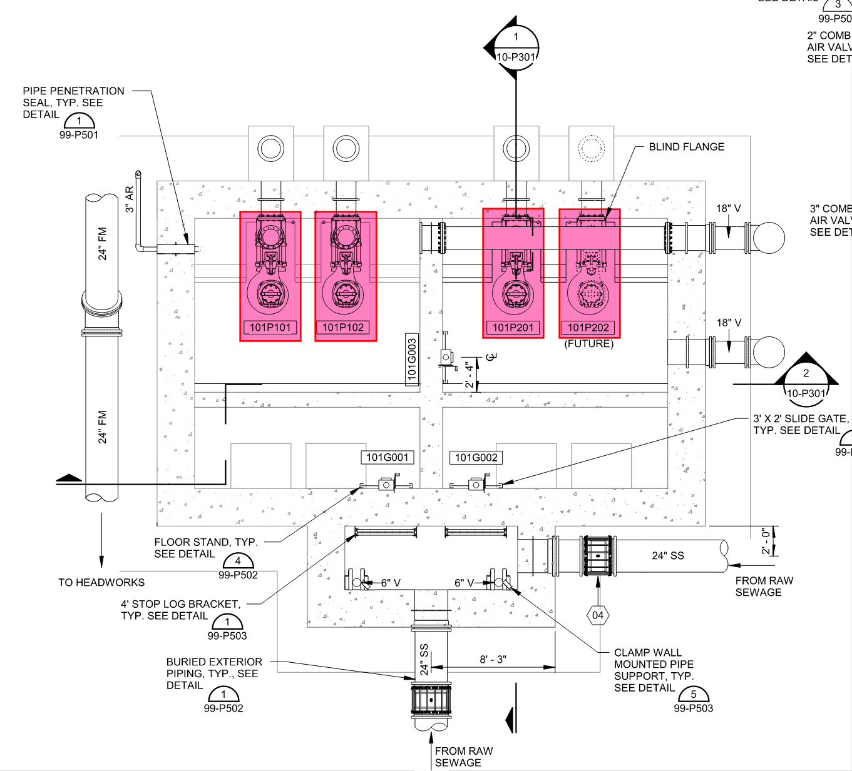
Pumps will be replaced in the future to reach full buildout flows of 17 MGD and additional upgrades be limited.
The 60’ deep wet well would remain a challenge to maintain with limited operational flexibility

Slide 26
The new lift station site reduced high risk items and provides the long-term solution for the District
Pros
Cons
Adequate pumping capacity
Longest lead time for additional pumping capacity (2-3 years)
Shallower wet well depth (45’)
Property acquisition needed for new lift station site
Easier access during inspection and maintenance
Significant temporary construction easement needs
Eliminates inverted siphon and related heavy solids deposition
Lift station can be designed for easy expansion as contributing area continues to develop
Limited use of bypass pumping
Pros | Cons
Adequate pumping capacity Shallower wet well depth (45’) Easier access during inspection and maintenance Eliminates inverted siphon and related heavy solids deposition Lift station can be designed for easy expansion as contributing area continues to develop Limited use of bypass pumping Eliminates system surcharging Infrastructure in USACE property limited to pressure pipe and ARVs | Longest lead time for additional pumping capacity (2-3 years) Property acquisition needed for new lift station site Significant temporary construction easement needs
Eliminates system surcharging
Infrastructure in USACE property limited to pressure pipe and ARVs

Slide 27
Alternatives Summary
Alternative | Does it Meet the Critical Success Factors? |  |  |  |  | OPCC
 | Bypass flows from the WILS | Increases Pumping Capacity of the WILS | Mitigate Sediment Issues in 36-inch Siphon | Improves wet well accessibility for future maintenance | Minimize 100-year floodplain infrastructure and USACE Impact
New Lift Station, New Force Main, Decommission WILS | Yes | Yes | Yes | Yes | Yes | $16,526,250
Bypass Suction Pit, Rehab WILS, New Dry Weather Barrel Siphon | Yes | Yes | Yes | No | No | $7,792,500*
*Does not factor in future cost for a second future lift station to meet buildout flows

Slide 28

Bidding update

Slide 29
Bids were recently received for the Lift Station and lake crossing were in line with our original estimates.
WILS Bids | Total Bid
Bidder #1 | $11,953,375
Bidder #2 | $12,142,000
Bidder #3 | $12,430,000
Preliminary LS OPCC | $12,750,000
Lake Crossing Bids | Total Bid
Bidder #1 | $1,420,640
Preliminary HDD OPCC | $1,350,000

