Slide 1



Texas Association of Clean Water Agencies
Wastewater PFAS Challenges and Proactive Management
David L. Clark, PE, WEF Fellow
Patrick R. Young, PE
February 28, 2025

Slide 2
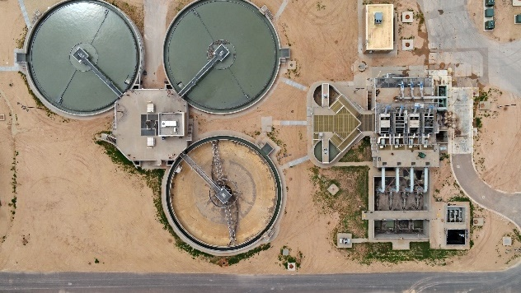
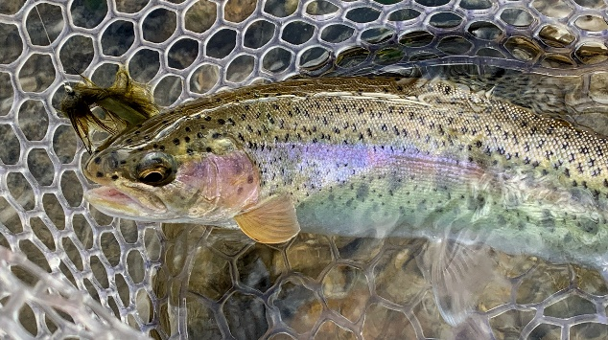
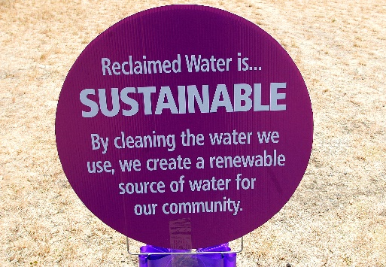
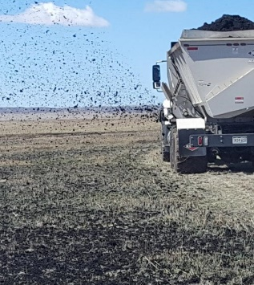
Wastewater PFAS Challenges and Proactive Management
Notes:
A few comments to get started on Wastewater specific issues

Slide 3


Wastewater PFAS Challenges and Proactive Management
Preserving Sustainable Effluent Management, Reuse, and Biosolids Beneficial Reuse
PFAS Regulation and Compliance Management
  Recent Updates
Wastewater Treatment
  Human Health Water Quality Criteria
Biosolids Management
  EPA Risk Assessment
Source Control
  Monitoring and Preparing Pretreatment Programs
Very Briefly:
  Domestic and Commercial PFAS Management
  Strategic Communications

Slide 4
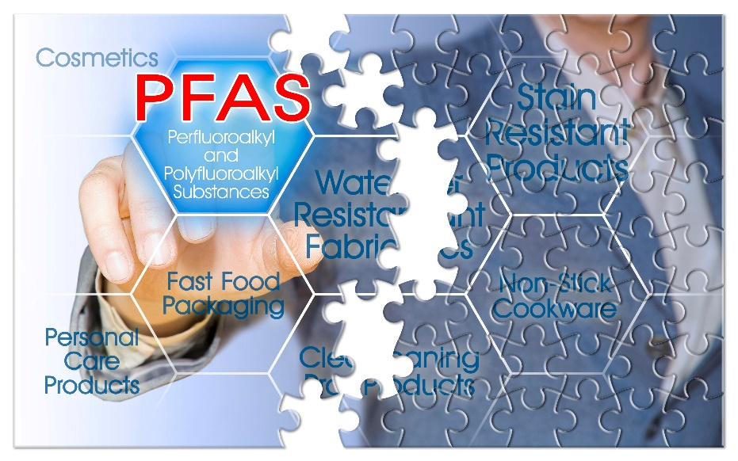
Preserving Sustainable Effluent Management, Reuse, and Biosolids Beneficial Reuse
PFAS Monitoring: Wastewater Influent, Effluent & Biosolids
  Ubiquitous Commercial PFAS Chemicals
Source Reduction Focus
  Industrial Pretreatment is Key
  Domestic and Commercial Challenges
Product Stewardship
  Chemical Action Plans (CAP)
Support Good Science
  EPA’s Risk Assessment
Strategic Communications
  Convey Accurate, Reliable, Science-based Information
Notes:
Here’s a summary of the top things to consider right Now to preserve and protect effluent quality and beneficial Biosolids Reuse.
First, we need to monitor to quantify current conditions and where we’re beginning
Next, we need to focus on Source Reduction and Pretreatment is Key
For the sources that aren’t easily reduced by Industrial/Commercial Source control, we’ll need other Product Stewardship tools, such as Chemical Action Plans
We want to support good science to inform regulatory requirements and policy. And avoid uninformed knee jerk policy restrictions
And we need to Communicate with our base; Wastewater Customers

Slide 5
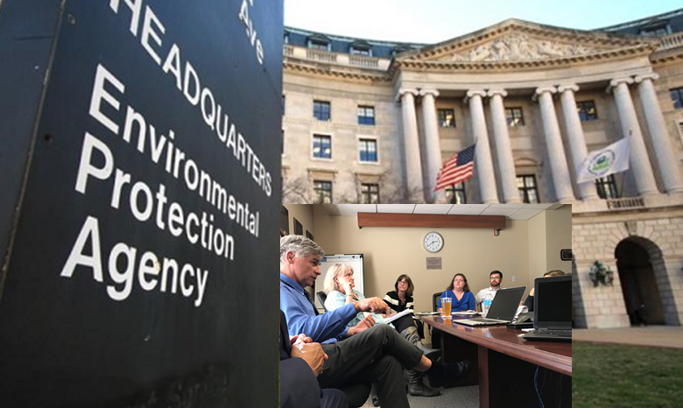


PFAS Regulation and Compliance Management
Updates
NPDES Permits
Human Health Water Quality Criteria
Biosolids Risk Assessment
Notes:
Ok, let’s shift gears to Compliance strategies

Slide 6
EPA’s December 5, 2022 Memo: State Issued NPDES Permits and Pretreatment Programs 1
B. Recommendations for Publicly Owned Treatment Works
  1. All POTWs
  2. Effluent, influent, and biosolids monitoring
    40 PFAS parameters detectable by draft Method 1633 at least quarterly
    Adsorbable Organic Fluorine Method 1621 can be used in conjunction
  3. Pretreatment program activities
    Update IU Inventory
    Utilize BMPs and pollution prevention to address PFAS discharges
      Develop IU BMPs or local limits.
December 5, 2022 EPA Memorandum
Addressing PFAS Discharges in NPDES Permits and Through the Pretreatment Program and Monitoring Programs
Notes:
EPA’s December 5, 2022 does just that on all POTW NPDES permit
Calls for Influent, Effluent, and Biosolids monitoring using Method 1633

Slide 7
EPA’s December 5, 2022 Memo: State Issued NPDES Permits and Pretreatment Programs 2
C. Recommended Biosolids Assessment
  a. Use draft Method 1633 to analyze biosolids for presence of 40 PFAS chemicals
  b. Where present in biosolids from industrial sources, EPA recommends…
    Update IU permits/control mechanisms to require quarterly monitoring
    Develop IU BMPs or local limits
    Issue IU control mechanisms
  c. Validate PFAS reductions with regular monitoring of biosolids.
December 5, 2022 EPA Memorandum
Addressing PFAS Discharges in NPDES Permits and Through the Pretreatment Program and Monitoring Programs
Notes:
And EPA’s December 5, 2022 Memo also calls for Biosolids Assessment using Method 1633

Slide 8
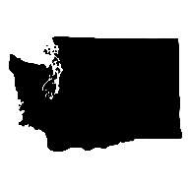



Example 2023 Washington NPDES Permit PFAS Requirements
S6.F. Pretreatment Identification and Control of PFAS
  By April 1, 2025 Update or revise IU inventory
    EPA Targeted Industries
  By July 1, 2025, begin including a requirement in pretreatment permits for the pretreatment permittee to complete a PFAS pollution prevention/source reduction evaluation.
  By July 1, 2025, evaluate other best management practices and pollution prevention strategies it can include in pretreatment permits to control the discharge of PFAS from IUs.
Notes:
We’re seeing that now in recent NPDES permits
Here’s a draft NPDES permit from Washington
Requires utilities to stand-up a Pretreatment Program for PFAS
Includes specific dates for the following:
1. Conduct Industrial User Survey
2. Include Pollution Prevention Plan for PFAS
3. BMPs for PFAS

Slide 9
PFAS Strategic Roadmap: Surface Waters
Draft 2022 Aquatic Life Ambient Water Quality for Perfluorooctanoic acid (PFOA) and Perfluorooctane Sulfonic Acid (PFOS)
Acute Criteria
  PFOS 3.0 mg/L PFOA 49 mg/L
Chronic Criteria
  PFOS 0.0084 mg/L PFOA 0.0949 mg/L
Aquatic Life Criteria Unlikely to Control Wastewater Effluent Discharges

Slide 10
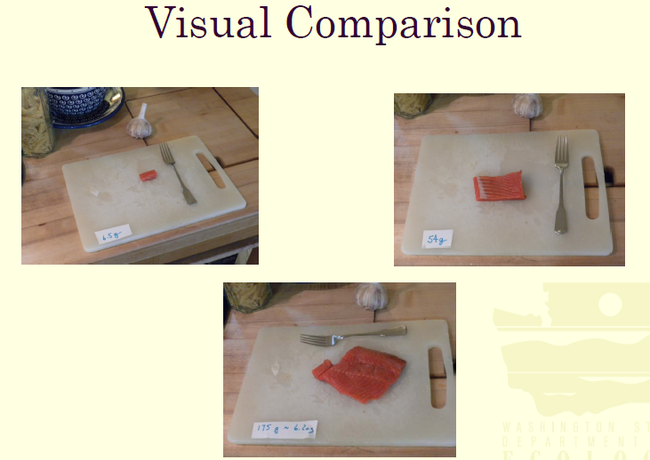
PFAS Strategic Roadmap: Surface Waters
Publish Final Recommended Ambient Water Quality Criteria for PFAS – Winter 2022 & Fall 2024
Human Health
“EPA will first develop human health criteria for PFOA and PFOS, taking into account drinking water and fish consumption”
Criteria Based on Human Fish, Shellfish, and Water Consumption and Multiple Assumptions
  Body Weight, Bioconcentration Factor, Reference Dose, Cancer Risk, Relative Source Contribution, ….
Reference: “Fish Consumption Rate Report – Brief Overview & Issues for Consideration Technical Workshop on Fish Consumption in Washington State,” Craig McCormack, Toxics Cleanup Program, Department of Ecology, December 2011

Slide 11
PFAS Strategic Roadmap: Surface Waters
Draft Human Health Ambient Water Quality Criteria for PFOA, PFOS, and PFBS. December 26, 2024
Table 1. Draft Human Health Criteria (HHC) for Three PFAS
PFOA 0.0009 ng/L (0.9 pg/L)
PFOS 0.06 ng/L (60 pg/L)
PFBS 400 ng/L (400,000 pg/L)
Draft Human Health Criteria Are Extraordinarily Low Concentrations

Slide 12

Surface Water Human Health and Aquatic Life Criteria, Analytical Laboratory Method, Drinking Water Limits
Human Health (Water + Organism)
PFOA 0.0009 ng/L
PFOS 0.06 ng/L
Aquatic Life
Acute
  PFOS 3,000,000 and PFOA 49,000,000 ng/L
Chronic
  PFOS 8,400 and PFOA 94,900 ng/L
Laboratory Method 1633
Limit of Quantification (LOQ) 1 to 4 ng/L
Method Detection Limits (MDLs)
  PFOA 0.54 ng/L, PFOS 0.63 ng/L
Final PFAS National Primary Drinking Water Regulation
HPFOA 4.0 ng/L
PFOS 4.0 ng/L
Human Health Criteria Likely to Control Wastewater Effluent Discharges

Slide 13
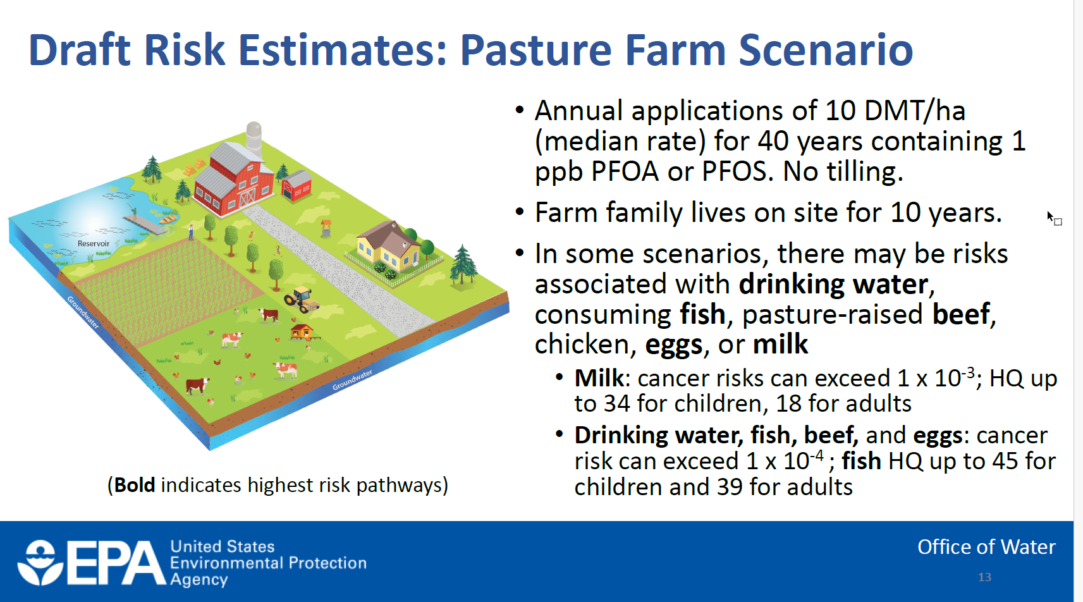
Draft Sewage Sludge Risk Assessment for PFOA and PFOS:
Information for Wastewater Treatment Plants, January 2025

Slide 14
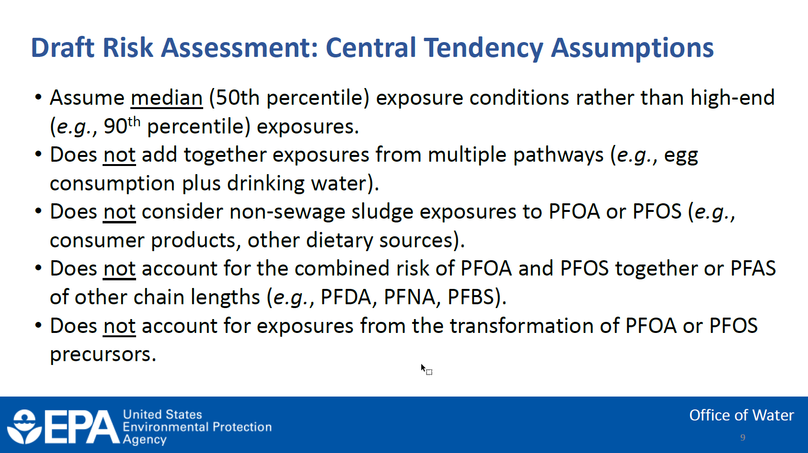
Draft Sewage Sludge Risk Assessment for PFOA and PFOS:
Information for Wastewater Treatment Plants, January 2025

Slide 15
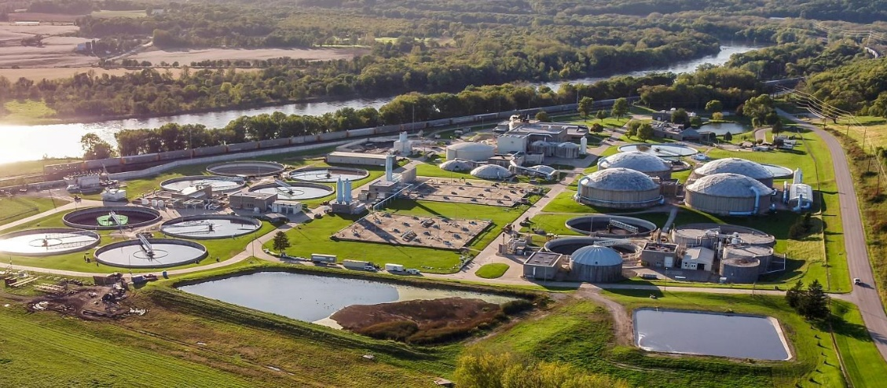
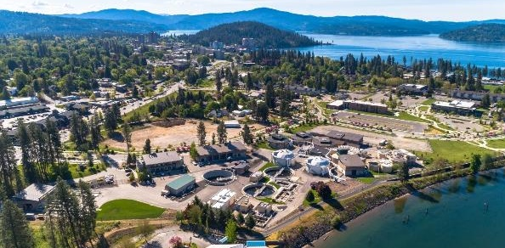
Wastewater Treatment
Updates
Human Health Water Quality Criteria
Notes:
Briefly on Wastewater treatment

Slide 16
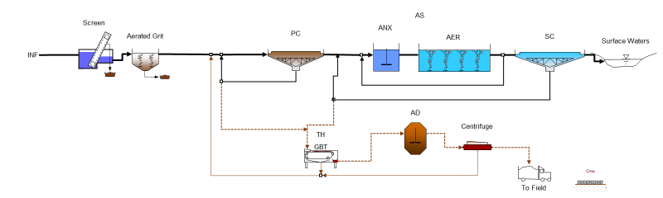
Wastewater Treatment PFAS Fate and Transport
Source Control Benefits
Water Reclamation Facility (WRF)
Influent WW
Effluent
Short-Chain PFAS Dominant in Liquid Effluent
Long-Chain PFAS Dominant in Solids
Biosolids
Industrial Pretreatment Program (IPP)
Chemical Action Plans
  Commercial Products
  Product Stewardship
Effluent
  Surface Water Discharge
  Groundwater Recharge
  Reuse
    IPR/DPR
Biosolids
  Land Application
  Incineration
  Landfill
Monitoring
Source Control
Monitoring
Reduced Loadings
Monitoring
Reduced Loadings
Notes:
Source reduction is key for Wastewater
We need to understand fate and transport of PFAS in wastewater treatment, but Source Reduction is the first step
That’s different than Drinking Water; we can’t have people drinking water contaminate with PFAS and there are treatment technologies readily available; Ion Exchange and GAC
Wastewater is more complicated because you can’t just slap a polishing step on the back of a Secondary Treatment because you’ll foul all of those precious sorption sites needed to capture the PFAS.

Slide 17
Example Wastewater Influent and Effluent PFAS for Tertiary Membrane Filtration Facility
Predominantly Residential and Commercial Service Area
Method 1633 Analysis
Draft Surface Water Human Health Criteria (Water + Organism)
PFOA 0.0009 ng/L
PFOS 0.06 ng/L
Compliance with PFOA HHWQC Requires Effluent Dilution with Clean Water of 3,600-to-1

Slide 18
National Estimate of Effluent PFOA Concentrations
National Mean Effluent PFOA 69 ± 20 ng/L
PFOA 0.0009 ng/L EPA 2024 Draft Surface Water Human Health Criteria (Water + Organism)
National Mean Effluent PFOA 69 ng/L is 77,000X HHWQC 0.0009 ng/L
  Requires 99.999% Reduction
CDM. 2024. Occurrence of PFAS Compounds in U.S. Wastewater Treatment Plants. Water Research Foundation (WRF5031).

Slide 19
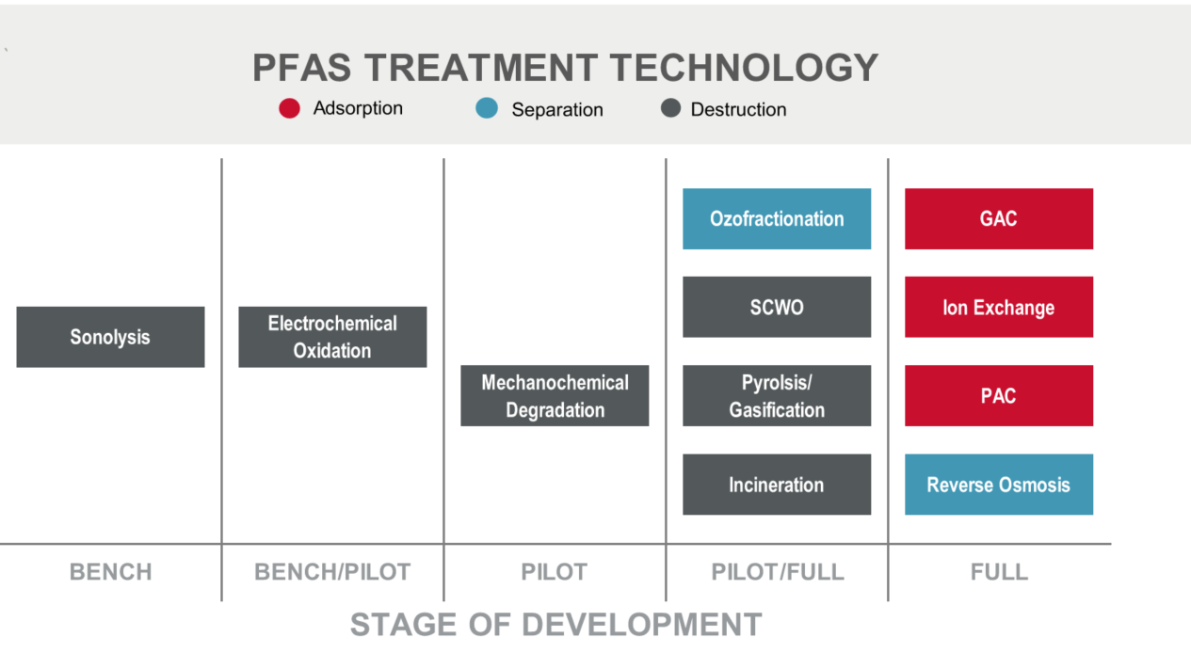
Notes:
There are 3 basic ways to remove PFAS from Water: Adsorption, Separation and Destruction
Adsorption is Ion Exchange or GAC
Separation is Reverse Osmosis
But water industry conferences are flooded with Destruction Technology presentations!

Slide 20
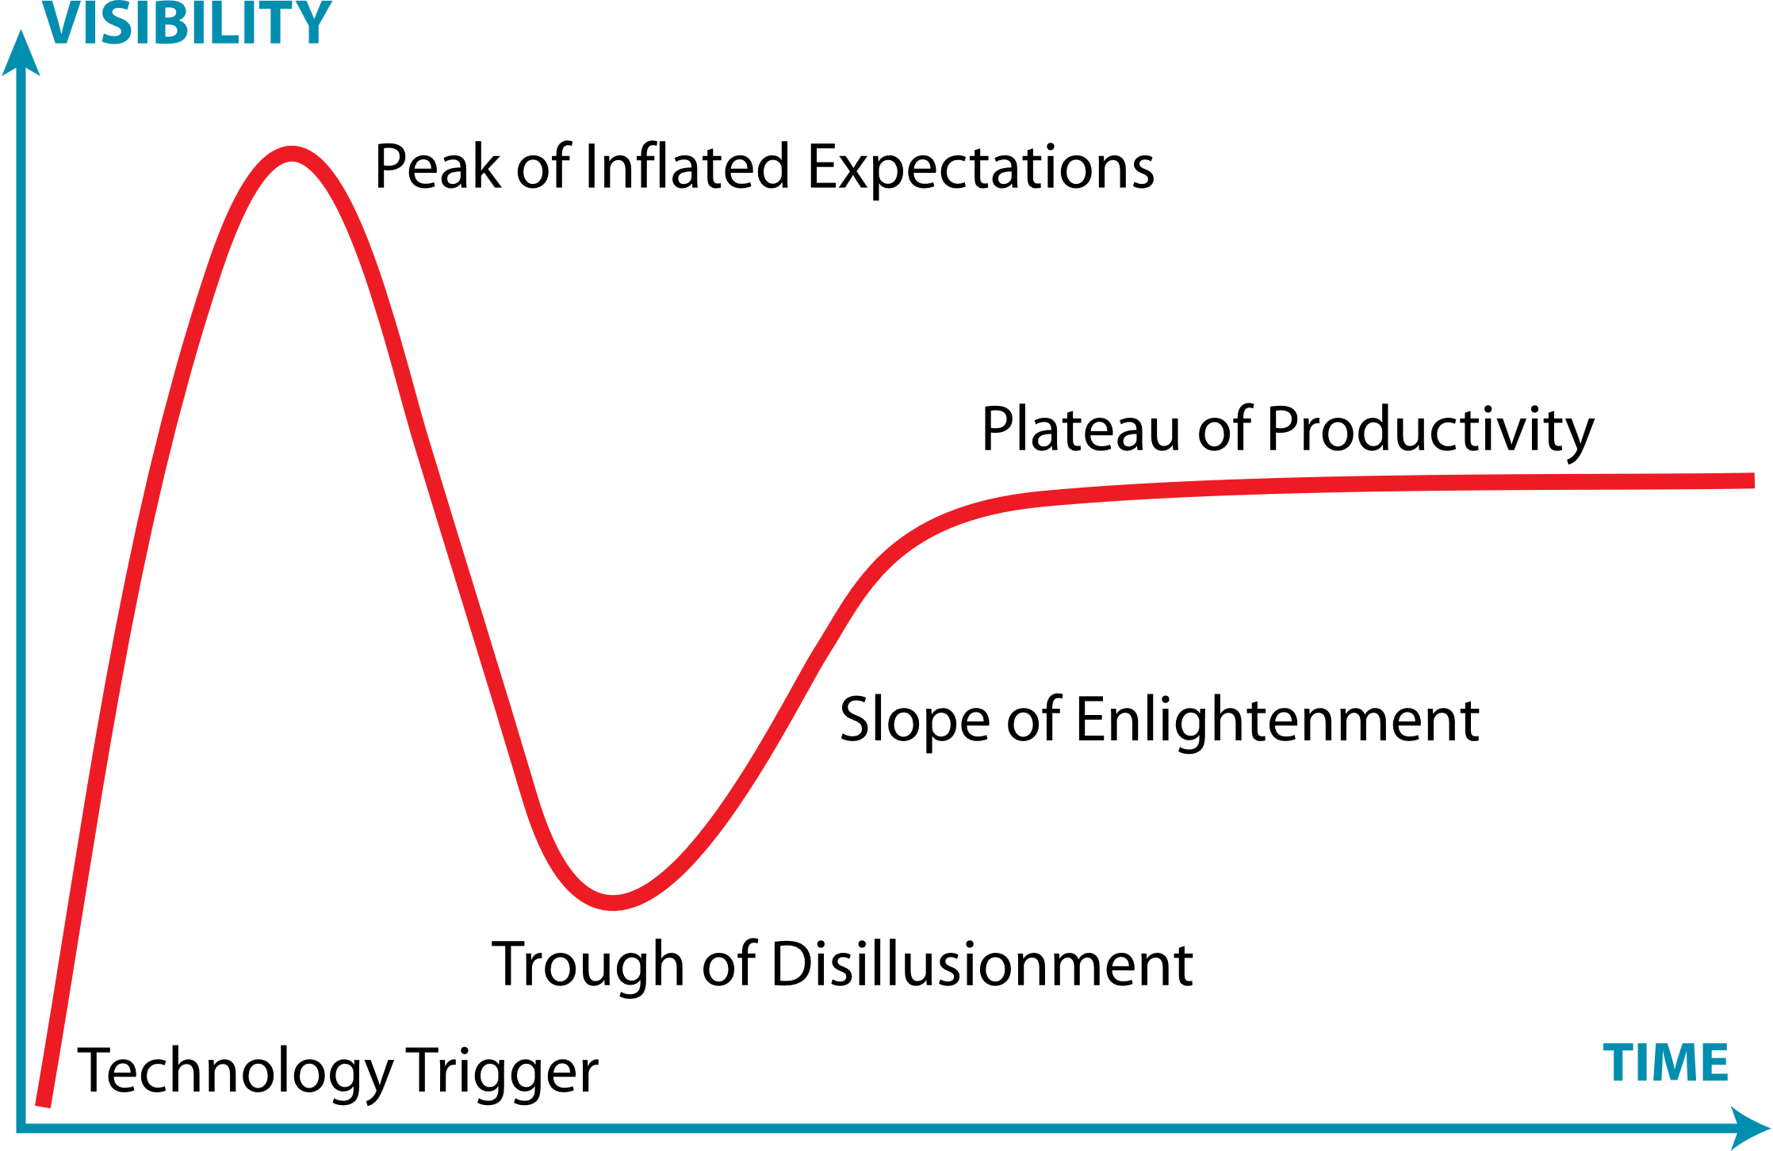
PFAS Treatment Technologies
Adsorption
Destruction
Separation
Gartner Hype Cycle
Gartner Hype Cycle Research Methodology | Gartner
Notes:
Maybe we’ll get there eventually with PFAS Destruction, but don’t count on it soon and don’t get distracted from what can be accomplished right now with Source Control as a first step
Because its going to take years to prove out Destruction technologies for full scale application
Here’s the Gartner Hype Cycle to show where we are
Destruction is getting a huge amount of attention with high Visibility
But we haven’t yet reached the Peak and we have entered the Trough of Disillusionment!
By comparison, Adsorption and Separation are proven at full scale right now – and available, as long as Wastewater is polished to a high degree first.

Slide 21
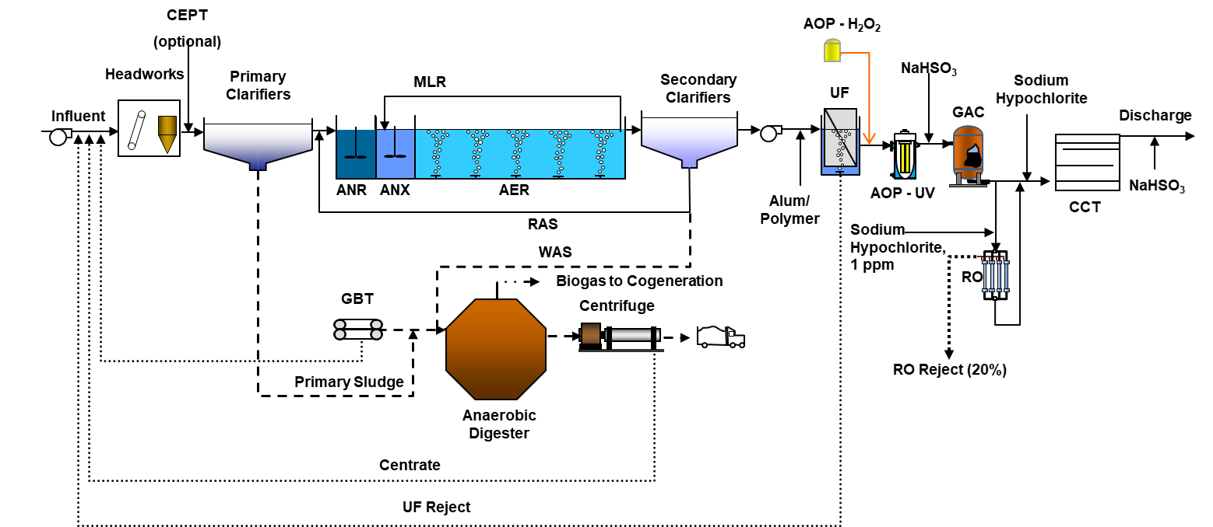
Intersection of Advanced Treatment and Indirect/Direct Potable Reuse (IPR/DPR)
Proven Technologies at Full Scale: Tertiary UF/AOP/GAC/RO
  Excellent Effluent Quality
  Remaining Challenges
    HHWQC Criteria at Extraordinarily Low Concentrations (e.g. PFOA 0.0009 ng/L)
    Spent Media, RO Concentrate, etc.
    Biosolids Content

Slide 22

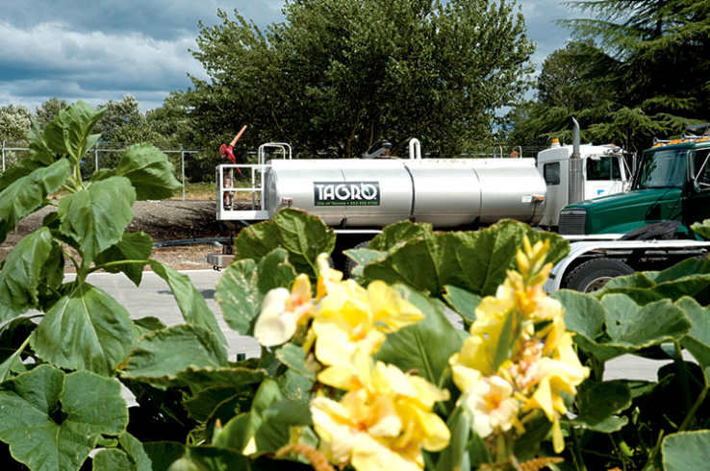

Biosolids Management
Updates
POTW PFAS Influent Study and National Sewage Sludge Survey (NSSS)
Biosolids Risk Assessment
Notes:
Now shifting to Biosolids

Slide 23
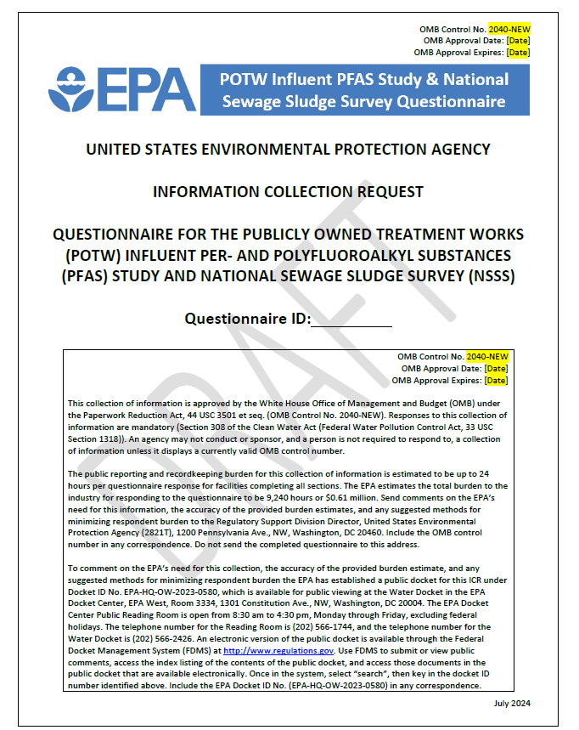
EPA POTW PFAS Influent Study and National Sewage Sludge Survey (NSSS)
EPA CWA Section 308 Information Collection Request (ICR)
  Federal Register Notice October 10, 2024
    Comments Due November 12, 2024
Largest 400 POTWs
  Influent, Effluent, and Biosolids
  Up to 10 Industrial Users
  Method 1633 and Method 1621 Adsorbable Organic Fluorine (AOF)
  Sampling Mid - Late 2024 to Early 2025?
DRAFT Sampling Narrative, September 2023
  Characterize Industrial Users (IUs) and Domestic Sources
  Collect data on Adsorbable Organic Fluorine (AOF) Concentrations
  Better understand PFAS pass through in POTWs to biosolids and effluent
Notes:
EPA is planning a PFAS Survey of the 400 largest municipal facilities nationwide
The Survey may roll out this year and is a Section 308 Information Collection Request with mandatory response
EPA considering both Method 1633 and Method 1621

Slide 24

EPA POTW Influent Study: 27 Texas Facilities
Central WWTP - TRA
Village Creek STP
Central WWTP - Dallas
69th Street Plant
Southside WWTP - Dallas
Dos Rios WWTP
Walnut Creek STP
Salado Creek WWTP
Wilson Creek WWTP
Leon Creek WWTP
Sims Bayou WWTP
Hillebrandt WWTP
Southwest - Houston
Roberto Bustamante WWTP
South Austin Regional STP
Waco Regional WWTP
South Mesquite Creek WWTP
Southeast WRP
Rowlett Creek WWTP
Rowlett Creek WWTP #1
Haskell St WWTP
Brushy Creek Regional WWTP
Ten Mile Creek WWTP
Pecan Creek WWTP
Longview Main WWTP
Hamby WWTP
Texarkana South Regional WWTP
Notes:
Just 1 in Idaho

Slide 25
Draft Sewage Sludge Risk Assessment for PFOA and PFOS:
Information for Wastewater Treatment Plants, January 2025
EPA Highlights Risks at Low 1 ppb (ug/kg) Biosolids Concentration for PFOA or PFOS
  “Based on the modeling in the draft sewage sludge risk assessment, the EPA finds that there may be human health risks exceeding the EPA’s acceptable thresholds for some modeled scenarios when land-applying sewage sludge that contains 1 part per billion (ppb) of PFOA or PFOS.”
EPA suggests avoiding biosolids land application to fields used for grazing and growing livestock feed, especially for dairy cows:
  “To reduce potential risk associated with land application, consider land-applying in areas that may be less sensitive to PFOA and PFOS pollution, like areas far from fishable waters or with deep protected drinking water aquifers. Consider avoiding land application in fields used to graze livestock or grow feed, especially for dairy cows. Fields used to grow fruits and grain may be better alternatives to those growing hay or leafy greens like spinach or kale.”
Draft Sewage Sludge Risk Assessment for Perfluorooctanoic Acid (PFOA) and Perfluorooctane Sulfonic Acid (PFOS) | US EPA

Slide 26
National Estimate of PFOA Concentrations in Biosolids
National Mean Biosolids PFOA 24 ± 7 ng/g
EPA Risk Assessment Highlights Risks at 1 ng/g (ug/kg) Biosolids Concentration of PFOA or PFOS
CDM. 2024. Occurrence of PFAS Compounds in U.S. Wastewater Treatment Plants. Water Research Foundation (WRF5031).

Slide 27



Comparisons with Michigan 2024 Land Application Interim Strategy
Michigan 2024 Updated Interim Strategy
Example Biosolids and Compost Products
PFOS or PFOA at or above 100 μg/kg
  Cannot land apply, Implement a source reduction plan
PFOS or PFOA at or above 20 ug/kg but below 100 ug/kg
  Considered elevated, Reduced land application rate of 1.5 dry tons per acre (dt/acre). Implement a source reduction plan
PFOS or PFOA below 20 μg/kg
  May be land applied with no additional requirements
Missoula Garden City Compost 59 ug/kg
Glacier Gold Compost 51 ug/kg
National Mean Biosolids PFOA 24 ug/kg
Colorado Biosolids PFOS <1.9 to 33 ug/kg
California Median PFOS 6.7 ug/kg
California Median PFOA 1.7 ug/kg
Draft Sewage Sludge Risk Assessment for PFOA or PFOS 1 ug/kg

Slide 28
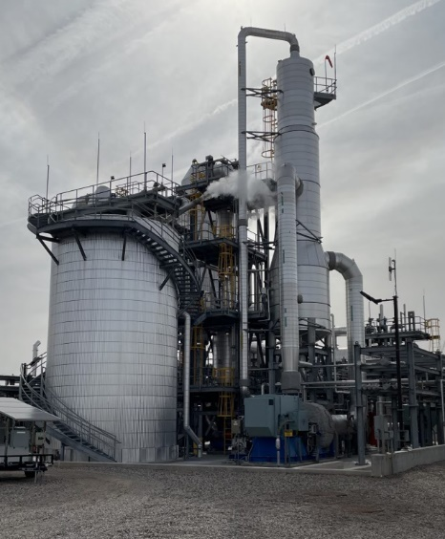
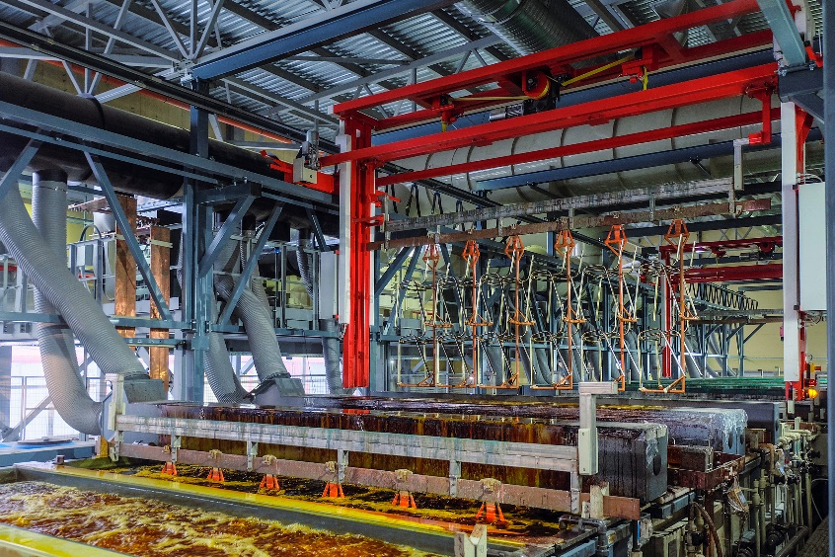
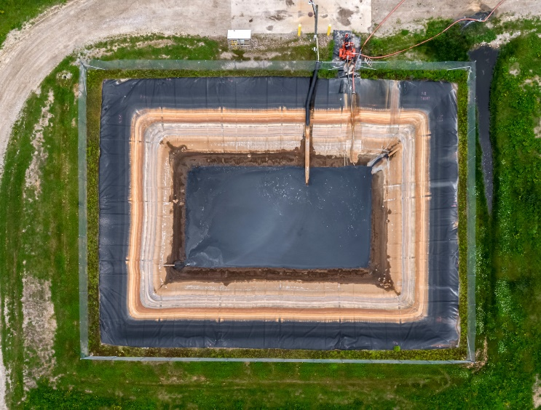
Source Control
Notes:
Now shifting to Source Control

Slide 29
City of Boise, Idaho Source Investigations
Service Population ~280,000
Established Pretreatment Program
  8 Staff
  15 Significant (SIUs) & Categorical (CIUs) Industries
  Major Microelectronics
2 Mechanical Reclamation Facilities
  ~39 mgd Capacity
Austin Walkins, City of Boise. PNCWA 2024 Conference. September 9, 2024

Slide 30



Colorado Source Investigations
Substantial Domestic and Commercial PFAS Contributions

Slide 31
SFEI BACWA Residential, Commercial, and Industrial PFAS Sources
Residential Accounted for Majority of PFAS Mass Loadings
High PFAS Levels From Industrial Laundries
Significant Unknown PFAS Precursors
Sample, ng/L | Method 1633 | TOP Analysis
Influent | 37 | 259
Effluent | 64 | 98
Residential | 16 | 287
Industrial Laundry | 177 | 11,000
Chrome Plater | 18 | 12
Semi-Conductor | 2 | 4
Hospital | 8 | 6
Car Wash | 74 | 326
Lin, et al. SFEI. 2024. Residential Wastewater as a Major Source of Per- and Polyfluoroalkyl Substances to Municipal Wastewater. ACS ES&T Water.
https://pubs.acs.org/doi/10.1021/acsestwater.4c00507?goto=supporting-info

Slide 32
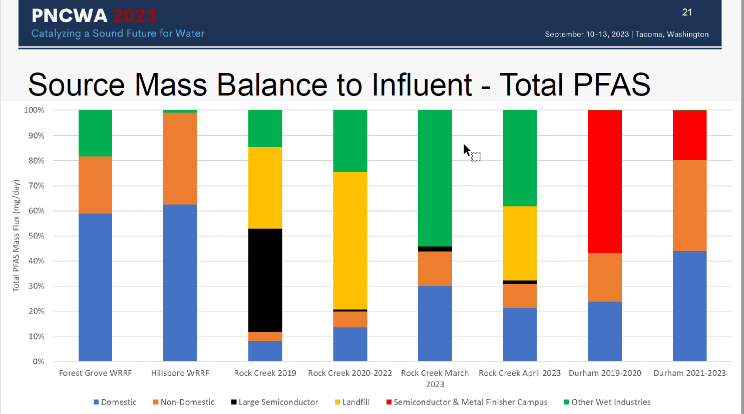
PFAS Sources Vary with Service Area Characteristics
Example Industrial, Commercial, Domestic Sources
  Landfill, Semiconductor, Metal Finishing, Wet Industry
Used with Permission, Scott Mansell, Clean Water Services, Hillsboro, Oregon. mansells@cleanwaterservices.org

Slide 33
Considerations for POTW Pretreatment Managers -- 1
Monitor → Quantify → Source Control & Reduction → Best Practices
Initiate Planning
  Communication & Coordination
    Review Current Industrial Customers
      EPA Recommended BMPs for “hot” industries
    Availability of Staff and Budget Resources
    Existing sampling & monitoring programs
  Objective:
    Avoid Surprises
    Budgeting
2. Monitoring (Benchmarking)
  Influent, Effluent & Biosolids
    Monitoring Plan (QAPP)
      Sample schedule, location, collection method
    Commercial Laboratory Availability, Costs, QA/QC
      Select Method 1633, Method1621, both?
    Data Analysis & Management
  Objectives: PFAS Quantification
      Early Identification of Potential Opportunities for Source Reduction
      Or, Early Identification of Issues
Notes:
Some considerations for managers to plan and implement source control efforts
Beginning with Planning
Then Monitoring

Slide 34
Considerations for POTW Pretreatment Managers -- 2
3. Plan for NPDES Permit Renewal
  New Monitoring and Reporting Requirements (Method 1633)
  New Requirements
    Industrial User Inventory Update
    Industrial Source Reduction Planning
    Best Management Practices (BMP)
  Objective: Advance Preparation
    NPDES Permit Renewal Application
    Dialog with State Regulatory Agency
4. Pretreatment Program Updates
  Local Ordinance Updates?
  RFIs and Initial Screening Letters
  New Monitoring and Reporting Requirements
  Industrial Source Reduction Planning
  Best Management Practices (BMP) and Pollutant Minimization Program (PMP)
  Objective: PFAS Source Reduction
5. Long Term/Future Pretreatment Program
Applicable Federal Categorical PFAS Limits?
Local Limits?
Notes:
Planning for NPDES Permit Renewal

Slide 35


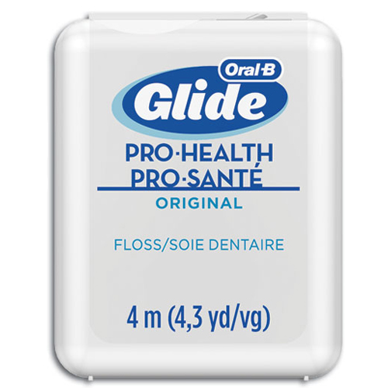
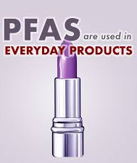
Domestic and Commercial PFAS Management
Product Stewardship
Toxic Substances Control Act (TSCA)
Product Bans
Extended Producer Responsibility (EPR)
Notes:
Now shifting to Source Control

Slide 36
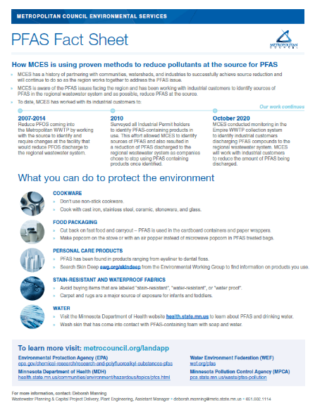
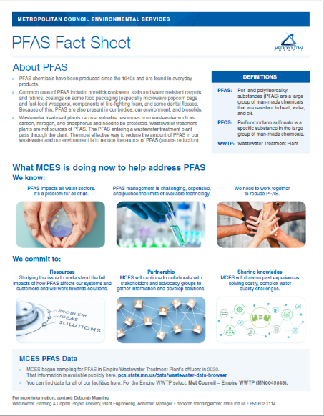
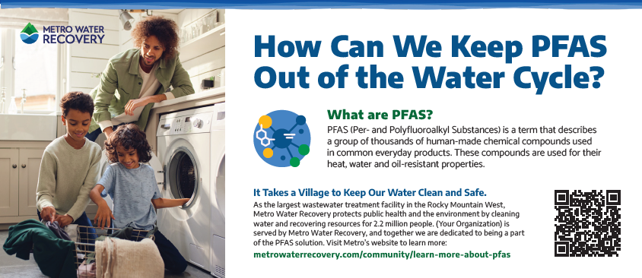
Strategic Communications
Notes:
Now shifting to Source Control

Slide 37
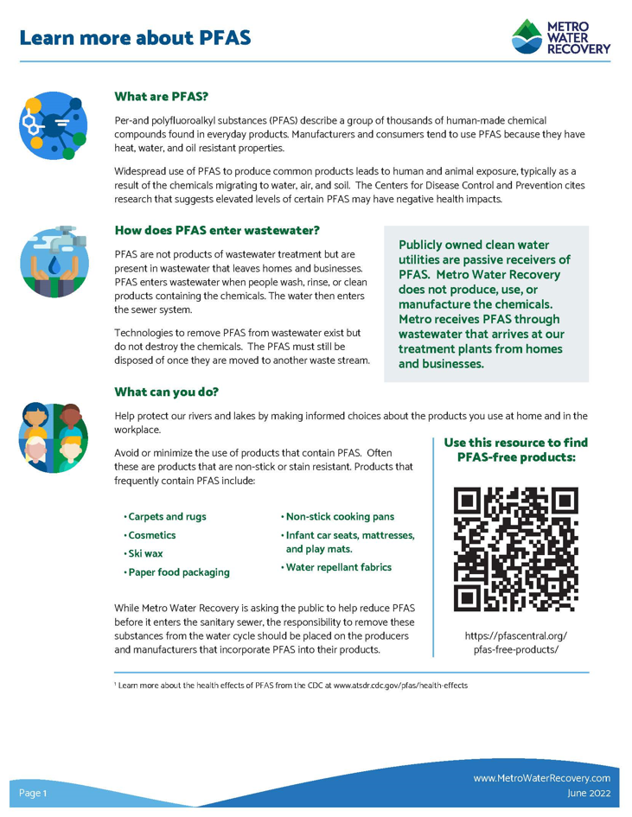
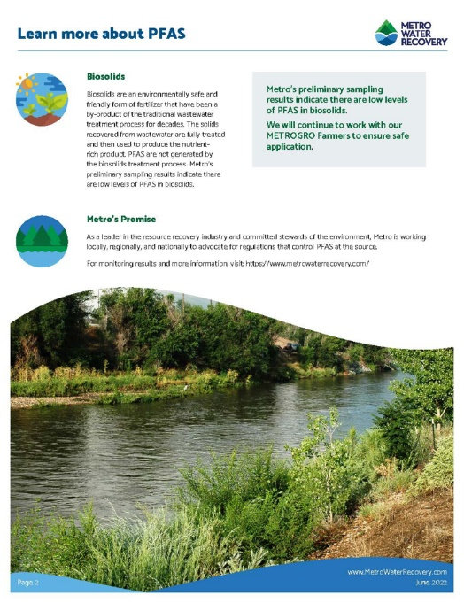
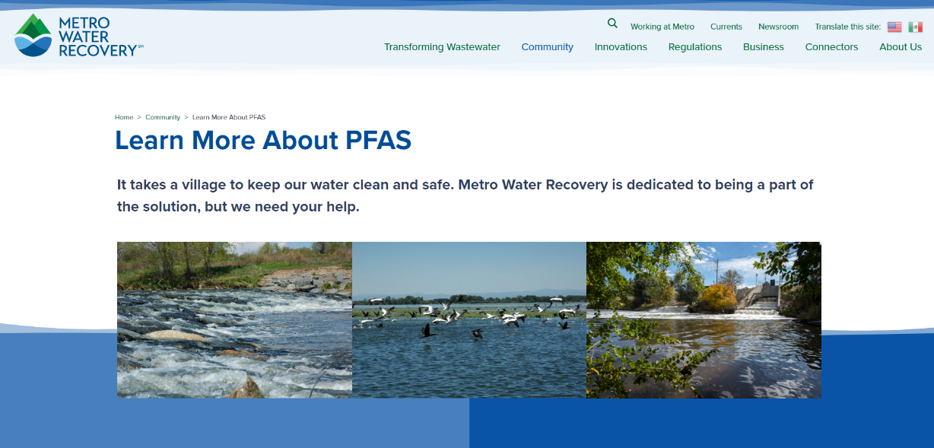
Denver Metro Water Recovery
Notes:
Amy - https://www.metrowaterrecovery.com/community/learn-more-about-pfas/

Slide 38
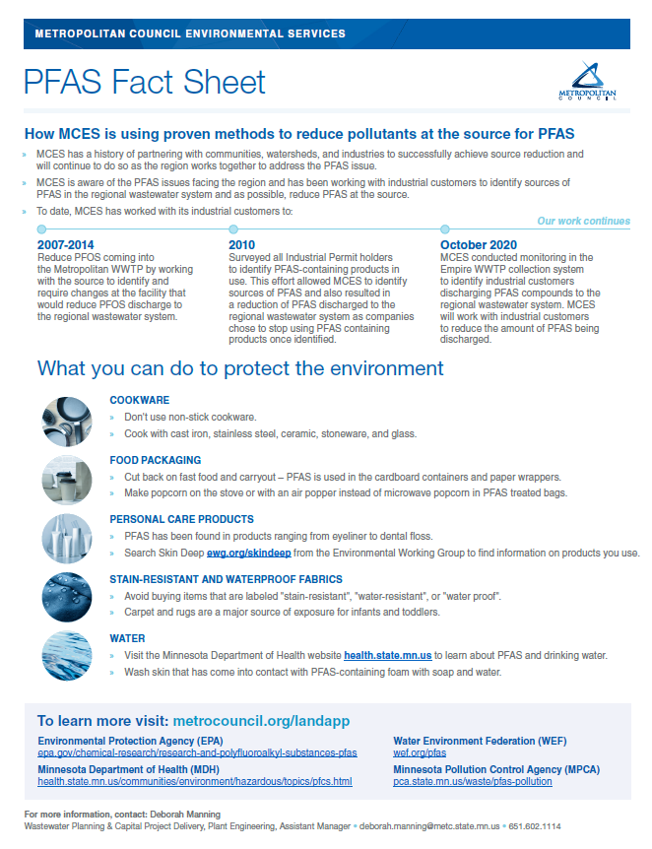
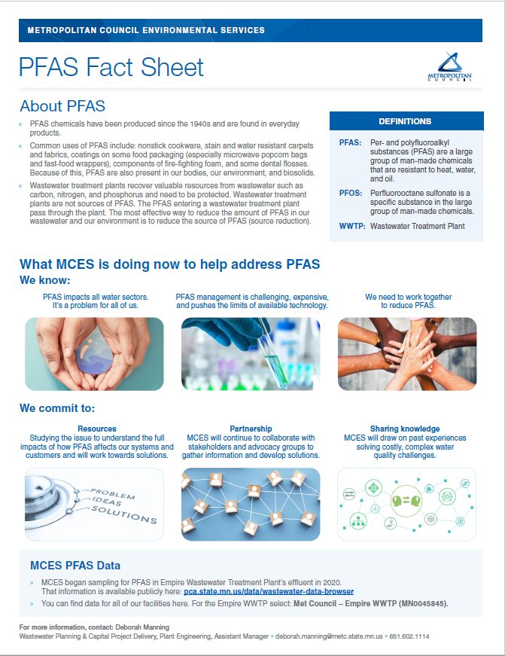
Metropolitan Council
St. Paul, Minnesota
Fact sheet
Handout
Notes:
Amy

Slide 39
Preserving Sustainable Effluent Management, Reuse, and Biosolids Beneficial Reuse
PFAS Monitoring: Wastewater Influent, Effluent & Biosolids
  Ubiquitous Commercial PFAS Chemicals
Source Reduction Focus
  Industrial Pretreatment is Key
  Domestic and Commercial Challenges
Product Stewardship
  Chemical Action Plans (CAP)
Support Good Science
  EPA’s Risk Assessment
Strategic Communications
  Convey Accurate, Reliable, Science-based Information
Notes:
Here’s a summary of the top things to consider right Now to preserve and protect effluent quality and beneficial Biosolids Reuse.
First, we need to monitor to quantify current conditions and where we’re beginning
Next, we need to focus on Source Reduction and Pretreatment is Key
For the sources that aren’t easily reduced by Industrial/Commercial Source control, we’ll need other Product Stewardship tools, such as Chemical Action Plans
We want to support good science to inform regulatory requirements and policy. And avoid uninformed knee jerk policy restrictions
And we need to Communicate with our base; Wastewater Customers

Slide 40
Texas Association of Clean Water Agencies
Wastewater PFAS Challenges and Proactive Management
David L. Clark, PE, WEF Fellow
Patrick R. Young, PE
February 28, 2025

