Slide 1
Why Replace-in-Kind when You Can Build it Better? Performance Improvements from Rehabilitation of an Aging Nitrifying Facility
Samir Mathur, P.E., BCEE
TACWA Meeting
May 16, 2025

Slide 2
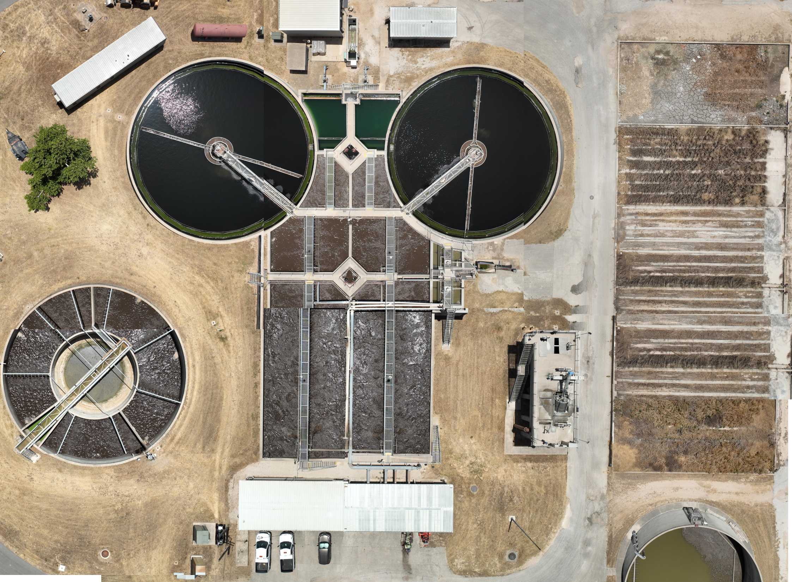
Agenda
San Gabriel Wastewater
Treatment Plant (WWTP) Overview
Design Considerations
Maintenance of Plant Operations
Lessons Learned
Clarifiers
Sludge Drying Beds (rarely used)
Grit Facility
Treatment Units
Headworks
Wet Weather Basin
Aerated Sludge Holding Tank
Blowers

Slide 3
San Gabriel Wastewater Treatment Facility

Slide 4
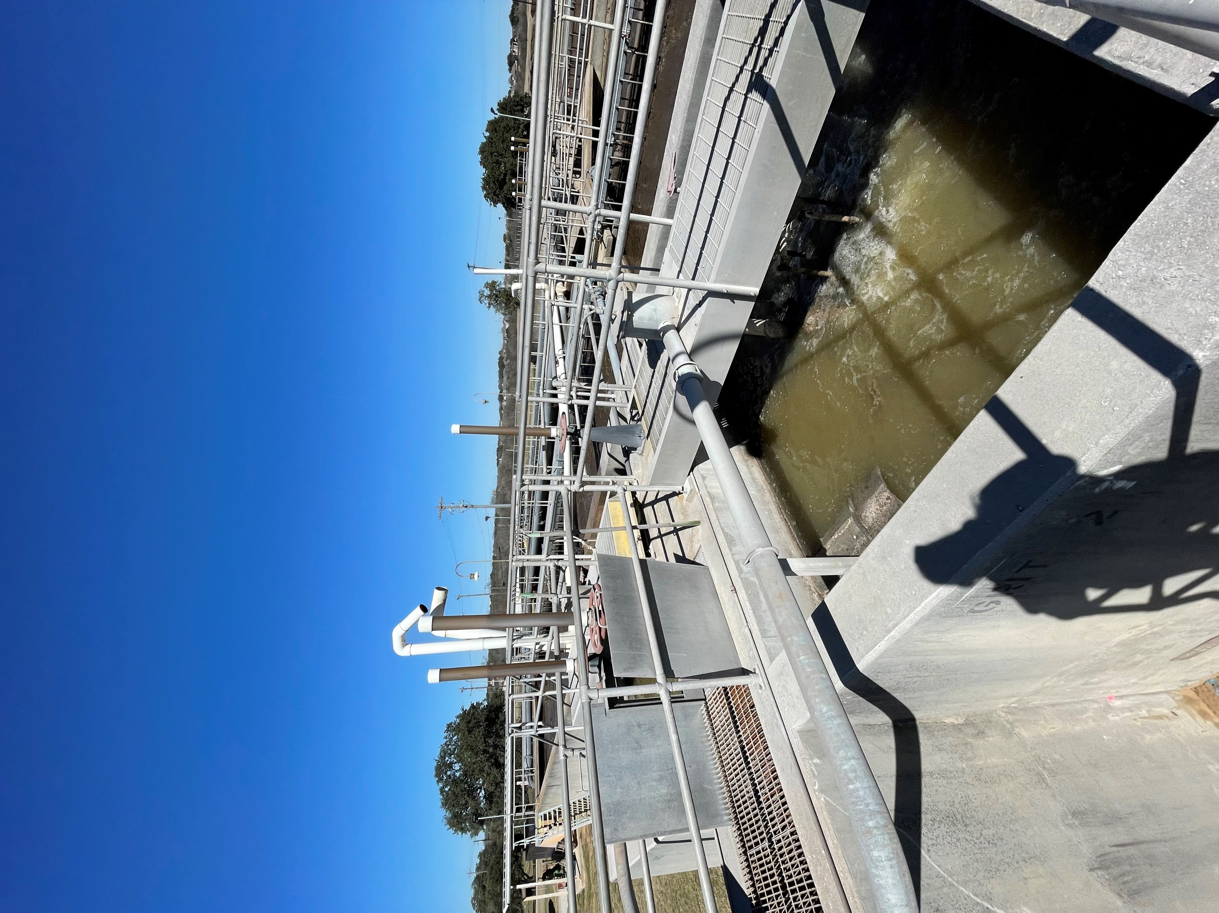
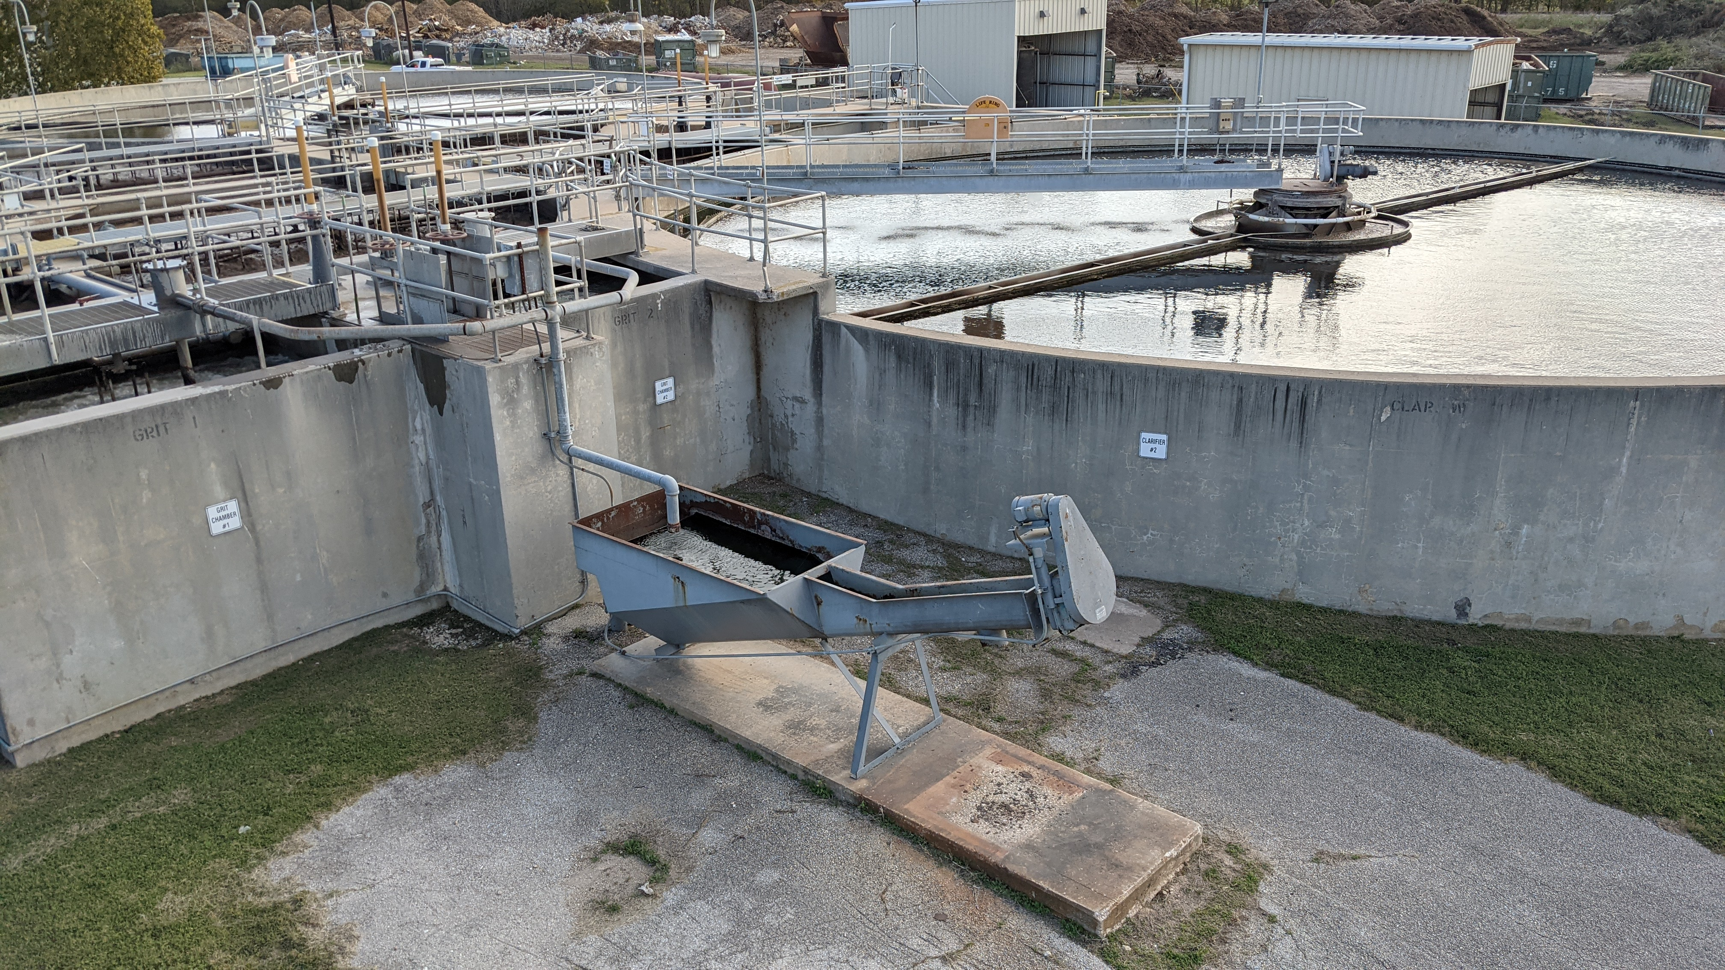
Plant Background
1981: Contact Stabilization Plant
1990’s: Ammonia Limit Added to Permit
2011 and 2019: Misc. Plant Improvements
2023-2025: Design and Construction of Rehabilitation Project
2021: Facility Planning Technical Memorandum

Slide 5
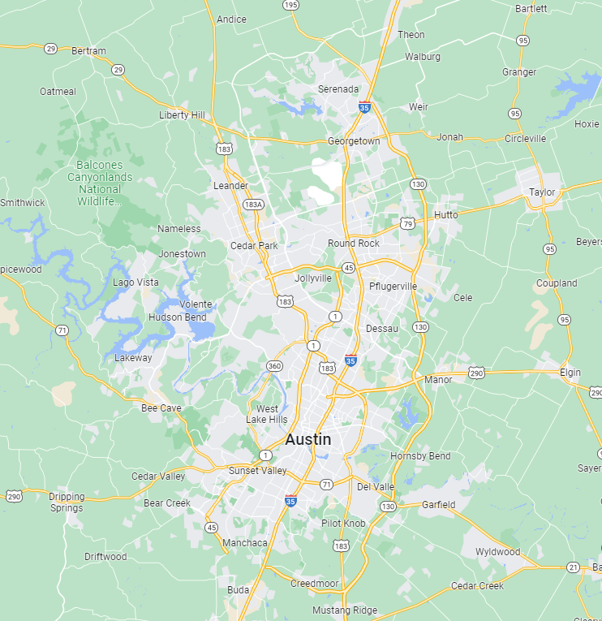




Georgetown, Texas
Growing suburb outside of Austin
Located along I-35 corridor
High growth in tech companies

Slide 6
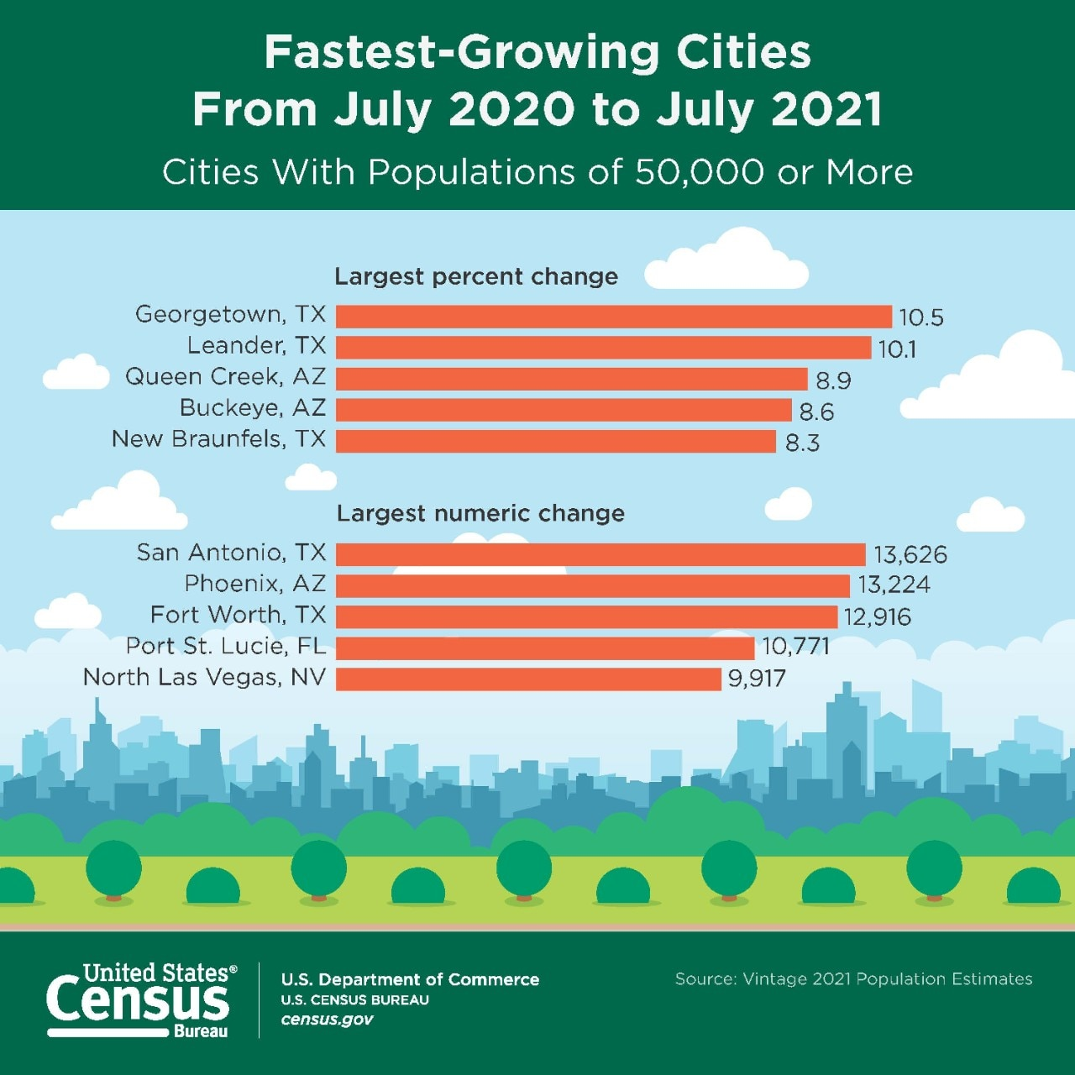
Population Growth

Slide 7
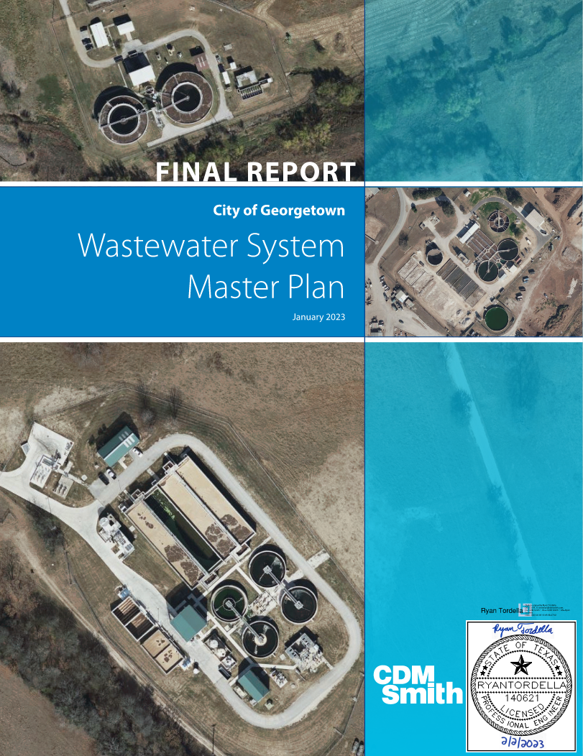
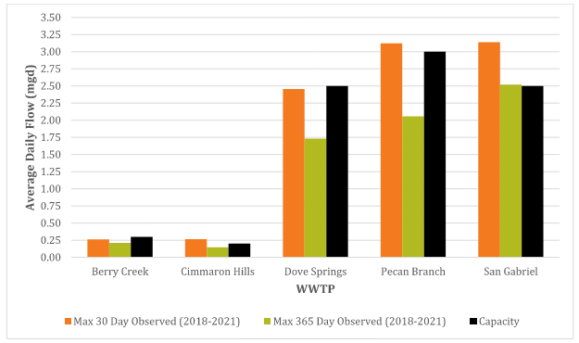
WWTPs Nearing Capacity

Slide 8
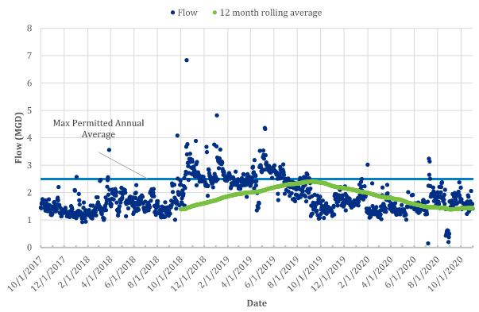
San Gabriel Wastewater Treatment Plant
City of Georgetown’s (CoG) oldest wastewater treatment plant operating at 90-100% of design capacity
Cannot expand due to ban on new discharges to Edwards Aquifer recharge zone
  CDM Smith designed ability for San Gabriel WWTP to divert flow to Dove Springs WWTP and to store and transfer flow to Pecan Branch WWTP to allow for maintenance activities
City is a rapidly growing community for over a decade

Slide 9
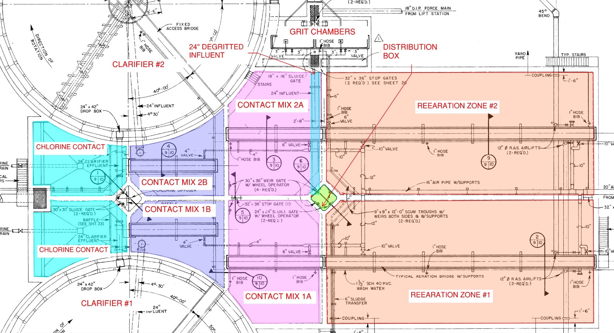
Treatment Structure Process Flow – Contact Stabilization
24” DEGRITTED INFLUENT
DISTRIBUTION BOX
CLARIFIER #2
REAERATION ZONE #2
CONTACT MIX 2A
CHLORINE CONTACT
CONTACT MIX 2B
CONTACT MIX 1B
CHLORINE CONTACT
CONTACT MIX 1A
REAERATION ZONE #1
CLARIFIER #1

Slide 10
Treatment Structure Process Flow – 1990s
24” DEGRITTED INFLUENT
DISTRIBUTION BOX
CLARIFIER #2
REAERATION ZONE #2
CONTACT MIX 2A
CHLORINE CONTACT
CONTACT MIX 2B
CONTACT MIX 1B
CHLORINE CONTACT
CONTACT MIX 1A
REAERATION ZONE #1
CLARIFIER #1

Slide 11
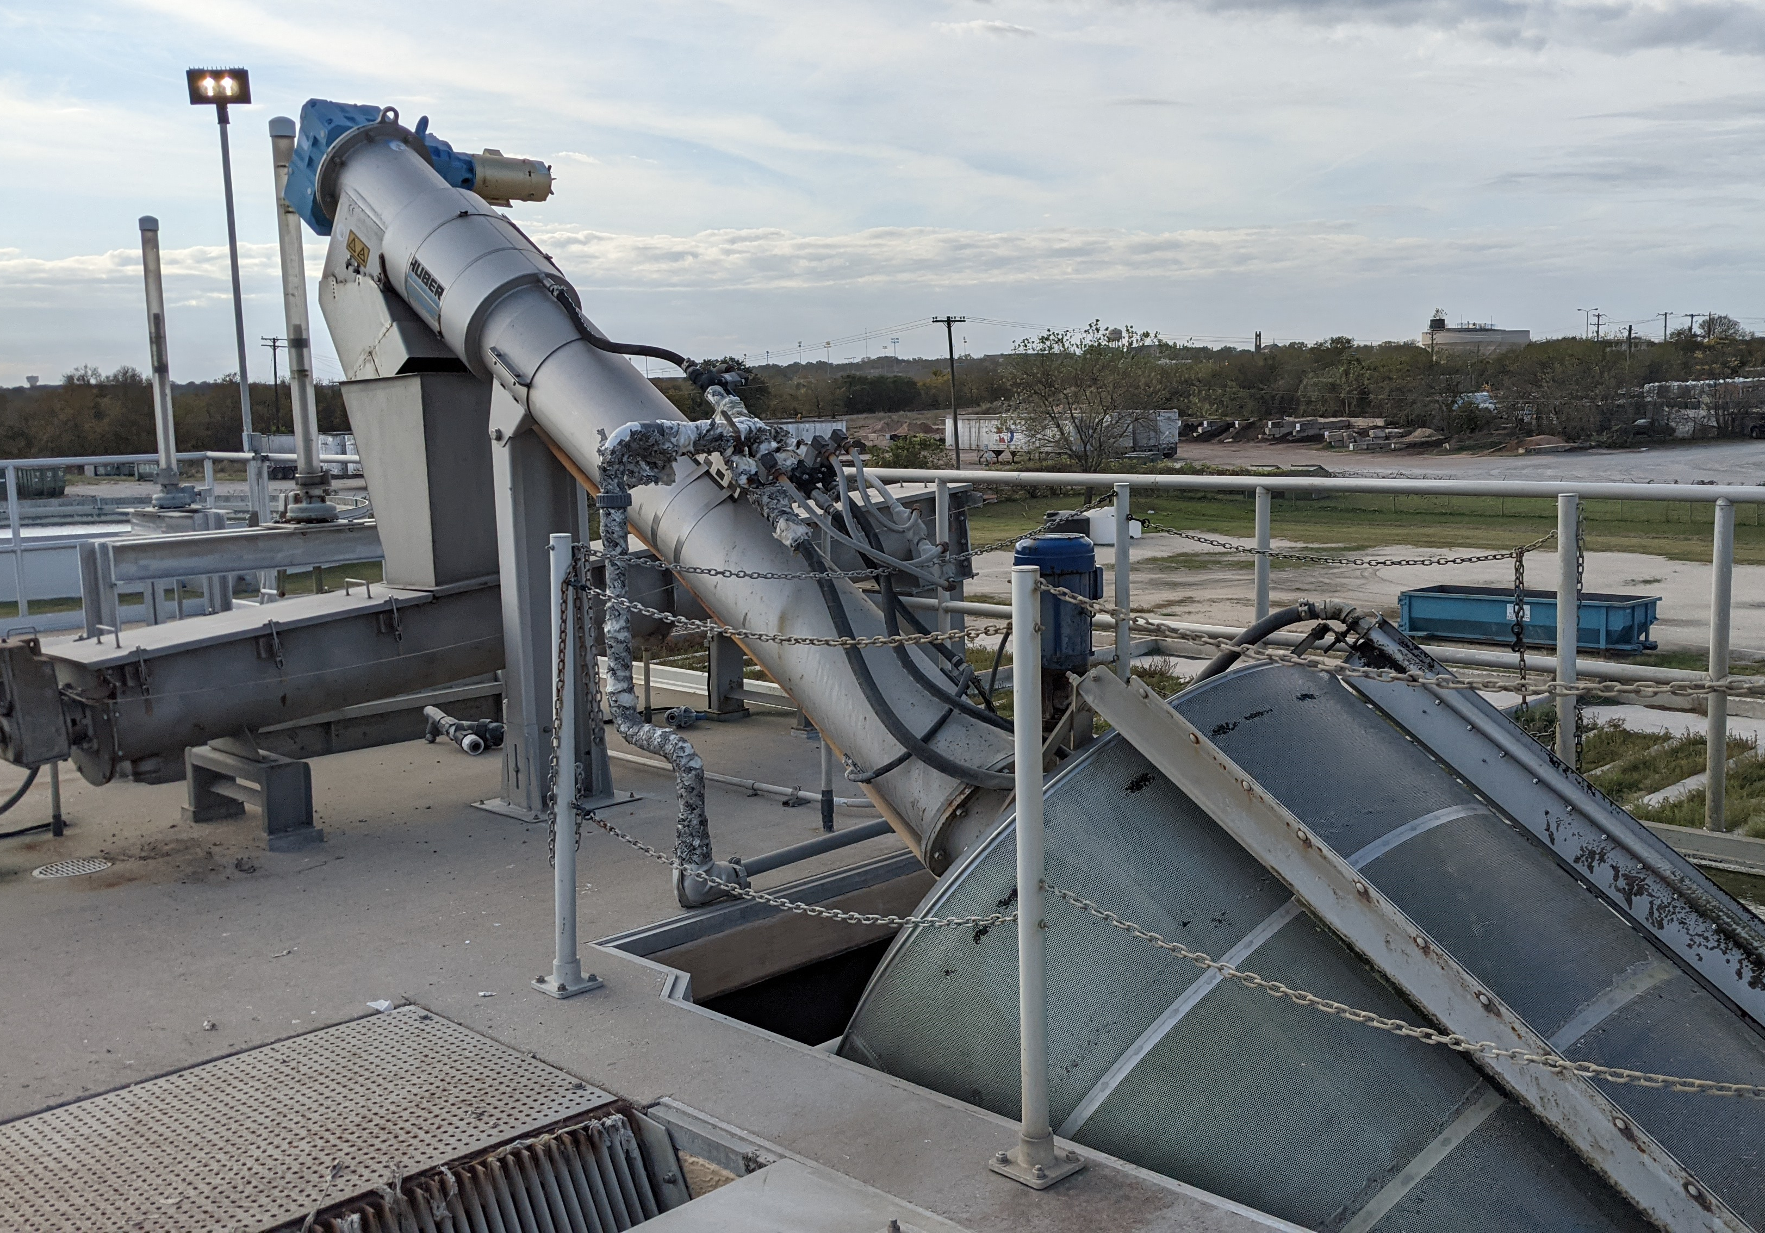
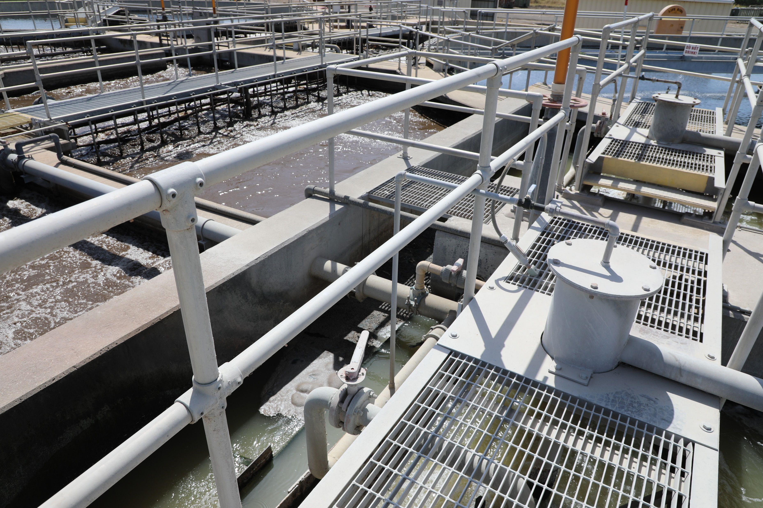
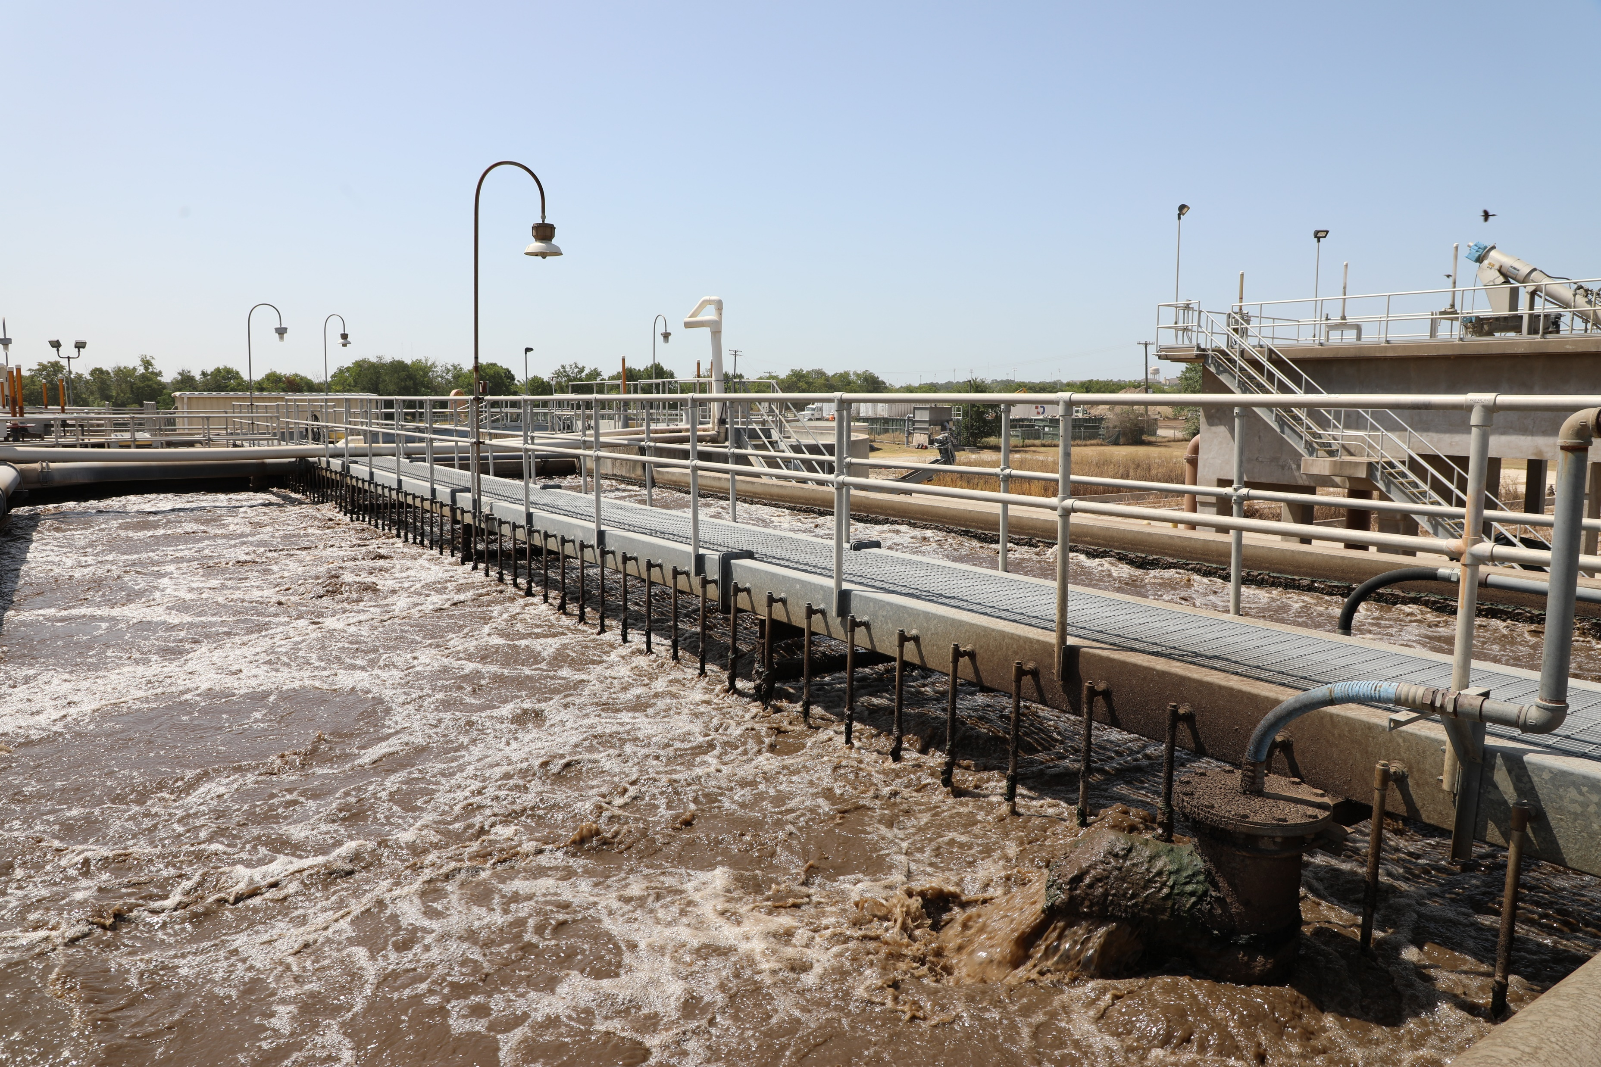
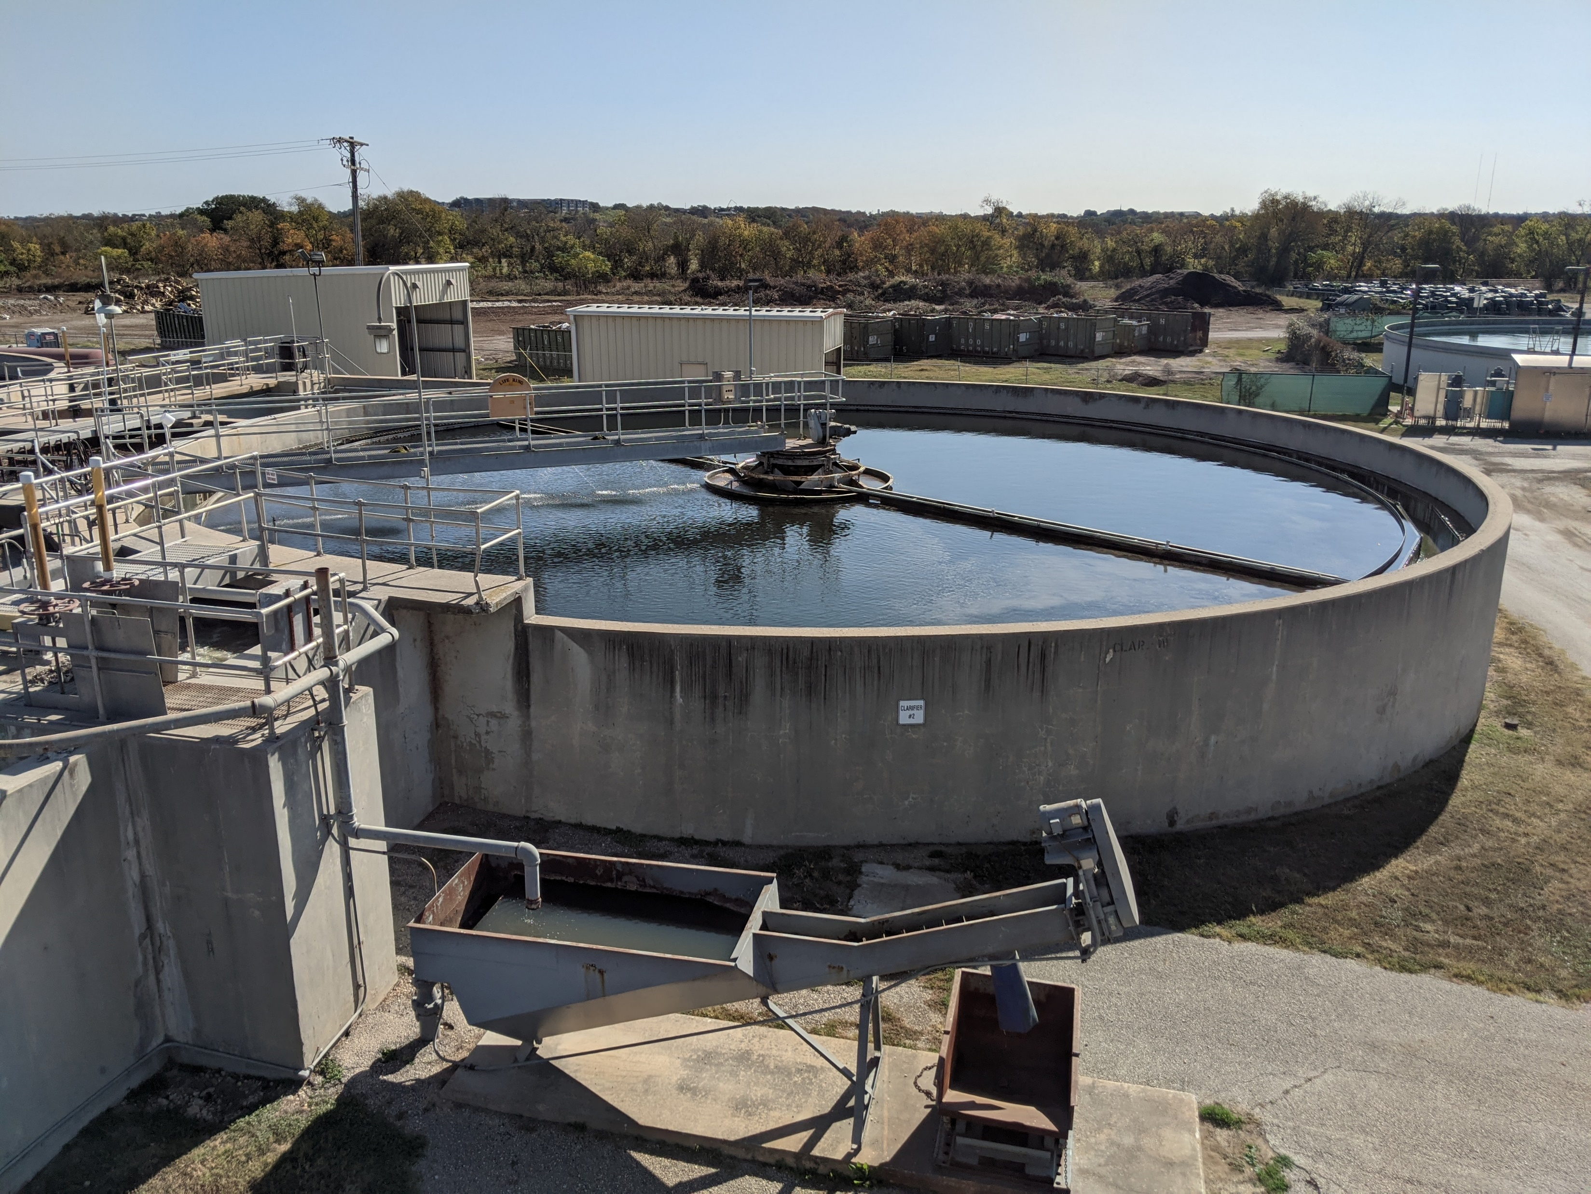
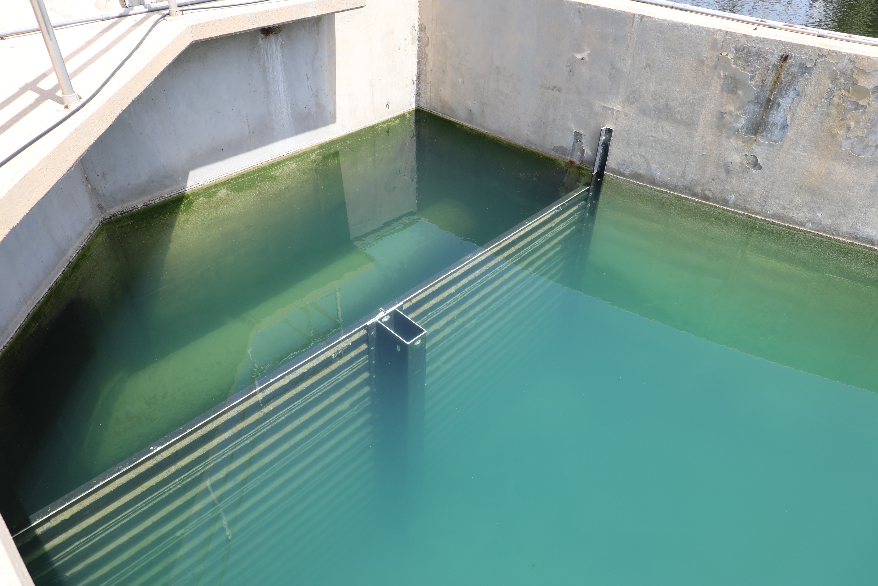
Existing Treatment Processes
Screenings + Headworks
Grit Removal
Secondary Treatment
Clarification
Chlorine Contact

Slide 12
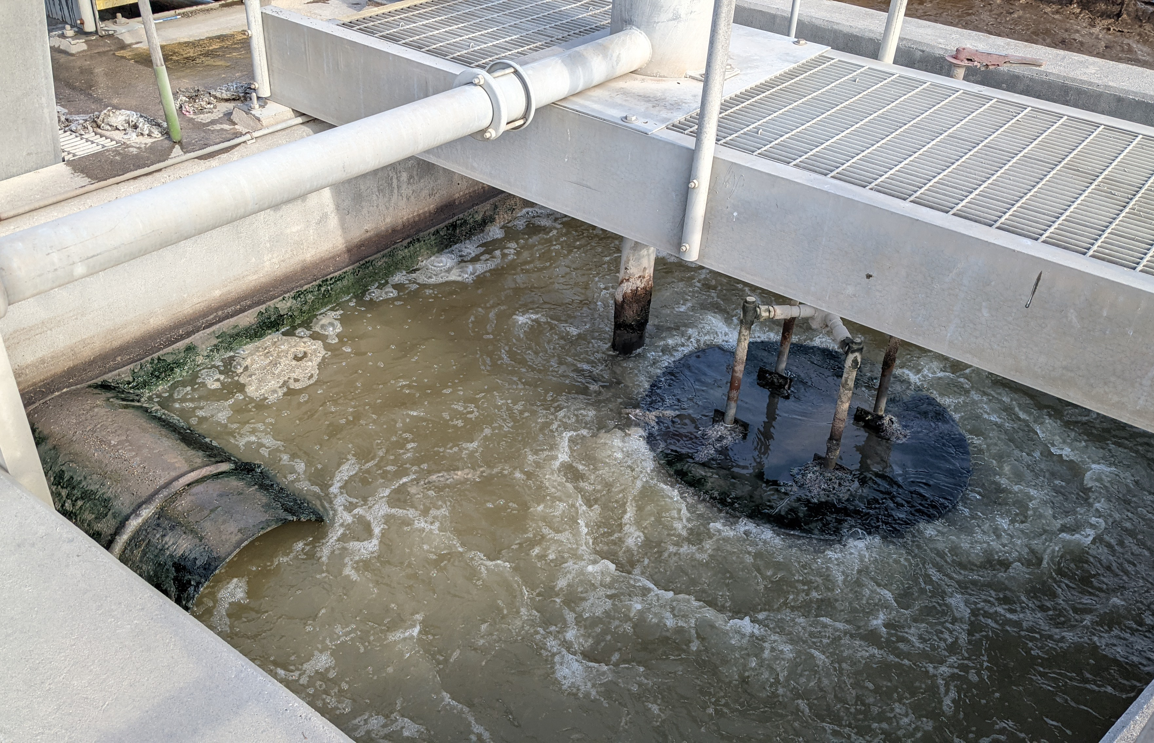
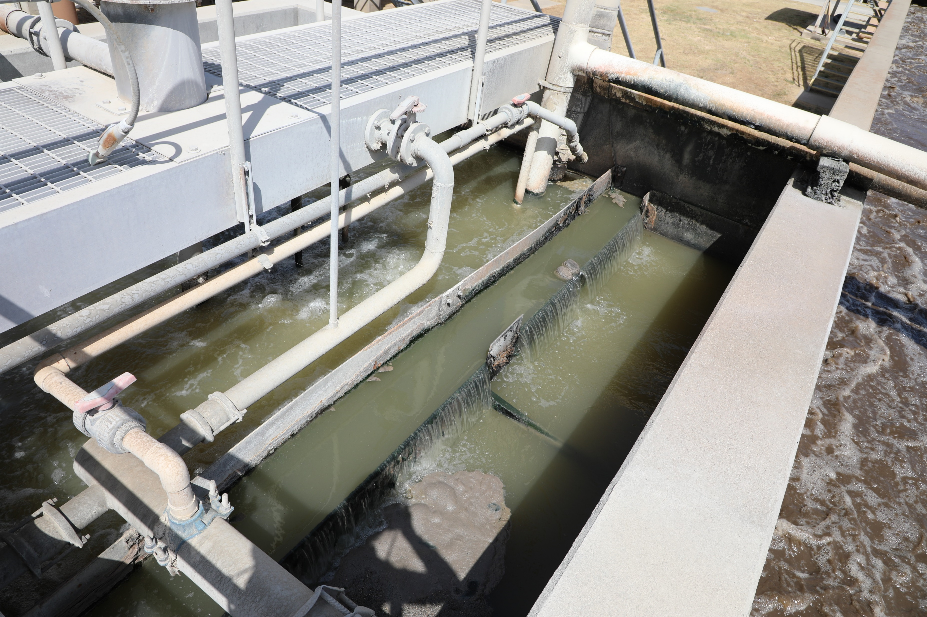
Grit Removal Basin
(2) Aerated grit chambers with draft-tube style aerator and airlift for grit slurry removal
Original design sent degritted raw wastewater through a single 24” pipe to distribution box between reaeration and contact mix zones
Issues Noted:
  Walls have overtopped – 24” pipe clogged
  Clogging of airlift pipe
  Grit classifier required replacement after 40 years

Slide 13
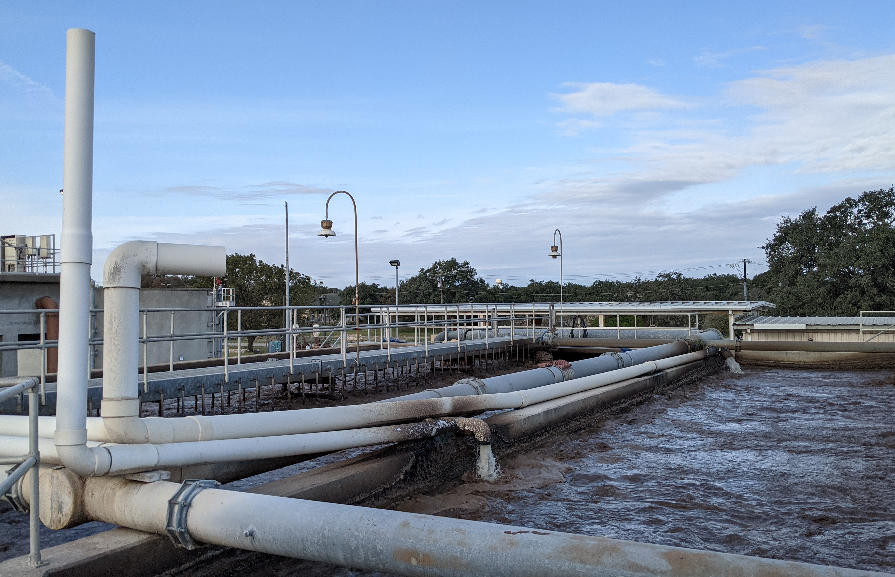
Secondary Treatment
Converted in 1990’s with the addition of an ammonia limit
Contact stabilization is not allowed as a process for nitrifying facilities
Low-cost conversion to a step feed process was implemented using airlift pumps from the grit effluent channel
    Balanced food / microorganism ratio
    Good sludge settleability in clarifiers
Uses single drop coarse bubble diffusers

Slide 14
Design to Construction

Slide 15
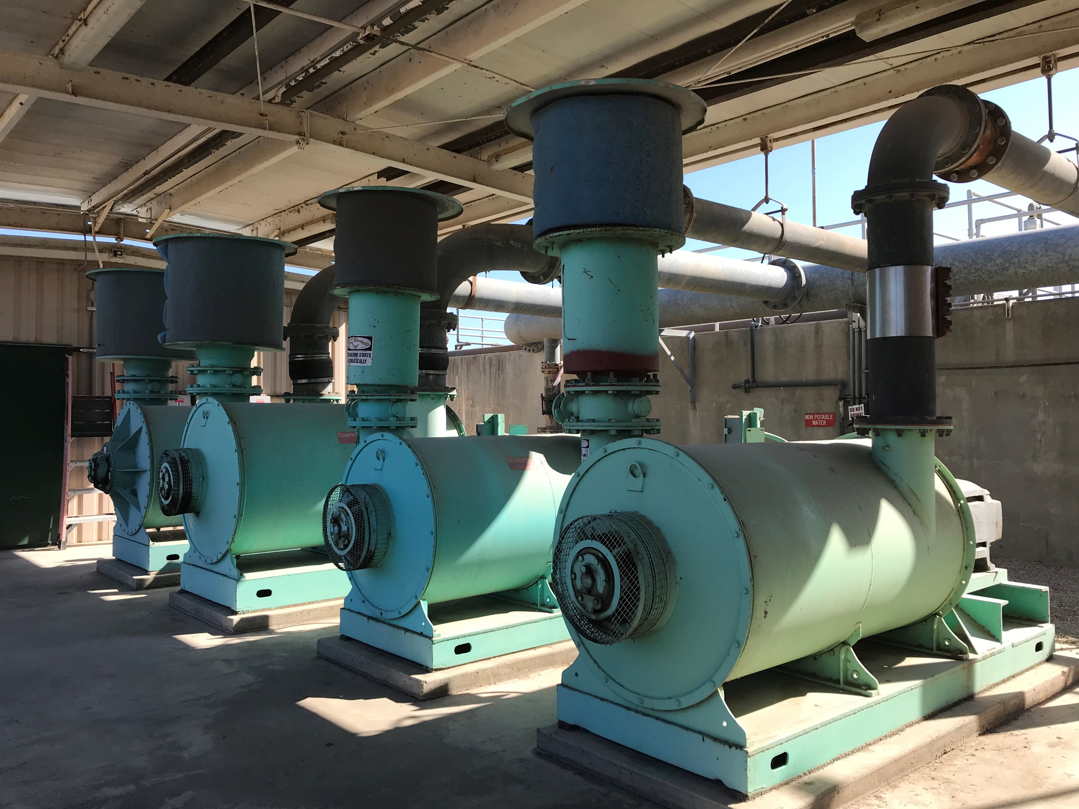

Need for Rehabilitation
Replace aging equipment
Modernize treatment technologies
Improve treatment performance

Slide 16
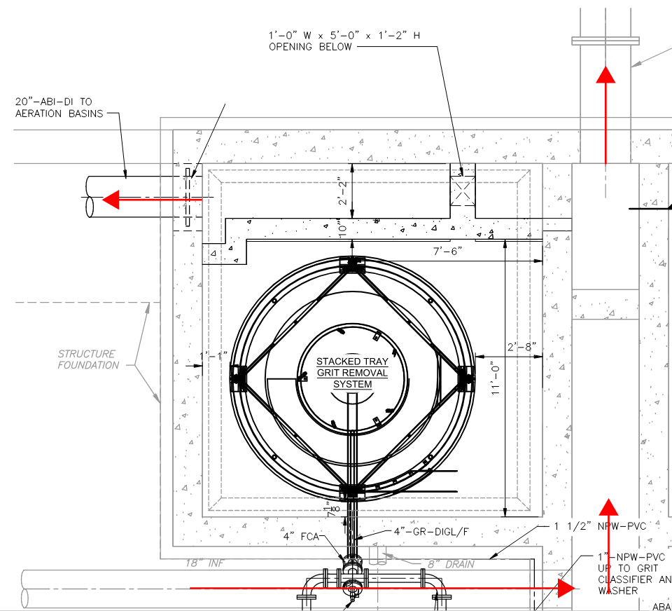
Hydraulic Analysis
Existing 24” Degritted raw to Distribution Box
New 20” ABI to Front of Aeration Basin
Full hydraulic profile analysis to review proposed improvements:
    New grit removal technology
    New aeration basin influent (ABI) pipeline to retain step feed approach
Understand grit basin overtopping
Existing 18” RAW to Grit Facility

Slide 17
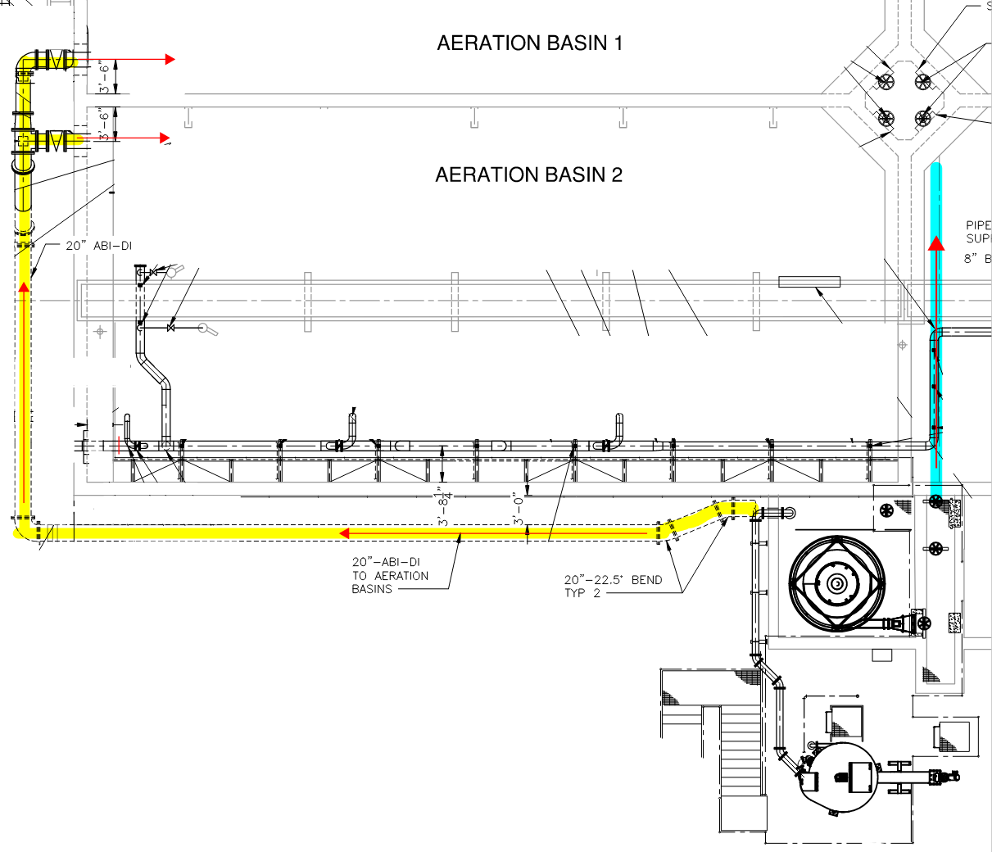
Step Feed Process and Hydraulic Analysis
New 20” influent to front of aeration basins allows for more permanent and reliable solution for partial plug flow.
Design to keep step feed approach:
  Passive hydraulic flow split had limitations at peak 2-hour flow
    75% of Flow - Route new 20” influent from grit
    25% of Flow - Utilize existing 24” DI to distribution box

Slide 18
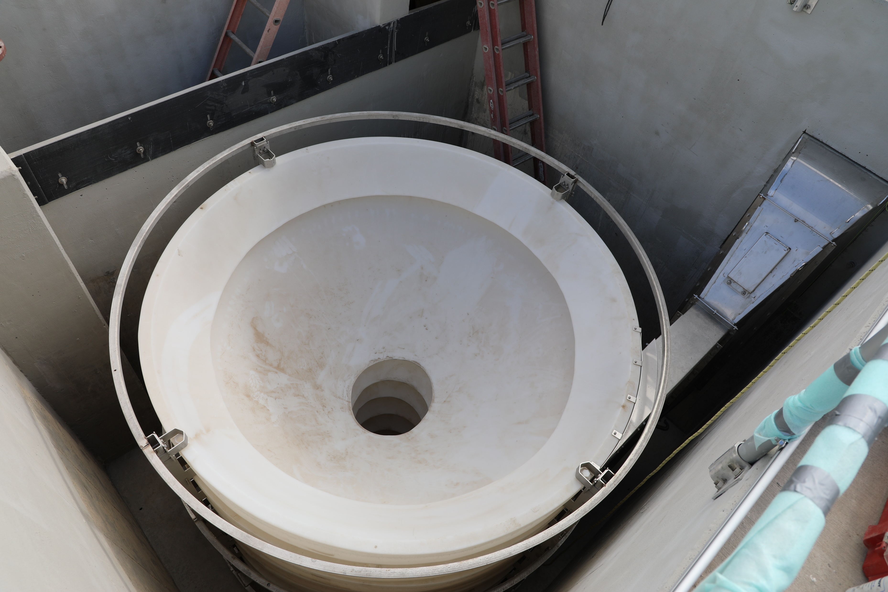
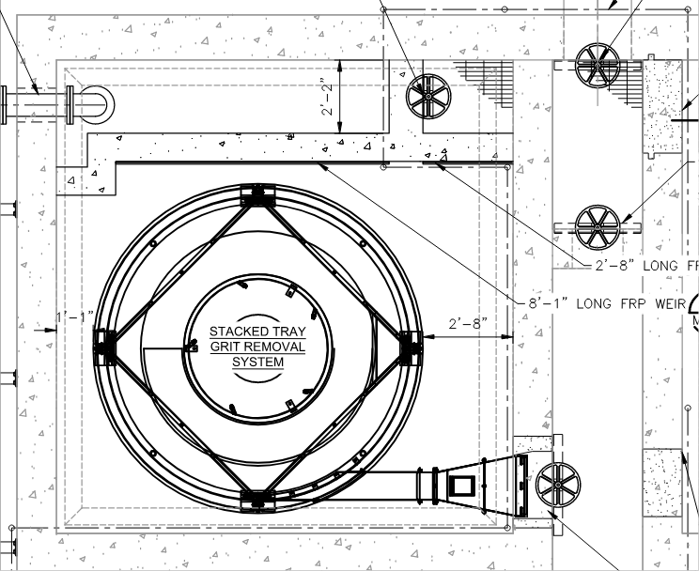
Grit Facility Rehabilitation Design
Conversion of one of two tanks to a stacked tray grit removal system
    Significantly greater removal efficiency of fine grit particles
Retrofit and modifications of existing tankage was feasible with Manufacturer
Use of slide gates to allow for operational flexibility with bypassing

Slide 19
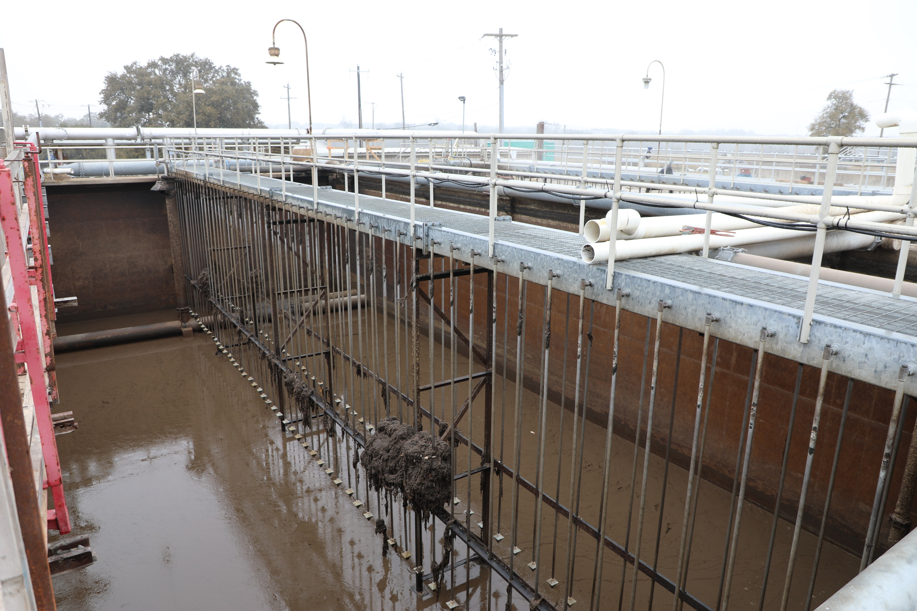
Secondary Treatment Improvements
Replacement of coarse bubble diffusers with fine bubble diffusers
New multistage blowers and
low-pressure air lines

Slide 20
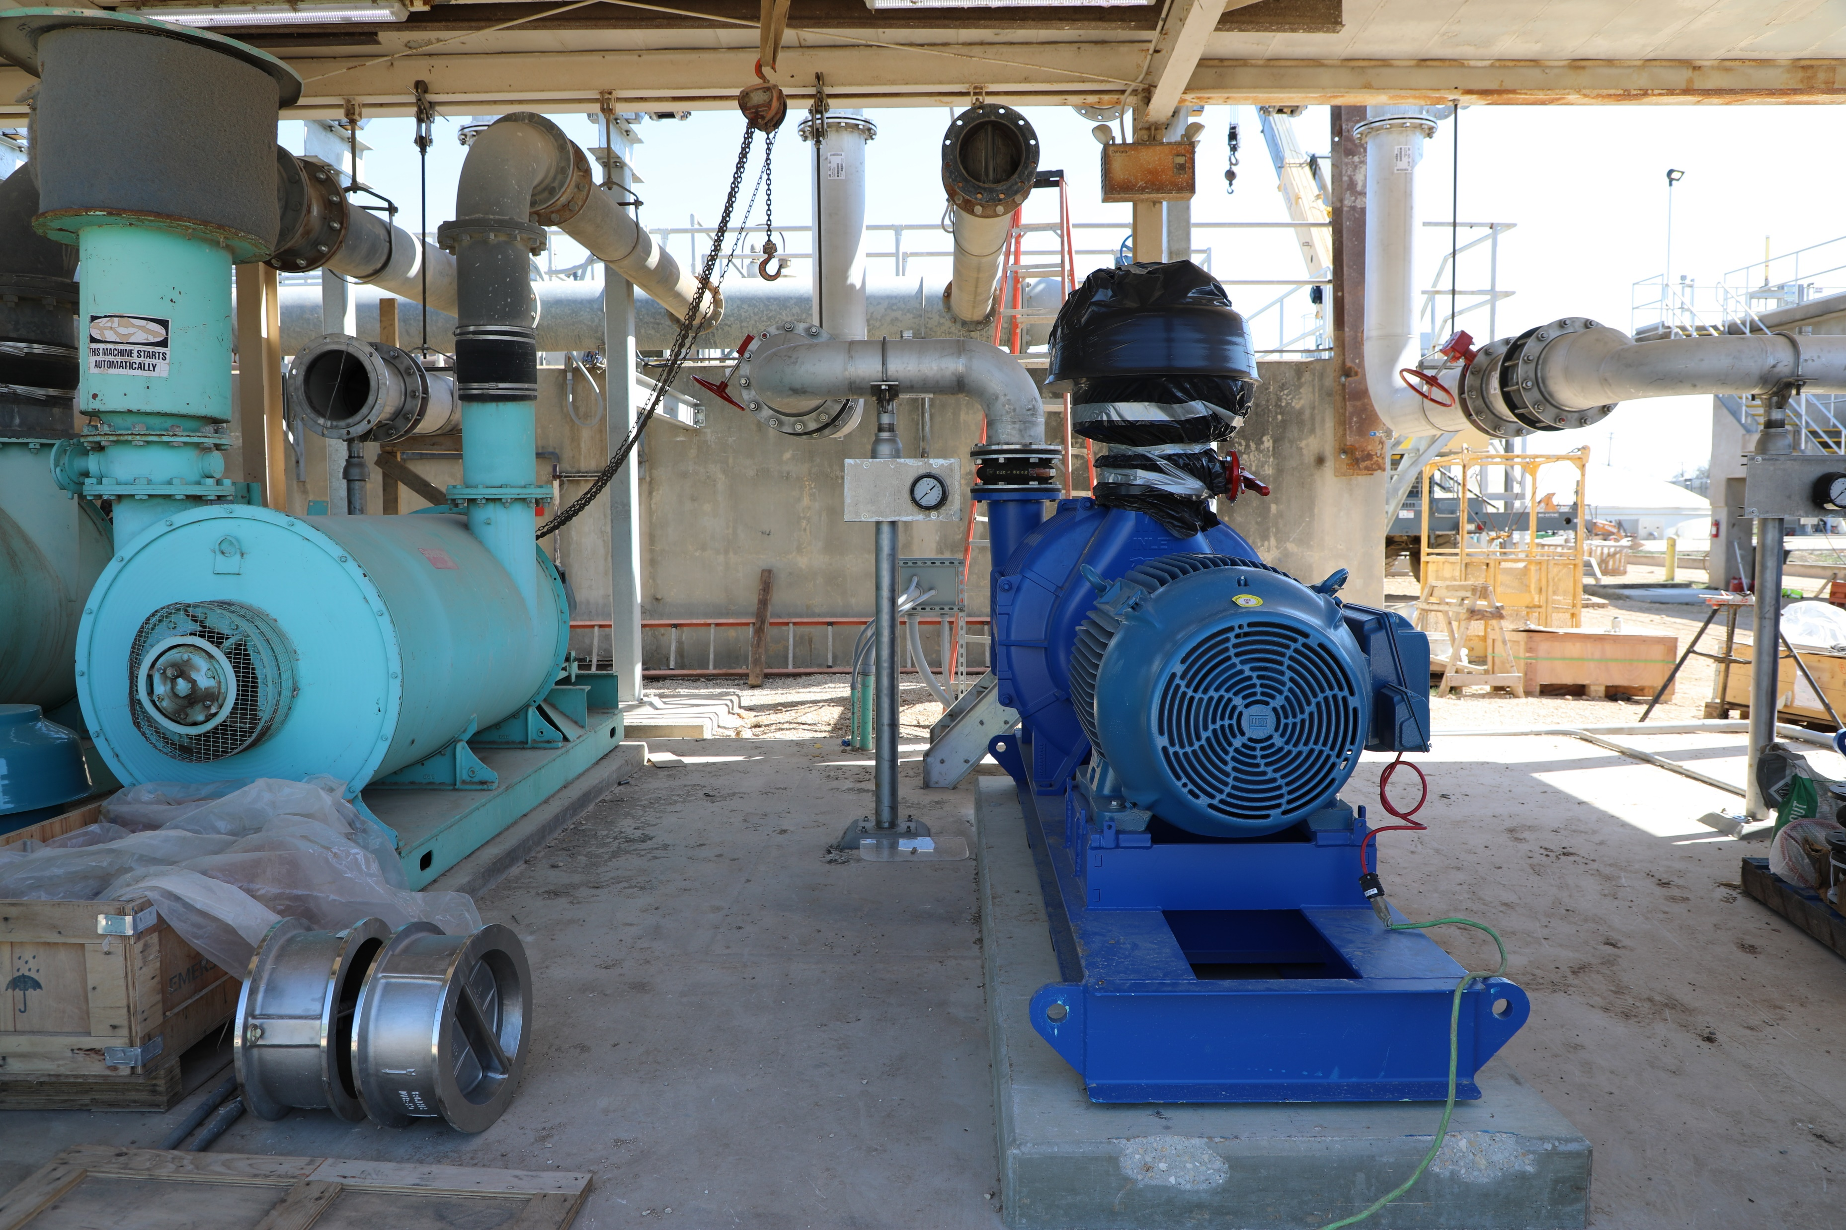
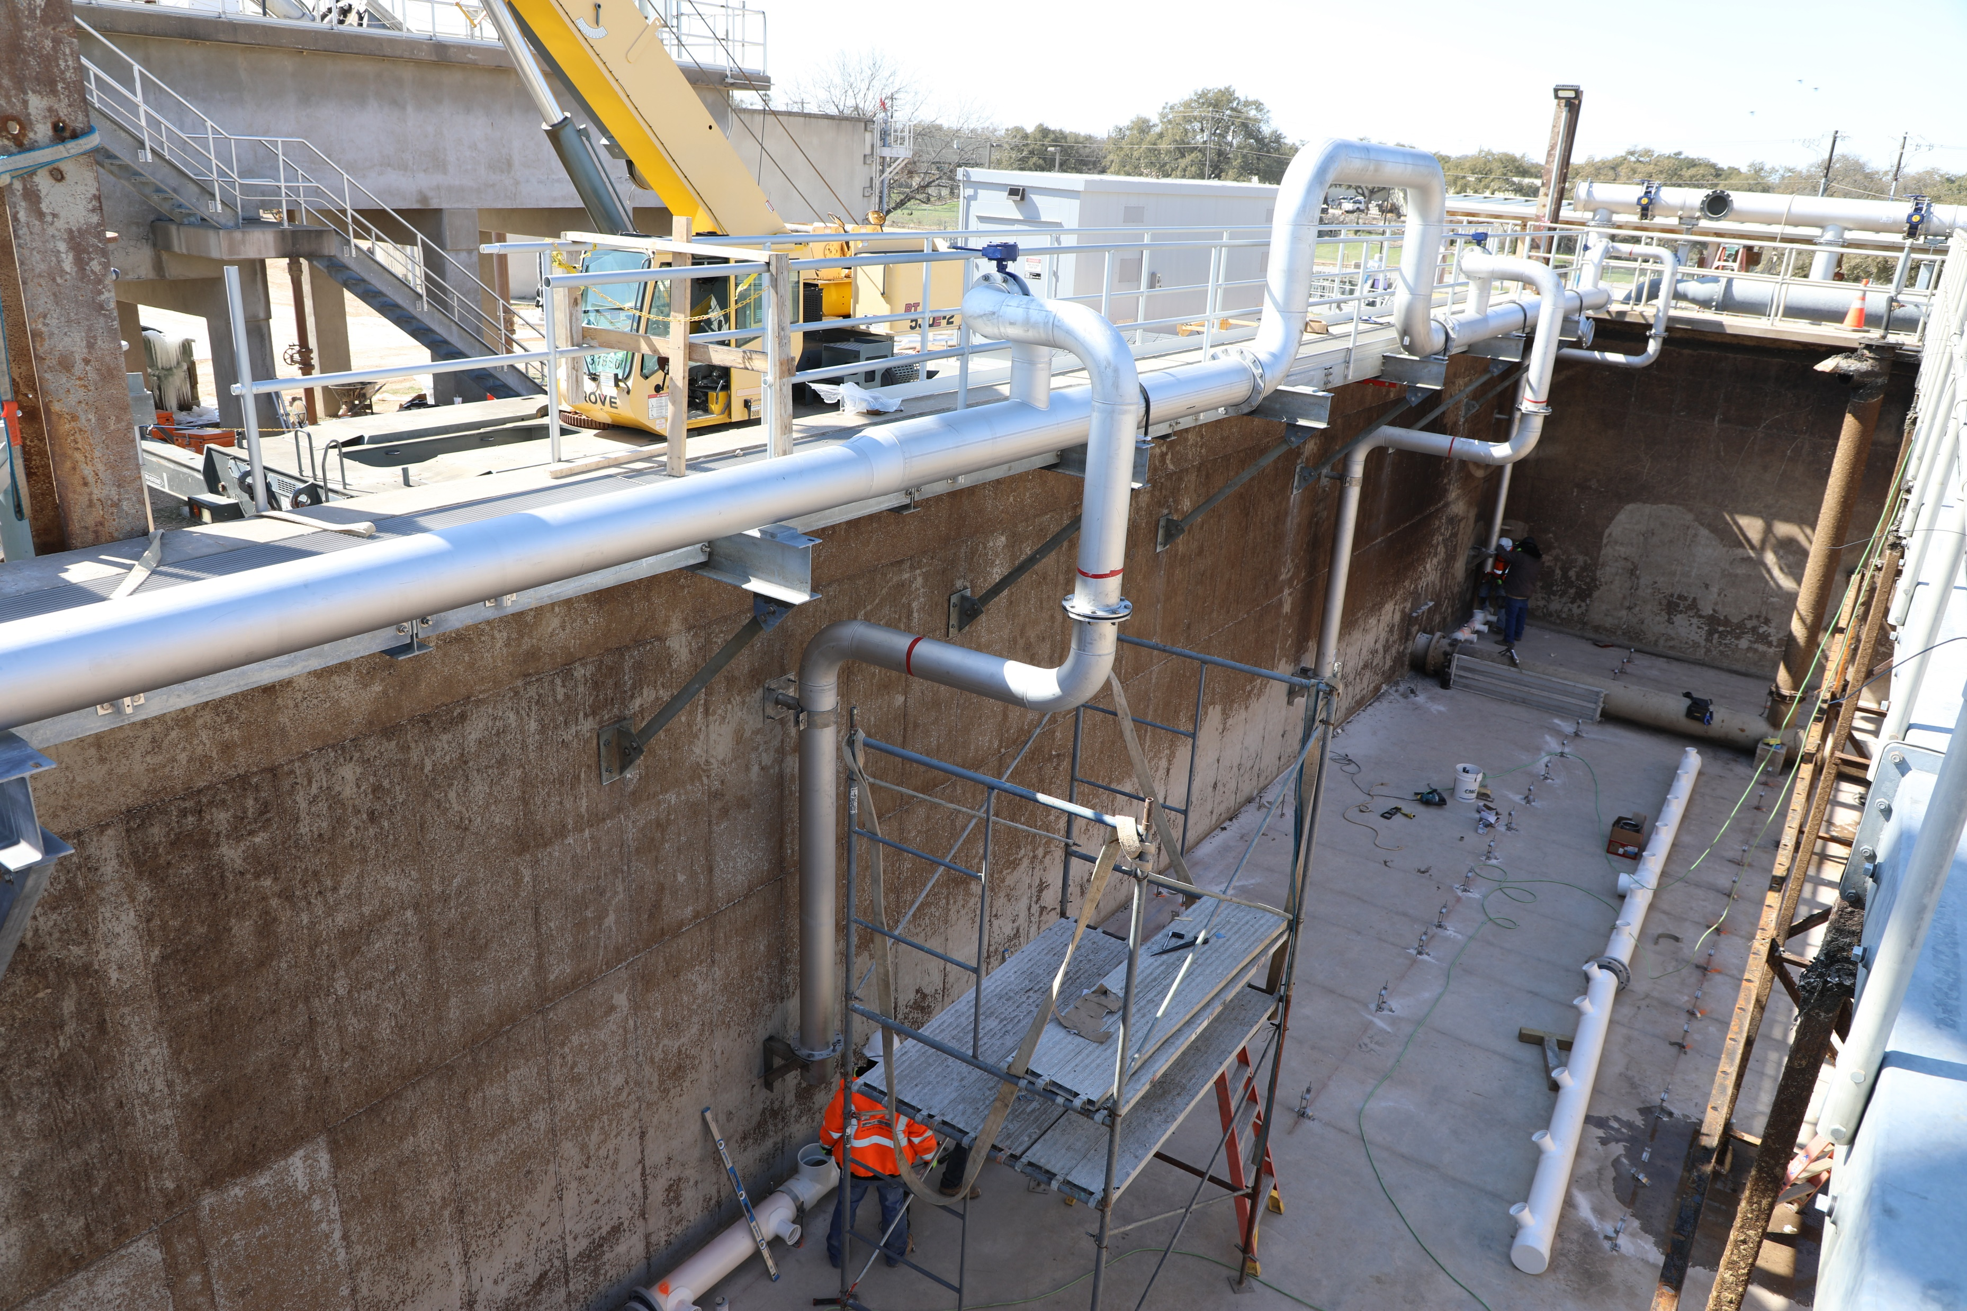
Secondary Treatment Improvements
Critical sequence of construction to keep half the plant running during installation of new equipment

Slide 21
Maintenance of Plant Operations (MOPO)

Slide 22
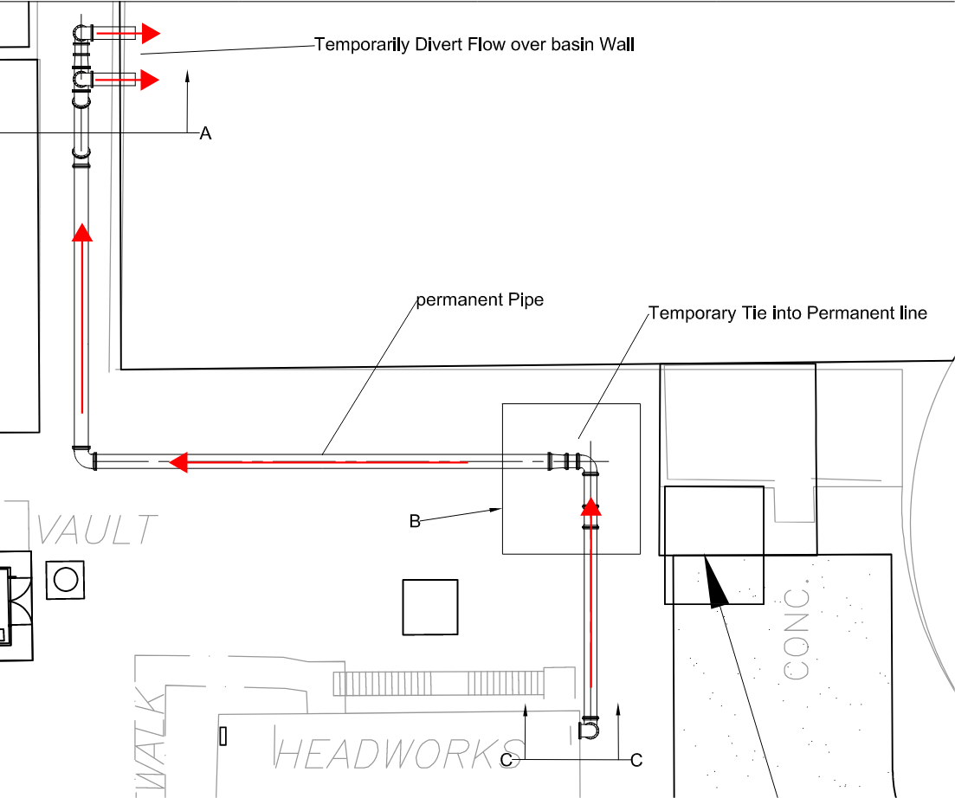
Bypass Creativity to Keep the Plant Running
Contract required bypass pumping, however contractor thought of more creative, cost-effective approach to eliminate need of pumping
Temporary pipe connection from headworks to permanent 20” ABI piping to bypass grit facility using gravity
Temporary airlifts on the 20” ABI piping to continue step feed flow path
Use of hydraulic modeling to confirm new flow path didn’t disrupt existing hydraulic profile
Temporarily Divert Flow over Basin Wall
Permanent 20” Pipe
Temporary Tie Into Permanent Line
Existing 18” RAW from Headworks

Slide 23
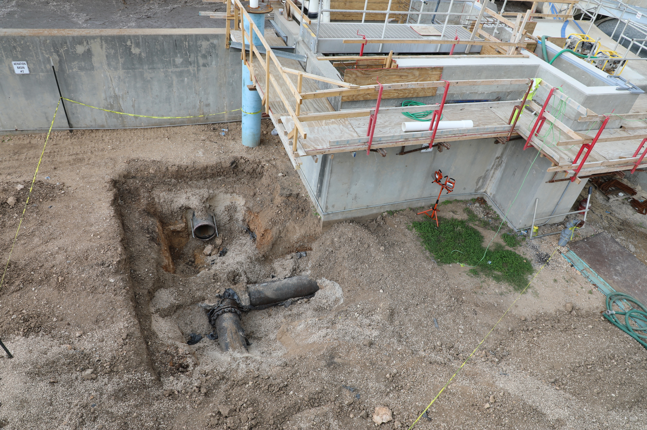
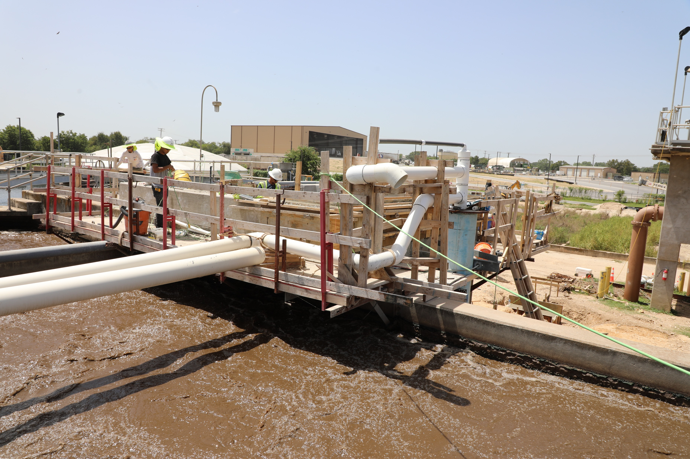
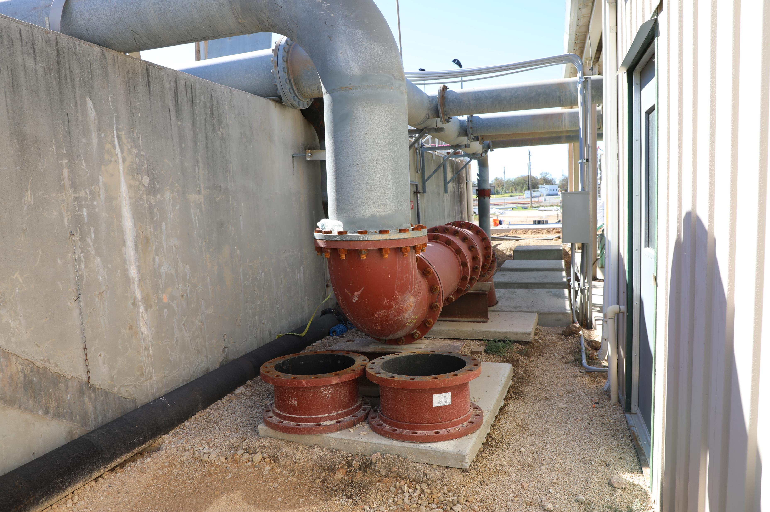
Bypass Creativity to Keep the Plant Running
Connecting to Existing 18” RAW to Bypass Grit Facility
Temporary
Airlifts
Temporary Routing of
Piping Up and Over Wall
New 20” ABI to Front of AB
Existing 18” RAW to Grit Facility
Airlift and Piping

Slide 24
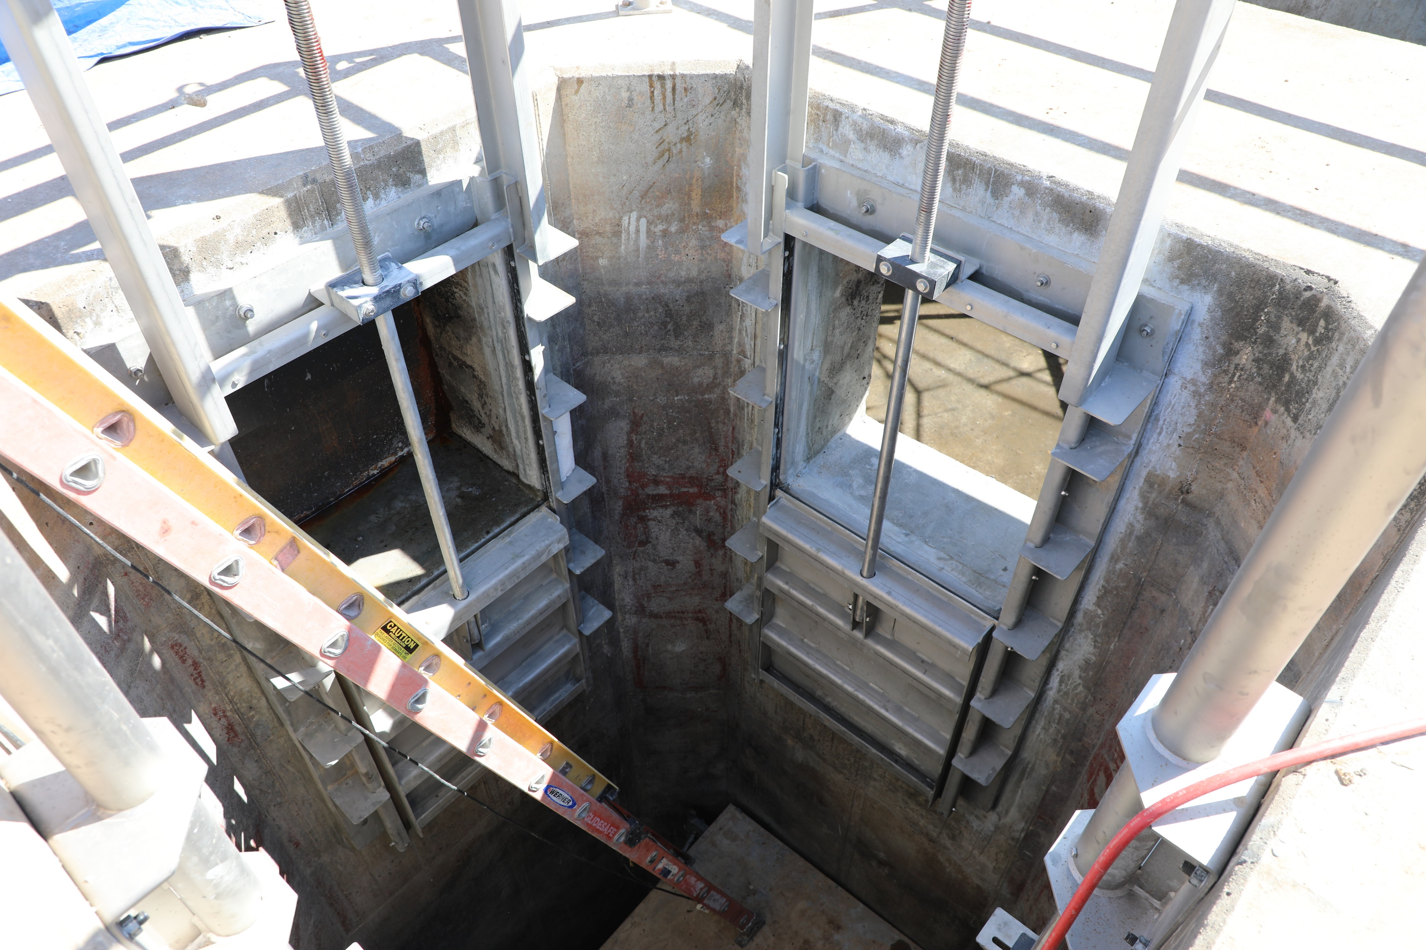
Slide Gate Replacement
Concrete coring of wall between aeration basin zones to aid in distribution box gate replacement
  Eliminated need for bypass pumping
Hole must be patched and repaired upon completion of work

Slide 25
Lessons Learned

Slide 26
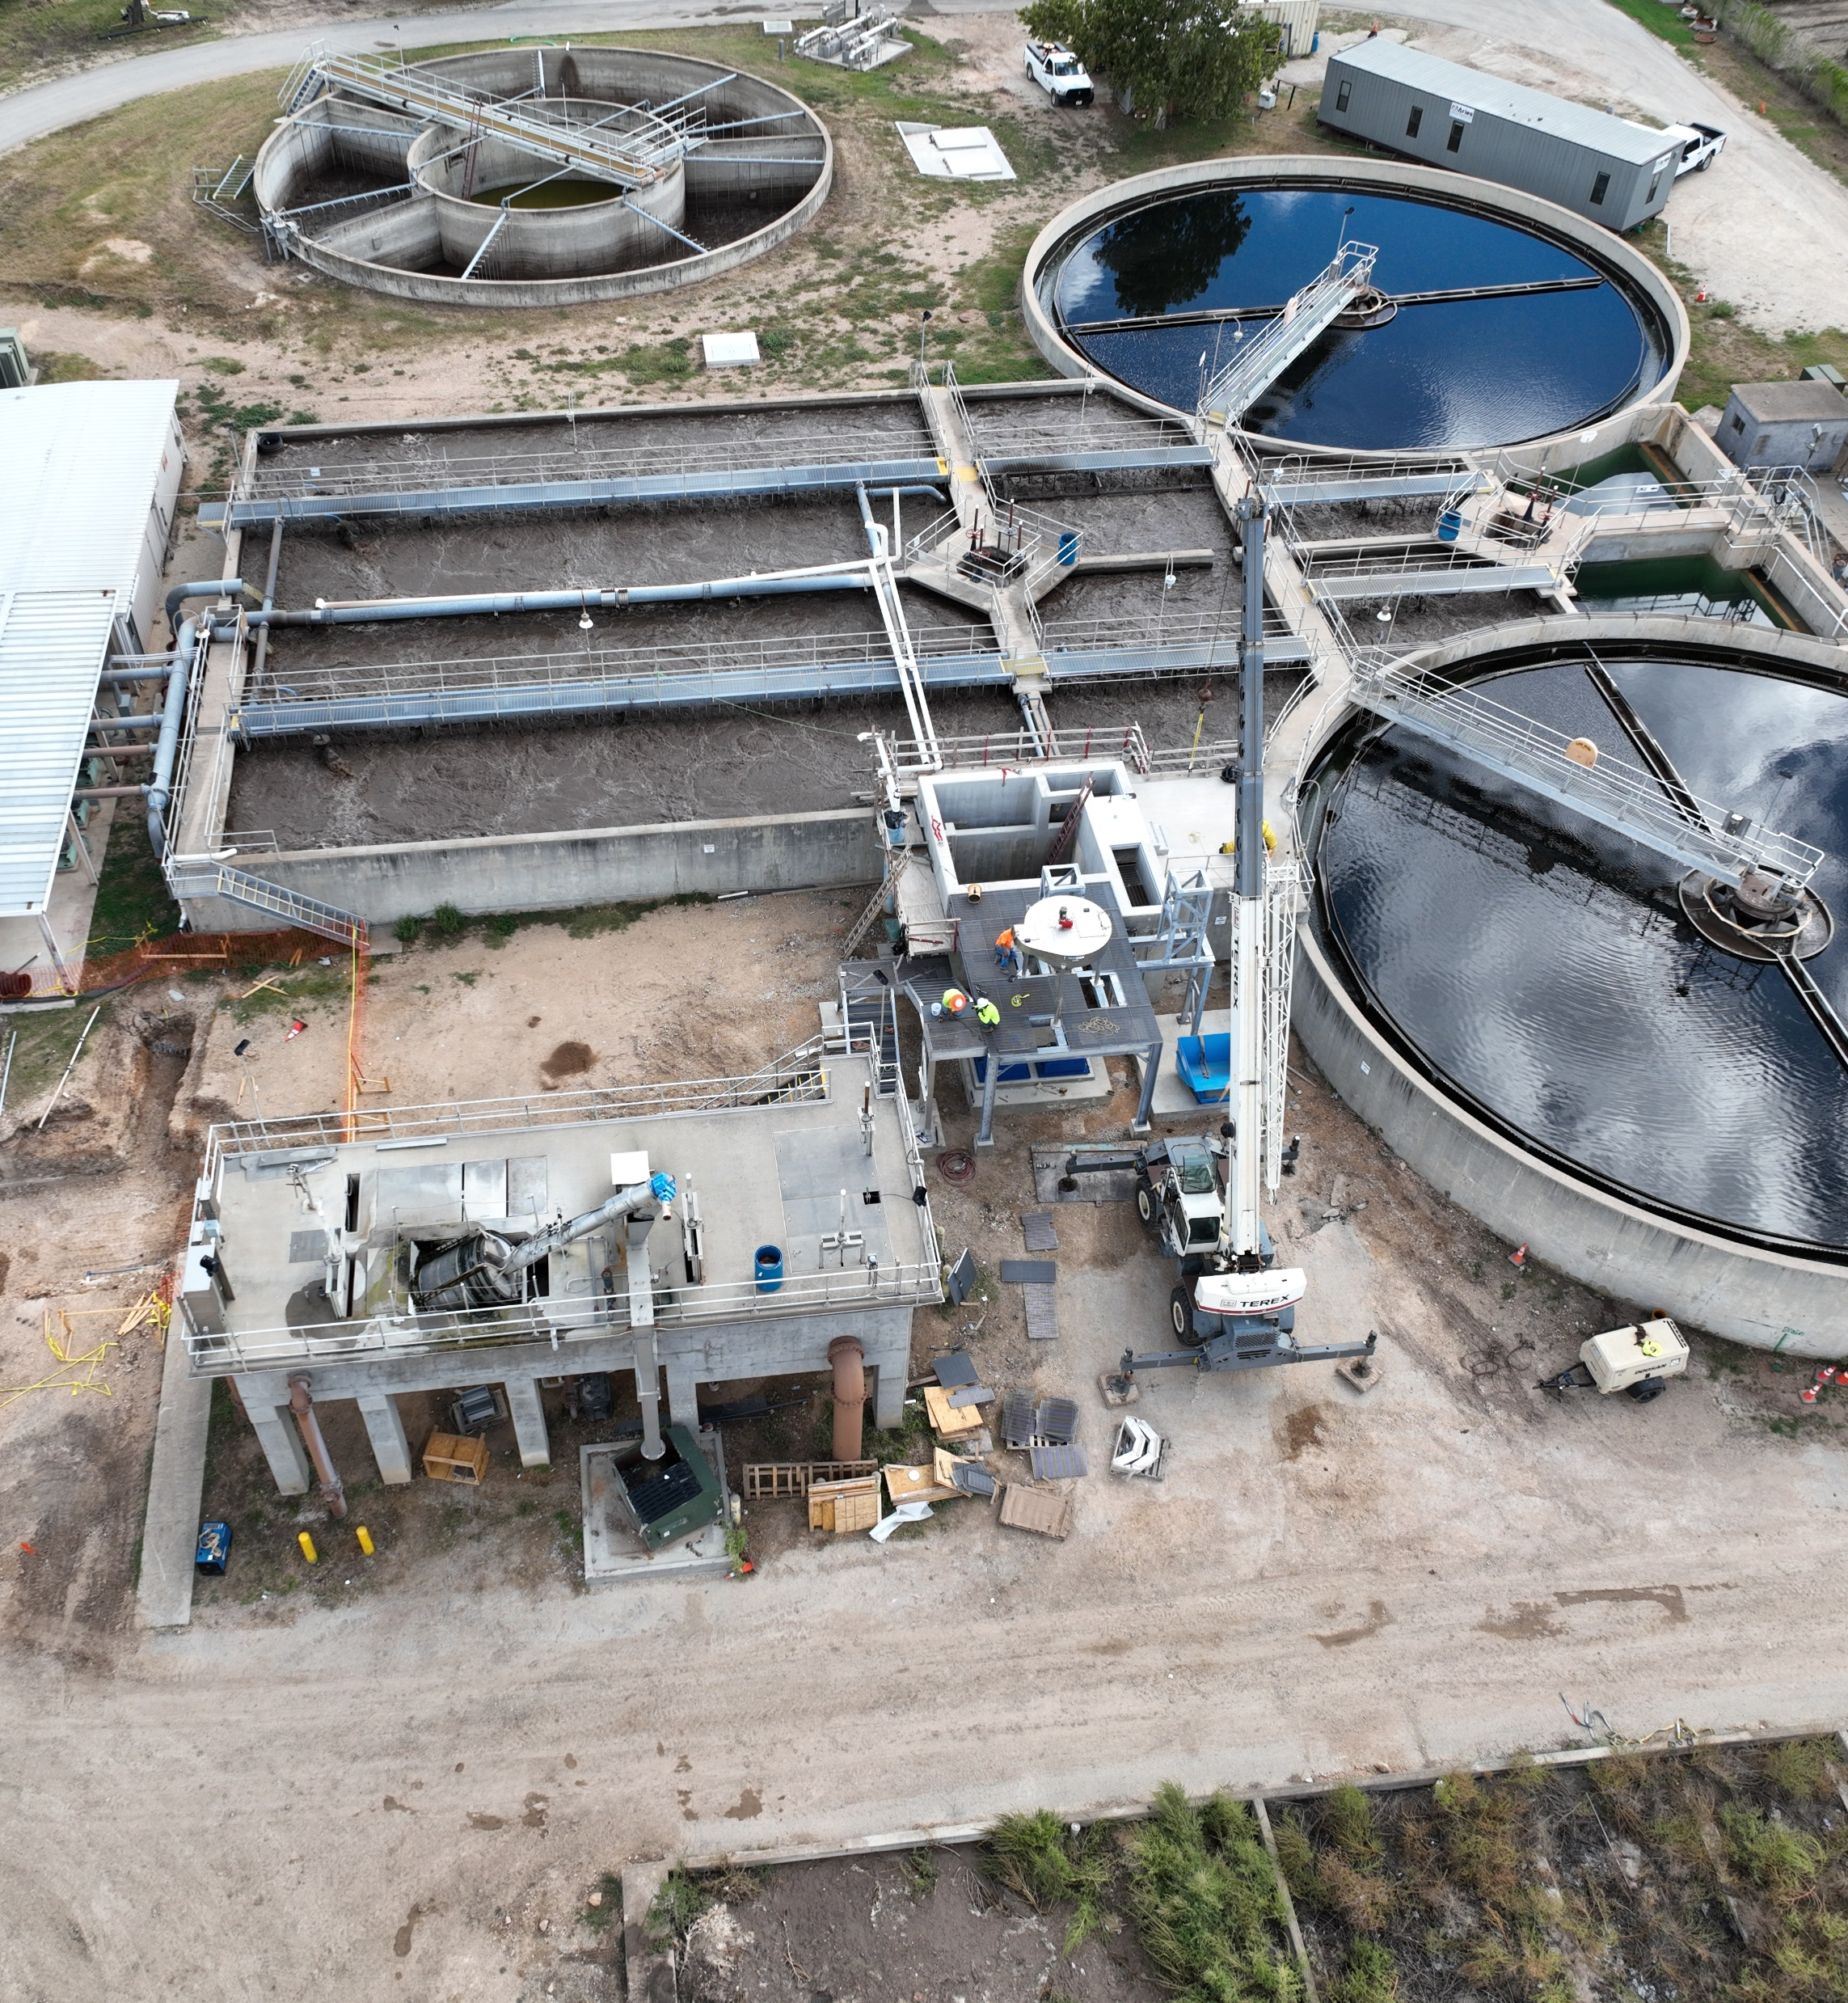
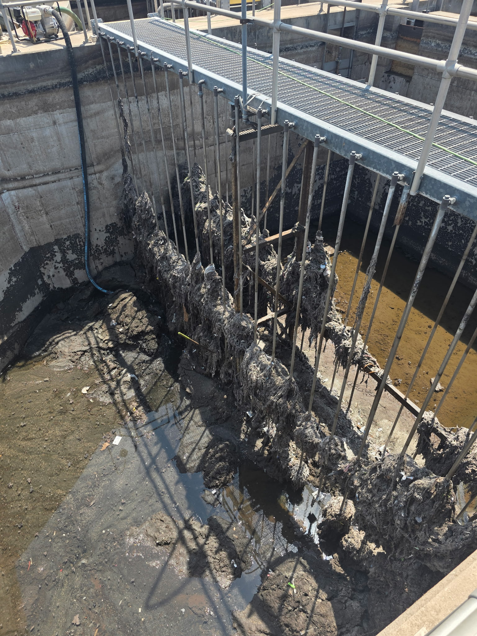
Lessons Learned and Embracing the Unknown of Rehabilitation Projects
Construction phase of projects requires accountability and adaptability
Establishing rapport with the operations staff who live and breathe the facility
Understanding construction sequencing and practicality is a critical aspect to consider during the design phase
Importance of record drawings!

Slide 27
Acknowledgements
CDM Smith: Alex Doody, Chris Varnon, and Allen Woelke
City of Georgetown Staff: Chelsea Solomon, Chris Pousson, Tim Walker, Larry Taylor, Joshua Naylor, Tony Medlock, and Randall Swenson
Matous Construction: Blake Pitts and John Yanez

Slide 28
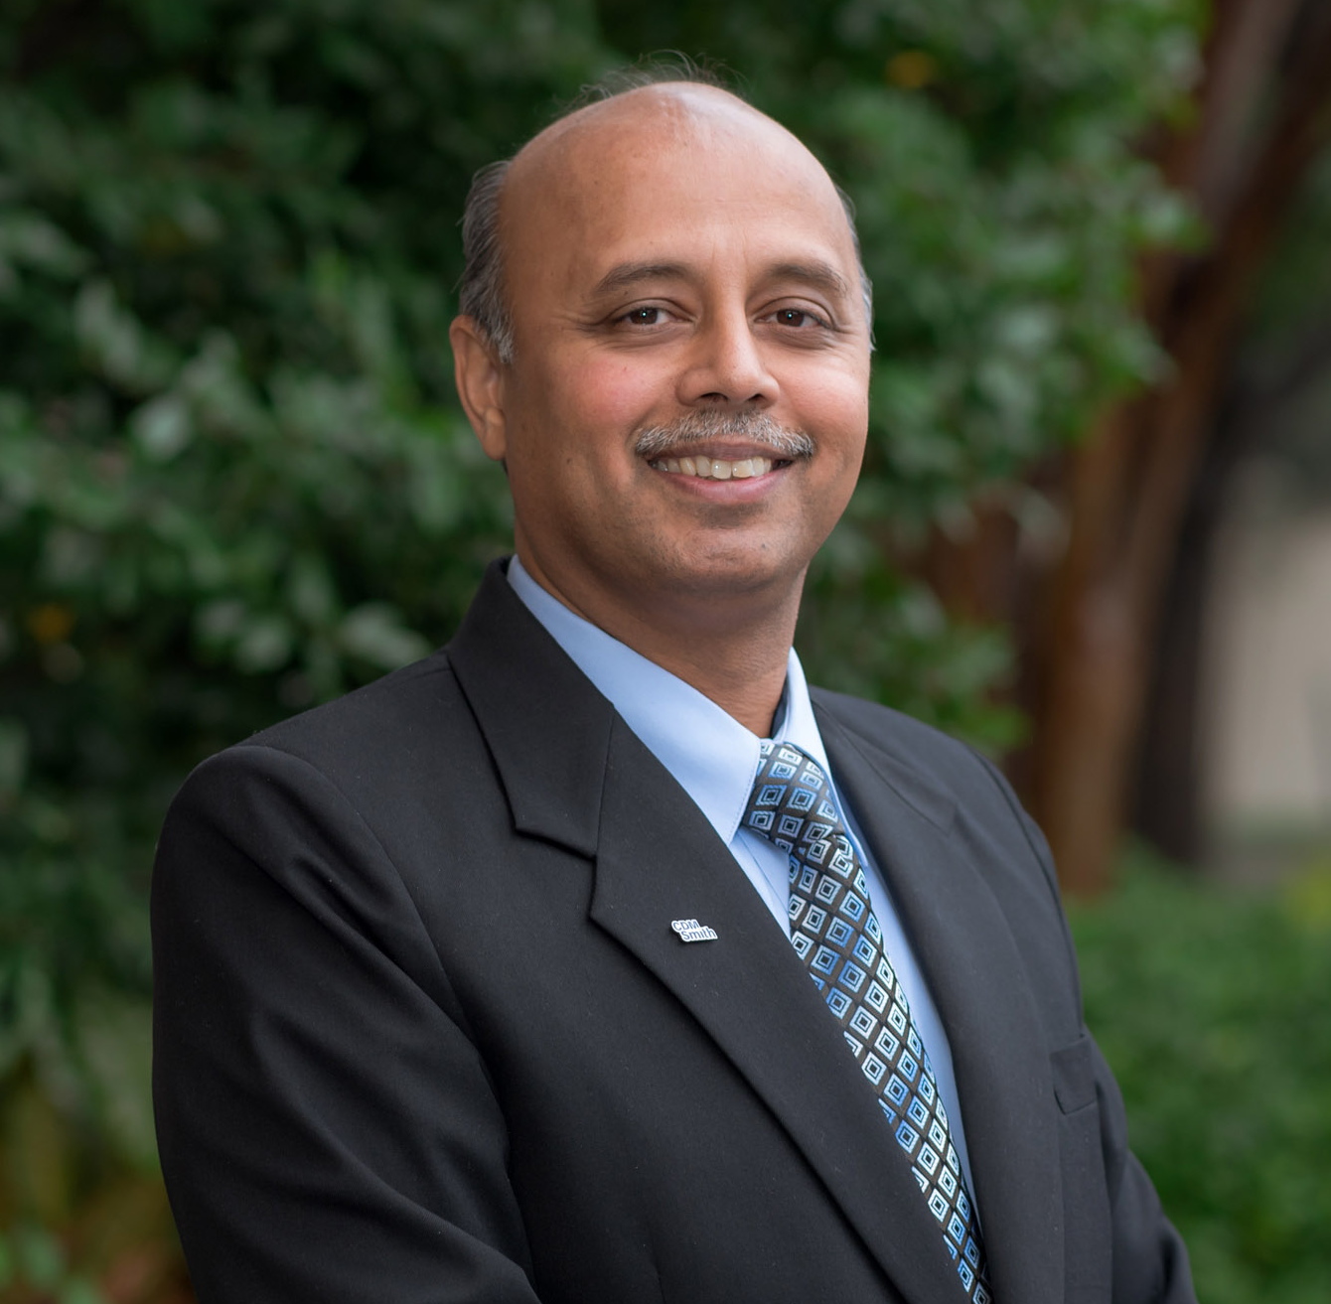

Thank You
To learn more, please reach out to:
Samir Mathur, PE, BCEE
Global Water Reclamation Practice Leader
CDM Smith
MathurS@CDMSmith.com
214-346-2800
Connect with me on LinkedIn:

