Slide 1

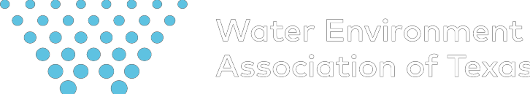

89th Texas Legislative Session:
Stop Me if You’ve Heard this One Before
as
Tex of
on
ati i
oc
s
s A
ronment i
Env
ater
W
Julie Nahrgang, WEAT| TACWA
julie@weat.org
89th Texas Legislative Session
February 28, 2025
Notes:
Good morning and I’m really excited talk water and the 88th Regular Session of the Texas Legislature today. And folks, it truly is always a water session in Texas.
And as much as things change, and there’s been quite a bit of change, things also stay the same. We’re going to take a look back at the 88th to help us understand where we’re headed in the 89th.

Slide 2


88th Special Session(s): A Series of Firsts
4 Special Sessions in the same year
House Impeachment of Ken Paxton
Senate Acquittal in Impeachment
Trial
Unanimous Expulsion of Rep
Bryan Slaton
Notes:
JULIE
They spent more time in
session than any other Legislature since the Texas Legislature first convened in 1846.
(Abbott, Phelan, Patrick) is divided on hot button political issues
This is speculation but don’t think it’s a coincidence so many senior members
are retiring after this past session

Slide 3
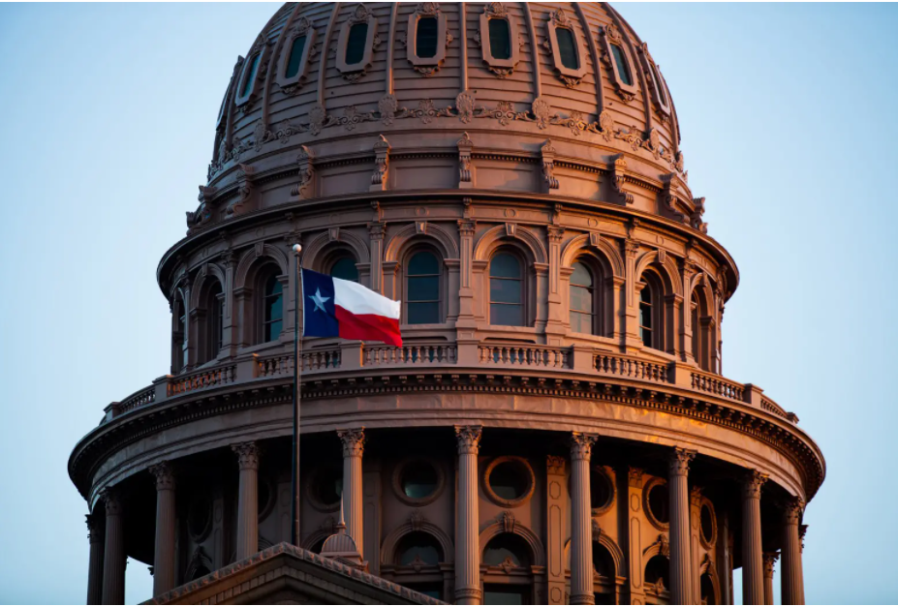
88th Regular Session of the Texas Legislature:
Key Dates:
November 5 – Election Day
November 11 – 1st day of prefiling
January 14 – 1st day of 89th Lege
March 14 – Bill Filing Deadline
June 2 – Sine Die – Final Day
June 22 – Veto Deadline
Key Dates:
November 8 – Election Day
November 14 – 1st day of prefiling
January 10 – 1st day of 88th Lege
March 10 – Bill Filing Deadline
May 29 – Sine Die – Final Day
June 18 – Veto Deadline

Slide 4
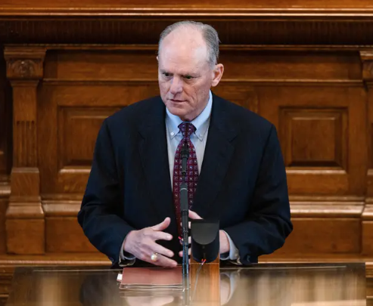
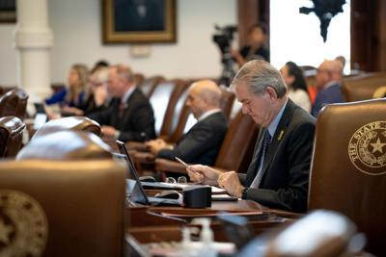
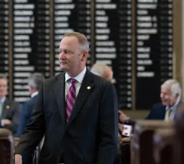
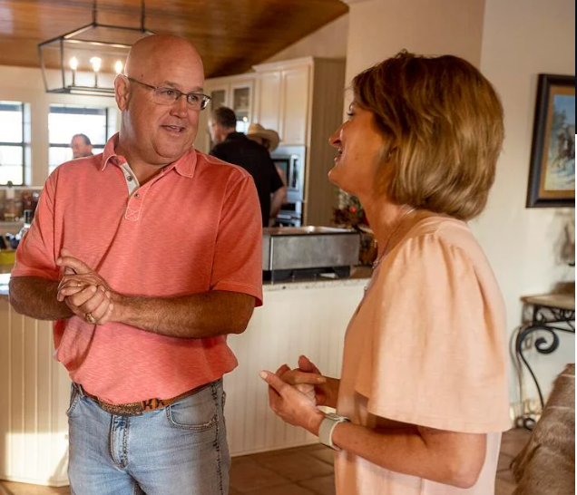
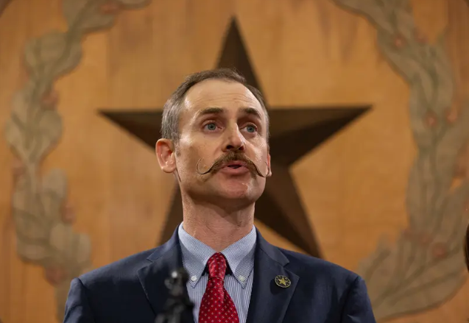
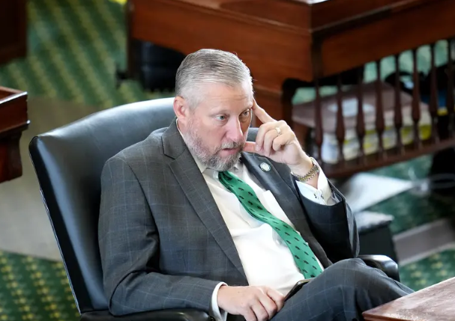
The Great Water Loss
Chairman Tracy King (Chair of HNRC)
Vice Chair Ed Thompson (VC of HNRC)
Representative Four Price (HNRC)
Representative Kyle Kacal (HNRC)
Representative Andrew Murr (Former HNRC)
Senator Drew Springer (Former SWAR)
Notes:
JULIE
Representative and Chairman of the House Natural Resources Committee, Tracy King announced he was retiring and would not seek reelection in a stunner on July 11.
"After much reflection I have decided not to seek re-election to another term for the office of State Representative," King said in a statement. "It has been an honor and privilege to represent the citizens of House District 80, and I will forever be grateful to the men and women that supported us through the years."
With the announcement, King will be placing the District 80 seat, which he has held since 2005, up for grabs in the 2024 election. King won the seat most recently in an uncontested election in 2022.
The seat oversees Texas District 80, which oversees the counties of Atascosa, Dimmit, Frio, Uvalde, Zavala and part of Webb.
Four Price is an Amarillo Republican who has served on the House Natural Resources Committee and was among rural GOP members oppose school voucher proposals
Price was one of 24 Republicans who joined Democrats in April to pass a budget amendment banning state funds for voucher programs.
Kacal and 19 other Republicans joined with the Democrats to pass the amendment, sending the bill back to committee where it is likely to die. Both Kacal and Raney voted to impeach Texas Attorney General Ken Paxton last spring, another contentious split among Republicans.
“I’ve put ranch work on hold, often to its own detriment, and now — quite literally — cows are calling me home.”
Murr, 46, also faced the prospect of a difficult reelection. After Paxton was acquitted at the conclusion of his impeachment trial in September, he vowed revenge on the House Republicans who had voted overwhelmingly to indict him in May. In passionate floor speeches in the House and Senate, Murr risked his standing among Republicans by urging the conviction of one of the party’s most powerful members, a statewide elected official.
Drew Springer – past-member of the Senate Water, Ag. &amp; Rural Affairs Committee; Vice-
chairman of the Senate Local Government Committee

Slide 5
88th Texas Legislature
Contentious Republican Primaries & Runoffs
Retained Seat in Runoff:
Speaker Dade Phelan
Gary VanDeaver
Retired:
Four Price
Andrew Murr
Tracy King
Ed Thompson
Kyle Kacal
John Raney
Lost Seat:
Travis Clardy
Ernest Bailes
Hugh Shine
Glenn Rogers
Steve Allison
Stan Lambert
Jacey Jetton
Reggie Smith
Kronda Thimesch
Justin Holland
Stephanie Klick
DeWayne Burns
John Kuempel
Lynn Stucky
Frederick Frazier
Notes:
JULIE
Dade Phelan is fought for his political life against David Covey. An enormous amount of money, nationally, has poured into Covey’s cauffers.
Because of the controversial issues (impeachment, school choice to name a few), about one-
third of the Legislature has primary opponents. Practically, this means those Legislators are
going from an intense regular session to four special sessions straight into competitive
primary races that require fundraising and voter contact.

Slide 6
89th Legislature
Texas House and Senate Election Results
Texas Senate:
  15 of 31 seats up for election
  Adam Hinojosa (R) picked up District 27 over incumbent
  Sen. Morgan LaMantia
  2025 Regular Session, 20 R’s and 11 D’s
Texas House:
  Rs picked up two House seats
  Don McLaughlin Jr. (R) picked up Chairman Tracy King’s
  District and Denise Villalobos (R) won
  Rep. Abel Herrero’s (D) District
  2025 Regular Session, 88 R’s and 62 D’s

Slide 7
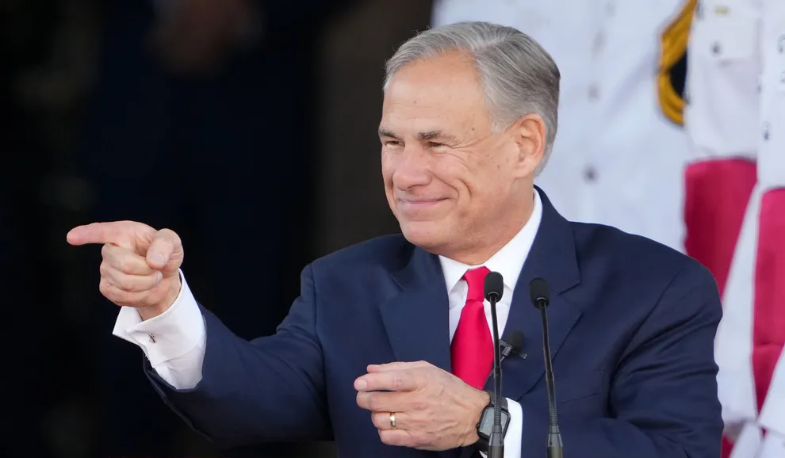
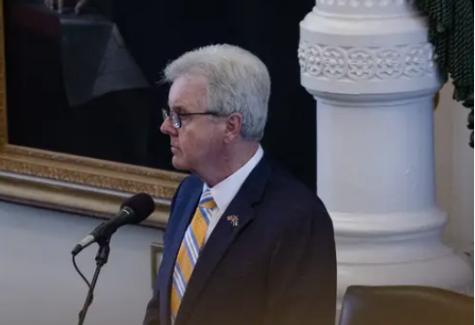
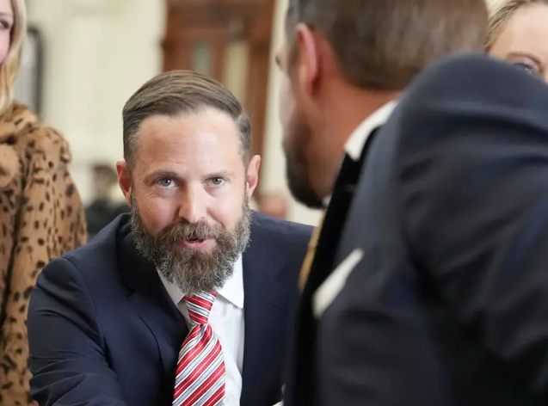
89th Legislature
The Big 3 and Big Issues
Budget Surplus
Property Taxes
School Choice/Voucher Program (passed Senate)
Strengthening Electrical Grid
Social/Cultural/Religious Issues
Border Security/Law Enforcement
Notes:
In many ways, the tone and tenor of the legislature is set by the relationship between the big 3 and how they agree or disagree on priority issues.
After serving three terms, we know Dade Phelan will not be back leading the House as speaker. He could not overcome the wave of Republican backlash and dropped from the speaker race on Dec 6, which ended a difficult period of intraparty fight.
Dustin Burrows, a Phelan ally representing the Lubbock area, and David Cook of Mansfield. David Cook recently won the GOP caucus vote and Governor Abbott has signaled support for Cook. But in the end, Dustin Burrows edged out cook by a vote of 85-55. The house speaker position is a crucial legislative vote. If relationships among that group are good, legislative sessions can go fairly smoothly. But if the bonds are strained, major pieces of legislation can grind to a halt.
Lt Gov Priorities – SB 10 and SB 11 - Placing 10 commandments in school and protecting the freedom to pray
SB 14 Texas DOGE – improving Governmental Efficiency
SB 24 – educating Texas students on the horrors of communism.
Ban all forms of consumable THC
In
JULIE start and Sarah backstop
The “Big Three” dynamic
Sessions always hinge on the relationship among the Big Three — the governor, the lieutenant governor and the House speaker. This time around, there is ample cause for tension from the outset of the session. Hostility by the end of the mararthon
The session saw significant right-wing victories in the cultural issue area
The two chamber leaders do not like one another, especially after the marathon of sessions in 2021. Patrick repeatedly criticized Phelan’s management of the House after Democrats broke quorum over the GOP’s priority elections bill. And then Patrick wielded his clout with former President Donald Trump to try to gin up primary opposition to Phelan, who ultimately ran unopposed.
“We have to get along to do the business of the state,” Phelan said in September before dryly adding, “and I have to tell you, our staffs get along very well.”
145-3
The surplus, or one-time money that was left over from the previous budget cycle, is historic in its enormousness. But not all of it is up for grabs. A share of it is reserved for highway funds, and some of it will flow into the state’s rainy day fund, also called the Economic Stabilization Fund.
keeping their grasp on every statewide elected office. That means Texans can expect the Legislature to continue to swing conservative on both fiscal and social matters. That said, the priorities will reflect the ideology of the party in power, but there is an internal struggle going on. Just how conservative they go will be the main question, as the battle between far-right, socially conservative Republicans and business-oriented GOP legislators, who have tried to move away from fights over social issues, continues within the party.

Slide 8
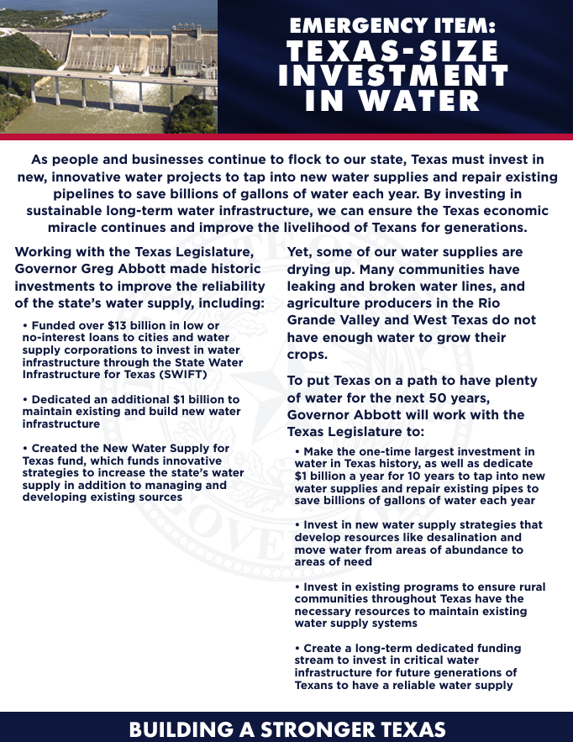
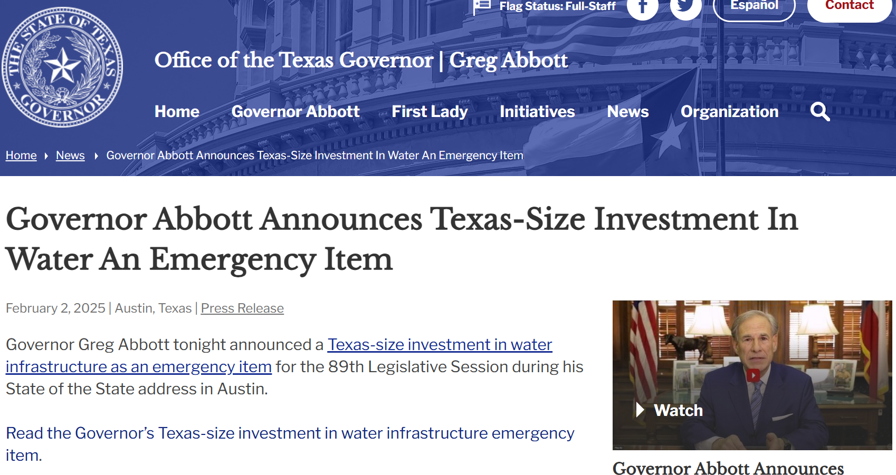
The Priorities
$24 billion budget
surplus
Texas-Size
Investment in Water
Priority #7
Notes:
As people and businesses continue to flock to our state, Texas must invest in new, innovative water projects to tap into new water supplies and repair existing pipelines to save billions of gallons of water each year. By investing in sustainable long-term water infrastructure, we can ensure the Texas economic miracle continues and improve the livelihood of Texans for generations.
Working with the Texas Legislature, Governor Gr
• Funded over $13 billion in low or no-interest loans to cities and water supply corporations to invest in water infrastructure through the State Water Infrastructure for Texas (SWIFT)eg Abbott made historic investments to improve the reliability of the state’s water supply, including:
• Dedicated an additional $1 billion to maintain existing and build new water infrastructure • Created the New Water Supply for Texas fund, which funds innovative strategies to increase the state’s water supply in addition to managing and developing existing sources
Yet, some of our water supplies are drying up. Many communities have leaking and broken water lines, and agriculture producers in the Rio Grande Valley and West Texas do not have enough water to grow their crops.
To put Texas on a path to have plenty of water for the next 50 years, Governor Abbott will work with the Texas Legislature to: • Make the one-time largest investment in water in Texas history, as well as dedicate $1 billion a year for 10 years to tap into new water supplies and repair existing pipes to save billions of gallons of water each year • Invest in new water supply strategies that develop resources like desalination and move water from areas of abundance to areas of need • Invest in existing programs to ensure rural communities throughout Texas have the necessary resources to maintain existing water supply systems • Create a long-term dedicated funding stream to invest in critical water infrastructure for future generations of Texans to have a reliable water supply

Slide 9


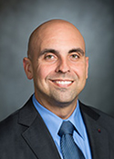
88th Texas Legislative Session:
Water Leadership
House Natural Resources Committee
Position Member
Chair Rep. Cody Harris
Vice Chair: Rep. Armando Martinez
Members: Rep. Trent Ashby
Rep. Jeff Barry
Rep. Cecil Bell
Rep. Brad Buckley
Rep. Caroline Fairly
Rep. Erin Elizabeth Gamez
Rep. Josey Garcia
Rep Mary E. Gonzalez
Rep Ramon Romero, Jr
Rep Denise Villalobos
Rep. Erin Zwiener
Notes:
Tracy King is the slow talking yet fast thinking Democrat representing the 80th district covering areas in Uvalde, Zavala, and Laredo. He’s been a Texas House Representative for nearly 28 years and is a great water leaders. He knows the system in which he works and has found great (relative) success as a Democrat in a Republican dominated lege
Ed Thompson, District 29, Brazoria Co - also sits on the appropriations committee
Lost Will Metcalf and moved Cody Harris to VC,
Lost Jessica Farrar (did not seek reelection)
Lost Rep. Poncho Nevarez (drug scandle)
The Seniority appointments included Tracy Kin, Lyle Larson, Eddie Lucio III, Amrmando Walle.
Tracy King is out of the Uvalde area and has always been a great water leader.
And, you’ll notice Lyle Larson lost his powerful position as Chair. This is in no small part due to his vocal opposition and calls for the former speaker, Dennis Bonnen, to step down after secret recordings of his disparaging remarks against other lawmakers came to light. Larson and I believe 5 other senior lawmakers called for Bonnon to step down and there was a polictial price to pay.

Slide 10
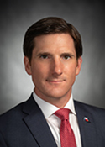

88th Texas Legislative Session:
New and Familiar Faces
House Environmental Regulation Committee
Position: Member
Chair: Rep. Brooks Landgraf
Vice Chair: Rep. Claudia Ordaz
Rep. Rafael Anchia
Rep. Keith Bell
Rep. Ben Bumgarner
Rep. Penny Morales Shaw
Rep. Tom Oliverson
Rep. Ron Reynolds
Rep. Steve Toth
Notes:
Brooks Landgraf – Odessa, so his continuants are very interested in O&G,
Rep Guerra – D from McAllen area has been a representative since 2012
3 Seniority pics – Morrison, Kuempel, and Reynolds. Seniority picks, write on card where they want to be. Speaker defers to seniority. Get it regardless of if speaker
John Turner not on there.

Slide 11

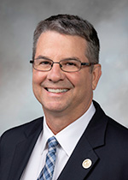
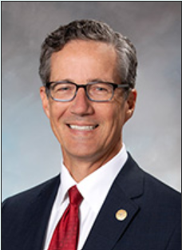
Senate Committees
New and Familiar Faces
Senate Water, Agriculture & Rural Affairs Committee
Position Member
Chair Sen. Charles Perry
Vice Chair: Sen. Kelly Hancock
Members: Sen Cecar Blanco
Sen Brian Birdwell
Sen Roland Gutierrez
Sen Adam Hinojosa
Sen Nathan Johnson
Sen Louis Kolkhorst
Sen. Kevin Sparks
Notes:
SWAR is chaired by the incredibly powerful Senator Charles Perry out of Lubbock. Importantly, Perry is also on the Finance committee – An accountant turned senator advocating for districts interests – including rural and small systems, desal, and produced water,
Senator Kelly Hancock (R) represents District 9 in Tarrant County – has been in the senate since 2013
And we already know that Perry’s big focus is on produced water issues. His much anticipated Produced Water consortium bill was just filed.
at Texas Tech to bring together leaders in O&G, academics,, and people with tech to work on the issue reuse of produced water for a number of purposes. And with EPA’s granting of delegation to TCEQ to issue discharge permits for produced water, we see a shift in value of water resources and a continued hard look at produced water as an important piece of the aird west Texas water portfolio.
Creighton is also now the Chair of the Senate Select Committee on Ports
Brian Birdwell, Chair Senate Committee on Natural Resources and Economic Development
Brian Birdwell, Chair

Slide 12
Lt. Gov. Patrick’s Priority Bills:
Senate Bill 1 – Senate’s Budget for Texas
Senate Bill 2 – Providing School Choice
Senate Bill 3 – Banning THC in Texas
Senate Bill 4 – Increasing the Homestead Exemption to $140,000 ($150,000 for seniors)
Senate Bill 5 – Combatting Alzheimer’s – Establishing DPRIT (Dementia Prevention & Research Institute of Texas)
Senate Bill 6 – Increasing Texas’ Electric Grid Reliability
Senate Bill 7 – Increasing Investments in Texas’ Water Supply
Senate Bill 8 – Requiring Local Law Enforcement to Assist the Federal Government’s Deportation Efforts
Senate Bill 9 – Reforming Bail – Keeping Violent Criminals Off Our Streets
Senate Bill 10 – Placing the Ten Commandments in School
Senate Bill 11 – Protecting the Freedom to Pray in School
Senate Bill 12 – Establishing a Parental Bill of Rights in Public Education
Senate Bill 13 – Guarding Against Inappropriate Books in Public Schools
Senate Bill 14 – Texas DOGE – Improving Government Efficiency
Senate Bill 15 – Removing Barriers to Affordable Housing
Senate Bill 16 – Stopping Non-Citizens from Voting
Senate Bill 17 – Stopping Foreign Adversaries’ Land Grabs
Senate Bill 18 – Stopping Drag Time Story Hour
Senate Bill 19 – Stopping Taxpayer Dollars for Lobbyists
Senate Bill 20 – Stopping AI Child Pornography
Senate Bill 21 – Establishing the Texas Bitcoin Reserve
Senate Bill 22 – Establishing Texas as America’s Film Capital
Senate Bill 23 – Removing the Cap on the Rainy Day Fund to Secure Texas’ Long-term Financial Future
Senate Bill 24 – Educating Texas Students on the Horrors of Communism
Senate Bill 25 – Making Texas Healthy Again

Slide 13
Texas Water Caucus
Chairman: Rep Stan Kitzman
73 Members
Serve as a platform to inform legislators of
our state’s most important water issues
Elevate water as a policy priority
Cultivate, inform, and inspire the next
generation of water champions at the
Texas Legislature

Slide 14
89th Legislature
When Biosolids Hit the Fan
Johnson Co. Famers/PEER v EPA
Johnson Co. Farmers/PEER v Synagro and Renda
Local Counties enacting bans
Office of the State Chemist proposed rule change for “biosolids fertilizers”
AG Ken Paxton sues PFAS manufacturers
Letters from Representative Orr and Representative Kitzman requesting the State Chemist hold stakeholder meetings around proposed rule change
Dec 6, 2024 EPA moves to promulgate method 1633 – PFAS method test
Jan 2025, EPA released it’s PFAS in Biosolids Risk Assessment
EPA directs 200 utilities to conduct PFAS testing of influent, effluent and biosolids, which will inform eventual PFAS effluent and biosolids limits
Johnson Co. votes to declare county a disaster area
Notes:
As we know, biosolids are a highly regulated and sought after soil amendment that have also been the focus of a number of debates across Texas and in other states too. Texas regulates the land application and quality of biosolids to a more stringent level than the EPA and rule writing here in Texas that created the third class of biosolids, Class AB was concluded less than 10 years ago. Biosolids or the residuals from resource recovery plants are a fact of cleaning water – and an incredibly expensive part of water treatment that for some have required capitol improvement projects costing upwards of a quarter of a billion dollars. So, biosolids are a fact of treatment and expensive business. The issue at hand today is around the PFAS content in biosolids that are land applied. In 2021 EPA began its work on the their PFAS strategic roadmap to research, restrict, and remediate exposure to PFAS.
Those that work in water know that a new contaminant found in a multitude of household and everyday items like food packaging, clothing, personal care products, firefighter foam, and many holdhold has been recognized by the EPA and is received as a pass
We

Slide 15
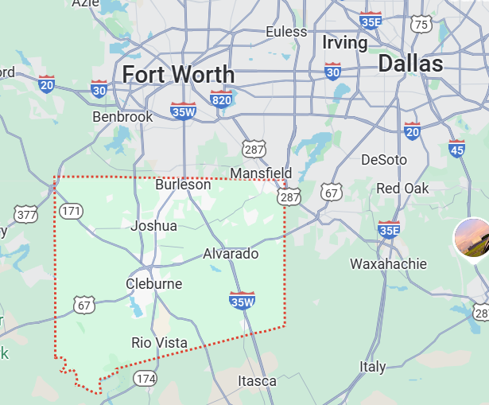
89th Legislature
When Biosolids Hit the Fan
HB 1674/SB 886 (Kirwin/Sparks)
Relating to the production, sale, and
use of certain agricultural products containing perfluoroalkyl and polyfluoroalkyl substances (PFAS);
creating a criminal offense
Moves biosolids regulatory authority from TCEQ to the Office of the State Chemist (impacts TPDES permits)
Labels biosolids with PFAS above limits as hazardous material that would then need to be disposed of in a hazardous material landfill
Includes domestic septage
Unit of measure is PPT
Statewide bill
Effective date September 1, 2025

Slide 16

89th Legislature
PFAS PFAS PFAS…
HB 1730/SB 768 (Morales-Shaw/Menendez)
Relating a study regarding the effects of
perfluoroalkyl and polyfluoroalkyl chemicals
on public health.
Study bill out of University of Houston investigating PFAS on human health
Health impacts on PFAS in produce, meat, and food packaging
  Groundwater, rivers, lakes reservoirs, and other drinking water water supplies
  Equipment or materials that likely contain PFAS and professionals that regularly come into contact with PFAS
Notes:
relating to a study regarding the effects of perfluoroalkyl and polyfluoroalkyl chemicals on public health. BE IT ENACTED BY THE LEGISLATURE OF THE STATE OF TEXAS: SECTION 1. STUDY. The president of the University of Houston shall designate a department or entity at the university to conduct, in collaboration with the Railroad Commission of Texas and the Texas Commission on Environmental Quality, a study on the effects of perfluoroalkyl and polyfluoroalkyl chemicals on public health. The study must include an assessment of the health impact of perfluoroalkyl and polyfluoroalkyl chemicals found in: (1) produce, meat, and other food and beverage products, including their packaging; (2) groundwater, rivers, lakes, reservoirs, and other water sources used to supply the public with drinking water; and (3) equipment or materials that: (A) likely contain perfluoroalkyl and polyfluoroalkyl chemicals; and (B) regularly come in contact with professionals, including firefighters and chemical manufacturing workers. SECTION 2. REPORT. Not later than December 1, 2026, the department or entity at the University of Houston designated by the president of the university to conduct the study under Section 1 of this Act shall prepare a report with the conclusions of the study and submit the report to the legislature.

Slide 17
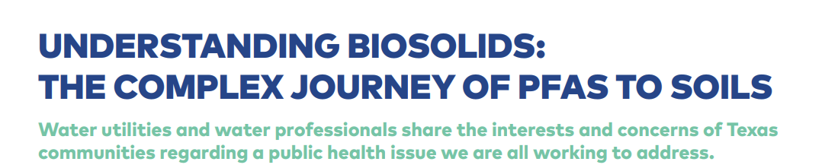
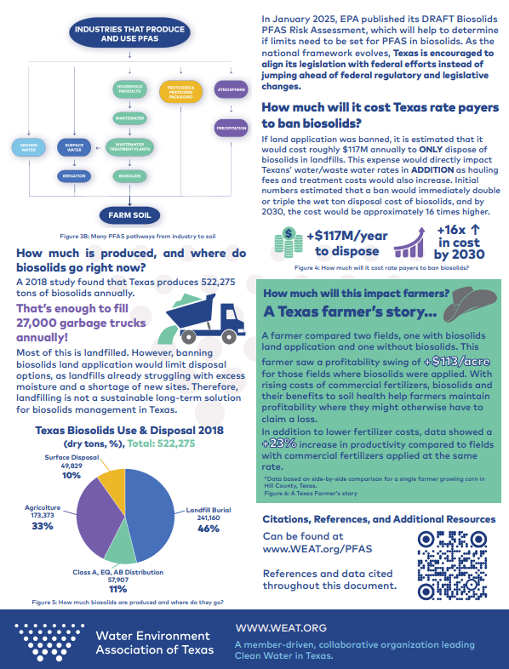
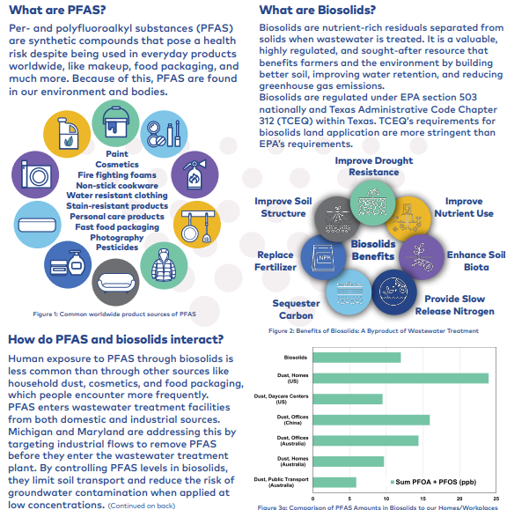
www.weat.org/pfas

Slide 18
89th Texas Legislature
Notification, Occupational licensing
HB 482 (Lopez) Relating to the provision by the TCEQ to the pertinent state representative and state senator of notice of certain administrative actions of the commission. (Similar to Vetoed Bill in 88th)
HB 1237 (Guillen) Relating to the renewal by the TCEQ of certain expired occupational licenses and registrations.
Notes:
HB 482 notify state rep or senator of TCEQ administrative actions
HB 1237 – this can be understood as a workforce bill and it relaxes the step up fee to renew your occupational license after more than 30 days expired to more than 90 days expired. And allows individuals to renew their license up to a year afer it has expired instead of no more than 30 days

Slide 19
89th Texas Legislature
Lobbying, Political Subdivisions, and Government Bodies
HB 309 (Loe-Wilson)/HB 1189 (Troxclair)/HB 1294 (Patterson)/SB Middleton Relating to the use by a political subdivision of public funds for lobbying and certain other activities
HB 571 (Cain)/HB 671 (Shaheen) Relating to the use by a political subdivision of public funds for lobbying and certain other activities
HB 755 (Spiller) Relating to certain requirements applicable to certain public entities that engage in lobbying
HB 811 (Spiller) Relating to applicability of lobbyist registration requirements to a person who provide legal services to a political subdivision (refiled)
HB 2388 (Kirwin) Relating to the definition of governmental body for the purposes of the public information law
Notes:
HB 309 Prohibits a political subdivision from sending public funds to hire a lobbyist or pay a nonprofit state association/organization that primarily represents political subdivisions and hires or contracts with lobbyists
HB 571 has certain carveouts for associations to provide bill tracking,

Slide 20
89th Texas Legislature
Funding, Research, and Resiliency
HB 156 (Raymond) Relating to a study by the TCEQ regarding the protection of certain water facilities from catastrophes.
HB 157 (Raymond) Relating to the production by the TCEQ on an annual report on public drinking water systems (Refiled)
HB 310 (Guillen) Relating to the use of money transferred from the Texas Water Fund
HB 365 (Gonzalez) Relating to the authority of the TWDB to provide financial assistance from the economically distressed areas account that is not required to be repaid.
HB 422 (Gonzalez) Relating to limitations on the issuance of bonds by the TWDB for the development of certain projects in economically distressed areas.
Notes:
HB 310 Expand priorities of TWF to include separate priority for municipalities with a population of less than 20,000
HB 365 Grants
HB 422 Increase caps on EDAP bonds from 25M to 100M

Slide 21
89th Texas Legislature
Funding, Research, and Resiliency
HB 1344 (Troxclair) Relating to prioritization of requests for financial assistance from certain funds administered by the TWDB
HB 1501 (Tinderholt) Relating to the study of the feasibility of using seawater desalination process in Texas.
HB 1400 (Harris)/ SB 718 (Kolkhorst) Relating to the creation of the groundwater science, research, and innovation fund to be administered by the TWDB.
HB 1523 (Gerdes) Relating to the prohibition on the authorization by the TCEQ of the use of a Class V injection well for certain aquifer storage and recovery projects.
SB 191 (Menendez) Relating to the adoption of a healthy and safe school water plan by public schools. (Similar to previously filed bill)
Notes:
HB 1344 priority assistance to high growth areas
HB 1400 – creates the groundwater science innovation fund administered by the TWDB and provides grants and funding to further understanding of a number of groundwater uses and subject.
HB 1501 – directs Texas State University meadows center for water the the environment to study the feasibility of incentivizing the development of seawater desal along the gulf coast. Will study other countries efforts and look at brine disposal and potential applications in nuclear energy.
HB 1523 – heavily bracketed and would prohibit TCEQ from authorizing Class V injection wells for use in ASR in Bastrop county
SB 191 – would test for lead levels in school water sources and restrict access if lead levels are over 15 parts per billion

Slide 22
89th Texas Legislature
Safety, Green, Hodge Podge
HB 1523 (Gerdes) Relating to the prohibition on the authorization by the TCEQ of the use of a Class V injection well for certain aquifer storage and recovery projects.
SB 191 (Menendez) Relating to the adoption of a healthy and safe school water plan by public schools. (Similar to previously filed bill)
SB 526 (Eckhardt) Relating to the use of green stormwater infrastructure in new state buildings.
HB 2605 (Gerdes) Relating to water losses reported by certain municipally owned utilities to the TWDB, authorizing administrative penalties
Notes:
HB 1523 – heavily bracketed and would prohibit TCEQ from authorizing Class V injection wells for use in ASR in Bastrop county
SB 191 – would test for lead levels in school water sources and restrict access if lead levels are over 15 parts per billion

Slide 23
89th Texas Legislature
Resiliency and (Cyber)Security
SB 448 (Hinojosa) Relating to certain cost sharing requirements for a desalination facility operating under a public private partnership.
SB 1290 (Schwertner) Relating to requiring backup generation at certain wastewater treatment facilities
SB 1034 (Sparks/Perry) Relating to cybersecurity for retail utilities that provide water or sewer service.
SB 1625 (Johnson) Relating to the reporting of certain security incidents by public water systems to the TCEQ and Department of information resources.
Notes:
SB 448 – cost sharing around desal plants. Would require the private entity to pay at least 50% of the energy costs to opera
SB 1290 (1) back up generation for wastewater facilities at pocket plants "Emergency operations" means the operation of a package plant during an extended power outage that impacts the package plant. (2) "Extended power outage" means a power outage lasting for more than 24 hours. (3) "Package plant" means a pre-manufactured wastewater treatment facility with a capacity of less than 500,000 gallons per day. The term includes an extended aeration plant, sequencing batch reactor, or oxidation ditch. (b) The operator of a package plant shall: (1) ensure the emergency operation of the package plant during an extended power outage as soon as safe and practicable following the occurrence of a natural disaster; and (2) adopt and submit to the commission for its approval: (A) an emergency preparedness plan that demonstrates the operator's ability to provide the emergency operations described by Subdivision (1); and (B) a timeline for implementing the plan described by Paragraph (A).
SB 1034 Sparks/Perry adds special district to retail public utility, defines cyber security, can’t use USB into intranet, or network, asks for security assessment, security incident notification (no more than 48 hours)
SB 1625 amends the Texas Health and Safety Code to require public water supply and wastewater systems to notify the Texas Commission on Environmental Quality (TCEQ) and the Department of Information Resources (DIR) of certain security incidents that may impact water services or system integrity.
The bill expands the types of reportable security events to include unauthorized disclosures of sensitive personal information, ransomware attacks, unauthorized attempts to access proprietary system data, and computer or network disruptions that affect system operations. Additionally, the bill clarifies that TCEQ must establish procedures to report these security incidents to DIR. Existing reporting requirements remain in place for unauthorized entries, acts of terrorism, theft of critical infrastructure, natural disasters, and unplanned water outages.

Slide 24
89th Texas Legislature
Interlocal and International
HB 1353 (Guillen) Relating to international cooperation agreements between certain state agencies and the United Mexican States and funding for the infrastructure investment in this state.
SB 480 (Perry) Relating to the authority of a local government to enter into an interlocal contract with certain entities to participate in water research or planning
HB 1353 (Guillen) Relating to international cooperation agreements between certain state agencies and the United Mexican States and funding for the infrastructure investment in this state.
HCR 77 (Longoria) / SCR (Hinojosa) Urging the U.S. Department of State and the United States Section of the International Boundary and Water Commission to take appropriate action to ensure that Mexico complies with the 1944 Treaty regarding shared water resources.
Notes:
SB 480 Clarify that local government may contract with another local government, the state, or the federal government to jointly participate in research or planning activities related to water resources

Slide 25
89th Texas Legislature
Groundwater
HB 1050 (Dorazio) Relating to the award of attorney’s fees in certain suits involving a groundwater conservation district (Refiled)
HB 1633 (Gerdes) / SB 624 (Kolkhorst) Relating to certain criteria considered by groundwater conservation districts before granting or denying a permit or permit amendment
HB 1689 (Gerdes) Relating to the use of certain groundwater export fees collected by a groundwater conservation district
HB 1690 (Gerdes) Relating to an application for a permit for the transfer of groundwater out of a groundwater conservation district
Notes:
1633 Amends code to requires a GCD to consider if the proposed use of water unreasonably affects wells that are registered with the district and exempt from permitting
1690
Adopt rules requiring notice of export permits

Slide 26
89th Texas Legislature
Groundwater
HB 2034 (Gerdes) Relating to an application for a permit for the transfer of groundwater out of a groundwater conservation district
HB 2077 (Gerdes) Relating to persons eligible to appeal the desired future conditions adopted by a groundwater conservation district
HB 2078 (Gerdes) Relating to the joint planning of desired future conditions in groundwater management areas
HB 2080 (Gerdes) Relating to the review of duties of a groundwater conservation district the TCEQ
SB 1387 (Zaffarini) Relating to the membership of the Texas Groundwater Protection Committee
Notes:
2077 amends water code to reinstate definition of affected person for purposes of appealing a desired future condition
2078 requires plan language on explanation of how a GCD is monitoring and tracking achievement of a DFC

Slide 27
89th Texas Legislature
Reservoirs
HB 2109 (VanDeaver) Relating to the removal of a proposed reservoir project from the State Water Plan
HB 2114 (VanDeaver) Relating the engineering feasibility and construction of a reservoir
Notes:
Marvin Nichols and Region D and Region C water planns

Slide 28
89th Texas Legislature
Produced Water/TLAP and Wastewater Regionalization
SB 1145 (Birdwell) / HB 2584 (Landgraf) Relating to the authority of the TCEQ to issue permits for the land application of water produced from certain mining and oil and gas extraction operations
HB 1145 (Morales Shaw) Relating to a study regarding the use of perfluoroalkyl and polyfluoroalkyl chemicals in hydraulic fracturing. (Refiled)
HB 2608 (Zwiener) Relating to the consideration by the TCEQ of alternative waste collection, treatment, and disposal options before issuing permits to discharge certain waste
Notes:
SB 1145 TLAP of produced water
HB 2608 Regionalization bill
HB 1145 another morales shaw bill for PFAS in fracking

Slide 29
89th Texas Legislature
Wastewater Regionalization, Discharge, Package Plants/MUDs
HB 3252 (Harris) / SB 1586 (Davila) Relating to the issuance by the Texas Commission on Environmental Quality of permits for certain wastewater treatment facilities
HB 3333 (Morales) Relating to a restriction on permits authorizing direct discharges of waste or pollutants into water in certain stream segments, stream assessment units, and drainage areas
SB 1302 (Kolkhorst) Relating to eligibility for a general permit to discharge waste into or adjacent to waters in the state
Notes:
HB 3252 amends the Texas Water Code to prohibit the Texas Commission on Environmental Quality (“TCEQ”) from issuing a permit to a proposed package plant if the plant is located within 1,000 feet of a municipal wastewater line unless the applicant demonstrates (1) they will implement measures to ensure the security and weatherization of the package plant, and (2) they have adequate financial assurances to provide for future maintenance of the plant. HB 3252 defines “package plants” as re-manufactured wastewater treatment facilities with a capacity of less than 500,000 gallons per day, including extended aeration plants, sequencing batch reactors, and an oxidation ditch. SB 1586 is the identical companion bill to HB 3252.
Package Plant
HB 3333 HB 3333 seeks to add a new section to Chapter 26 of the TWC, which would protect “classified stream segments” and “assessment units within a classified stream segment” by prohibiting the TCEQ from issuing new permits authorizing direct discharge of waste or pollutants into the drainage area of such segments and units. HB 4146 defines “classified stream segments” and “assessment units” as a classified stream segment or an assessment unit within a classified stream segment monitored under the TCEQ’s Surface Water Quality Monitoring Program as it existed during the period from January 1, 2010 to January 2020.
a total phosphorus level below 0.06 milligrams per liter in 90 percent or more of all water quality samples taken from the stream segment or stream assessment unit over the 10 calendar years preceding January 1, 2024; and
Under the proposed statute, permits for municipalities and river authorities, individual permits for a municipal separate storm sewer systems, and general permits for stormwater and associated non-stormwater discharges are excepted from HB 4146’s prohibition on discharge permits to classified stream segments and assessment units. The statute, as proposed, is only effective against future permits considered on or after the effective date.
This section does not affect the authority of the commission to issue: (1) a new or amended permit to a municipality or a river authority that authorizes a direct discharge from a domestic wastewater treatment facility of waste, effluent, or pollutants into a stream segment, stream assessment unit, or drainage area to which this section applies; (2) an individual permit for a municipal separate storm sewer system; or (3) a general permit for stormwater and associated non-stormwater discharges.
SB 1302 – five year ban after denial or suspension of permit

Slide 30
89th Texas Legislature
Design Build
SB 553 (Flores) Relating to the design-build method for certain government construction projects
SB 1301 Relating to the design-build method for certain government construction projects
Notes:
SB 553 – amends Texas Government Code to specify gov entities may use “fixed price design-build” or progressive design build” methods for the construction, alteration, or repair of water and wastewater infrastructure. Amends code so that design build requirements for civil works projects under that chapter apply to all governmental entities regardless of population size. Finally, SB 553 specifies that water and wastewater infrastructure projects including pump stations and water storage tanks constitute one single integrated project for the purposes of design-build contracting under that Chapter.
SB 1301 amends the Texas Government Code concerning construction methods for water and wastewater infrastructure projects. SB 1301 would require any governmental entity which commissions a design-build water and wastewater infrastructure project to contract for that project in a single integrated contract, rather than a contract for aggregated projects at multiple locations. However, SB 1301 would clarify that water and wastewater infrastructure projects, such as desalination plants, treatment facilities, well fields, pump stations, water storage facilities, and pipelines, would be considered a single integrated project for the purposes of contracting for a design-build project.

Slide 31
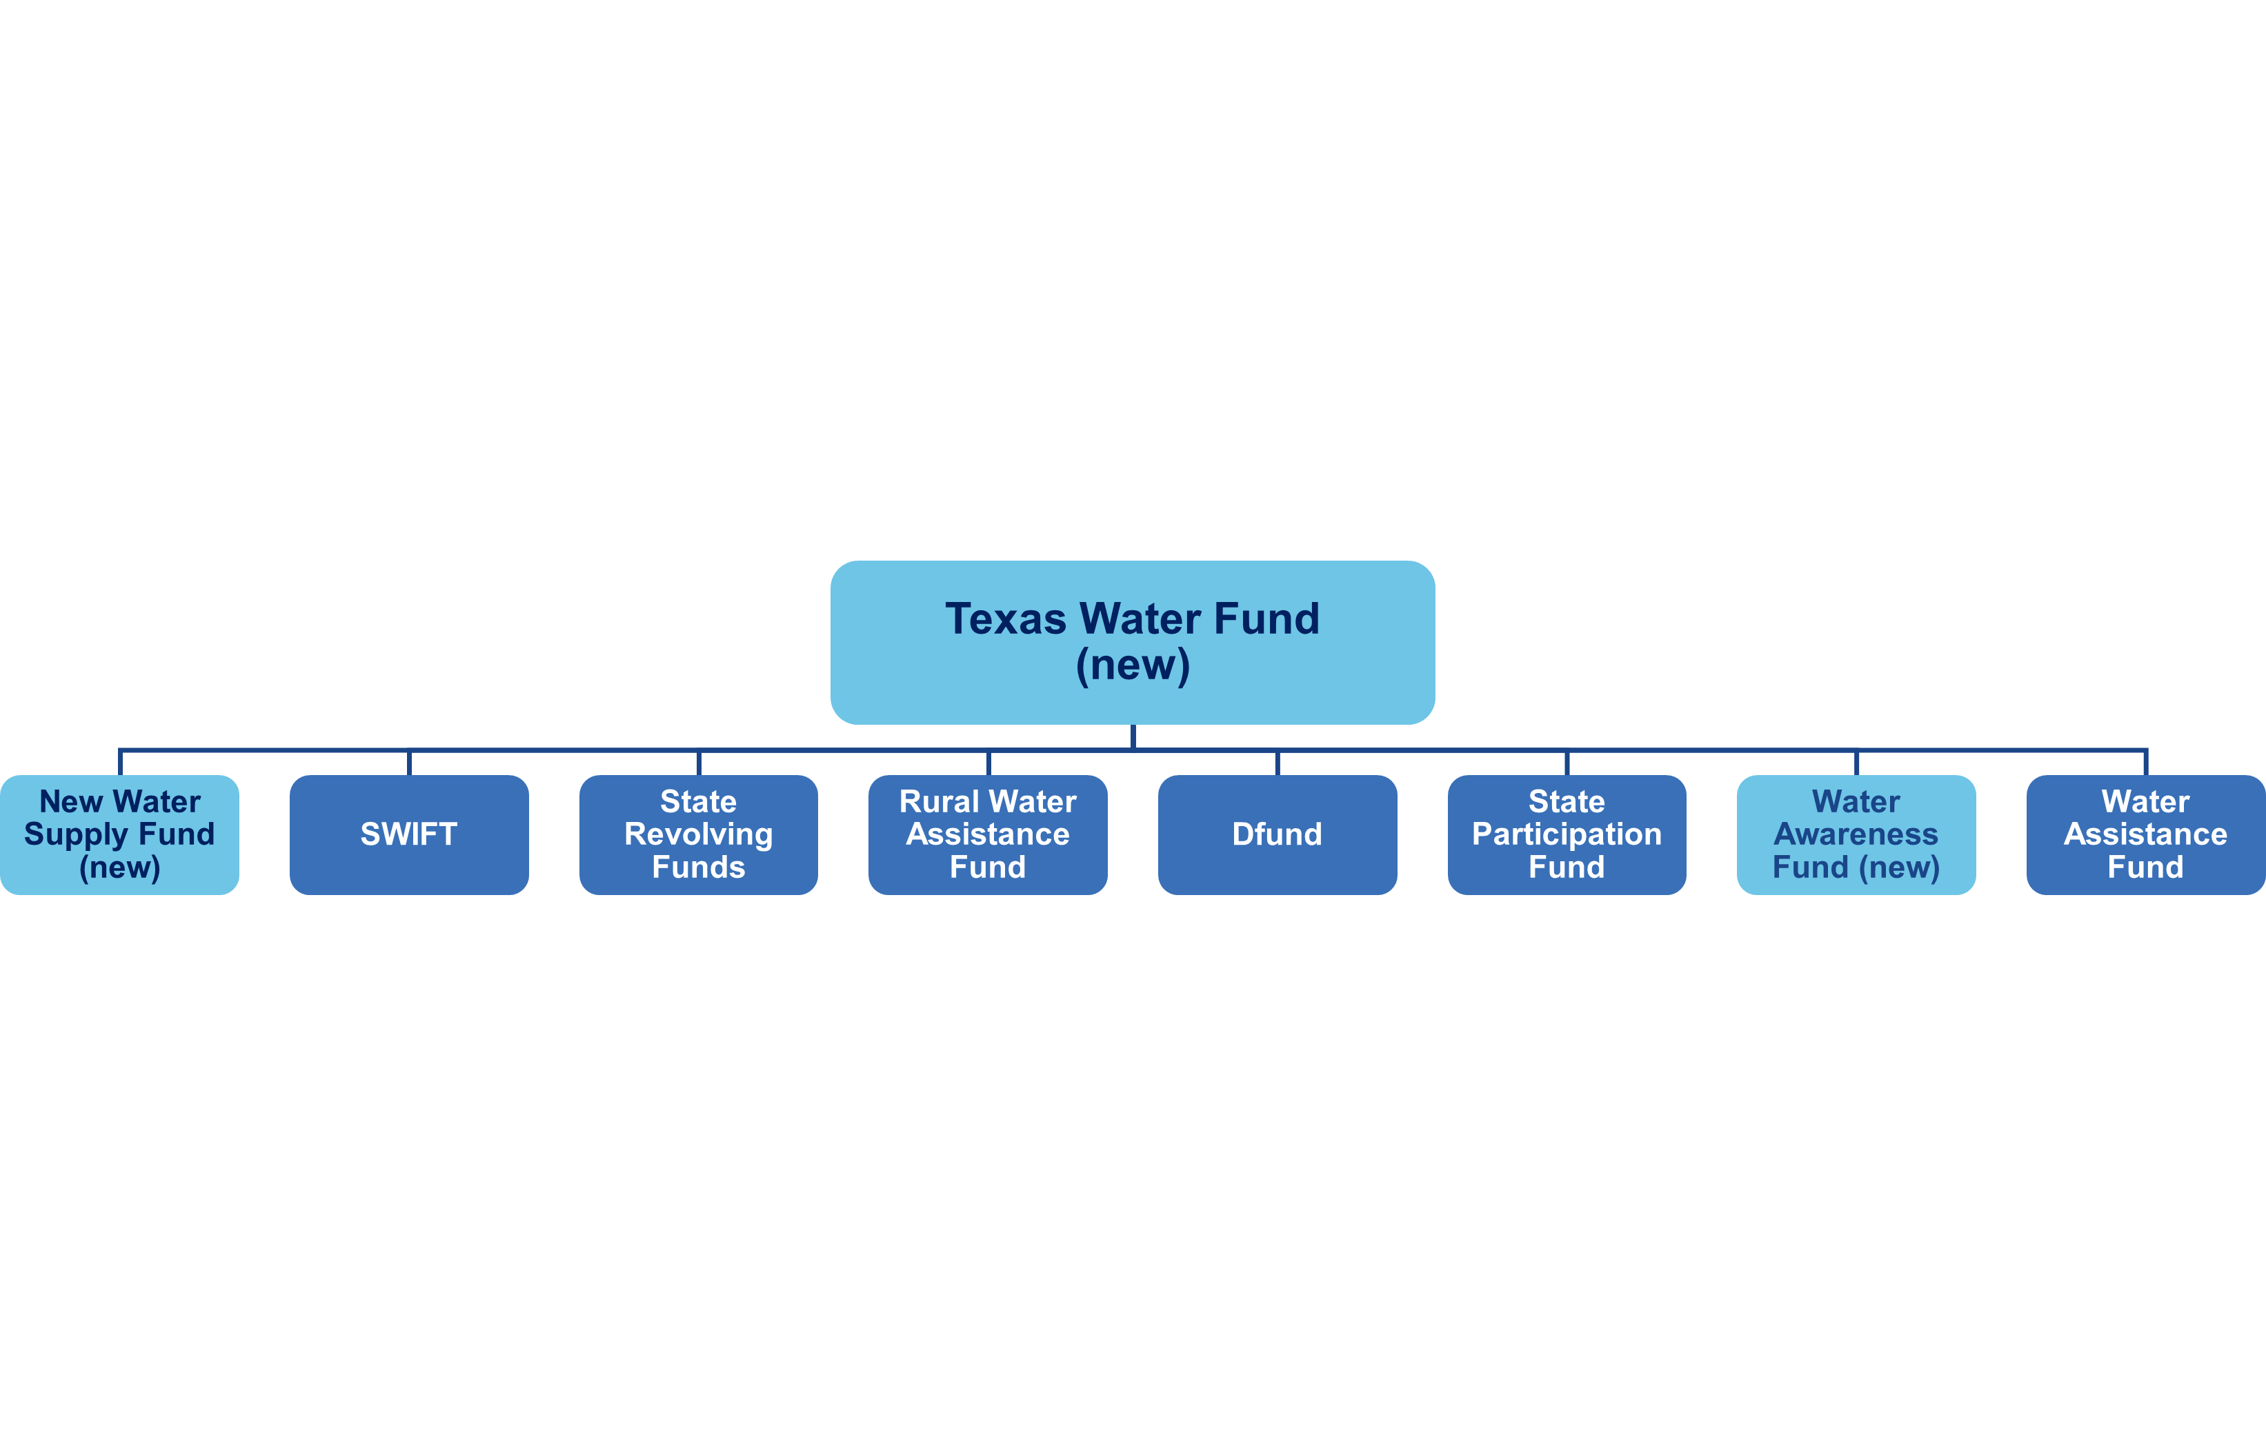
Texas Water Fund
Texas Water Fund (new)
New Water Supply Fund (new)
SWIFT
State Revolving Funds
Rural Water Assistance Fund
DFund
State Participation Fund
Water Awareness Fund (new)
Water Assistance Fund
Notes:
Umbrella fund, lege dumps in money ($1B), TWDB distributes through other funds/programs
TWDB was instructed to prioritize midsize, small and rural communities, shovel ready projects, water loss and conservation strategies, and funding the new water awareness fund. And of course, as we know, at least 250M goes to the NWSF. And while we’re talking about it, what is deemed as new water is defined by Senator Perry as desalination projects, ASR, use of produced water outside of oil/gas, and transportation of water made available by NWS projects. These projects are not common in the SWP, rely on more innovative tech, and are more expensive.
Consent decree is essentially a settlement that SSOs, between the EPA, TCEQ, and a city to resolve infrastructure issues causing clean water act violations
Aging infrastructure
Population growth
Compliance
9% said economic projects have been halted, hindered, or cancelled over the past 5 years due to insufficient wastewater treatment capacity. There’s widespread concern that wastewater infrastructure could impair future devellpoment
Just as water as water supply and drinking water infrastructure can be an economic driver, so too is wastewater
Houston has experienced more than 4,000 SSOs over the past five years caused by pipe blockages, insufficient sewer capacity and system failures. These SSOs have resulted in discharges exceeding 9 million gallons of untreated sewage into local waterways or backups into city streets or homes, causing serious water quality and public health problems. Affected waterways include Buffalo Bayou and Sims Bayou which reach Galveston Bay within the Gulf of Mexico.
SSOs, which are self-reported by the city, are caused by structural defects, line breaks, capacity constraints, and other infrastructure deficiencies

Slide 32
Texas Water Fund
Umbrella fund that does not directly award funds; TWDB has discretion to move money into other eligible funds/programs
Legislative priorities for use of this money include:
  water infrastructure for rural communities and municipalities with a population under 150,000
  projects with completed permitting
  water awareness campaign
  water conservation strategies
  water loss mitigation
25% of the $1 billion must go to the New Water Supply Fund
Notes:
SARAh

Slide 33
New Water Supply Fund
Focused on “New Water”
Eligible projects include:
  Desalination (marine and brackish groundwater)
  Aquifer storage and recovery (ASR)
  Use of produced water outside of oil/gas
  And transport of water made available by projects above
These eligible projects generally rely on more innovative technology and are more expensive. These projects are not common in the State Water Plan.
Notes:
SARAH

Slide 34


89th Legislature
TWF 2.0: The Perry Plan
Up to 6 pieces of legislation
  Funding, implementation, legislative oversight,
  and streamlining components
Clean up and clarifying bill to TWF, rolling
FIF under TWP, clarify NWSF to shovel ready
Create new entity, Texas Water Supply
Distribution Authority
Expand produced water
Lump sum appropriations (one-time infusion)
?What is the percentage breakdown?
Dedicated revenue stream
?What is the percentage breakdown?
Notes:
TWSDA – Gridzilla, new entity(like river authority) to build out the distribution network of pipelines to convey water from new water sources to municipal, commercial, industrial, and ag water users
Expand produced water treatment and beneficial reuse; move land application permits from the RRC to TCEQ
Like a RA, TWSDA will be overseen by a board of gubernatorial appointees. Statewide district not new state agency
Conveys water from
Has eminent domain authority, however, seek existing transportation and pipeline righ-of-ways
Empowered to negotiate out of state water rights

Slide 35
89th Texas Legislature
Texas Water Fund
SB 1288/ HB 3316 (Perry)/(Harris) Relating to the redesignation of the State Water Implementation Fund for Texas Advisory Committee as the Texas Water Fund Advisory Committee, the abolition of the Texas Infrastructure Resiliency Fund Advisory Committee, and the composition and functions of the Texas Water Fund Advisory Committee.
SB 1289/ HB 3315 (Perry)/(Harris) Relating to the permissible use of the Texas Water Fund
Notes:
reorganize the Texas Advisory Committee for the State Water Implementation Fund of Texas (“SWIFT Fund”). SB 1288 and HB 3316 would revive the Texas Advisory Committee for the SWIFT Fund and rename it as the “Texas Water Fund Advisory Committee.” The Advisory Committee would be assigned discretionary, rather than mandatory, functions such as providing recommendations to the Texas Water Development Board on how to spend money appropriated to the SWIFT Fund, the Texas Water Fund, the Flood Infrastructure Fund, and the Texas Infrastructure Resiliency Fund. SB 1288 and HB 3316 would instill the following individuals as new members of the Advisory Committee: the chair of the committee of the Senate having primary jurisdiction over water resources, the chair of the committee of the House of Representatives having primary jurisdiction over water resources, and the director of the Texas Division of Emergency Management as a non-voting member.

Slide 36
89th Texas Legislature
Texas Water Fund
SB 1629 (Perry) Relating to the administration by the TWDB of the Texas Water Bank and certain funds and accounts
HB 3316 (Harris) Relating to the redesignation of the State Water Implementation Fund for Texas Advisory Committee as the Texas Water Fund Advisory Committee, the abolition of the Texas Infrastructure Resiliency Fund Advisory Committee, and the composition and functions of the Texas Water Fund Advisory Committee
Notes:
SB 1629 amends the Texas Water Code to expand the Texas Water Development Board’s
(TWDB) authority over the Texas Water Bank and certain water development funds. The bill
broadens the permissible uses of the state water fund beyond its existing support for desalination,
aquifer storage and recovery, and produced water treatment, to now include reservoir
projects—provided they have both a Section 404 permit from the U.S. Army Corps of Engineers
and a state water rights permit from the Texas Commission on Environmental Quality. The bill
also adds funding for infrastructure to transport or integrate water from these projects into supply
systems.
SB 1629 authorizes the TWDB to transfer funds from the state water fund to the Texas Water
Development Fund II state participation account to support eligible water supply projects.
Additionally, the bill expands TWDB’s authority to purchase, hold, and transfer water or water
rights in its own name, including water originating outside Texas, for the purpose of providing
water for the use or benefit of the state.
The bill also expands the state participation account’s scope, which previously funded
interregional water supply projects, stormwater retention, groundwater recharge, and flood
protection, to now also include projects described by Section 15.153(b)(1) of the Water Code,
such as desalination, aquifer storage and recovery, produced water treatment, and reservoir
projects.
HB 33156 – Creates Texas Water Fund advisory committee: the comptroller, chair of senate committee with primary jurisdiction, chair house, 2 members appointed by Lt Gov, 2 members of house appointed by speaker, a director of Texas division of emergency management, All are co-presiding officers,
SWIFT, TWF, FIF, TIRF (Texas infrastructure resiliency fund) review operation, function of structure of each fund semiannually

Slide 37
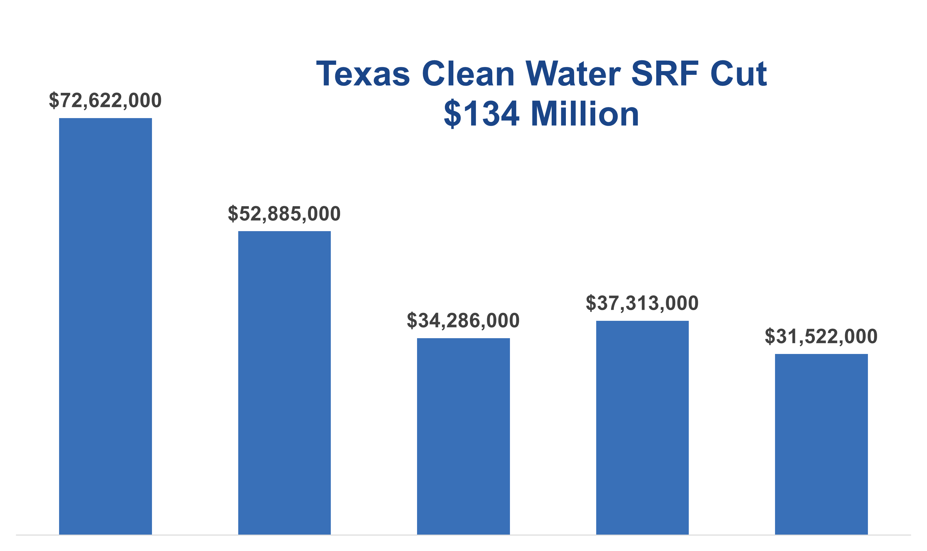
Clean Water Funding
CW SRFs
SWIFT (“water reclamation plant”)
D-Fund (very limited)
Texas Water Fund (new)
New Water Supply Fund (new)
SWIFT
State Revolving Funds
Rural Water Assistance Fund
DFund
State Participation Fund
Water Awareness Fund (new)
Water Assistance Fund
Notes:
Umbrella fund, lege dumps in money ($1B), TWDB distributes through other funds/programs
TWDB was instructed to prioritize midsize, small and rural communities, shovel ready projects, water loss and conservation strategies, and funding the new water awareness fund. And of course, as we know, at least 250M goes to the NWSF. And while we’re talking about it, what is deemed as new water is defined by Senator Perry as desalination projects, ASR, use of produced water outside of oil/gas, and transportation of water made available by NWS projects. These projects are not common in the SWP, rely on more innovative tech, and are more expensive.
Consent decree is essentially a settlement that SSOs, between the EPA, TCEQ, and a city to resolve infrastructure issues causing clean water act violations
Aging infrastructure
Population growth
Compliance
9% said economic projects have been halted, hindered, or cancelled over the past 5 years due to insufficient wastewater treatment capacity. There’s widespread concern that wastewater infrastructure could impair future devellpoment
Just as water as water supply and drinking water infrastructure can be an economic driver, so too is wastewater
Houston has experienced more than 4,000 SSOs over the past five years caused by pipe blockages, insufficient sewer capacity and system failures. These SSOs have resulted in discharges exceeding 9 million gallons of untreated sewage into local waterways or backups into city streets or homes, causing serious water quality and public health problems. Affected waterways include Buffalo Bayou and Sims Bayou which reach Galveston Bay within the Gulf of Mexico.
SSOs, which are self-reported by the city, are caused by structural defects, line breaks, capacity constraints, and other infrastructure deficiencies

Slide 38
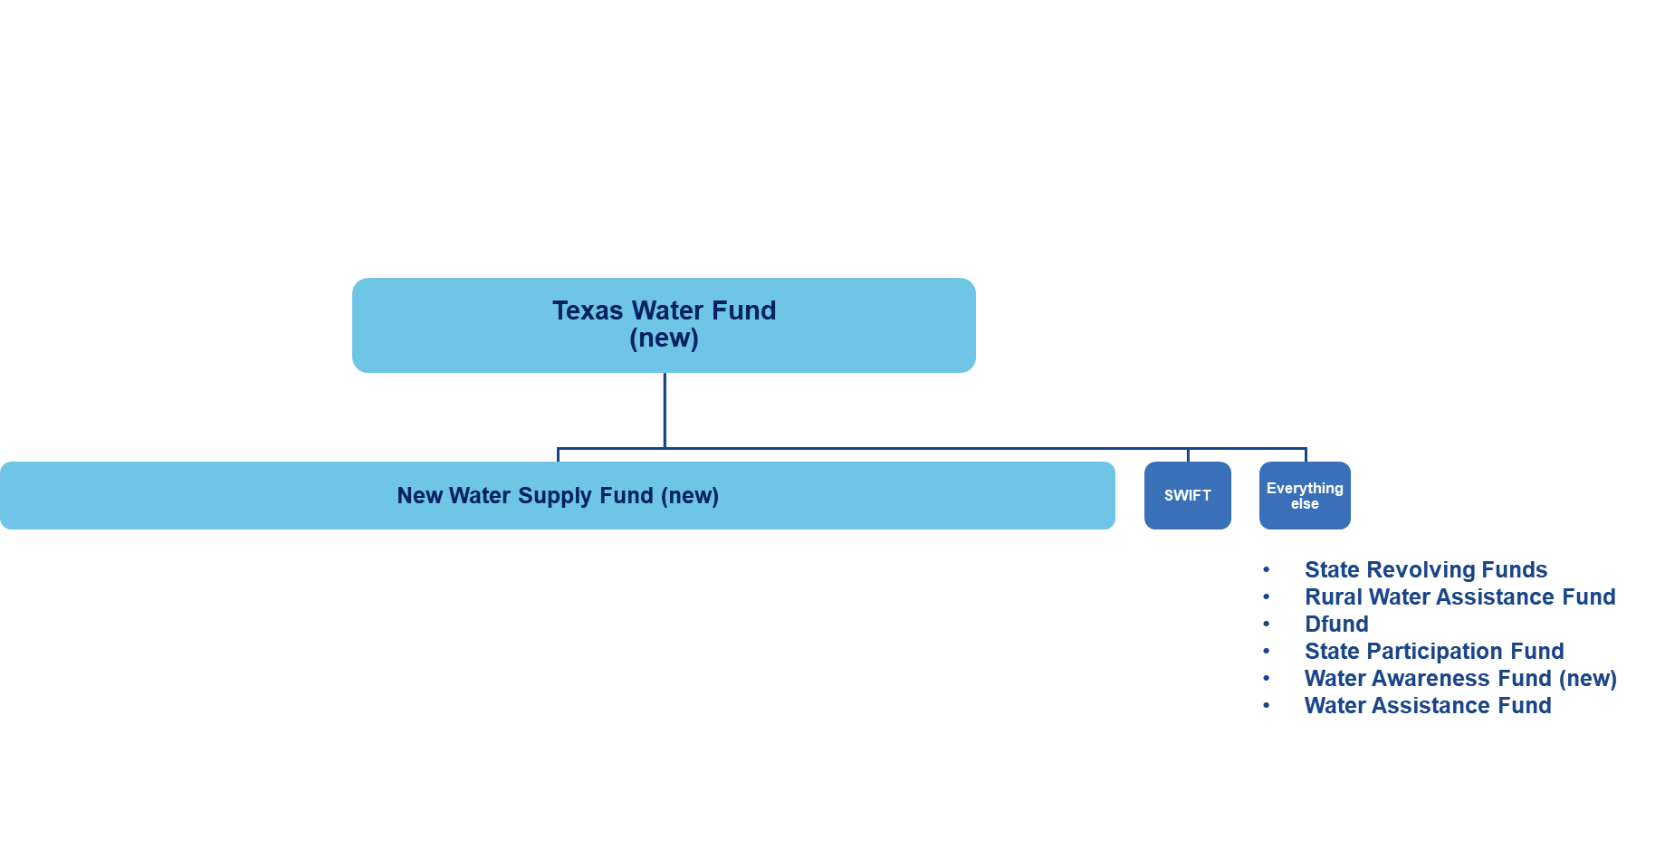
Texas Water Fund
Texas Water Fund (new)
New Water Supply Fund (new)
SWIFT
State Revolving Funds
Rural Water Assistance Fund
DFund
State Participation Fund
Water Awareness Fund (new)
Water Assistance Fund
Notes:
Umbrella fund, lege dumps in money ($1B), TWDB distributes through other funds/programs
TWDB was instructed to prioritize midsize, small and rural communities, shovel ready projects, water loss and conservation strategies, and funding the new water awareness fund. And of course, as we know, at least 250M goes to the NWSF. And while we’re talking about it, what is deemed as new water is defined by Senator Perry as desalination projects, ASR, use of produced water outside of oil/gas, and transportation of water made available by NWS projects. These projects are not common in the SWP, rely on more innovative tech, and are more expensive.
Consent decree is essentially a settlement that SSOs, between the EPA, TCEQ, and a city to resolve infrastructure issues causing clean water act violations
Aging infrastructure
Population growth
Compliance
9% said economic projects have been halted, hindered, or cancelled over the past 5 years due to insufficient wastewater treatment capacity. There’s widespread concern that wastewater infrastructure could impair future devellpoment
Just as water as water supply and drinking water infrastructure can be an economic driver, so too is wastewater
Houston has experienced more than 4,000 SSOs over the past five years caused by pipe blockages, insufficient sewer capacity and system failures. These SSOs have resulted in discharges exceeding 9 million gallons of untreated sewage into local waterways or backups into city streets or homes, causing serious water quality and public health problems. Affected waterways include Buffalo Bayou and Sims Bayou which reach Galveston Bay within the Gulf of Mexico.
SSOs, which are self-reported by the city, are caused by structural defects, line breaks, capacity constraints, and other infrastructure deficiencies

Slide 39
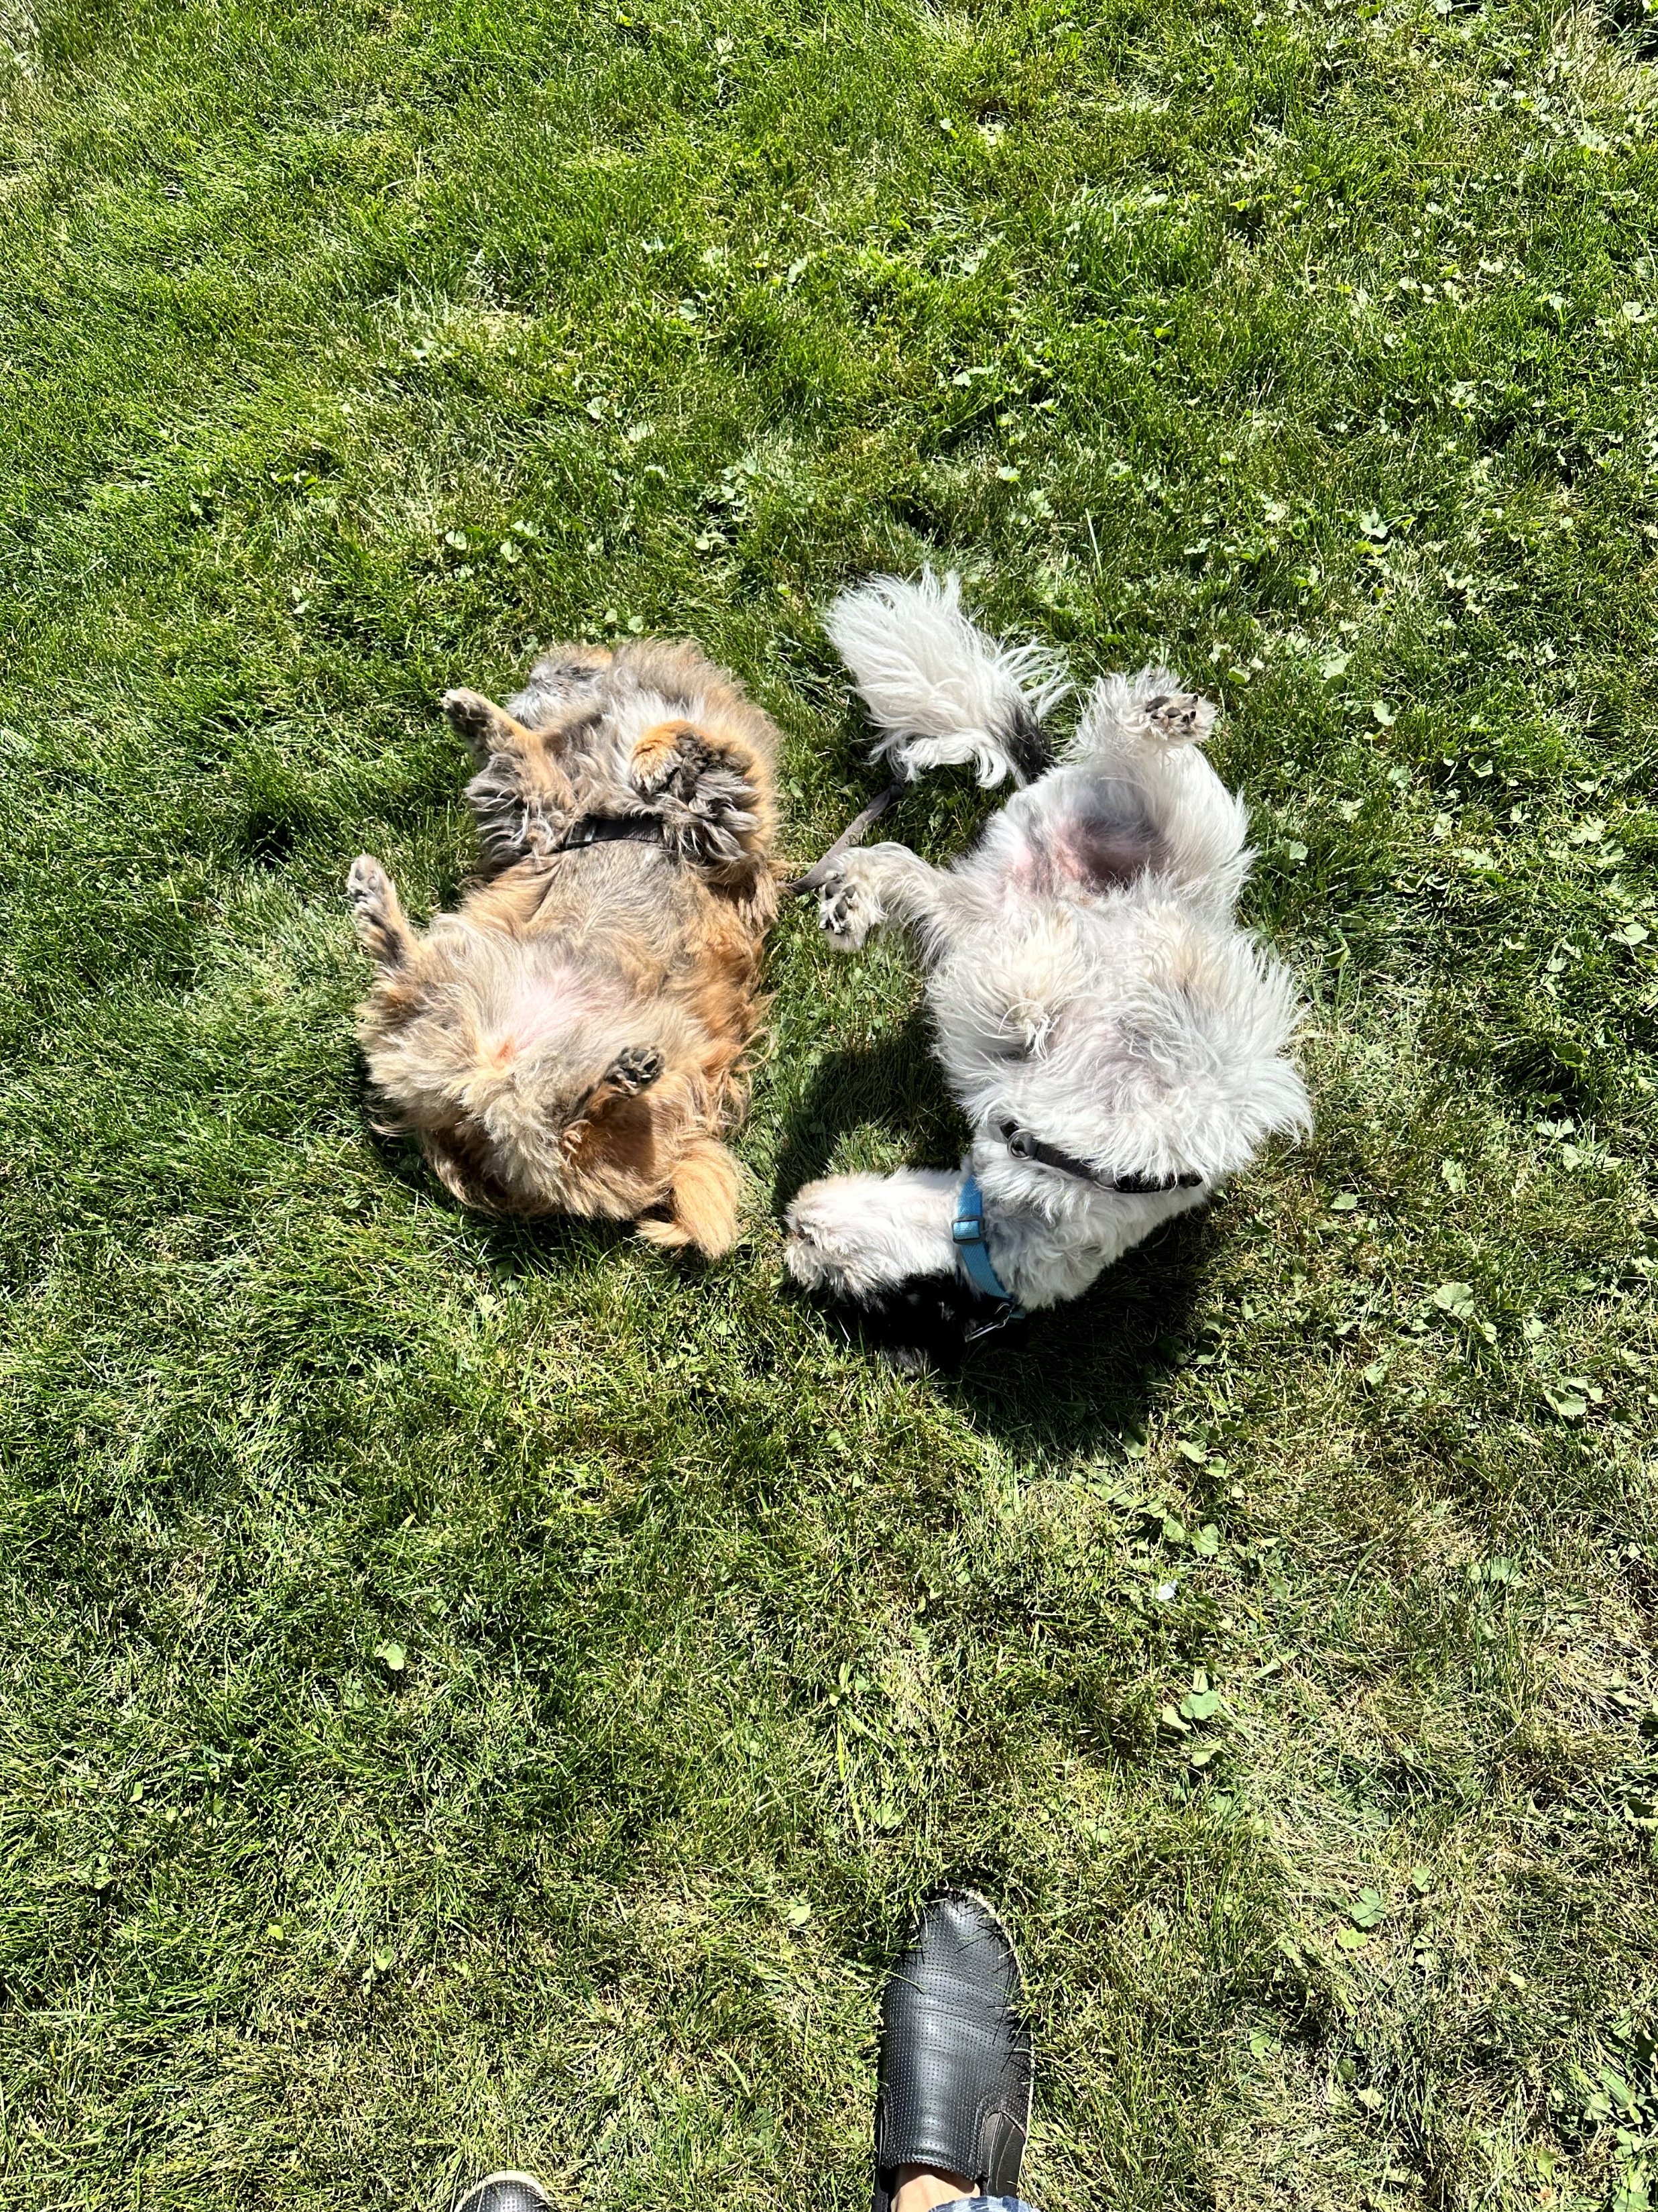



Slide 40
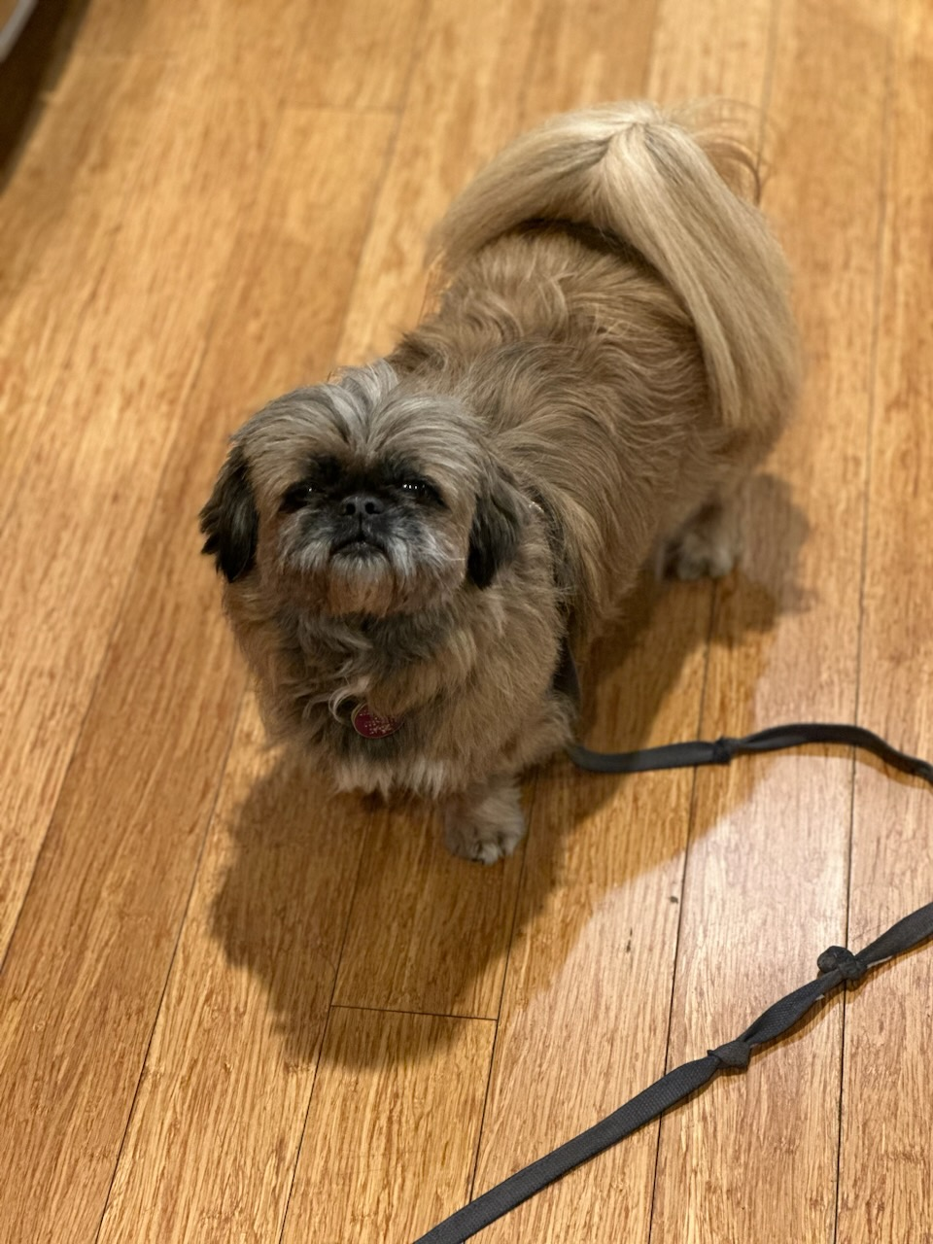


Slide 41
89th Texas Legislative Session:
Stop Me if You’ve Heard this One Before
as
Tex of
on
ati i
oc
s
s A
ronment i
Env
ater
W
Julie Nahrgang, WEAT| TACWA
julie@weat.org
89th Texas Legislative Session
February 28, 2025
Notes:
Good morning and I’m really excited talk water and the 88th Regular Session of the Texas Legislature today. And folks, it truly is always a water session in Texas.
And as much as things change, and there’s been quite a bit of change, things also stay the same. We’re going to take a look back at the 88th to help us understand where we’re headed in the 89th.

