Slide 1
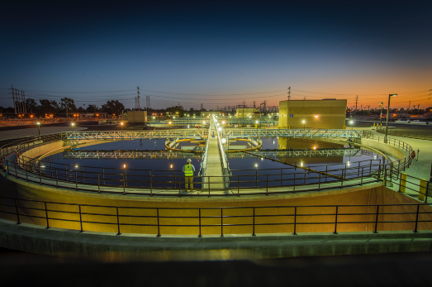
Pushing it to the limit
State of the art technology to meet ultra-low phosphorus
Dr. Andrew Shaw
Global Practice & Technology Leader
Sustainability and Wastewater
Christine deBarbadillo
Plant Optimization Practice Leader

Slide 2

Previous TACWA Presentation…

Slide 3
Agenda
Phosphorus Cycle and Forms of Phosphorus
Biological Phosphorus Removal
Chemical Phosphorus Removal
Taking it lower (down to 0.02 mg/L?)

Slide 4
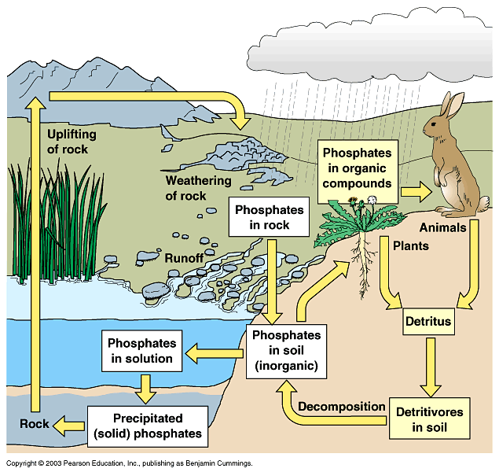
Phosphorus Cycle
Phosphorus in Wastewater
Human contribution
Fertilizers
Detergents, soaps etc.
Paints, pesticides

Slide 5
Forms of Phosphorus
Total Phosphorus
Inorganic Phosphorus
Organic Phosphorus
Orthophosphate
Dissolved
Polyphosphates
Particulate

Slide 6
Process Considerations for P Removal
Generally remove 1/3 to 1/2 of influent P through primary and secondary treatment without incorporating a specific process for P removal
  Primary Settling
    Removes some particulate P
  Conventional Biological Treatment
    Hydrolyzes much of the remaining particulate P
    Utilizes some soluble P for bacterial growth
Additional P removal
  Chemical
  Biological
P removal to very low levels
  Tertiary treatment

Slide 7
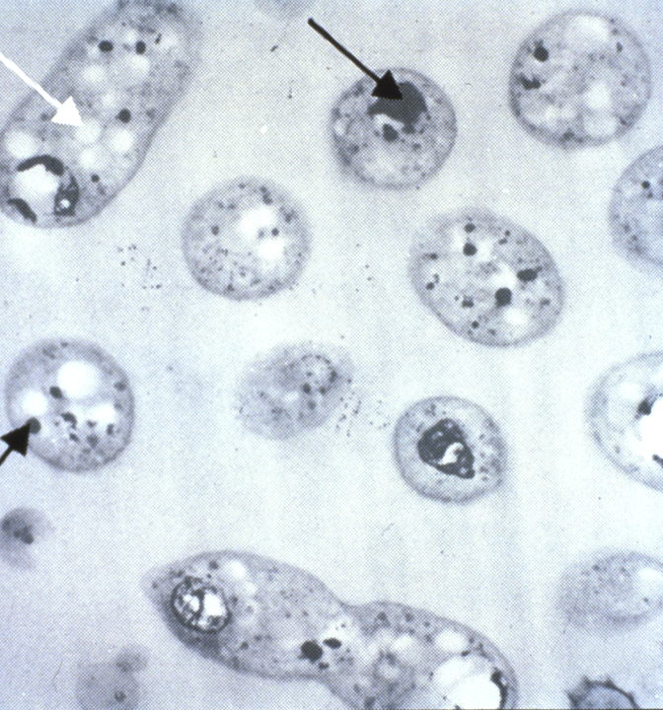
Conventional Biological Phosphorus Removal
Poly-P
PHB

Slide 8
Biological Phosphorus Removal Theory
Step 1: VFA uptake and P release
Step 2: “Luxury uptake” by phosphate-accumulating organisms (PAOs)
Aerobic
Anaerobic
Fuhs & Chen, 1975
Notes:
In bio-P, we’re growing a certain class of bugs called phosphate-accumulating organisms (PAOs) that have the ability to store phosphorus in excess of their growth requirements through a process that’s been coined the “luxury uptake” of phosphorus.
In the absence of oxygen, the PAOs convert volatile fatty acids (mainly acetate) to energy-rich carbon polymers called polyhydroxyalkanoates (PHAs), the major one being polyhydroxybutyrate (PHB). The energy to do this is generated from the breakdown of polyphosphate molecules (poly-P). This stage actually releases phosphates into the wastewater.
In the aerobic zone, instead of obtaining energy from phosphorus release, the PAOs oxidize the previously stored PHB to obtain energy. Also under these conditions, the PAOs restore their poly-P energy reserves through phosphorus uptake and polymerization. The stored phosphorus in the PAOs can then be removed in the WAS stream.
The overall result is a net phosphorus removal from the wastewater.

Slide 9
Conventional BPR Flow Schematic
MLSS Recycle at 4Q
Influent
Effluent
Anaer-
obic
Anoxic
Aerobic
Anoxic
Aerobic
Waste Activated Sludge
RAS
Conventional BNR plants can work well as long as the influent rbCOD:P ratio is over 15.
When wet weather hits, retention time in the anaerobic zone becomes shorter and there is less time to make VFA. And during a storm there is less flow time so less fermentation in the collection system
End result is sporadic BPR Performance!!!

Slide 10
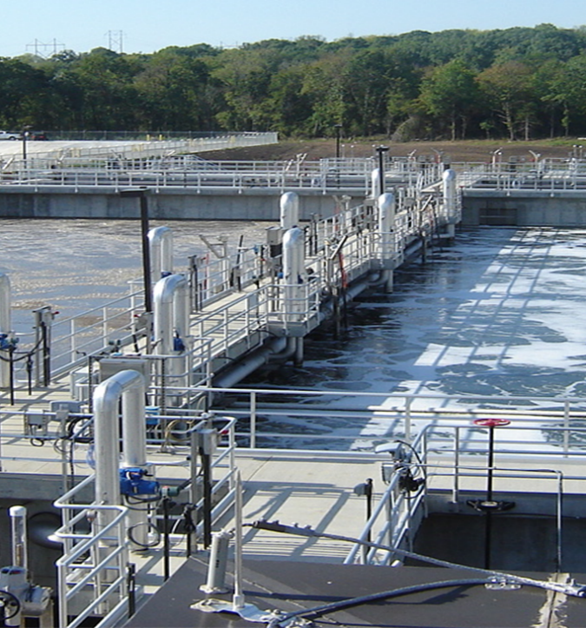
“Side-Stream EBPR”
S2EBPR

Slide 11
S2EBPR: The Answer to Conventional BPR System Inconsistencies
MLSS Recycle at 4Q
PC Effluent
Effluent
Anoxic
Aerobic
Anoxic
Aerobic
GT Overflow
S2EBPR Fermenter
Waste Activated Sludge
80-95% of RAS bypasses Fermenter
RAS
Fermenter is not in the main stream of flow which allows constant ideal conditions to be maintained for fermentation. Storm flow does not impact process
No Chemical Addition needed
Carbon is obtained from GT Overflow and die off of heterotrophic organisms

Slide 12
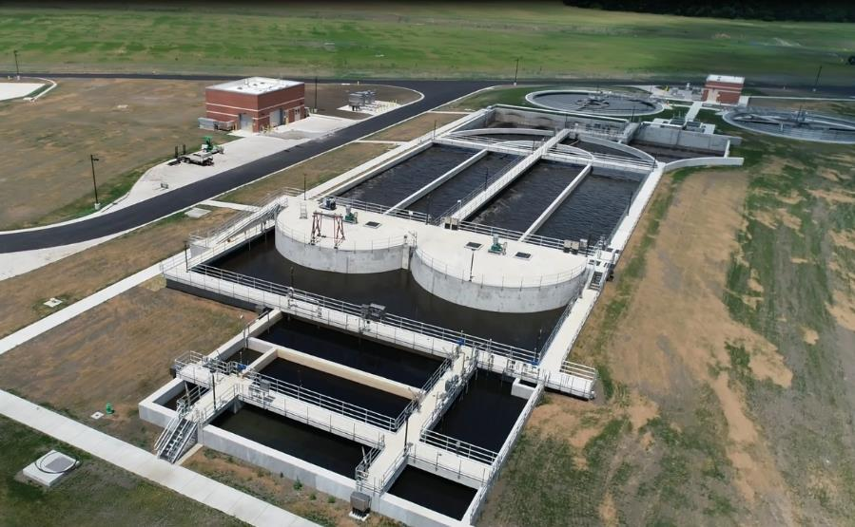
Example S2EBPR: Wakarusa WWTP (Lawrence, KS)
Greenfield, Oxidation Ditch Plant
ADF of 10 MLD (2.5 mgd), peak of 15 MLD (7.5 mgd)
3-Stage BNR Configuration
S2EBPR design, MLSS Fermentation
Plant is heavy with on-line instrumentation: Eff OP, Eff NH3-N, Eff NO3-N, Anoxic inf and eff NO3-N, TSS in oxic zone, anaerobic zone and fermenter

Slide 13
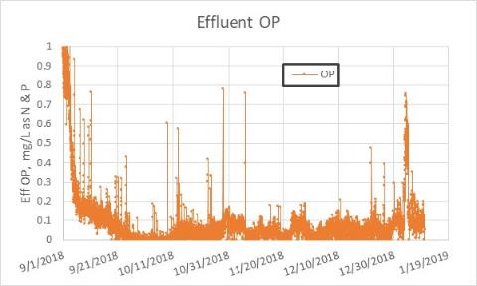
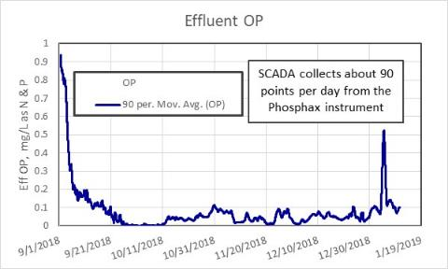
Secondary Treatment Performance (Wakarusa WWTP)
Fermenter has exceeded expectations.
Permit limit is 1 mg/L annual average. Note the scale on the graphs below. Effluent Ortho Phosphate is usually below 0.1 mg/L as P.
No iron has been added and no supplemental carbon has been added. Summer nitrification upsets did impact BPR but performance since Sept 1 has been phenomenal.
instrument data – each data point

Slide 14
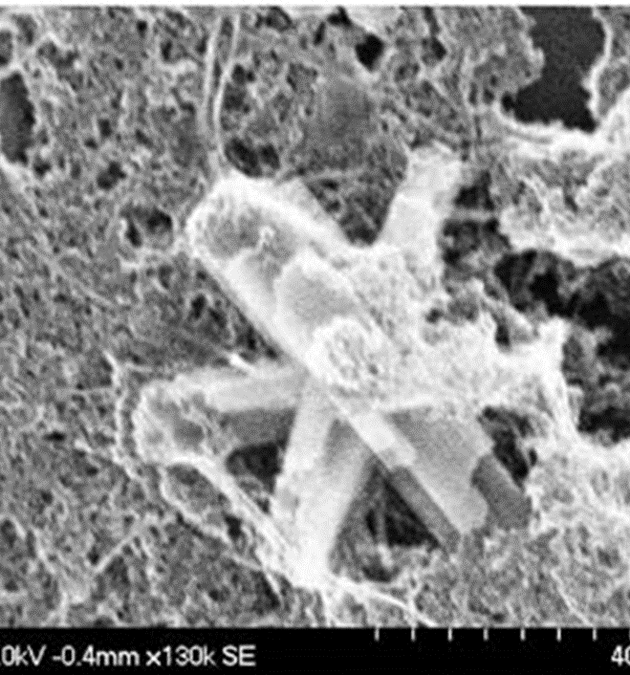
Chemical Phosphorus Removal
Scott Smith, Wilfrid Laurier University

Slide 15
Chemical Phosphorus Removal
Add chemical to precipitate soluble phosphorus
Alum, ferric chloride, ferrous chloride, magnesium hydroxide, polyaluminum chloride, etc.
Multiple dosing locations
Increases sludge production, consumes alkalinity
Tertiary
P
removal
PC
Aeration
SC
Filters
Influent
RAS
Effluent
WAS
Raw PS

Slide 16
Chemicals used for phosphorus precipitation
Chemical | Formula | Removal mechanism | Effect on alkalinity
Aluminum Sulfate (Alum) | Al₂(SO4)₃.14.3(H₂O) M.W. = 599.4 | Metal hydroxides | Removes alkalinity
Ferric Chloride | FeCl₃ M.W. = 162.3 | Metal hydroxides | Removes alkalinity
Poly Aluminum Chloride | Al_{n}Cl_{(3n-m)}(OH)_{m} Al₁₂Cl₁₂(OH)₂₄ | Metal hydroxides | Removes some alkalinity
Ferrous sulfate (pickle liquor) | Fe₂SO₄ | Metal hydroxides | Removes alkalinity
Lime | CaO, Ca(OH)₂ | Insoluble precipitate | Raises pH to above 10
Notes:
Andy

Slide 17
Indicative Relative Costs – Central Texas Example
Alternative | 1 – Chem-P | 2 – Bio-P (with Chemical Trim)
Chemicals, per month
Alum | $70,210 | $6,530
NaOH | $65,210 | --
Total | $135,420 | $6,530
New aeration basins | $8,596,000 | $11,461,000
Sludge hauling, per month | $84,630 | $82,250
Blower energy, per month | $22,210 | $17,310
20-year relative cost | $57,595,000 | $33,027,000
If you can get Bio-P without adding carbon, generally speaking, it’s more cost effective. But always case specific!
Notes:
Gretchen

Slide 18
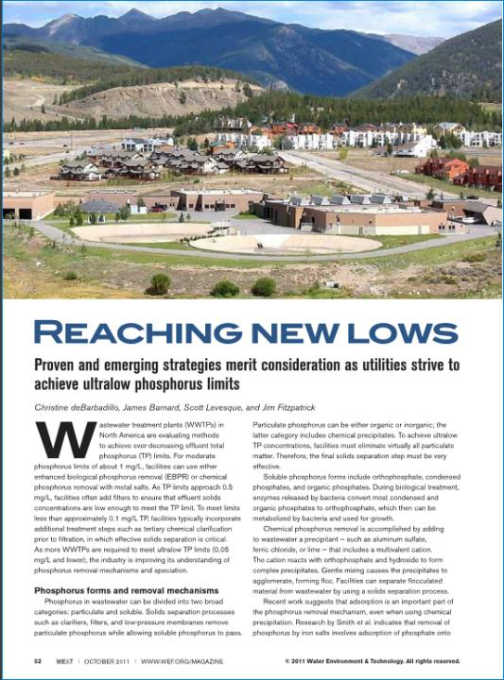
How Low Can We go?
Pushing P removal to the Limits of Technology

Slide 19
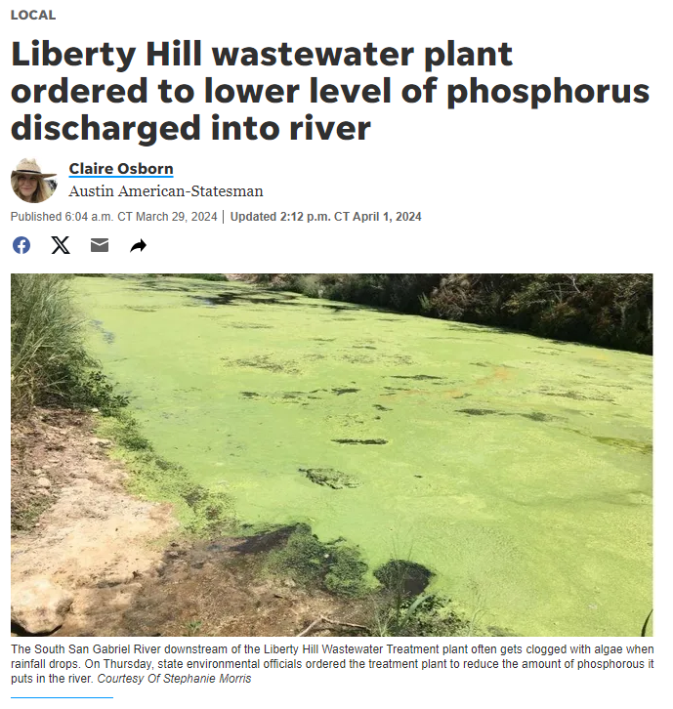
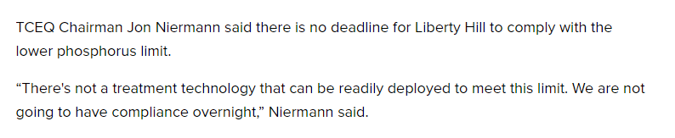
How low can we go in Texas?
“The Texas Commission on Environmental Quality's three commissioners voted Thursday to lower the phosphorus limit that the Liberty Hill Wastewater Treatment Plant discharges into the river from the current level of 0.15 milligrams per liter to 0.02 milligrams per liter.”
Liberty Hill wastewater ordered to lower phosphorous discharged | kvue.com
Liberty Hill plant must lower phosphorus release in San Gabriel River (statesman.com)

Slide 20
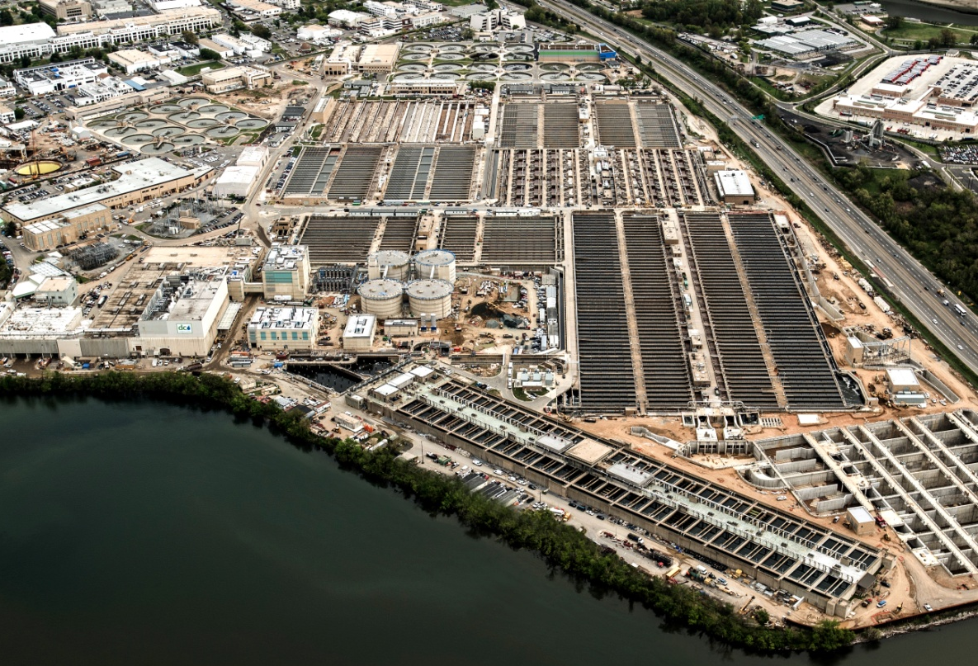
Chemical P Removal + Filtration
TP generally lower than 0.1 mg/L
Fe3+/P molar dose approximately 1.5

Slide 21
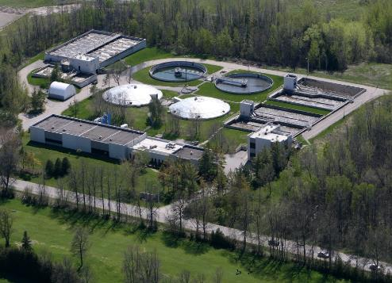
Lakeshore WPCP, Innisfil, Ontario
3.8 mgd average flow
Extended aeration with alum addition, filtration
Potential TP requirement of 0.024 mg/L
Pilot Testing of Four Tertiary Phosphorus Removal Technologies at Innisfil, Ontario
Ontario WEA 2010
London, Ontario
Chris deBarbadillo, Black & Veatch
Town of Innisfil: G. Shellswell, W. Cyr
Ainley Group: J. Mullan, R. Mitchell, M. Ainley
Black & Veatch: B. Edwards, R. Waite, B. Sabherwal

Slide 22
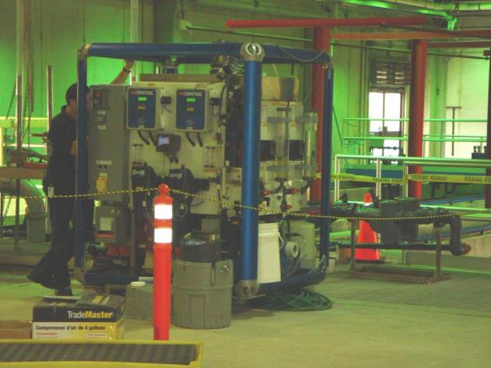
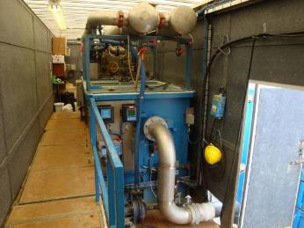
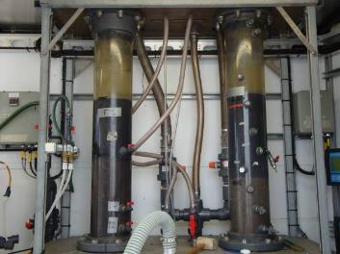
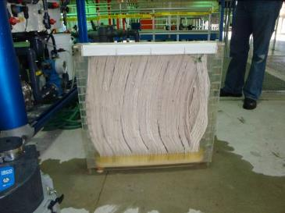
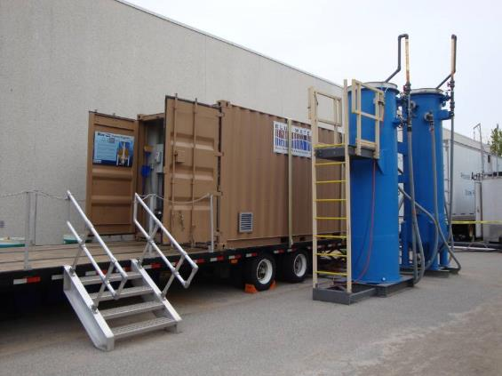
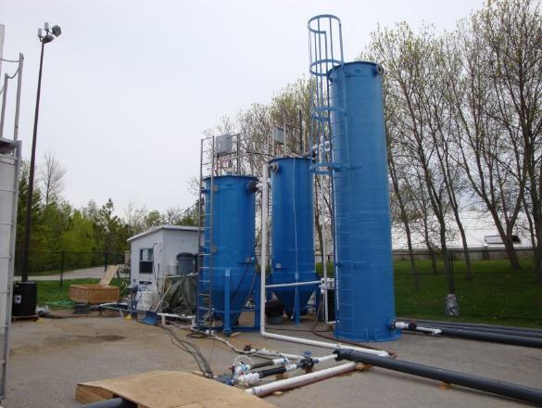
Tertiary Treatment Technologies Tested
GE Ultrafiltration Membranes
Actiflo + Filters
BluePro Reactive Filtration Series System
Parkson DynaSand D2 Dual Filtration System

Slide 23
Phosphorus Speciation Results
All pilots did a good job of removing OP
High chemical dosages required
GE/Zenon and Blue Water were more successful at removing particulate P
Dissolved organic P is 0.005 to 0.01 mg/L

Slide 24
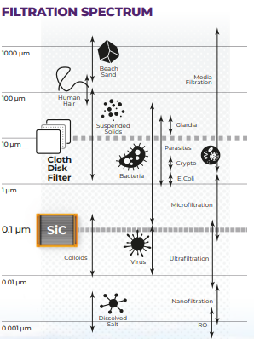
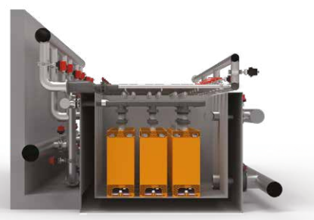
Ovivo SiC for Phosphorus Removal
Pilot results from 3 Sites

Slide 25
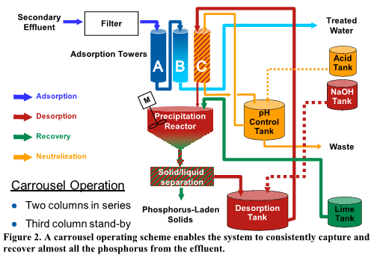
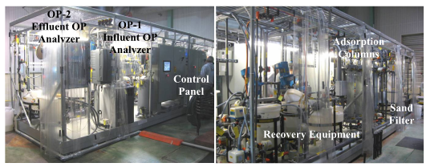
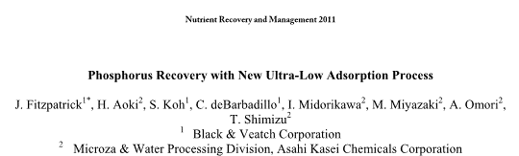
Asahi Adsorption Media Pilot

Slide 26
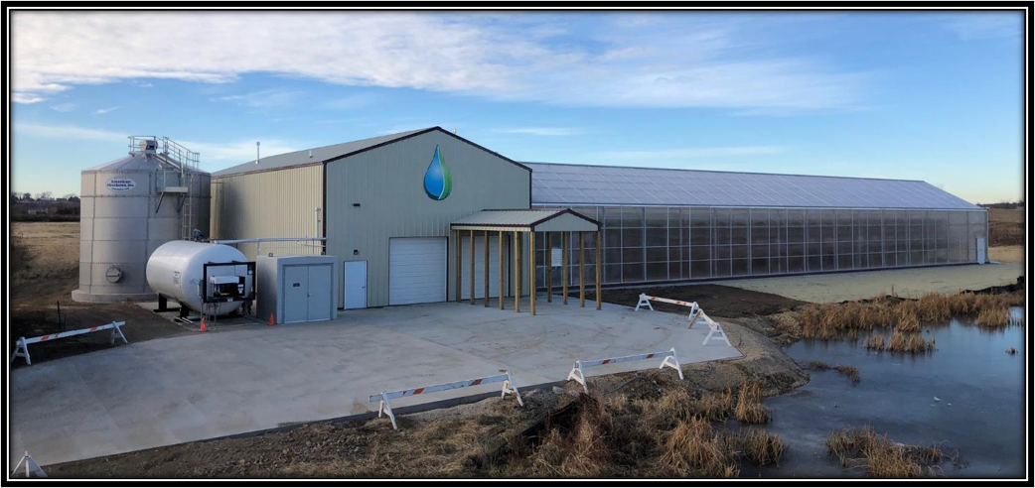
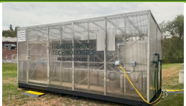
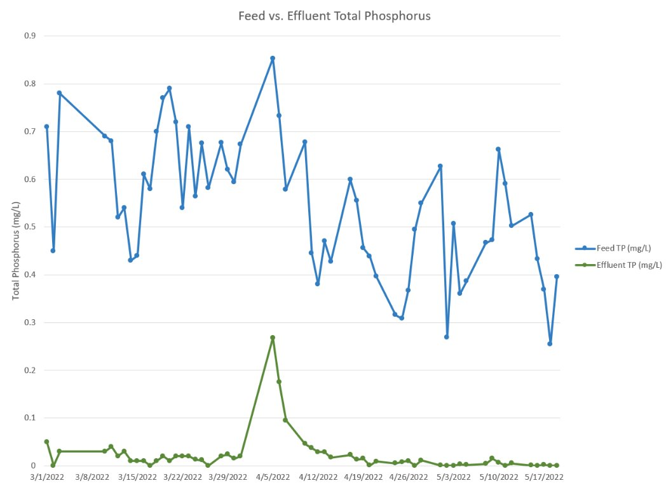
Algal-based treatment
Gross-Wen Pilot, Ontario Canada
CLEARAS: VILLAGE OF ROBERTS, WI
Feed Average TP (mg/L): 0.094
Effluent Average TP (mg/L): 0.037
Feed Average TP (mg/L): 0.54
Effluent Average TP (mg/L): 0.02

Slide 27
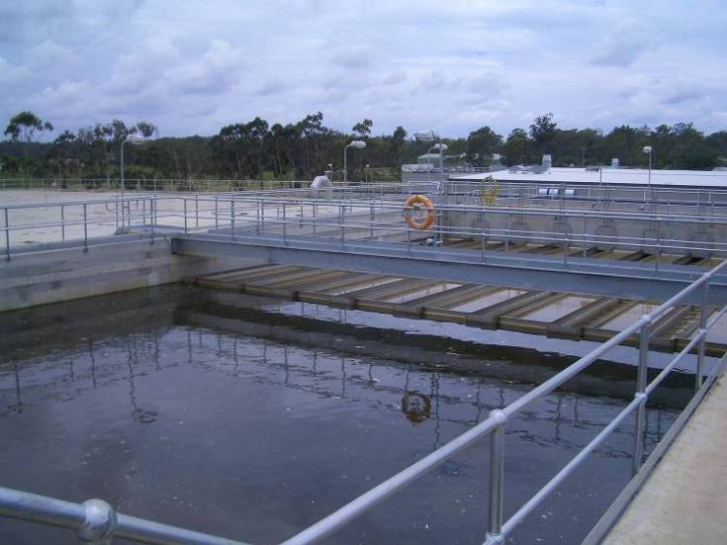
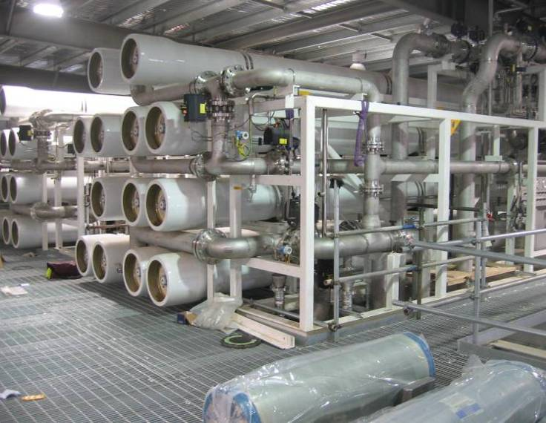
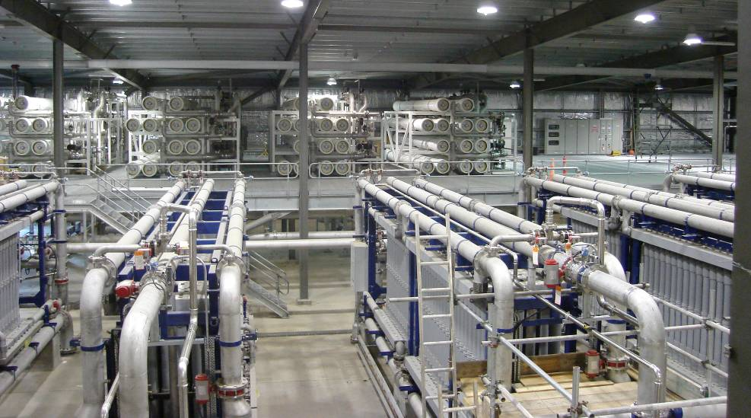
Bundamba Performance – Floc/sed + MF + RO
Western Corridor Recycled Water Project, Queensland, Australia
  Achieved 0.01 to 0.02 mg/L TP

Slide 28
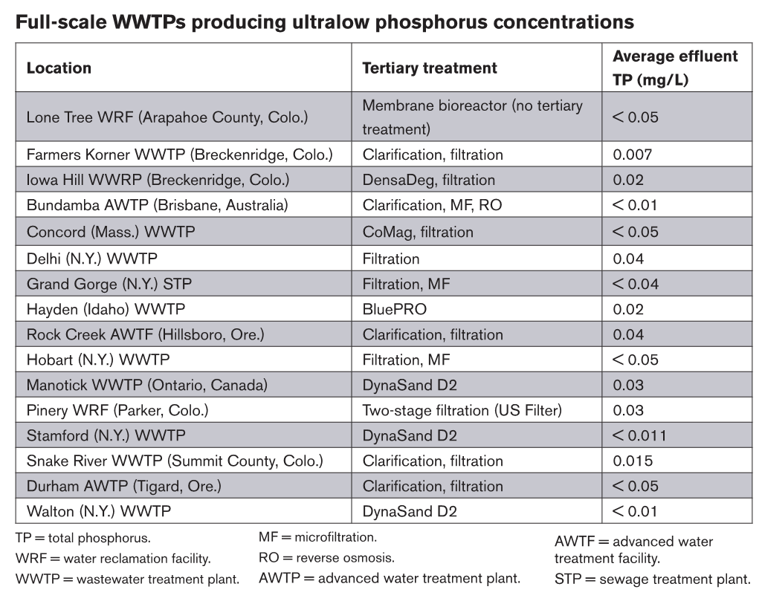

Slide 29
Summary
We can reliably reach <1 mg/L TP using biological phosphorus removal if we have sufficient carbon (C/P ratio)
  Well operating systems can go even lower
  Similar results can be achieved with chemicals
Getting lower than 0.5 mg/L
  Filters
  May need chemical trim
We can get to 0.05 mg/L with advanced treatment, BUT phosphorus speciation becomes very important (rDOP)
Getting below 0.02 mg/L is difficult and speciation is critical

Slide 30

Questions
Andy & Chris Contact info:
ShawAR@bv.com
deBarbadilloC@bv.com

