Slide 1
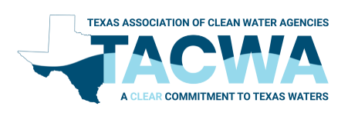
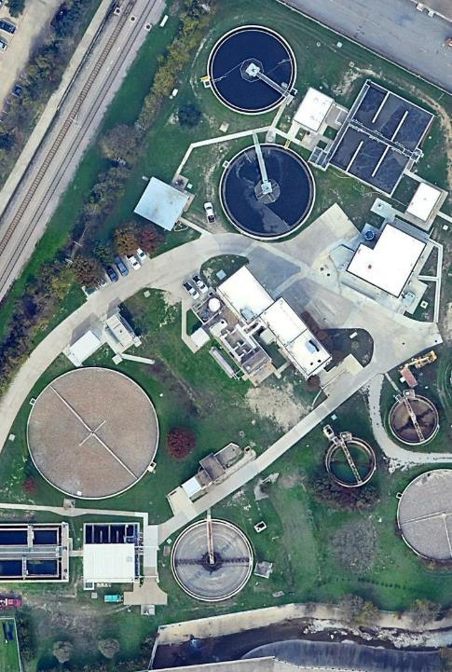
Managing Multiple Plants. A way to Optimize Multiple Plant Utilities’ Operation and Capital Expenses.
Rudy E. Kilian, P.E.
January 24, 2025

Slide 2
How do we BEST manage a system with multiple facilities that are interconnected
Individual Approach
Send it downstream and don’t answer the phone
Call the other supers and coordinate
Are any of these truly optimized or in the utility’s best interest.

Slide 3
Looking at specifics
Our Host’s System

Slide 4
Hickerson WWTP Capacity
High BOD
Addressed
2.8 mgd
to HRS
2038
Inactive Train Restored

Slide 5
Haskell+Hickerson Capacity
High BOD
Addressed
0.6 mgd
to FH
3.0 mgd from RRB
Inactive JTH Train Restored

Slide 6
Rehab. Upper Valley Outfall
Haskell +2 mgd
Hickerson -2 mgd
Maintain at 75% Cap.
Upgrade
HRS
2049
+11 yr.
3.0 mgd
from RRB
Addt’l 2 mgd from JTH
(4.8 mgd total)
Addt’l 2 mgd
to HRS
(4.8 mgd total)
0.6 mgd
to FH

Slide 7
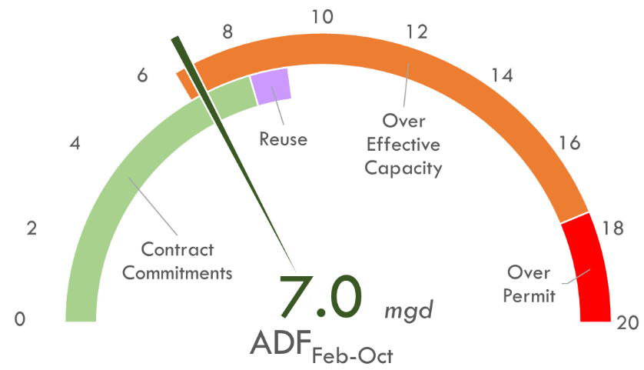
Hickerson WWTP Effluent needs

Slide 8
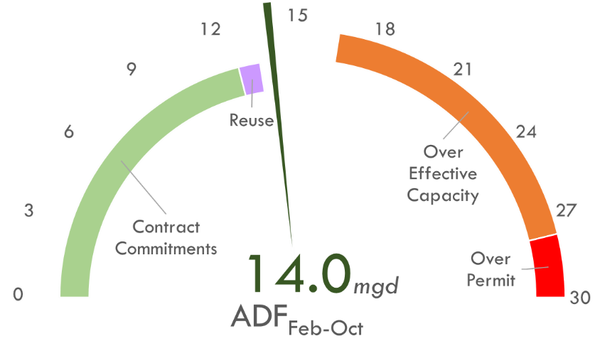
Haskell wwtp Effluent needs

Slide 9
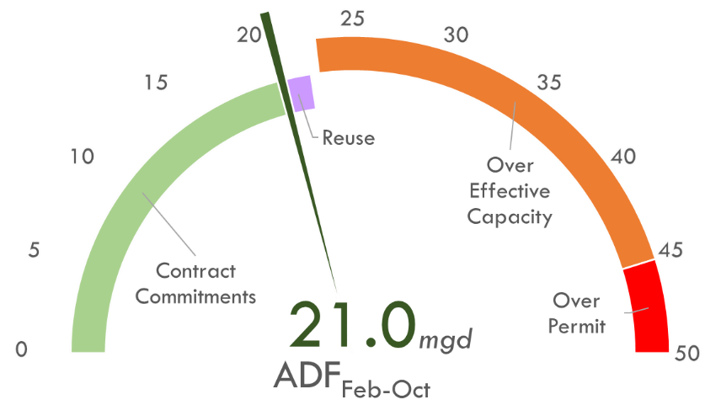
HICKERSON + haskell Effluent needs

Slide 10
Bustamante WWTP Capacity
Expand to 51 mgd
Rehab to 39 mgd
2037
3 mgd to HRS

Slide 11
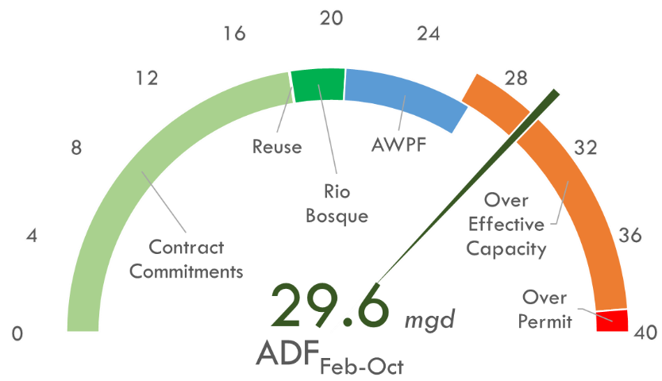
Bustamante wwtp Effluent needs

Slide 12
10 years…. Surely there is a better way!!!

Slide 13


Blue Plan-it® Is All About Connecting Dots…
Wastewater Treatment Analytics, NPW, IRP, DPR
Water and Wastewater Treatment Analytics, Biological Process Modeling using GPS-X
Desalination and Brine Management
Industrial Water Balance and Reuse
Hydraulic Modeling,
Distribution and Collection
System Modeling, Hydrology
GIS, 4D Decision Support
Simulation,
Optimization,
System Integration,
Data Pipeline
Digital
Twin
Machine
Learning,
Sustainability, Water Reuse, Water and Carbon Footprint, Water Resources Planning, Drought Resilience
Artificial Intelligence
Monte Carlo
Simulation, Reliability Analysis, Risk Assessment
Alternative Evaluation,
Scenario Manager
Capital, O&M and Life Cycle Costs
Capital Improvement Program Optimization, Capacity Management
Prioritization Dashboard,
Triple Bottle Line
Business Intelligence Dashboards, Power BI / Tableau, BPI Web App
Notes:
First, what is Blue Plan-it®? It is a fully customizable simulation, optimization, visualization platform for water industry developed by Carollo. Whether it’s water, wastewater…, from … Blue Plan-it® connects all the dots to better assist you to make decisions. Developed over the past decade and matured in the past five to six years, we have developed over 100 customized decision support models using Blue Plan-it®.

Slide 14
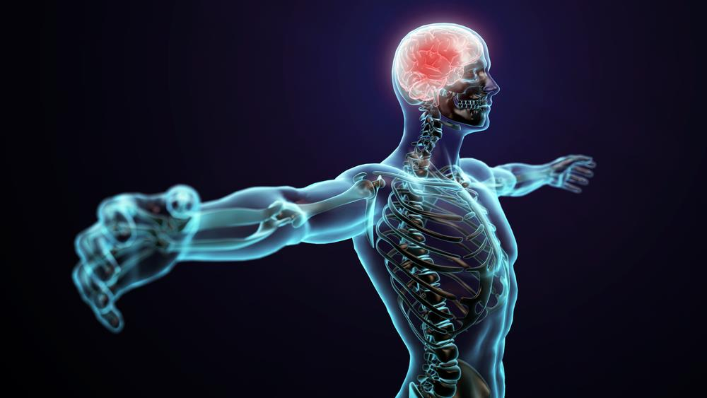


Self-”Calibration”
Data Driven
Programmed machine learning algorithms enable self-calibration, automating the learning process as more data absorbed
Physics informed hybrid
model fed with massive dynamic data from diverse sources…
Actional Outcomes
Built-in solvers and optimizers offer real-time decision-making intelligence.
Systemwide Capabilities
What is a WTP
Digital Twin?
AI facilitates modeling of complex, expansive systems more efficiently.
Notes:
there are huge differences between a “calibrated” model in the conventional sense with the ones that I would call digital twins for our water industry. Here are a few major differentiators from my prospectives:
1) Data driven – Besides the empirical and mechanistic based model that we have, we are leveraging more and more data driven models. Machine learning is one powerful approach, but not all Artificial Intelligences belongs to machine learning. Given the complexity, areas without known mechanisms cannot be modeled well using a conventional approach. Let alone to calibrate a model. Machine learning, Monte Carlo Simulation, Full Factorial Solver, etc. can allow us to solve the problem without writing explicit equations. That was impossible. But now we can do it as long as we have data. W are NOT giving up our “calibrated” models. That knowledge is still critical to have. Use a hybrid approach like what the industry calls “physics informed machine learning”, we combine our conventional model with machine learning seamlessly to tackle different processes.
2) Amount of Data –
We are talking about a large amount of data, that come from different sources (SCADA / sensor data in 15 seconds time interval, LIMS data at whatever sampling frequency the lab reports, manual data that the operator collects routinely and on special cases). Data came in different format. Such quantity and quality of the data, conventional models cannot even digest without manual data analysis that takes weeks using conventional approach. But now we have modules that can do that automatically: Grab the data from different sources. Scrub the data to remove outliers and errors. Resample the data to the same frequency that the process models and machine learning models can be fed (say hourly, daily, or every minute,…).
3) Self-calibration – The next key differences is that our digital twin models can continue to “grow” when it is fed with live data. The machine can continue to “learn”, recalibrate itself once a while using the programed machine learning algorithms. This can be automated. So the more data you got, the better accuracy it will have in the future.
To qualify as a digital twin, a model must emulate the intelligence of a living human. It needs sensors for data intake, swift information processing akin to nerves and brains, and the ability to generate specific actionable decisions in real time, and automating the learning process as more data was integrated. The digital twin goes beyond a simple calibrated model, reflecting a paradigm shift in modeling sophistication.
3) System-Wide – Given the limitation of the conventional “calibrated model”, to model the whole system could take lots of effort for collecting large amount of data, analyze the data manually, and soon when the system is too big and too complex, you can’t model the system anymore because there are NOT always mechanisms established to model everything. But AI and Machine learning model allow us to do much more complex things. So we could expand the boundaries to cover more and more components, and simulate their synergisms and impacts for a bigger system in a much faster way.
This is such a powerful new trick we learned. once we acquired this ability, the application of it grows so fast. I wish I can squeez three or more examples into this presentation.
4) Actionable Outcomes – The typical outcomes of a conventional calibrated model can help user to understand the process. But it is limited for decision support. Instead of just knowing “what’s happening?” or “how did it happen?” or “why did it happen?”, the digital twin users will be equipped with not only Predictive Analytics, which tells them “What is likely to happen?” if we do this or that (manual what-ifs, trial and error) ; and Prescriptive Analytics, which tells them “What do they need to do to make it happen?” using solver and optimizer in real time.
Not only in real time, but also ahead of time. We want to use the current time measurements or historical data to predict the future, 30 minutes in advance, 1 day in advance, 7 day in advance. So it will gain us more time to take actions.

Slide 15

When we say “Digital Twin”…
… isn’t’ it the same thing as a “calibrated model”?

Slide 16
Definition: A Digital Twin is a dynamic digital representation of real-world entities and their behaviors using models with static and dynamic data that enable insights and interactions to drive actionable and improved outcomes.
Industry aligned definition led by SWAN Digital Twin Working Group and "American Water Works Association Digital Twins Committee”
Notes:
By industry aligned definition led by SWAN Digital Twin Working Group and "American Water Works Association Digital Twins Committee”, a Digital Twin is a dynamic digital representation of real-world entities and their behaviors using models with static and dynamic data that enable insights and interactions to drive actionable and improved outcomes.
The key words to me are DATA and ACTIONABLE OUTCOMES. Because this leaves the static data in and the types of outcomes are also widely open, you could say a digital twin is a type of calibrated model.

Slide 17
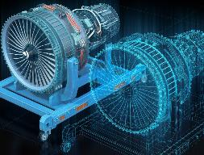
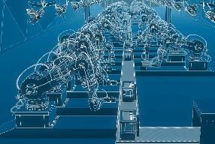
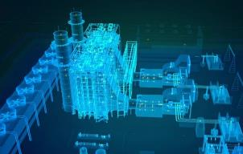
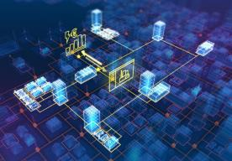
Blue Plan-it® Offers Digital Twins that Can Be Categorized into Several Different Types
Component Twins
Digital models of individual components or parts, such as motors, sensors, switches and valves
Asset Twins
Digital models of physical assets such as buildings and equipment
System Twins
Digital models of entire systems or processes
Process Twins
Digital models of entire business processes (e.g., Planning, Utility Management, Billing)
Blue Plan-it®
WTP & WWTP Models
Wellfield Models
Distribution System Models
Blue Plan-it®
Master Planning & Utility Management Model
Blue Plan-it®
Unit Process Models
& Equipment Models
Notes:
What are the different types of digital twin?

Slide 18
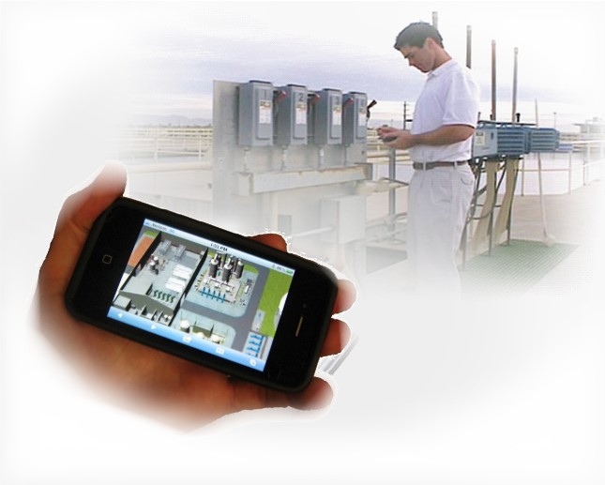
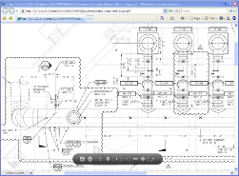
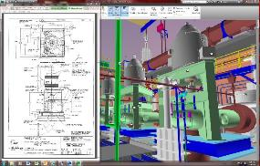
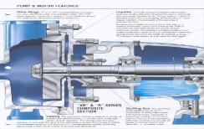
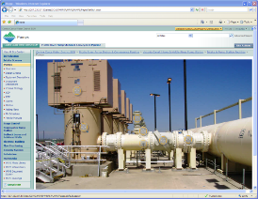
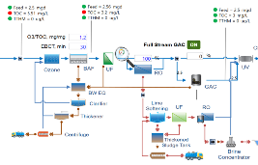
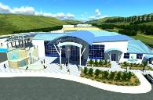
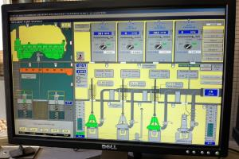
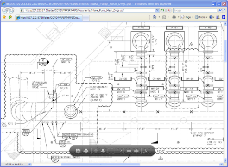
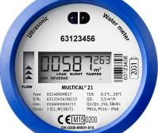
Digital Twin Technologies
Asset / Facility Data
GIS / BIM / CAD
Models and AI/ML
SCADA Integration
Documents / Media
Metering / Real-time Data
Notes:
TITLE AND BULLETS

Slide 19
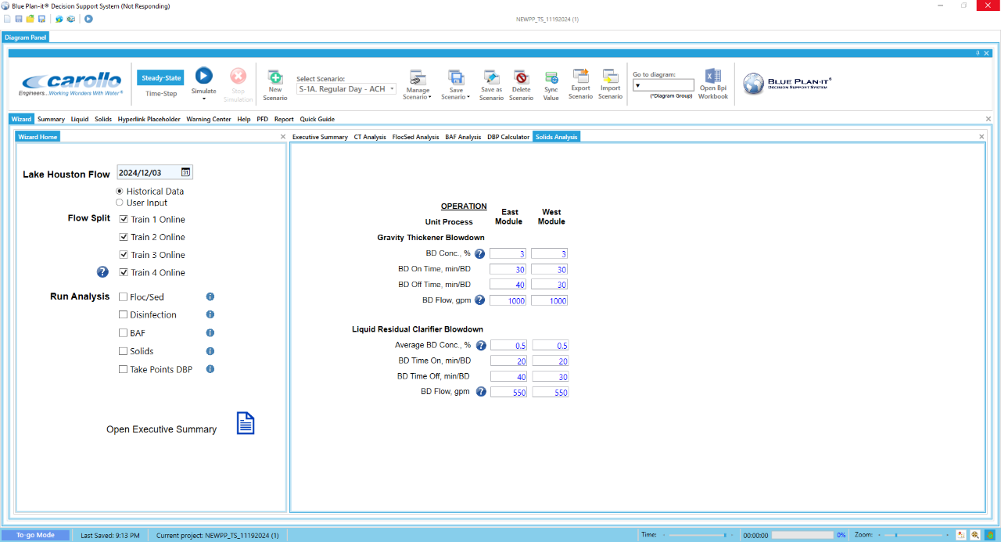
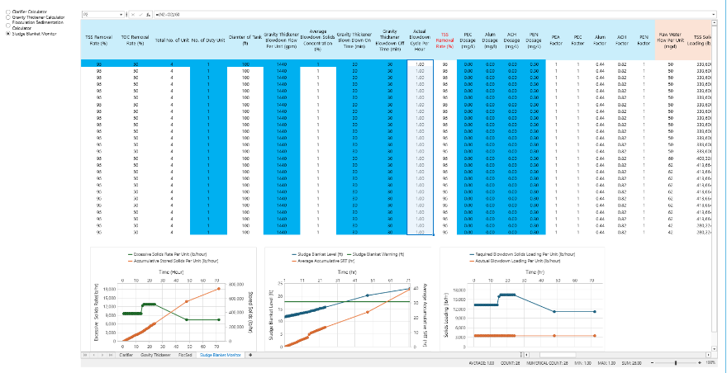


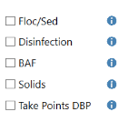



Quick Dynamic Checks for a Steady-State Run without Running Full Dynamic Model
Quick Inputs:
Analysis Included:
One Click

Slide 20
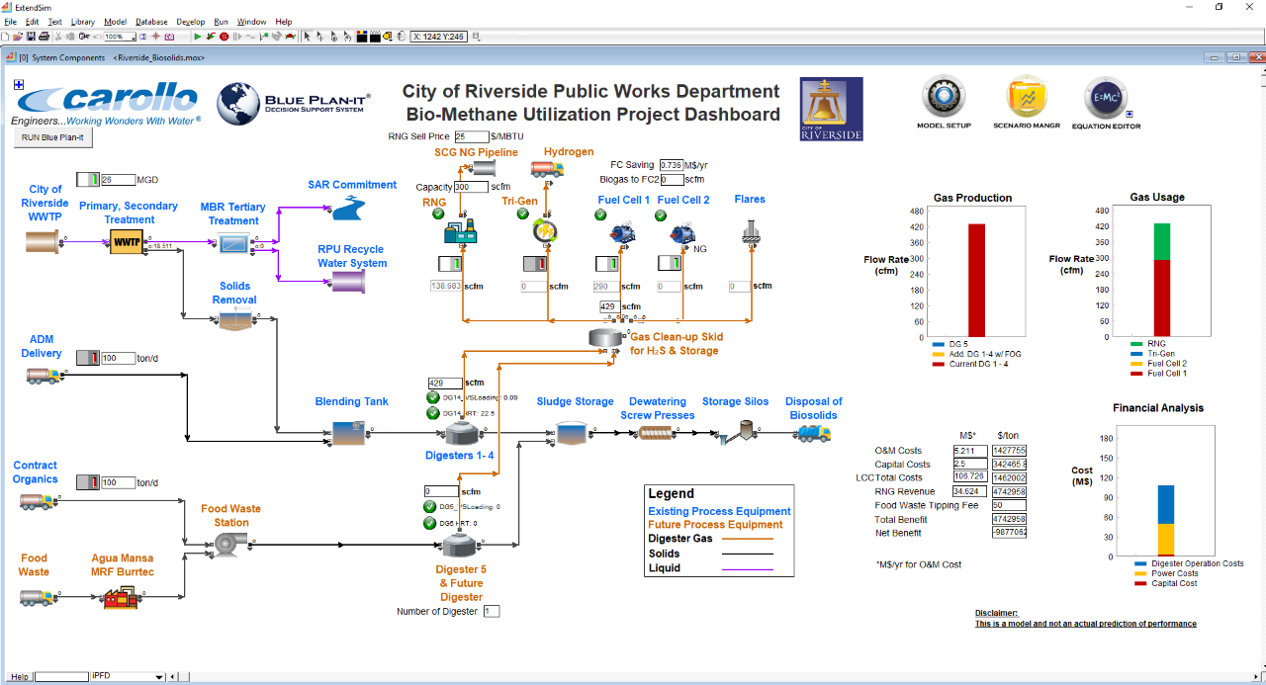

Slide 21
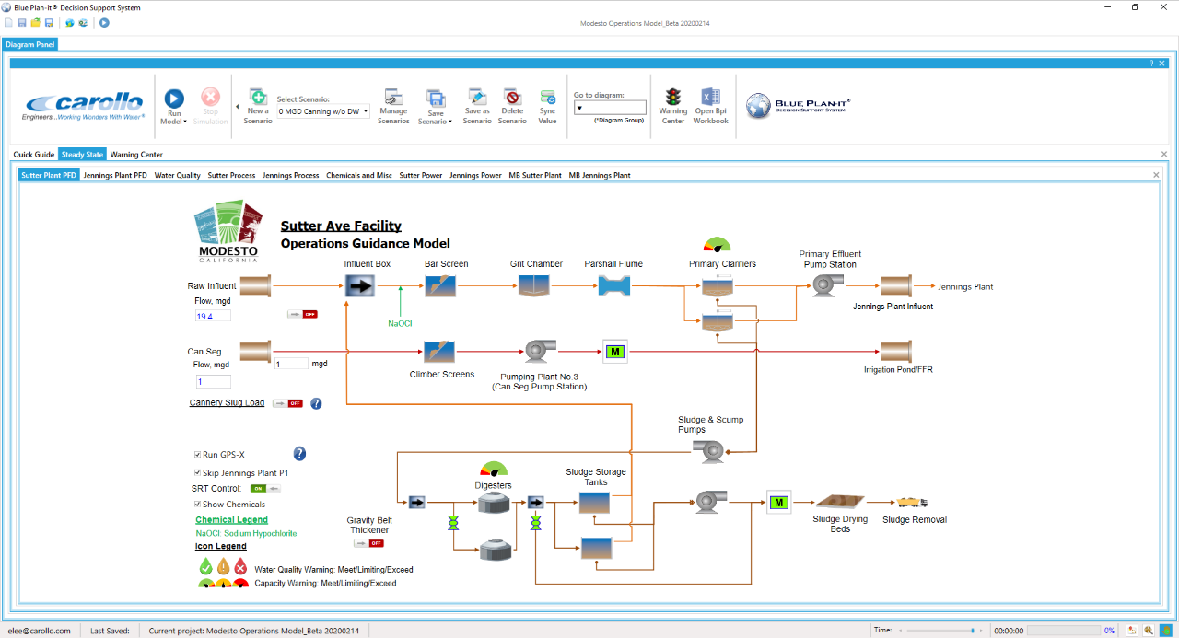

Slide 22
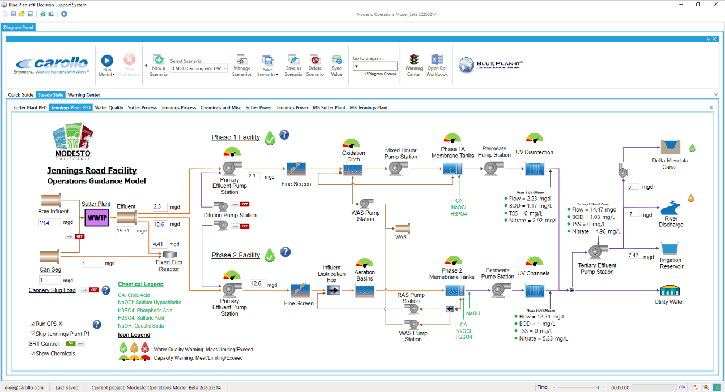

Slide 23
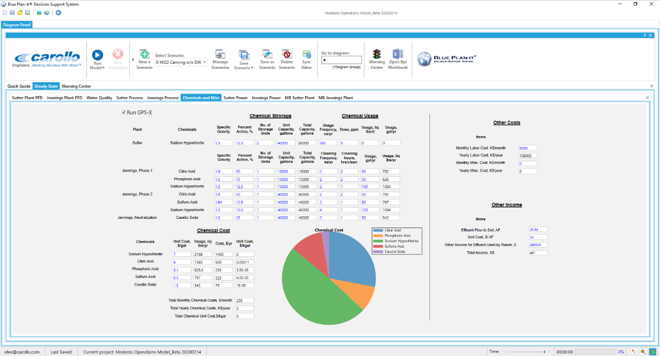

Slide 24
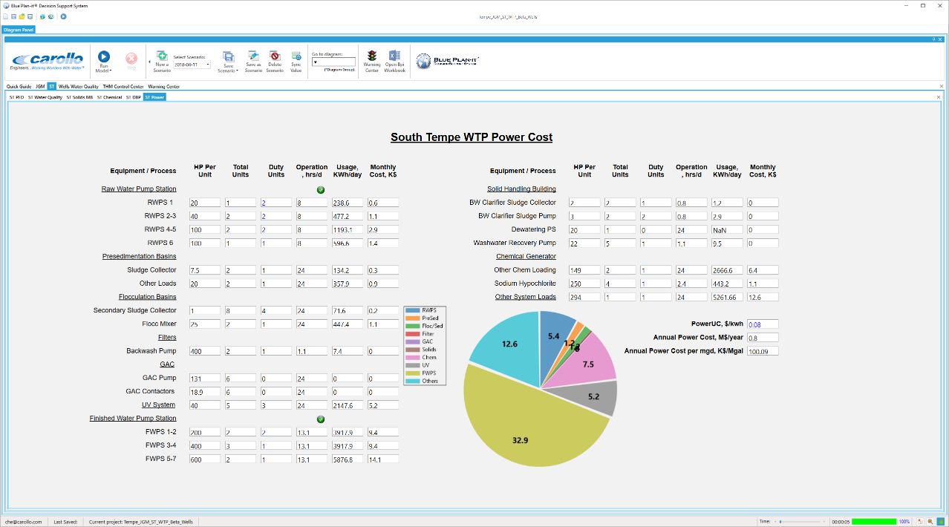
Power Consumption
Notes:
power consumption,

Slide 25
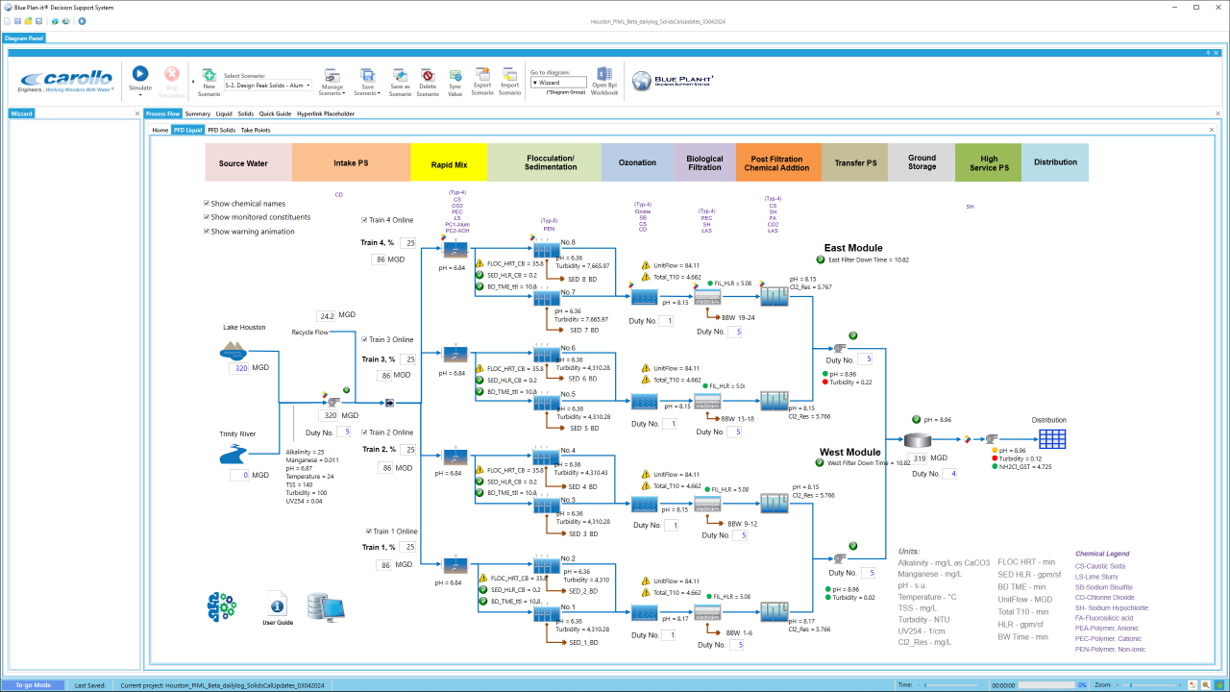

Slide 26
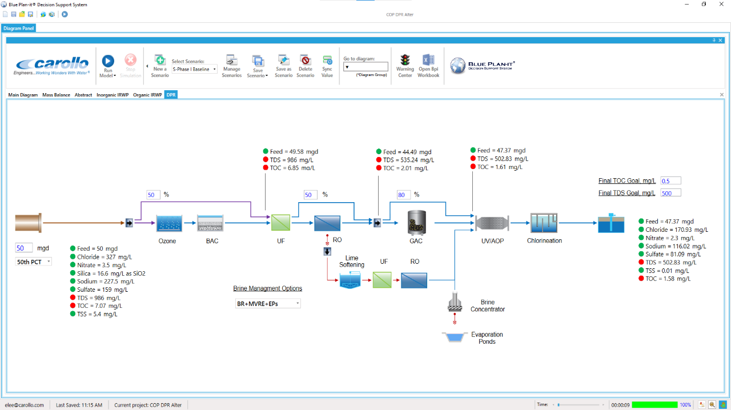
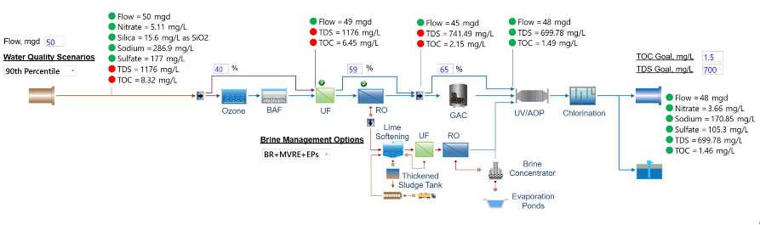
Blue Plan-it® DPR / IRP Model: Process Optimization

Slide 27

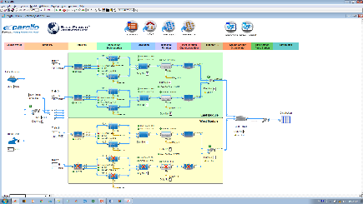
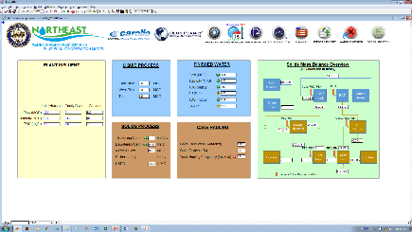
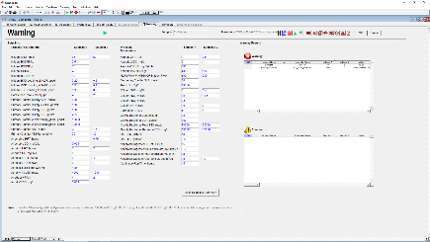
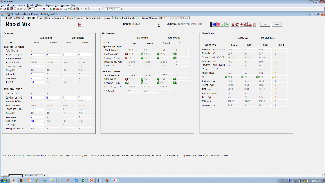
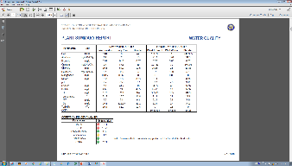
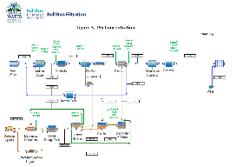
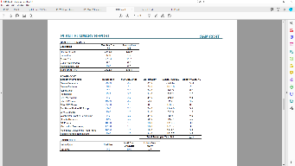
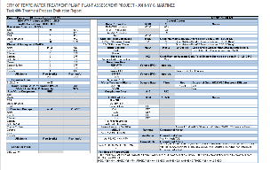
Blue Plan-it® Models Are …Customizable
Process Flow Diagrams
Dashboards
PFD
Dashboards
Reports
Mass balance, TTHM Control Center, CT Compliance Report, Basis of Design, Chemical Calculator, Warning Logs and SOP, Detailed Report
Virtual experimentation before implementing design and operational strategies
An operator training tool that captures institutional knowledge, a dynamic trouble shooting guide,
Warning and dynamic SOP
THM Control Center Report
PDF and Excel Reports
Mass Balance Diagrams
O&M Costs Summary

Slide 28
Industry is Starting to Provide Guidance
WERF/LIFT – Intelligent Water Systems: The Path to a Smart Utility,
WSEC-2016-WP-002
EPA – Smart Data Infrastructure for Wet Weather Control and Decision Support, 830-B-17-004
Smart Cities…etc.

Slide 29
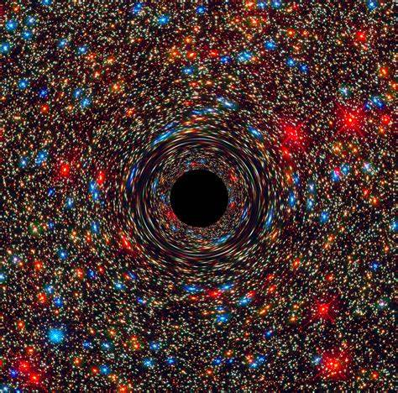
So… Is the future a massive black hole of Data Gathering?

Slide 30
What does ChatGPT think?
Managing the capacity of multiple wastewater treatment plants when one or more units are out of service can be complex, but there are a few best practices you can follow to ensure overall system stability and efficient operation:
1. **Prioritize Critical Plants**:
- Identify the plants with the most critical infrastructure and prioritize their operation. Focus on ensuring that the most essential plants are running at or near full capacity, especially during times of high demand or operational issues.
2. **Dynamic Load Balancing**:
- If possible, implement a dynamic load balancing system across all plants. This can involve redistributing the influent flow between plants based on their available capacity. Use automated systems to adjust flow rates in real time depending on which units are online and operational.
3. **Operational Flexibility**:
- Build operational flexibility by cross-training staff and having flexible equipment and processes that can be adjusted based on the plant's current capacity. This may include optimizing treatment processes to operate more efficiently with reduced capacity or using alternative treatment methods temporarily.
4. **Data-Driven Decisions**:
- Leverage real-time monitoring systems (SCADA) to track plant performance and provide data on flow rates, treatment efficiency, and capacity. By using this data, you can make informed decisions about how to manage the plants in real-time, ensuring no plant exceeds its capacity or operates inefficiently.
5. **Use of Buffer Storage**:
- When one plant is down, it may be helpful to temporarily store influent in buffer tanks or holding ponds, allowing you time to adjust flows or perform maintenance. This helps to manage variations in flow and treatment capacity without overwhelming any single plant.
6. **Contingency Plans and Maintenance Scheduling**:
- Have a clear contingency plan for when a unit or plant is down, which includes strategies for redistributing flow, maximizing remaining capacity, or deferring less critical maintenance. Properly scheduled and predictive maintenance will also help prevent unplanned downtime, minimizing the risk of capacity constraints.
7. **Backup Power and Equipment**:
- Ensure that there are backup power systems in place (such as generators or batteries) to keep essential equipment operational during power outages. Having spare parts and equipment on hand can also help minimize downtime for critical units.
8. **Communication Across Facilities**:
- Regular communication between the operators of different plants is key to coordinating operations and managing capacity. This helps prevent issues from escalating and ensures that adjustments can be made swiftly if there are problems at one plant.
9. **Evaluation and Long-Term Planning**:
- Regularly evaluate the capacity and operational status of each plant. If there is a pattern of frequent outages or capacity challenges at certain plants, it may be worth considering long-term infrastructure improvements, upgrades, or expansions to better handle fluctuations in demand or plant downtime.
By integrating these approaches, you can better manage the capacity of multiple wastewater plants during times of operational disruption. The goal is to minimize the impact of having units out of service while maintaining safe, effective treatment standards.

Slide 31
Thank you Q&A

