Slide 1
Texas Association of Clean Water Agencies
Disc Filter Technologies
Exploring the Benefits of Large Frame Cloth Media Filters
Tasie Kade, PE
May 16, 2025

Slide 2



Agenda
History and Regulatory Overview
Filter
Technology
Project Applications
Notes:
Tasie is going to tell you (1) About project overview: project drivers, schedule, cost (2) a brief history wet weather treatment regulations in Texas, and (3) an overview of the filter design. But before she does that I’m going to tell you about Duck Creek Wastewater Treatment Plant and the scope of this project.

Slide 3
History and Regulatory Overview

Slide 4
Cloth media filter timeline
1990s: First cloth media filtration utilized in the U.S.
2016: Cloth media filters designed for primary treatment enter market
1970: Cloth media filtration introduced to the European market
2013: Eighth circuit court struck down EPA’s effort to regulate blending
2023: TCEQ approves stormwater filters in Texas
2005: EPA proposed a wet weather discharge policy that disallowed bypass blending
Notes:
“now that you know we can meet permit, let me explain how this was approved”
“what caused this whole project to come about”
2017 gave TCEQ certainty that they could approve case by case if they wanted to.
1 – Clean Water Act requires municipal WWTP discharges to meet a minimum of secondary treatment.
2 - Definition of bypass: discharges that have not received secondary treatment
Port Arthor is the first approved

Slide 5
Filter Technology

Slide 6





Cloth media filter technologies
“Inside-Out”
“Outside-In”

Slide 7
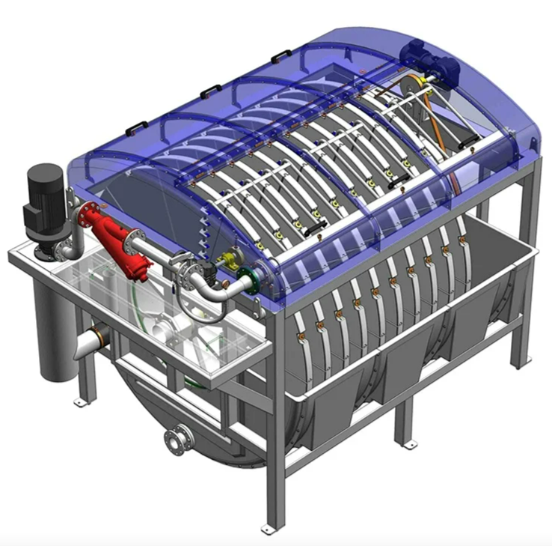
“Inside-Out” disk filter anatomy
High Pressure Spray Backwash
Backwash Pump
Effluent Trough
Inlet to Rotor Drum
SuperDisc™ Disc Filter
Image provided by WesTech
Notes:
Stainless steel frame

Slide 8
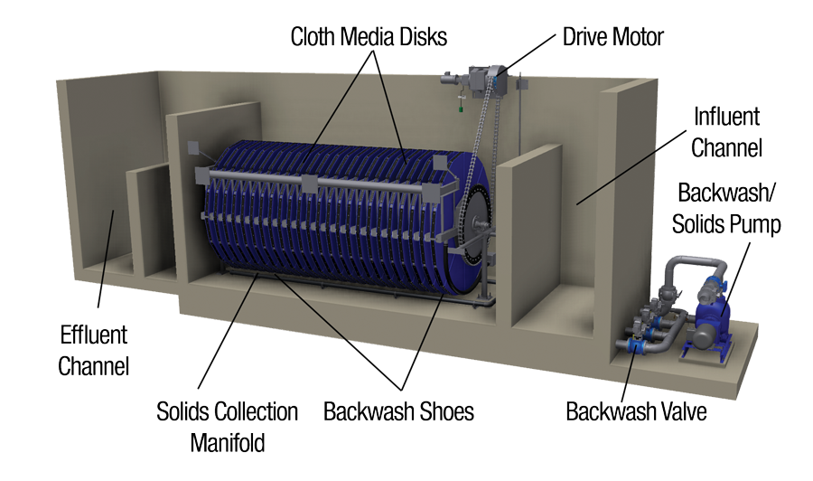
“Outside-In” disk filter anatomy
Standard Disk Filters (MegaDisk™)
Image provided by Aqua-Aerobic

Slide 9
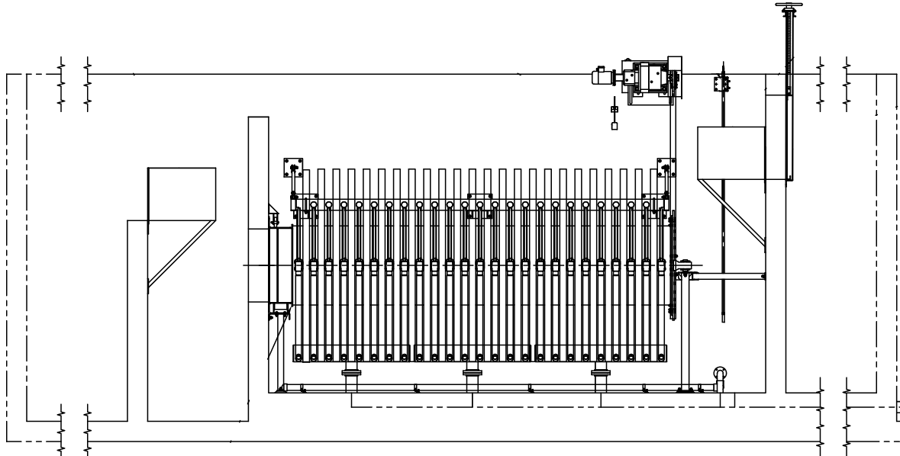
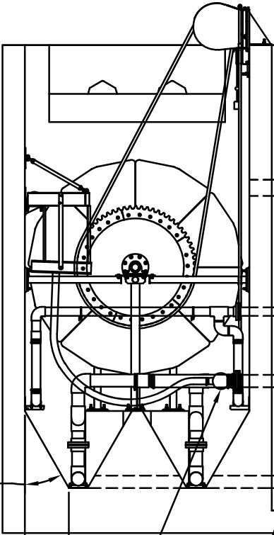
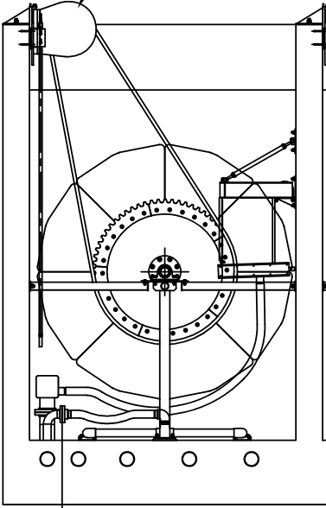
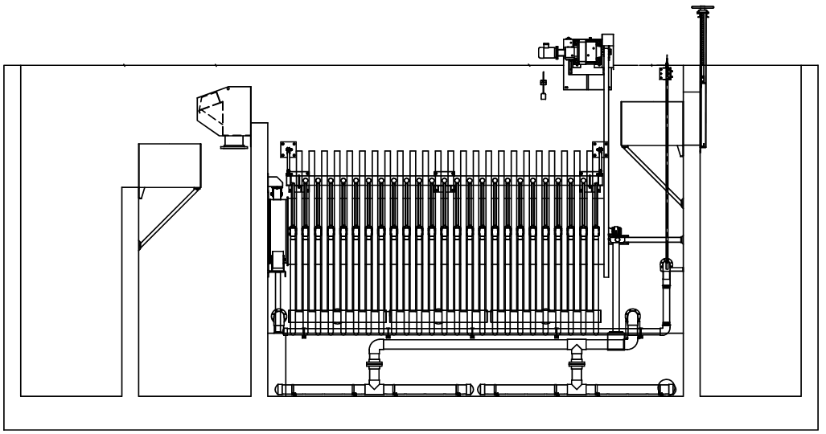
Cloth media filters can be used as primary clarification or tertiary filters
MegaDisk®
AquaPrime® & AquaStorm®
MegaDisk®
29’-8”
15’-10”
19’-8”
Scum Trough
AquaPrime® & AquaStorm®
More robust solids collection underdrain system
31’-4”
Notes:
Differences:
- Same configuration and same number of disks
- Added features to handle solids in basin
- More robust cloth media to handle high solids waste from primary effluent

Slide 10
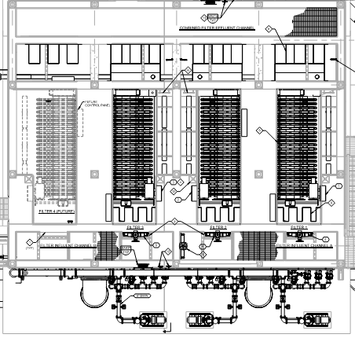
Disk filters provide a higher capacity with a smaller footprint
60’
90 ft
Traveling Bridge Sand Filter
Loading Rate: 3 gpm/sf
60’
62 ft
Dual Media Filter
Loading Rate: 4 gpm/sf
Cloth Media Filter
Loading Rate:
6.5 gpm/sf
Comparative sizes based on 24 MGD of capacity
Garland Duck Creek Facility
Rated Capacity: 72 MGD
Notes:
Less foot print = less concrete
TCEQ 217

Slide 11
Project Applications

Slide 12
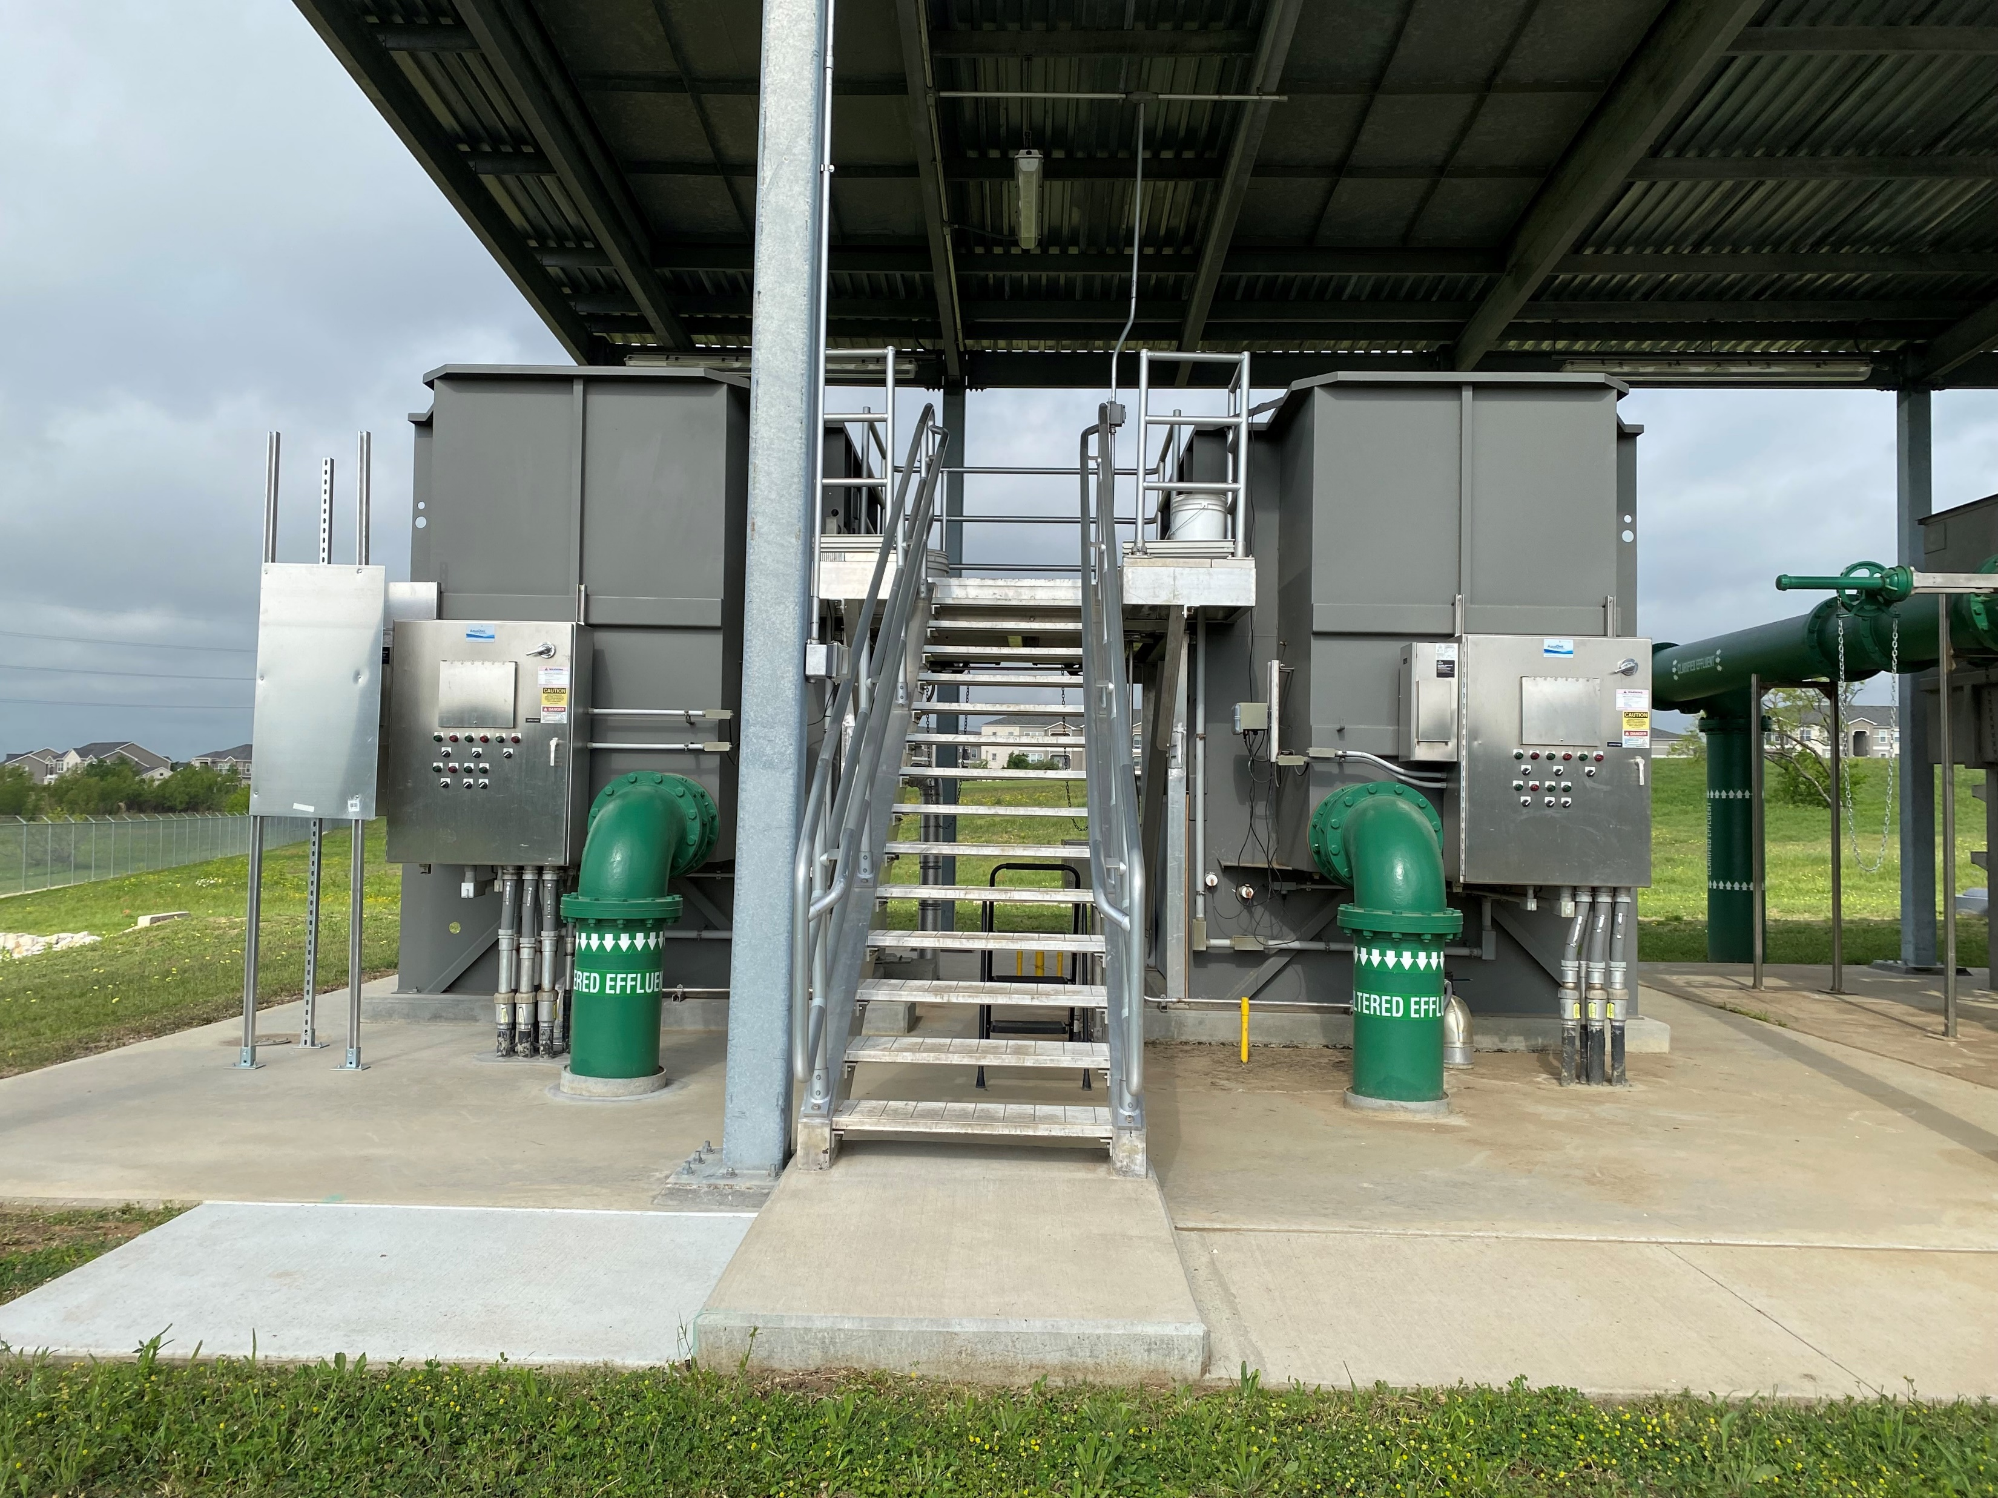
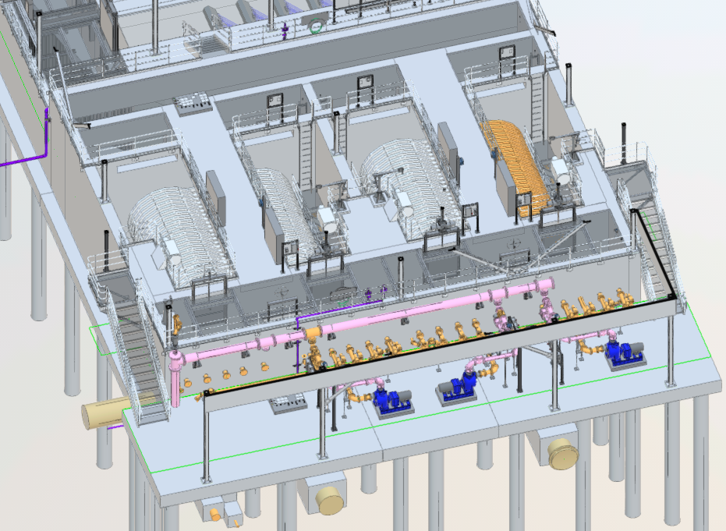
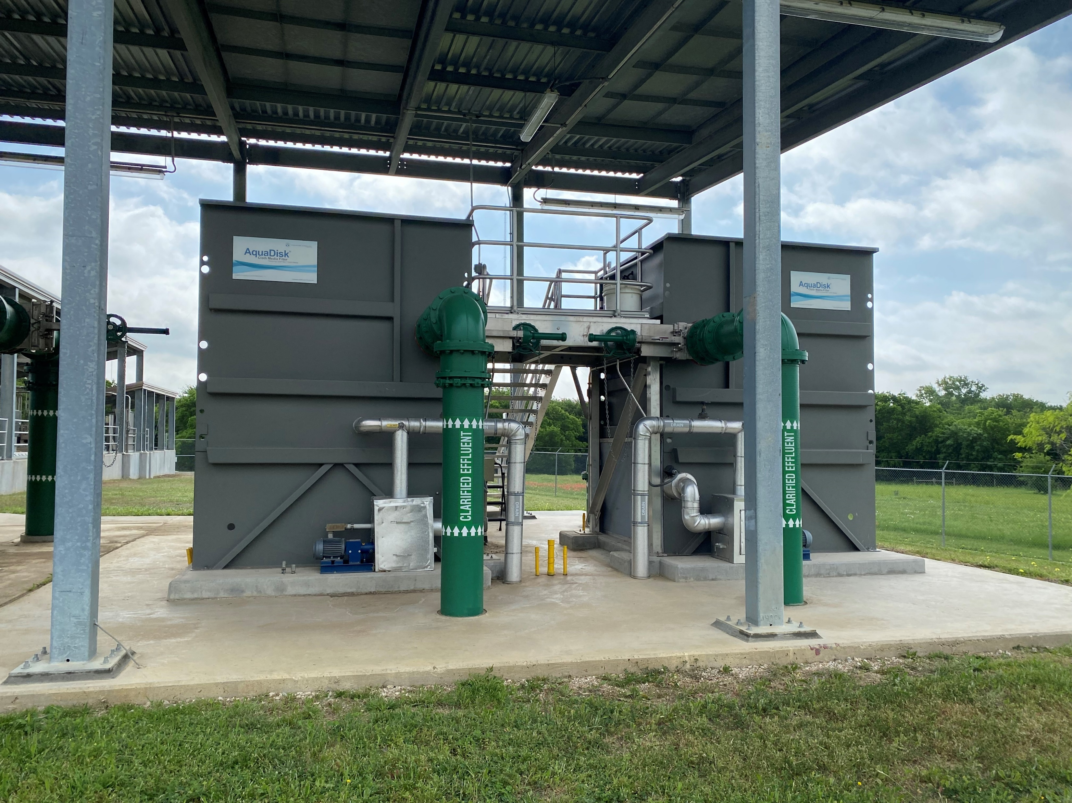
UTRWD – Doe Branch Wastewater Treatment Plant
Phase 1 (2 MGD) - Five Star
Phase 2B (12 MGD) – MegaDisk
(2 duty, 1 standby, 1 future)
Phase 2A (4 MGD) - AquaDisk
Notes:
Permit requires filters to meet discharge requirements. Disk filters selected because of low unit cost.
First two filters @ 2MGD were five star. When plant expanded to 4 MGD, went with AquaDisk.
Expanding from 4 MGD to 12 MGD, MegaDisk were selected for high capacity, low footprint, fits nicely with combined UV facility. Expanding existing filters was not an option.
AquaDisk is more equipment to maintain for the same capacity. Similar to more equipment cost, larger footprint.
Able to build out new MegaDisks and phase out existing small filters into on facility.

Slide 13
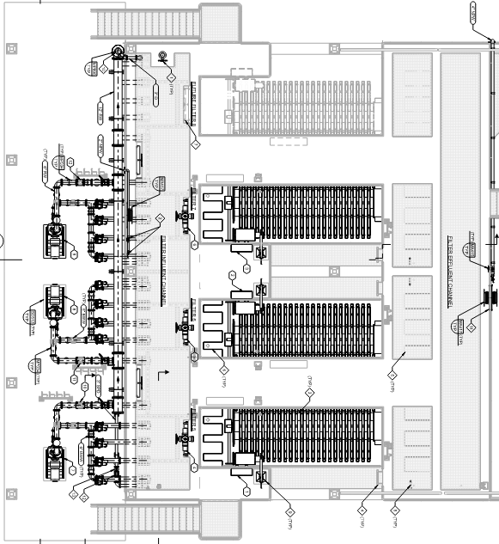
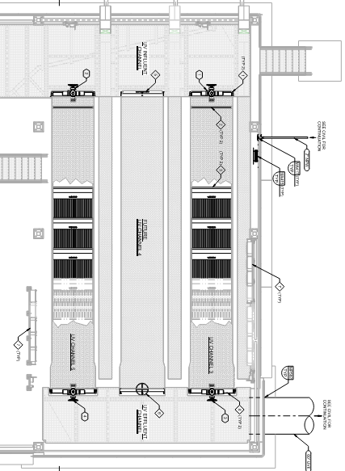
Large frame filters are compatible with UV disinfection in a common wall facility

Slide 14
Garland Duck Creek WWTP - existing process flow diagram
SECONDARY TREATMENT
(TRICKLING FILTER TRAIN)
PRIMARY TREATMENT
PRIMARY EFFLUENT SPLITTER
FINAL PUMP STATION
SAND
FILTERS
CHLORINE DISINFECTION
SECONDARY TREATMENT
(AERATION BASIN TRAIN)
OUTFALL
Notes:
As I showed on the site plan. The process includes primary treatment, the flow is then split between two separate secondary treatment trains. Flow is recombined at the final effluent pump station, which pumps flow to the sand filters and chlorine contact basins.

Slide 15
Garland Duck Creek WWTP - existing process flow diagram
SECONDARY TREATMENT
(TRICKLING FILTER TRAIN)
PROJECT SCOPE
PRIMARY TREATMENT
PRIMARY EFFLUENT SPLITTER
FINAL PUMP STATION
SAND
FILTERS
CHLORINE DISINFECTION
SECONDARY TREATMENT
(AERATION BASIN TRAIN)
OUTFALL
Notes:
The scope of this project is to replace the sand filters and chlorine disinfection with…….click for next slide

Slide 16
City of Garland – Duck Creek Wastewater Treatment Plant
SECONDARY TREATMENT
(TRICKLING FILTER TRAIN)
PRIMARY TREATMENT
PRIMARY EFFLUENT SPLITTER
FINAL PUMP STATION
CLOTH MEDIA DISK
FILTERS
UV DISINFECTION
SECONDARY TREATMENT
(AERATION BASIN TRAIN)
OUTFALL
Notes:
Filters are not a requirement for Duck Creek’s permit.
Goal was to avoid a major permit amendment, only a minor amendment for UV.
Explain why we selected disk filters in the first place for similar reasons to Doe Branch.
Tell the plan to design the filters for storm filters, and change course if needed to switch to megadisk

Slide 17
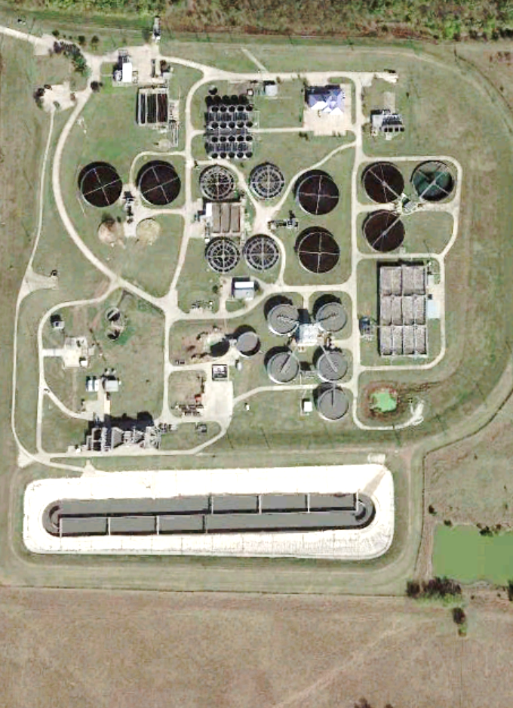
Storm filters provide the best approach for peak flow capacity increases
Additional Equalization Basin
Additional Equalization Basin
Notes:
Included in the filter replacement was to set the plant up for future treatment capacity of 100 MGD
EQ - store to keep peak below 72 MGD
Add Basins – treat entire 72 MGD of flow in real time

Slide 18
Storm filters provide the best approach for peak flow capacity increases
Additional Equalization Basin
Additional Equalization Basin
Additional Treatment
Notes:
Included in the filter replacement was to set the plant up for future treatment capacity of 100 MGD
EQ - store to keep peak below 72 MGD
Add Basins – treat entire 72 MGD of flow in real time

Slide 19
Storm filters provide the best approach for peak flow capacity increases
Additional Equalization Basin
Additional Equalization Basin
Additional Treatment
Additional Primary Treatment with Storm Filters
Notes:
Included in the filter replacement was to set the plant up for future treatment capacity of 100 MGD
EQ - store to keep peak below 72 MGD
Add Basins – treat entire 72 MGD of flow in real time

Slide 20
Project incorporated auxiliary storm flow treatment
SECONDARY TREATMENT
(TRICKLING FILTER TRAIN)
PRIMARY TREATMENT
PRIMARY EFFLUENT SPLITTER
FINAL PUMP STATION
STORM
FILTERS
UV DISINFECTION
SECONDARY TREATMENT
(AERATION BASIN TRAIN)
OUTFALL
Notes:
Disk filters were already approved, but we added this pipeline
This project also incorporated and auxiliary storm flow treatment pipeline shown here in orange. This is made possible by equipping the disk filters with additional features to make them storm filters and make them capable of handling high solids flow. This will allow the plant to send primary effluent directly to the filters during wet weather and prepare us for future peak flow capacity increases.
Tasie will tell you about the drivers for the replacement of the filters and provide details on the design, including details on the storm water filter technology.

Slide 21
Wet weather flow wastewater characteristics
Secondary Effluent (67%)
Stormwater Flow (33%)
Maximum TSS: 15 mg/L
Average TSS: 10 mg/L
Maximum TSS: 80 mg/L
Average TSS: 65 mg/L
Blended Filter Influent
24-Hr Avg TSS: 20 mg/L
Effluent Characteristics
Maximum TSS: 5 mg/L
24-Hr Avg Turbidity: 3 NTU
Anytime Max Turbidity: 5 NTU
Notes:
Well below the permit:
7-day average is 25 mg/L TSS
Daily average is 40 mg/L TSS
Single grab sample: 60 mg/L TSS

Slide 22
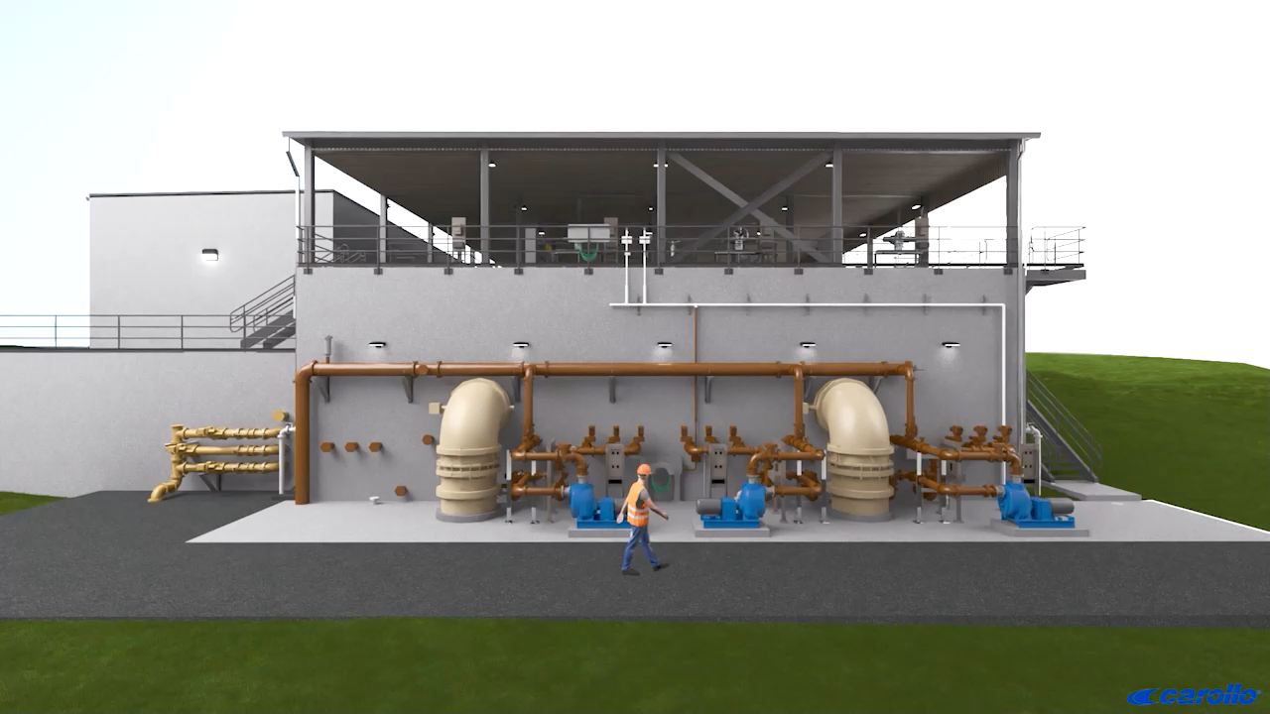
Look Ahead
Notes:
Fits nicely in common wall facility. Can construct offline.

Slide 23
Look Ahead
Thank you!
Tasie Kade, PE
TKade@carollo.com
Troy Laman
TLaman@carollo.com

Slide 24
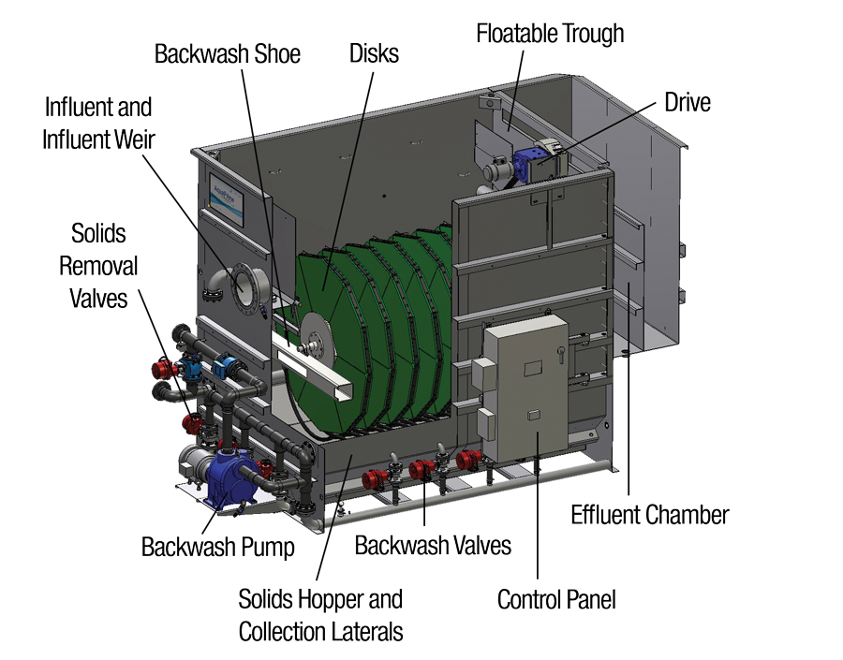
What are the advantages of disk filters?
60’
60’
Storm Flow Capable
Smaller Footprint
(Image provided by Aqua-Aerobic)
Notes:
Why did we pick disk filters vs. sand filters?

Slide 25
Advantage 2: Disk filters can serve as storm filters to address wet weather peak flows
Standard Disk Filters (MegaDisk™)
Image provided by Aqua-Aerobic

Slide 26
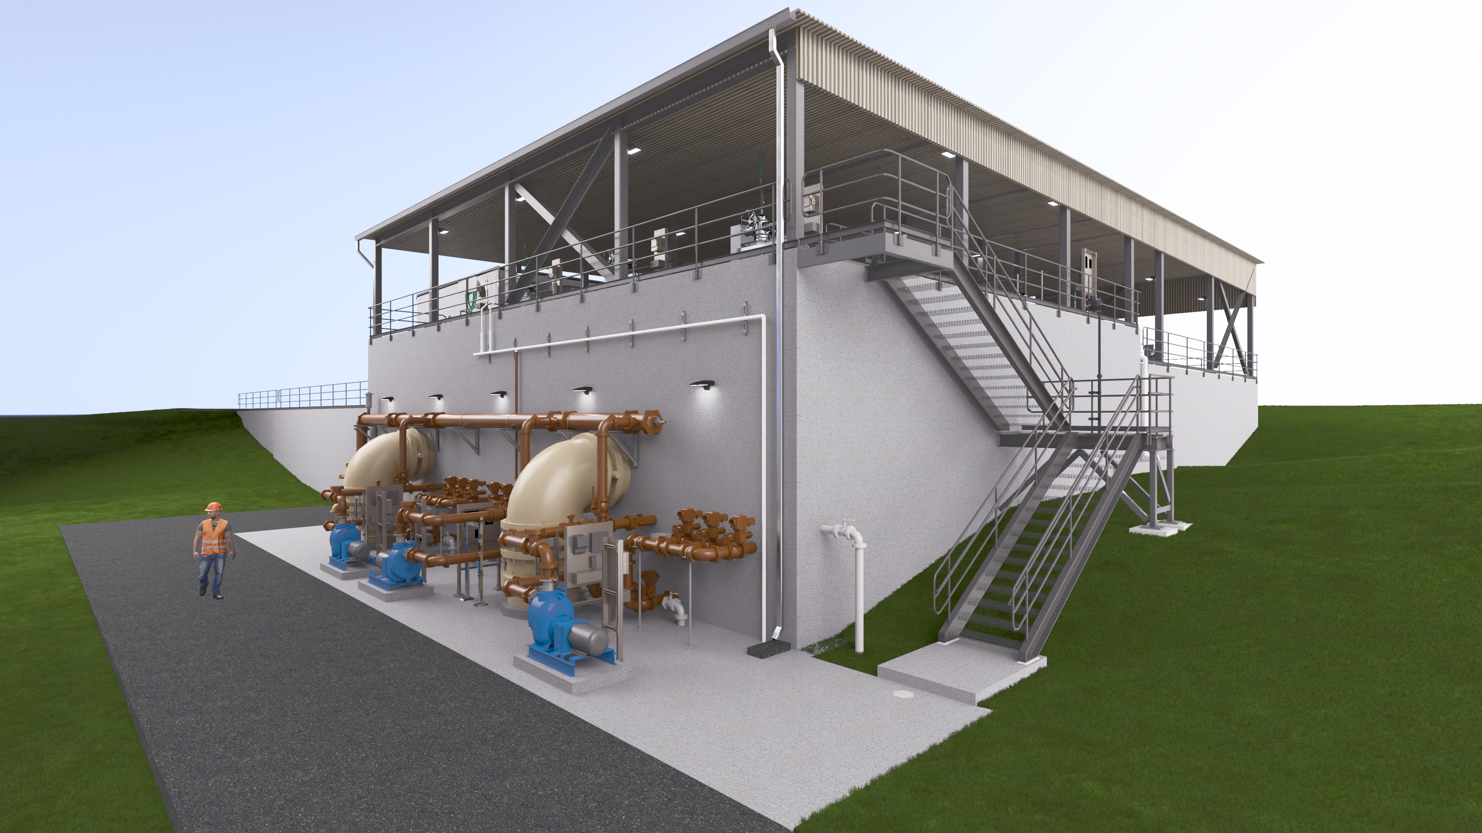
SOLIDS COLLECTION UNDERDRAIN

Slide 27
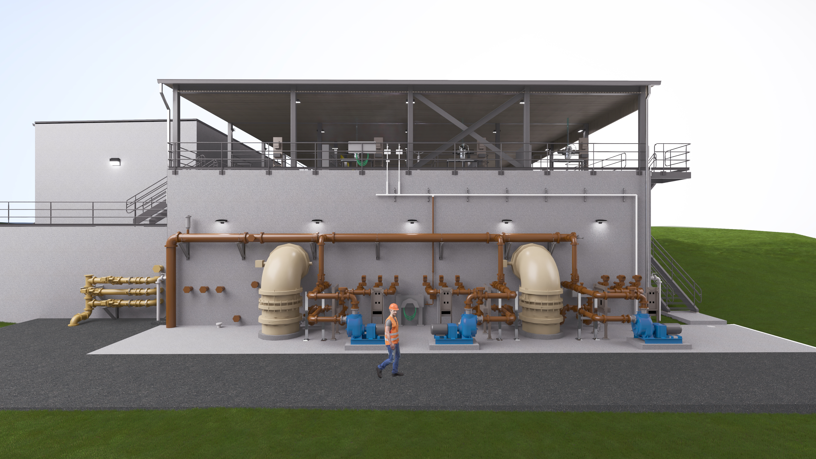
Scum trough
SCUM TROUGH ACTUATORS

Slide 28
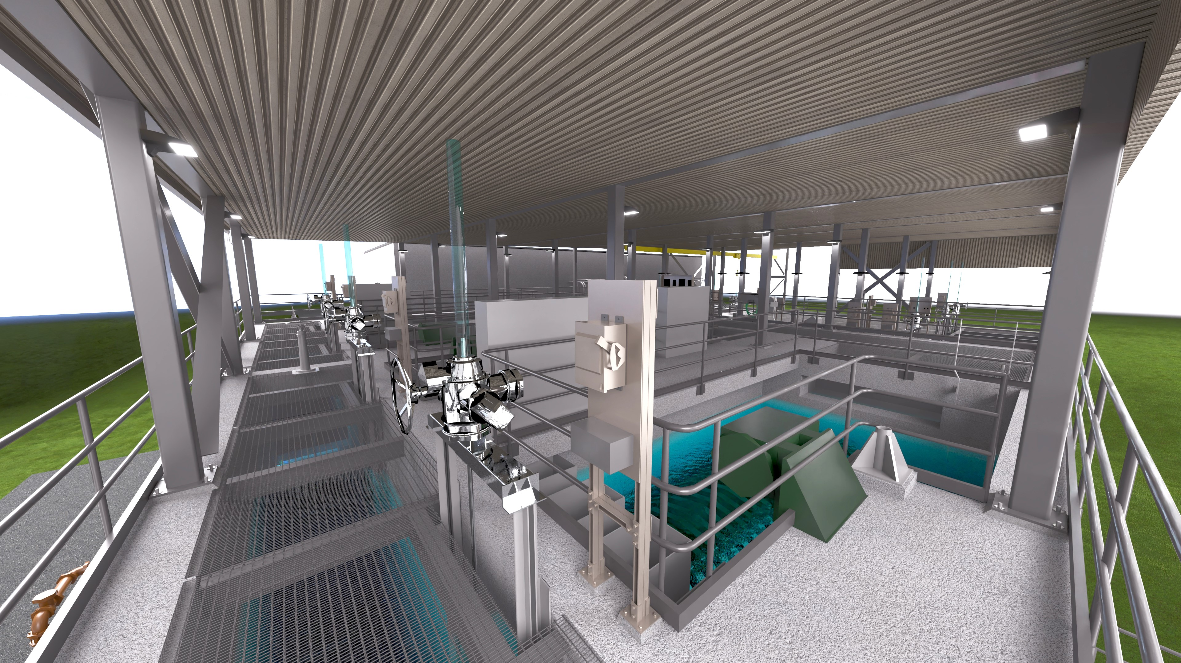
SCUM TROUGH

Slide 29
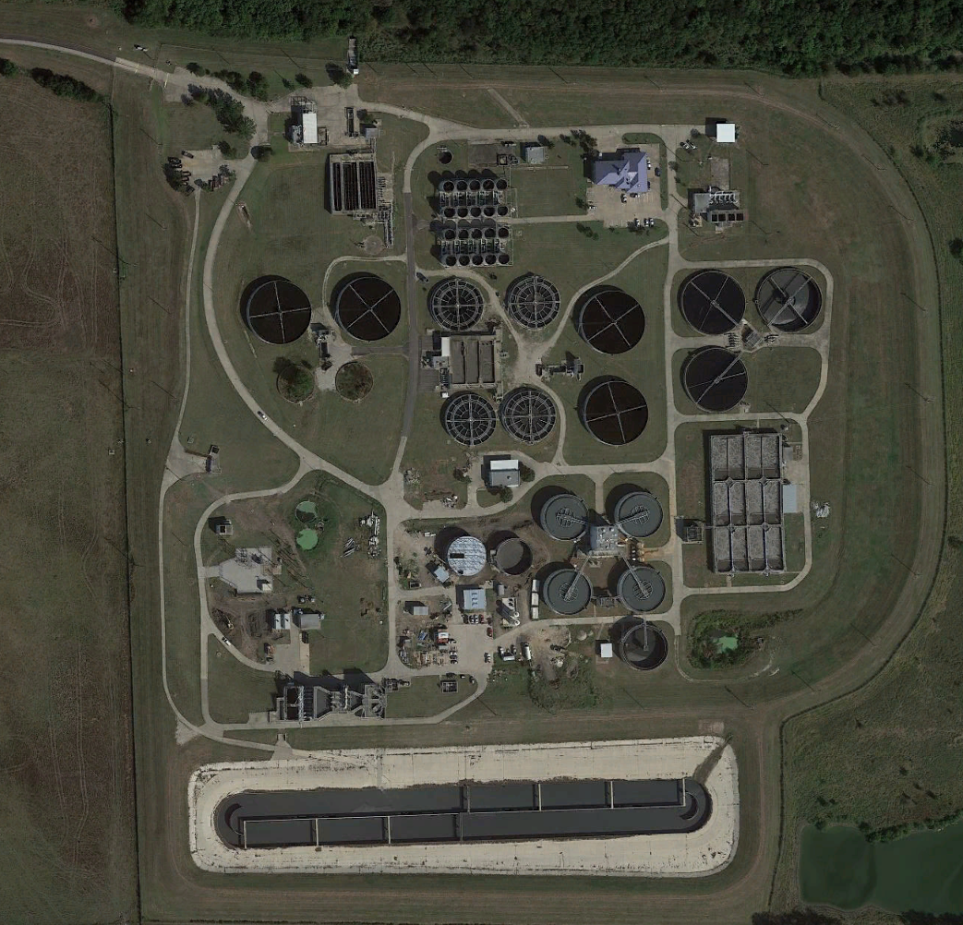
Duck Creek Wastewater Treatment Plant
FILTERS/UV
FEPS
PRIMARY EFFLUENT
CURRENT
ADF: 40 MGD
P2H: 72 MGD
PRIMARY CLARIFIER
FUTURE
P2H: 100 MGD
Notes:
On project completion, the plant can utilize the bypass pipeline to treat ADF and P2H flows.
To reach the projected P2H flow of 100 MGD, an additional PC will be constructed and the additional filter and UV equipment will be installed.

Slide 30
More robust cloth media to handle high solids waste from primary effluent
Same configuration and same number of disks
Added features to handle solids in basin
Storm Rated Disk Filters (AquaStorm™)
Image provided by Aqua-Aerobic

Slide 31

Wet Weather Filtration Regulatory Timeline
1948
2005
2013
Clean Water Act established discharge requirements for secondary effluent
EPA proposed a Peak Wet Weather Discharge Policy that disallowed bypass blending
Eighth Circuit Court struck down EPA’s efforts to regulate blending
2017
D.C. Circuit decision upheld the 2013 approach for approval on a case-by-case basis.
Decision only applies outside of the Eighth Circuit on a case-by-case basis
2023
Garland approved for use of stormwater filters in Texas.
Notes:
“now that you know we can meet permit, let me explain how this was approved”
“what caused this whole project to come about”
2017 gave TCEQ certainty that they could approve case by case if they wanted to.
1 – Clean Water Act requires municipal WWTP discharges to meet a minimum of secondary treatment.
2 - Definition of bypass: discharges that have not received secondary treatment
Port Arthor is the first approved

