Slide 1
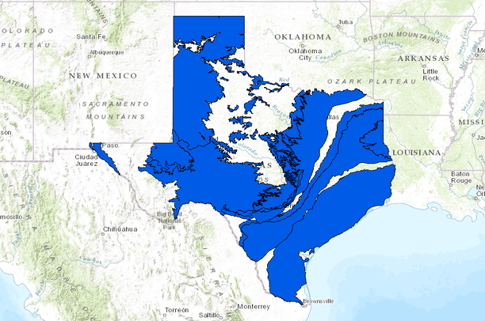
Let’s Tackle Texas Size Funding for Water Projects
Yuliana Porras-Mendoza
September 26, 2024

Slide 2
Funding in Texas is just as diverse as the water supplies of the state
Water in Texas
State Funding
Federal Funding
Strategic Funding

Slide 3
Water in Texas
State Funding
Federal Funding
Strategic Funding

Slide 4
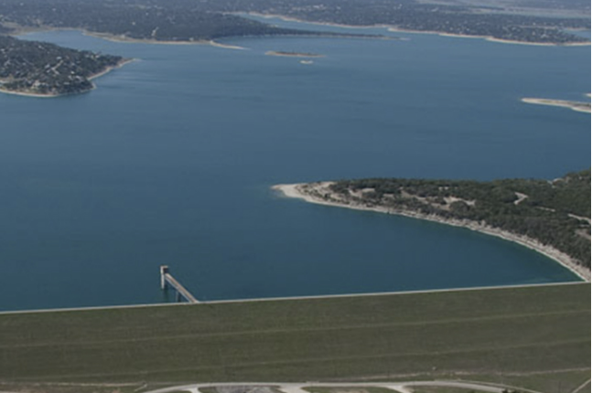
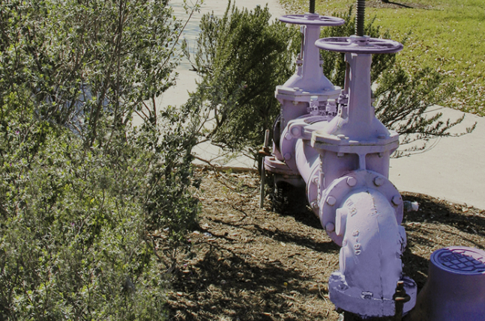
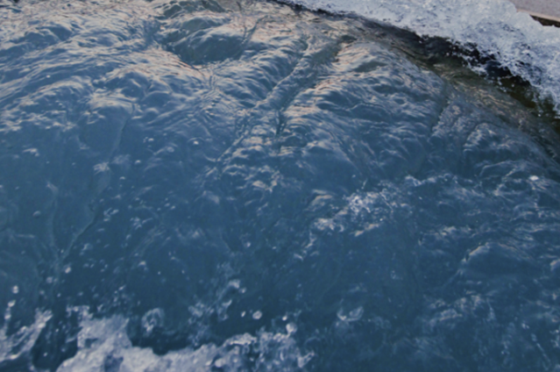
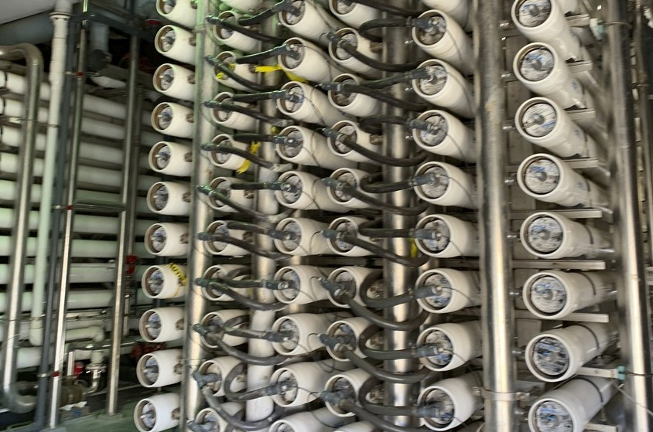
There are various water sources in Texas, the one used the most is surface water from rivers and reservoirs
Surface water
Recycled water
Groundwater
Seawater

Slide 5
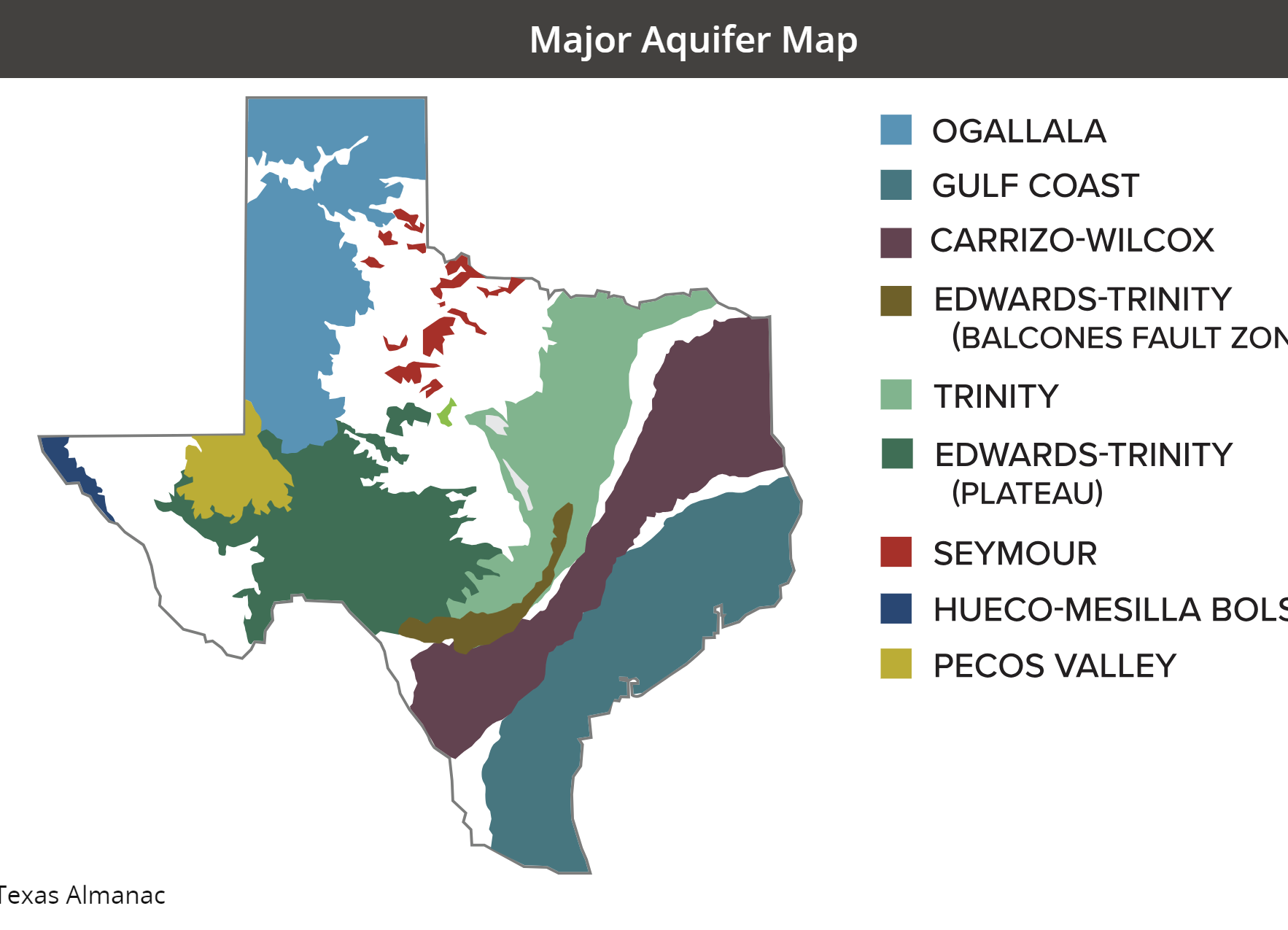
Nine major aquifers across the state

Slide 6
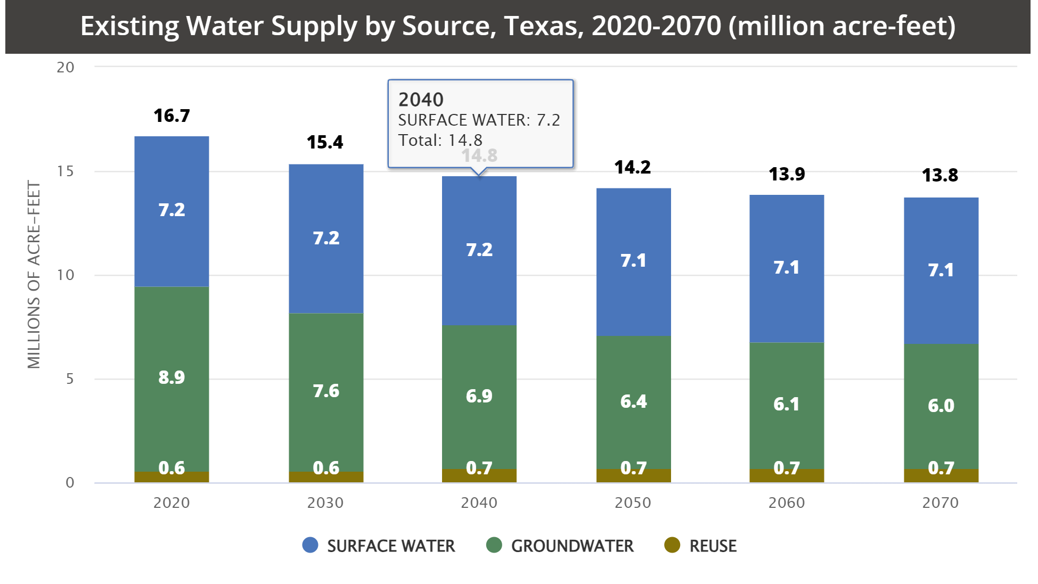

Slide 7




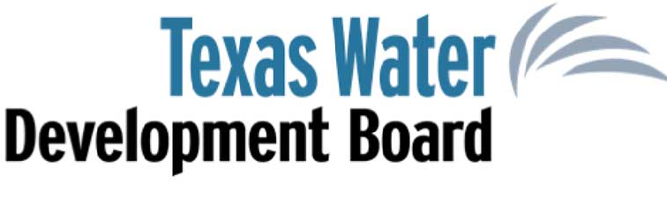
There are numerous entities that offer funding assistance
Federal:
United States Environmental Protection Agency (EPA)
United States Bureau of Reclamation (BOR)
United States Department of Agriculture (USDA)
State:
Texas Water Development Board (TWDB)
Texas Department of Agriculture (TDA)
Notes:
TDA – identify the affected persons by the projects then do income surveys
USBR – water conservation grant for Celina

Slide 8
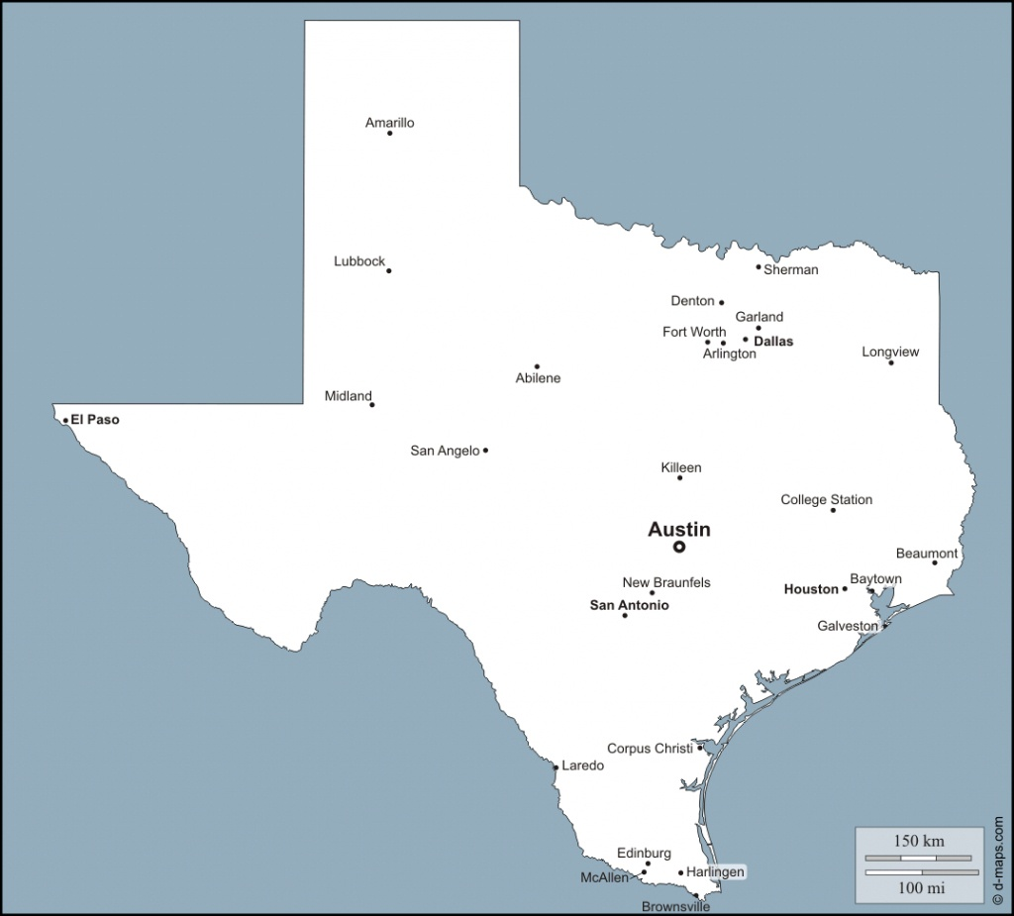
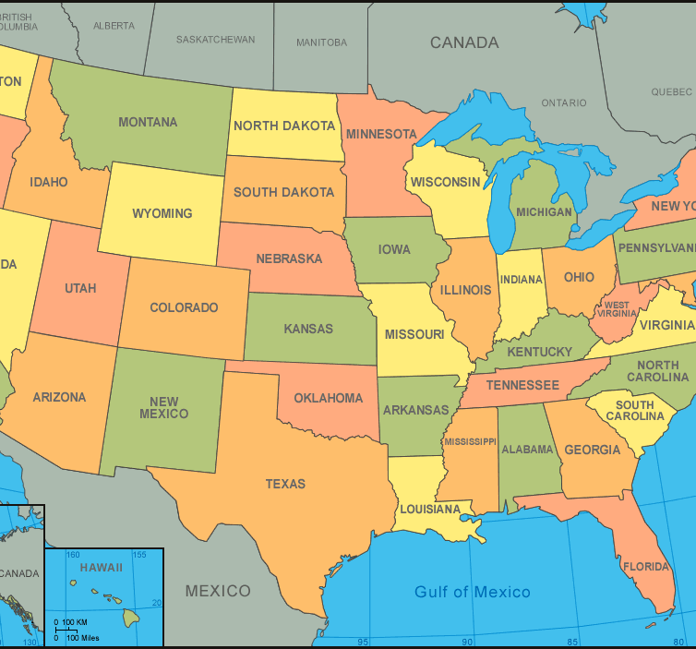
The programs that require non-Federal cost share, there are other funding programs that can be pursued
State Funding Programs
Federal Funding Programs
SWIFT
Texas Water Development Fund
Drinking Water State Revolving Fund
US Department of Agriculture
WIFIA
Notes:
SWIFT
Conservation and reuse
Desalinating groundwater and seawater
Building new pipelines
Developing reservoirs and wells fields
Purchasing water rights
TX Water Development Fund
Wells
Retail distribution and wholesale transmission lines
System acquisitions
Pumping facilities
Storage reservoirs and tanks
Water treatment plants
Purchase of water rights
DWSRF
Correcting water system deficiencies including water quality, capacity, pressure, and water loss
Upgrading or replacing water systems
Providing new or existing service to other water systems through consolidation projects
Purchasing capacity in water systems
Purchasing water systems
Implementing green projects
Implementing source water protection projects
ARPA
WIFIA

Slide 9
Water in Texas
State Funding
Federal Funding
Strategic Funding

Slide 10
The TWDB provides numerous financial assistance options
Agriculture Water Conservation Grants
Clean Water State Revolving Fund (CWSRF)
FEMA/Flood Protection
Rural Water Assistance Fund
State Water Implementation Fund for Texas (SWIFT)
Texas Water Development Fund (DFund)
Agriculture Water Conservation Loan
Drinking Water State Revolving Fund (DWSRF)
Groundwater Conservation District Loan
Economically Distressed Areas Program (EDAP)

Slide 11

The CWSRF and DWSRF programs allow for packaging of multiple projects in one loan
Streamlined communication with the applicable TWDB Regional Project Implementation Team
Single interest rate for all projects
Single loan closing
Required paperwork is consistent across projects
Notes:
Streamlined communication with the applicable TWDB Regional Project Implementation Team
Project Manager will be assigned upon submission of the application and will be the same for all projects
Garver has established strong working relationships with the TWDB’s various regional teams along with both the CWSRF and DWSRF Program Coordinators

Slide 12

The TWDB SRF review timeline is recurring, while DFund accepts applications year-round
Task | Dec | Jan | Feb | Mar | Apr | May | Jun | Jul | Aug
Project Solicitation
Rate and Rank Projects
TWDB Draft IUP
Public Comment
Final IUP Adopted by TWDB
December 1 – March 1
Submit PIFs within the December to March timeframe to be ranked for selection for principal forgiveness
Projects will be ranked and those included on the Initial Invited Projects List (IIPL) will be invited to submit a funding application
Multiple PIFs can be submitted at once
Notes:
IUP = Intended Use plan.
During our most recent application, we submitted 2 PIFs for the 2018 and 2019 funding cycles in case the 2018 was not selected.
We were notified that the 2018 PIFs were selected in June and were able to withdraw the 2019 PIFs after the loan application was approved.

Slide 13
Water in Texas
State Funding
Federal Funding
Strategic Funding

Slide 14
Each agency has various programs
US EPA WIFIA
US Department of Agriculture
3
4
Department of Defense
Bureau of Reclamation
Yuliana, please be sure to talk through ALL of the funding programs, and then mention #2 AND #4 specifically.
Notes:
Value Header: Your project satisfies the requirements for six Bureau of Reclamation grant programs.
Animation: I want to focus our time today on the the second one – the Desalination Construction Program.
Note from Yuliana:
We will focus on program #2 so not sure if we can highlight it a different color, add some animation to highlight we will focus on that one for their purposes and needs. I know the title is not a complete thought, what I am trying to list here is all programs I think they could pursue but only have time to focus on the one that they seemed more interested in at this time.

Slide 15



The WIFIA Program is offered nationwide and has a number of important program features
49%
Maximum portion of eligible project costs that WIFIA can fund
Interest rate will be ≥ to the U.S. Treasury rate of a similar maturity and will not be affected by borrower’s rating
$20 million
Minimum project size for large communities (≥25,000)
Interest accrual only upon drawdown
5 years
Maximum deferral period after substantial completion
Maximum loan maturity date of 35 years after substantial completion
Notes:
A single fixed interest rate is established at closing - A borrower may receive multiple disbursements over several years at the same fixed interest rate.
Treasury rate + 1 basis point
The rate is calculated using the weighted average life (WAL)
Interest rate is equal to the US Treasury rate of a similar maturity - The WIFIA program sets its interest rate based on the U.S. Treasury rate on the date of loan closing. The rate is calculated using the weighted average (WAL) life of the loan rather than the loan maturity date. The WAL is generally shorter than the loan’s actual length resulting in a lower interest rate.
Interest rate is not impacted by the borrower’s credit or loan structure - All borrowers benefit from the AAA Treasury rate, regardless of whether they are rated AA or BBB. The WIFIA program does not charge a higher rate for flexible financial terms.
Customized repayment schedules - Borrowers can customize their repayments to match their anticipated revenues and expenses for the life of the loan. This flexibility provides borrowers with the time they may need to phase in rate increases to generate revenue to repay the loan. This includes deferrals that are allowed during periods of high capital spending.
Flexibility to “sculpt” the repayment schedule to reduce burden on ratepayers; in other words, scaling up repayments over time to allow for small and steady rate increases to accommodate capital expenditures and debt service payments
Long repayment period - WIFIA loans may have a length of up to 35 years after substantial completion, allowing payment amounts to be smaller throughout the life of the loan.
Deferred payment - Payments may be deferred up to 5 years after the project’s substantial completion.
Subordination - Under certain circumstances, WIFIA may take a subordinate position in payment priority, increasing coverage ratios for senior bond holders.
AKA – Preservation of borrowers’ senior debt capacity – i.e., permitting borrowers to issue future non-WIFIA project-related debt at lower interest rates and more favorable terms
WIFIA loans can be combined with various funding sources - WIFIA loans can be combined with private equity, revenue bonds, corporate debt, grants, and State Revolving Fund (SRF) loans.

Slide 16






The WIFIA Program is offered nationwide and has a number of important program features
Can be combined with tax-exempt bonds, private equity, or SRFs
Customized repayment schedules
Credit processing fee that is not a percentage of the total loan
Can be subservient to other loans
You can match your funding to your debt service
NEPA, Davis-Bacon, American Iron and Steel*, and all federal cross-cutter provisions apply
*Any WIFIA projects that initiated project design planning prior to May 14, 2022, are exempt from Build America, Buy America (BABA) requirements
Notes:
Credit processing fee = $100,000-$300,000 per applicant (not a percentage of total loan)
A single fixed interest rate is established at closing - A borrower may receive multiple disbursements over several years at the same fixed interest rate.
Interest rate is equal to the US Treasury rate of a similar maturity - The WIFIA program sets its interest rate based on the U.S. Treasury rate on the date of loan closing. The rate is calculated using the weighted average (WAL) life of the loan rather than the loan maturity date. The WAL is generally shorter than the loan’s actual length resulting in a lower interest rate.
Interest rate is not impacted by the borrower’s credit or loan structure - All borrowers benefit from the AAA Treasury rate, regardless of whether they are rated AA or BBB. The WIFIA program does not charge a higher rate for flexible financial terms.
Customized repayment schedules - Borrowers can customize their repayments to match their anticipated revenues and expenses for the life of the loan. This flexibility provides borrowers with the time they may need to phase in rate increases to generate revenue to repay the loan. This includes deferrals that are allowed during periods of high capital spending.
Flexibility to “sculpt” the repayment schedule to reduce burden on ratepayers; in other words, scaling up repayments over time to allow for small and steady rate increases to accommodate capital expenditures and debt service payments
Long repayment period - WIFIA loans may have a length of up to 35 years after substantial completion, allowing payment amounts to be smaller throughout the life of the loan.
Deferred payment - Payments may be deferred up to 5 years after the project’s substantial completion.
Subordination - Under certain circumstances, WIFIA may take a subordinate position in payment priority, increasing coverage ratios for senior bond holders.
AKA – Preservation of borrowers’ senior debt capacity – i.e., permitting borrowers to issue future non-WIFIA project-related debt at lower interest rates and more favorable terms
WIFIA loans can be combined with various funding sources - WIFIA loans can be combined with private equity, revenue bonds, corporate debt, grants, and State Revolving Fund (SRF) loans.

Slide 17
The WIFIA application process can typically be completed on average in 12 months and as soon as 6 months in some scenarios
1. Pre-Application
2. Application Submission
3. Application Evaluation
4. Negotiations
5. Approval
6. Closing
7. Post-Closing
Up to 1 year
1-3 months
2-6 months
1-3 months
Life of Loan
Average Time = 6 months
Applying during the FY 2024 funding cycle could enable funding to be received as early as Summer 2025
Letter of Interest (LOIs) are accepted on a rolling basis until all funds are expended
Notes:
WIFIA allows applicants up to one year to submit an application after project selection

Slide 18
Key Bureau of Reclamation Programs
Desalination and Water Purification Research Program
Water and Energy Efficiency Grant Program
Drought Contingency Program
4
Title XVI Water Recycling
Desalination Construction
Water Strategy Programs
Yuliana, please be sure to talk through ALL of the funding programs, and then mention #2 AND #4 specifically.
Notes:
Value Header: Your project satisfies the requirements for six Bureau of Reclamation grant programs.
Animation: I want to focus our time today on the the second one – the Desalination Construction Program.
Note from Yuliana:
We will focus on program #2 so not sure if we can highlight it a different color, add some animation to highlight we will focus on that one for their purposes and needs. I know the title is not a complete thought, what I am trying to list here is all programs I think they could pursue but only have time to focus on the one that they seemed more interested in at this time.

Slide 19
Pipeline of funding across Bureau of Reclamation programs
Research
Planning
Design
Construction

Slide 20
Research Funding
Desalination and Water Purification Research Program
Water and Energy Efficiency Grant Program
Drought Contingency Program
4
Title XVI Water Recycling
Desalination Construction
Water Strategy Programs
Yuliana, please be sure to talk through ALL of the funding programs, and then mention #2 AND #4 specifically.
Notes:
Value Header: Your project satisfies the requirements for six Bureau of Reclamation grant programs.
Animation: I want to focus our time today on the the second one – the Desalination Construction Program.
Note from Yuliana:
We will focus on program #2 so not sure if we can highlight it a different color, add some animation to highlight we will focus on that one for their purposes and needs. I know the title is not a complete thought, what I am trying to list here is all programs I think they could pursue but only have time to focus on the one that they seemed more interested in at this time.

Slide 21
Planning Funding
Desalination and Water Purification Research Program
Water and Energy Efficiency Grant Program
Drought Contingency Program
4
Title XVI Water Recycling
Desalination Construction
Water Strategy Programs
Yuliana, please be sure to talk through ALL of the funding programs, and then mention #2 AND #4 specifically.
Notes:
Value Header: Your project satisfies the requirements for six Bureau of Reclamation grant programs.
Animation: I want to focus our time today on the the second one – the Desalination Construction Program.
Note from Yuliana:
We will focus on program #2 so not sure if we can highlight it a different color, add some animation to highlight we will focus on that one for their purposes and needs. I know the title is not a complete thought, what I am trying to list here is all programs I think they could pursue but only have time to focus on the one that they seemed more interested in at this time.

Slide 22
Design Funding
Desalination and Water Purification Research Program
Water and Energy Efficiency Grant Program
Drought Contingency Program
4
Title XVI Water Recycling
Desalination Construction
Water Strategy Programs
Yuliana, please be sure to talk through ALL of the funding programs, and then mention #2 AND #4 specifically.
Notes:
Value Header: Your project satisfies the requirements for six Bureau of Reclamation grant programs.
Animation: I want to focus our time today on the the second one – the Desalination Construction Program.
Note from Yuliana:
We will focus on program #2 so not sure if we can highlight it a different color, add some animation to highlight we will focus on that one for their purposes and needs. I know the title is not a complete thought, what I am trying to list here is all programs I think they could pursue but only have time to focus on the one that they seemed more interested in at this time.

Slide 23
Construction Funding
Desalination and Water Purification Research Program
Water and Energy Efficiency Grant Program
Drought Contingency Program
4
Title XVI Water Recycling
Desalination Construction
Water Strategy Programs
Yuliana, please be sure to talk through ALL of the funding programs, and then mention #2 AND #4 specifically.
Notes:
Value Header: Your project satisfies the requirements for six Bureau of Reclamation grant programs.
Animation: I want to focus our time today on the the second one – the Desalination Construction Program.
Note from Yuliana:
We will focus on program #2 so not sure if we can highlight it a different color, add some animation to highlight we will focus on that one for their purposes and needs. I know the title is not a complete thought, what I am trying to list here is all programs I think they could pursue but only have time to focus on the one that they seemed more interested in at this time.

Slide 24
The Federal application process can typically be completed on average in 12 months and as soon as 9 months in some scenarios
1. Pre-Application
2. Application Preparation
3. Application Submittal
4. Application Evaluation
5. Notice of Selection
6. Agreement Process
7. Start work
Up to 1 year
1-2 months
3-6 months
3-6 months
Term of Grant
Average Time = 6 months

Slide 25
Water in Texas
State Funding
Federal Funding
Strategic Funding

Slide 26
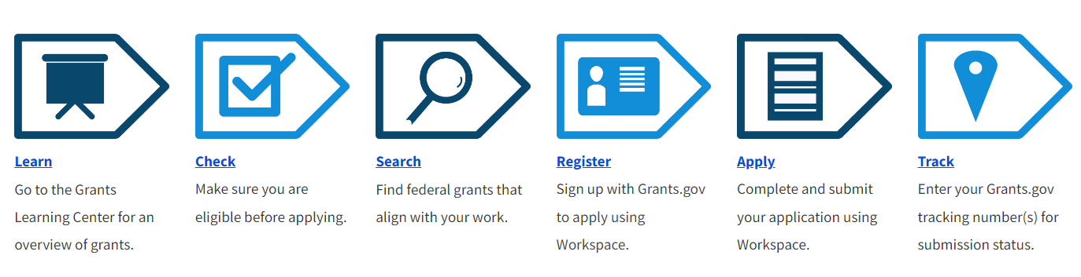







The process to apply for and obtain federal funding can be daunting.
Register
Register with Sam.gov. This may take >30 days to receive approval.
Learn
Explore the Grants Learning Center for an overview of grants.
Check
Check your eligibility before applying.
Search
Find federal grants that’ll work for you.
Register
Sign up with Grants.gov to apply.
Apply
Complete and submit your application.
Track
Use your tracking number for submission status.
Manage
Continue to manage your grant and close the agreement once work is complete.

Slide 27
With all the various programs, identifying what programs to apply is key to developing a good funding strategy
Registered entity with the Federal Government
When awarded, create an administrative process for the grant
Identify the program that best fits needs, budget, and timeline
Look for future opportunities and programs to plan appropriately

Slide 28
Just as cities are diversifying their water sources, funding needs to be diversified to successfully implement water projects.

Slide 29
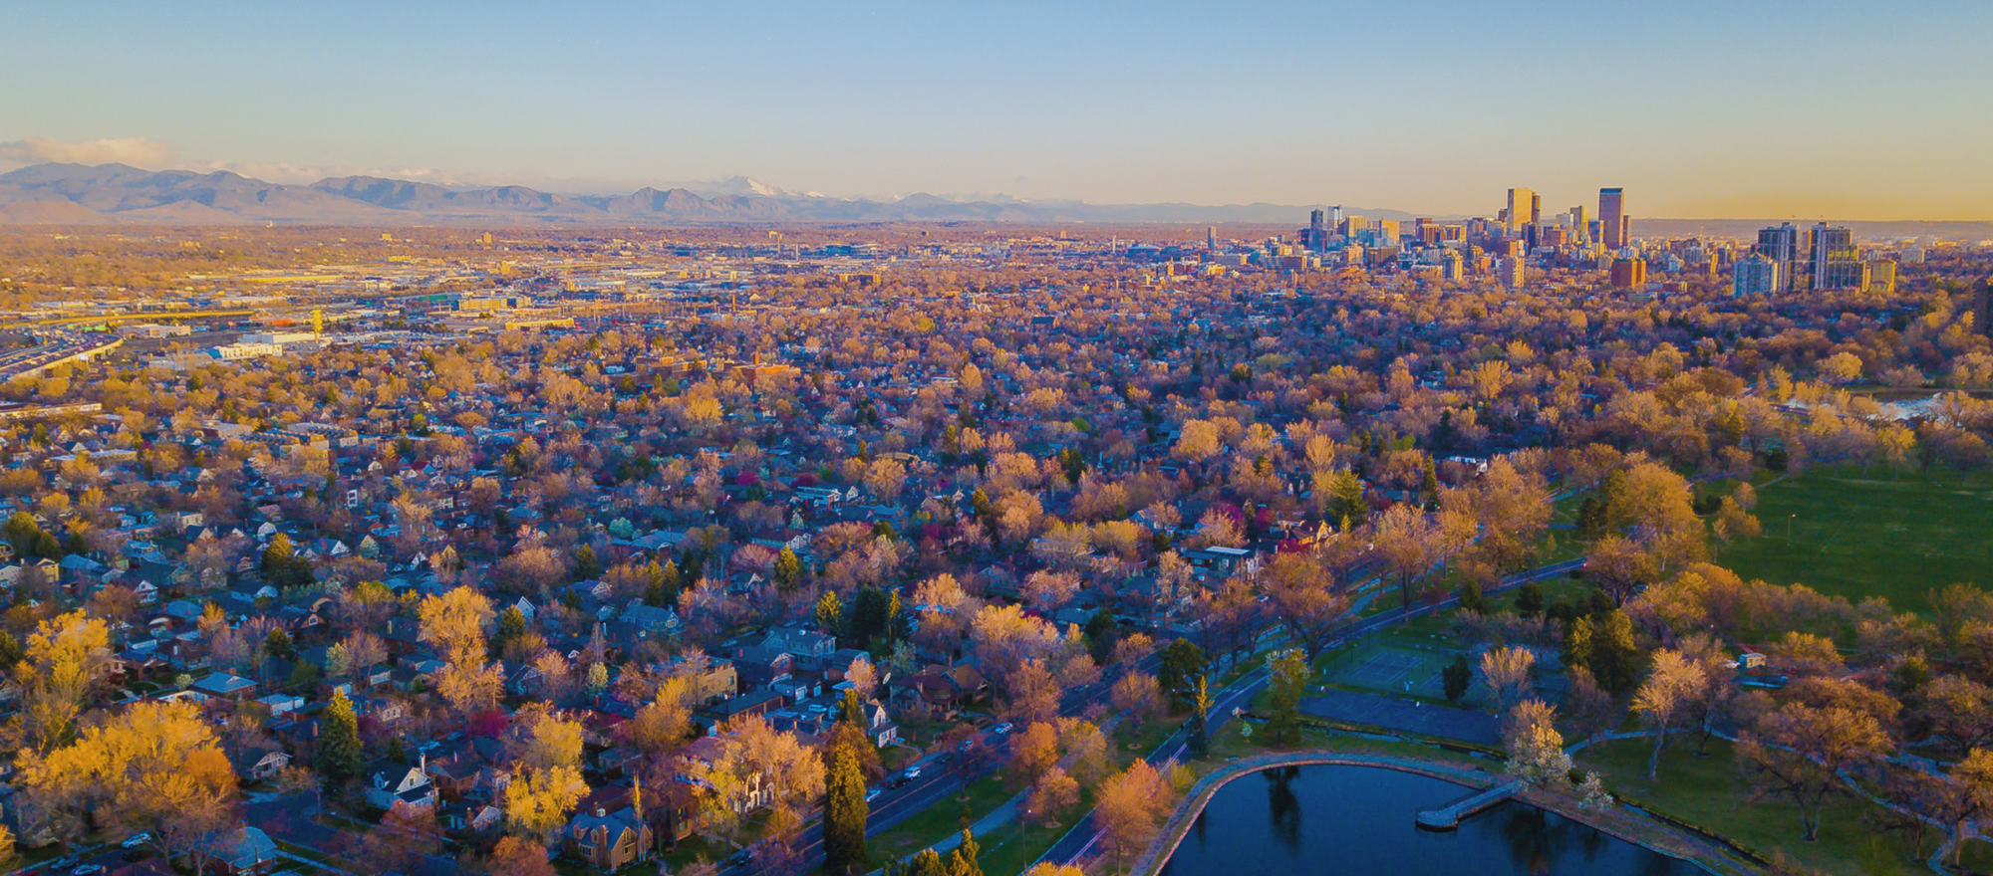
Questions?
Yuliana Porras-Mendoza
YEMendoza@GarverUSA.com

Slide 30
Both SRF programs offer potential principal forgiveness
EPA provides the TWDB with a capitalization grant each fiscal year
TWDB allocates additional funding to be awarded from other sources, including principal forgiveness
Disadvantaged communities (equivalency only)
Small/rural disadvantaged
(equivalency only)
Subsidized green projects
(equivalency or non-equivalency)
Emergency relief projects
(non-equivalency)
Increasingly competitive process
Notes:
Other sources of funds for TWDB include state match, principal and interest repayments from financial assistance, investment earnings, additional cash resources, and, if demand warrants, the net proceeds from bond issues
Disadvantaged communities
AMHI < 75% state AMHI
Small community < 10,000
Using the U.S. Bureau of the Census definitions of a rural area, not more than 20 percent of the residential service connections are in urbanized areas and not more than 50 percent are in urban clusters according to the most recent data available to TWDB.

Slide 31
The majority of the BIL/IIJA funding will be funneled through the SRF Programs
Funding Category | 2022 Texas Allocation | 2023 Texas Allocation | Total Nationwide Allocation through 2026 | Mandated Additional Subsidy
CWSRF Supplemental | $81,347,000 | $95,270,000 | $11,713,000,000 | 49%
DWSRF Supplemental | $140,993,000 | $167,867,000 | $11,713,000,000 | 49%
CWSRF Emerging Contaminants | $4,274,000 | TBD | $1,000,000,000 | 100%
DWSRF Emerging Contaminants | $59,202,000 | TBD | $4,000,000,000 | 100%
DWSRF Lead Service Line Replacement | $222,155,000 | TBD | $15,000,000,000 | 49%

Slide 32
The DFund is a year-round program with a flexible structure and fewer requirements
Eligible Projects
Program Requirements and Benefits
Water supply
Conservation
Water quality enhancement
Flood control
Wastewater
Notes:
Does not receive federal subsidies, so is not subject to most federal crosscutters
Enables the Board to fund multiple eligible components in one loan to borrowers (CAN COMBINE WATER + WASTEWATER PROJECTS INTO ONE LOAN)
Dfund = Texas Water Development Fund

Slide 33
The DFund is a year-round program with a flexible structure and fewer requirements
Eligible Projects
Program Requirements and Benefits
Required adoption of a Water Conservation and Drought Contingency Plan (› $500,000 assistance)
U.S. Iron and Steel Requirements
No maximum funding limits
Long-term fixed interest rates based on the TWDB’s cost of funds sold with the State’s General Obligation AAA rating
Generally, 20 to 30-year repayment terms; maximum of 50 years constitutionally
Multi-year commitments and access to loan funding year-round
State-level environmental review

Slide 34
CWSRF funds can be used for the planning, design, acquisition, and construction of wastewater projects
Eligible Projects
Program Requirements and Benefits
Wastewater treatment facilities
Wastewater recycling and reuse facilities
Nonpotable reuse
Existing wastewater facilities
Stormwater control
Nonpoint source pollution control projects
Wastewater collection systems

Slide 35
CWSRF funds can be used for the planning, design, acquisition, and construction of wastewater projects
Eligible Projects
Program Requirements and Benefits
Required adoption of a Water Conservation and Drought Contingency Plan (› $500,000 assistance)
Davis-Bacon wage requirements, American Iron and Steel, NEPA-type environmental review
DBE Program and additional procurement requirements
Loan origination fee (1.75% for SFY 2024 IUP)
Potential principal forgiveness
Below-market fixed interest rates
Up to 30-year repayment period and access to year-round funding
Notes:
CWSRF interest rate subsidies in the form of basis point reductions from market rate
Equivalency – 165 basis points off
Non-equivalency – 130 basis points off
SUBJECT TO MINIMUM INTEREST RATE

Slide 36
DWSRF funds can be used for the planning, design, acquisition, and construction of water projects
Eligible Projects
Program Requirements and Benefits
Correct water system deficiencies
Upgrade or replace water systems
Purchase capacity
Consolidate or purchase other systems
Implement green projects
Implement source water protection projects

Slide 37
DWSRF funds can be used for the planning, design, acquisition, and construction of water projects
Eligible Projects
Program Requirements and Benefits
Required adoption of a Water Conservation and Drought Contingency Plan (› $500,000 assistance)
Davis-Bacon wage requirements, American Iron and Steel, NEPA-type environmental review
DBE Program
Potential principal forgiveness
Below-market fixed interest rates
Up to 30-year repayment period and access to year-round funding
Loan origination fee (2.0% for SFY 2021 IUP)
Notes:
DWSRF interest rate subsidies in the form of basis point reductions from market rate
Equivalency – 155 basis points off
Non-equivalency – 120 basis points off
SUBJECT TO MINIMUM INTEREST RATE
Interest rates are subject to the term of the loan and the borrower’s underlying credit rating + basis points off from program chosen

Slide 38
The SWIFT Program funds projects included within the most recently approved Regional or State Water Plan
Eligible Projects
Program Requirements and Benefits
Completion of an Infrastructure Financing Survey
Required adoption of a Water Conservation and Drought Contingency Plan (› $500,000 assistance)
U.S. Iron and Steel requirements
Historically Underutilized Business (HUB) reporting
Fixed interest rates offered at below-market rate
Flexible financing structures (up to 30-year repayment period, no maximum funding limit)
Up to twice-a-year funding cycle
State-level environmental review
Deferral of loan repayments
Notes:
For the 2021 funding cycle, any political subdivision or nonprofit water supply corporation with a project included in the approved 2021 Regional Water Plan for their region is eligible. To qualify for a funding commitment the project will also need to appear as a recommended strategy in the 2022 State Water Plan, which is scheduled for adoption before SWIFT commitments are issued.
Interest rates are based on the TWDB’s cost of funds, which reflects the program’s AAA credit rating
This interest rate is further reduced by a subsidy established by the Board for each funding cycle
The TWDB anticipates selling bonds for each round of funding through the SWIFT program.
Includes a prioritization Process per application period

Slide 39
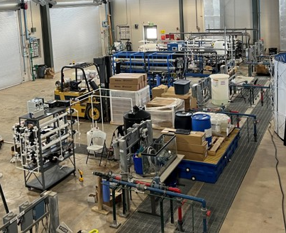
Desalination and Water Purification Research Program
Pitch to Pilot Projects
Research Projects
Pilot Projects
Projects to pilot innovative treatment technologies and/or processes
Two phase application process
Projects to treat any water source for any water use at the bench scale
Removal of contaminants
Energy efficiency
Reduce cost of treatment
Water supply augmentation
Projects to treat any water source for any water use at the pilot or demonstration scale
Removal of contaminants
Energy efficiency
Reduce cost of treatment
Water supply augmentation

Slide 40
Key elements of the Desalination and Water Purification Research Program
Request up to $300,000 for Project Type 1
No cost share required but encouraged
Request up to $250k for Project Type 2;
Request up to $800k for Project Type 3
Currently open, it closes November 13, 2024
Water districts, states, and municipalities
Funding available Summer 2025
Notes:
Water Strategy Grants
- projects to conduct planning to support water supply and management solutions (e.g., domestic water supply projects for disadvantaged communities, water marketing, water conservation, drought resilience, and ecological resilience) (see Section C.4.1 – Water Strategy Grants)
Project Design Grants
- projects to conduct project-specific design for projects to improve water management or water supplies (see Section C.4.2)
Drought Contingency Plan
- proposals to develop a new or update an existing Drought Contingency Plan (see Section C.4.3)
- 50% cost share

Slide 41
Water and Energy Efficiency Grant Program
Water Conservation Projects
Water Conservation Projects Cont’d
Renewable Energy Projects
Resulting in quantifiable and sustained water savings or improved water management
Canal Lining/Piping
Municipal Metering
Irrigation Flow Measurement
SCADA installation
Landscape Irrigation Measures (removing turf, installing smart irrigation controllers)
  Via rebates or direct-install programs
High-efficiency Indoor Appliances and Fixtures
Commercial Cooling Systems
Installing solar-electric, wind energy, or geothermal power systems
Replacing fossil fuel powered pumps with renewable energy-based pumps

Slide 42
Key elements of the Water and Energy Efficiency Grant Program
Request between $500k and $5M
Work needs to be completed within 2 to 3 years
50% non-Federal cost share
Funding opportunity closes October 30, 2024
Water districts, states, and municipalities
Funding available October 2025
Notes:
Water Strategy Grants
- projects to conduct planning to support water supply and management solutions (e.g., domestic water supply projects for disadvantaged communities, water marketing, water conservation, drought resilience, and ecological resilience) (see Section C.4.1 – Water Strategy Grants)
Project Design Grants
- projects to conduct project-specific design for projects to improve water management or water supplies (see Section C.4.2)
Drought Contingency Plan
- proposals to develop a new or update an existing Drought Contingency Plan (see Section C.4.3)
- 50% cost share

Slide 43
Drought Contingency Grant Program
Drought Resiliency Task A
Drought Resiliency Task B
Drought Resiliency Task C
Increasing the reliability of water supplies through infrastructure improvements
System modifications or improvements
Storing water and/or recharging groundwater supplies
Developing alternative sources of water supply including water treatment
Increasing the reliability of water supplies through groundwater recovery
Constructing wells to provide back-up water supplies during times of drought
Constructing extraction wells at groundwater banks or other recharge areas to improve extraction/return capabilities
Projects to improve water management through decision support tools, modeling and measurement
Develop online decision support tools
Develop new models or improving existing models
Develop water budgets and tiered pricing programs

Slide 44
Key elements of the Drought Response Program
Tasks A-C: Requests from $500k to $5M
Task D: Up to $10M
Water districts, states, and municipalities
Cost Share
Tasks A-C: 50% non-Federal
Funding opportunity potentially opens Fall/Winter 2024
Cost Share
Task D: 5% non-Federal, may request waiver for 0%
Funding available Spring/Summer 2025
Notes:
Cost share for Task D
Waiver requirements
Overwhelming federal interest
Financial hardship
Population-weighted median household income and average unemployment rate within the study area and the state based on the latest available data from the US Census Bureau’s American Community Survey
Family poverty level for the state as estimated by guidelines published annually by the US Department of Health and Human Services
A current financial statement of the applicant and a statement that the applicant does not possess sufficient funds or assets to pay for all or part of the required cost share

Slide 45
Title XVI Water Recycling & Reuse Program
Projects eligibility
Requirements
Project tasks covered
Projects must not be focused on removing salinity only
Must have a completed feasibility study submitted to the Bureau of Reclamation
WTR11-01 guidance
Water Reclamation and Reuse Facilities
Planning
Design
Construction

Slide 46
Key elements of the Title XVI Water Recycling & Reuse Program
Request up to $30M
Feasibility Study
75% non-Federal cost share
Funding opportunity closes September 30, 2024
Water districts, states, and municipalities
Funding available Fall 2025
Notes:
Cost Sharing Requirements
Water Strategy and Project Design with ecological benefits can cost share 25/75
Planning or Design of projects the purpose of which is to provide domestic water supplies to disadvantaged communities may be eligible for 0% cost share
Every other project is 50%
Water Strategy Grants
- projects to conduct planning to support water supply and management solutions (e.g., domestic water supply projects for disadvantaged communities, water marketing, water conservation, drought resilience, and ecological resilience) (see Section C.4.1 – Water Strategy Grants)
Project Design Grants
- projects to conduct project-specific design for projects to improve water management or water supplies (see Section C.4.2)
Drought Contingency Plan
- proposals to develop a new or update an existing Drought Contingency Plan (see Section C.4.3)
- 50% cost share

Slide 47
Desalination Construction Program
Projects eligibility
Requirements
Project tasks covered
Project must be constructed, operated, and maintained by an eligible applicant
Project must be included in a state-approved plan
Must have a completed feasibility study submitted to the Bureau of Reclamation
WTR11-01 guidance
Seawater and Brackish Groundwater
Planning
Design
Construction

Slide 48
Key elements of Desalination Construction Program
Request up to $30M
Feasibility Study
75% non-Federal cost share
Funding opportunity closes September 30, 2024
Water districts, states, and municipalities
Funding available Fall 2025
Notes:
Cost Sharing Requirements
Water Strategy and Project Design with ecological benefits can cost share 25/75
Planning or Design of projects the purpose of which is to provide domestic water supplies to disadvantaged communities may be eligible for 0% cost share
Every other project is 50%
Water Strategy Grants
- projects to conduct planning to support water supply and management solutions (e.g., domestic water supply projects for disadvantaged communities, water marketing, water conservation, drought resilience, and ecological resilience) (see Section C.4.1 – Water Strategy Grants)
Project Design Grants
- projects to conduct project-specific design for projects to improve water management or water supplies (see Section C.4.2)
Drought Contingency Plan
- proposals to develop a new or update an existing Drought Contingency Plan (see Section C.4.3)
- 50% cost share

Slide 49
Planning and Project Design Grant Program
Water Strategy Grants
Project Design
Drought Contingency Planning
Develop a strategy document for water supply, water marketing, water management, and/or restoration activities
Outreach and Partnership Building
Analyses, Scoping and Planning Activities
Development of a Water Strategy Document
Final design of medium and large-scale on the ground water supply construction projects
Development of project requirements and evaluation of design alternatives
Selection of project site
Preparation of final design, up to 60%
New or update a Drought Contingency Plan
Phase I; establish a task force and develop a detailed work plan
Phase II; complete the six required elements

Slide 50
Key elements of the Planning and Project Design Program
Request up to $400k
Project Design projects should be of $250k or more total cost
0%, 25%, and 50% non-Federal cost share
Funding opportunity potentially opens Fall/Winter 2024
Water districts, states, and municipalities
Funding available Spring/Summer 2025
Notes:
Cost Sharing Requirements
Water Strategy and Project Design with ecological benefits can cost share 25/75
Planning or Design of projects the purpose of which is to provide domestic water supplies to disadvantaged communities may be eligible for 0% cost share
Every other project is 50%
Water Strategy Grants
- projects to conduct planning to support water supply and management solutions (e.g., domestic water supply projects for disadvantaged communities, water marketing, water conservation, drought resilience, and ecological resilience) (see Section C.4.1 – Water Strategy Grants)
Project Design Grants
- projects to conduct project-specific design for projects to improve water management or water supplies (see Section C.4.2)
Drought Contingency Plan
- proposals to develop a new or update an existing Drought Contingency Plan (see Section C.4.3)
- 50% cost share

Slide 51
Water Recycling and Desalination Planning Program
Objectives
Project Design
Drought Contingency Planning
The development of new water recycling & desalination feasibility studies
Planning & preliminary design activities for water recycling or desalination construction projects
Environmental compliance activities for water recycling or desalination construction projects
Final design of medium and large-scale on the ground water supply construction projects
Development of project requirements and evaluation of design alternatives
Selection of project site
Preparation of final design, up to 60%
New or update a Drought Contingency Plan
Phase I; establish a task force and develop a detailed work plan
Phase II; complete the six required elements

Slide 52
Key elements of the Water Recycling and Desalination Planning Program
Funding Group 1: Request up to $1M - $5M
Funding Group 2: Request up to $5M
Non-Federal cost share
Group 1: 50%
Group 2: 75%
Funding opportunity potentially opens Winter 2025
Water districts, states, and municipalities
Funding available Fall 2025
Notes:
Cost Sharing Requirements
Water Strategy and Project Design with ecological benefits can cost share 25/75
Planning or Design of projects the purpose of which is to provide domestic water supplies to disadvantaged communities may be eligible for 0% cost share
Every other project is 50%
Water Strategy Grants
- projects to conduct planning to support water supply and management solutions (e.g., domestic water supply projects for disadvantaged communities, water marketing, water conservation, drought resilience, and ecological resilience) (see Section C.4.1 – Water Strategy Grants)
Project Design Grants
- projects to conduct project-specific design for projects to improve water management or water supplies (see Section C.4.2)
Drought Contingency Plan
- proposals to develop a new or update an existing Drought Contingency Plan (see Section C.4.3)
- 50% cost share

Slide 53
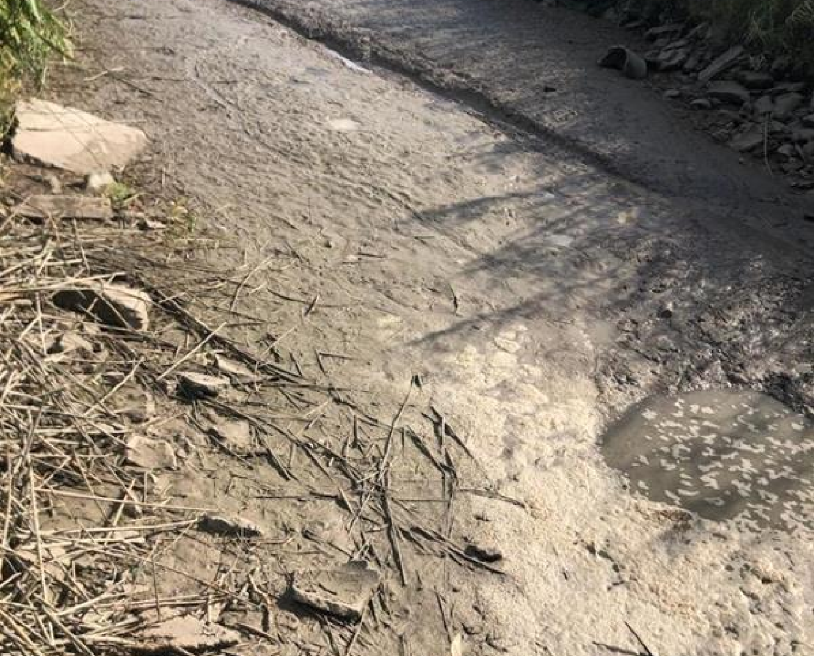
City of Santa Rosa received $9.5M in funding to address their need of domestic water supply
Drought Resiliency Improvements
1 million gallon ground storage tank
0.5 million gallon elevated storage tank
Emergency interconnection with a neighboring water supplier
7-day raw water reservoir at their WTP
Notes:
2,873 residents

Slide 54
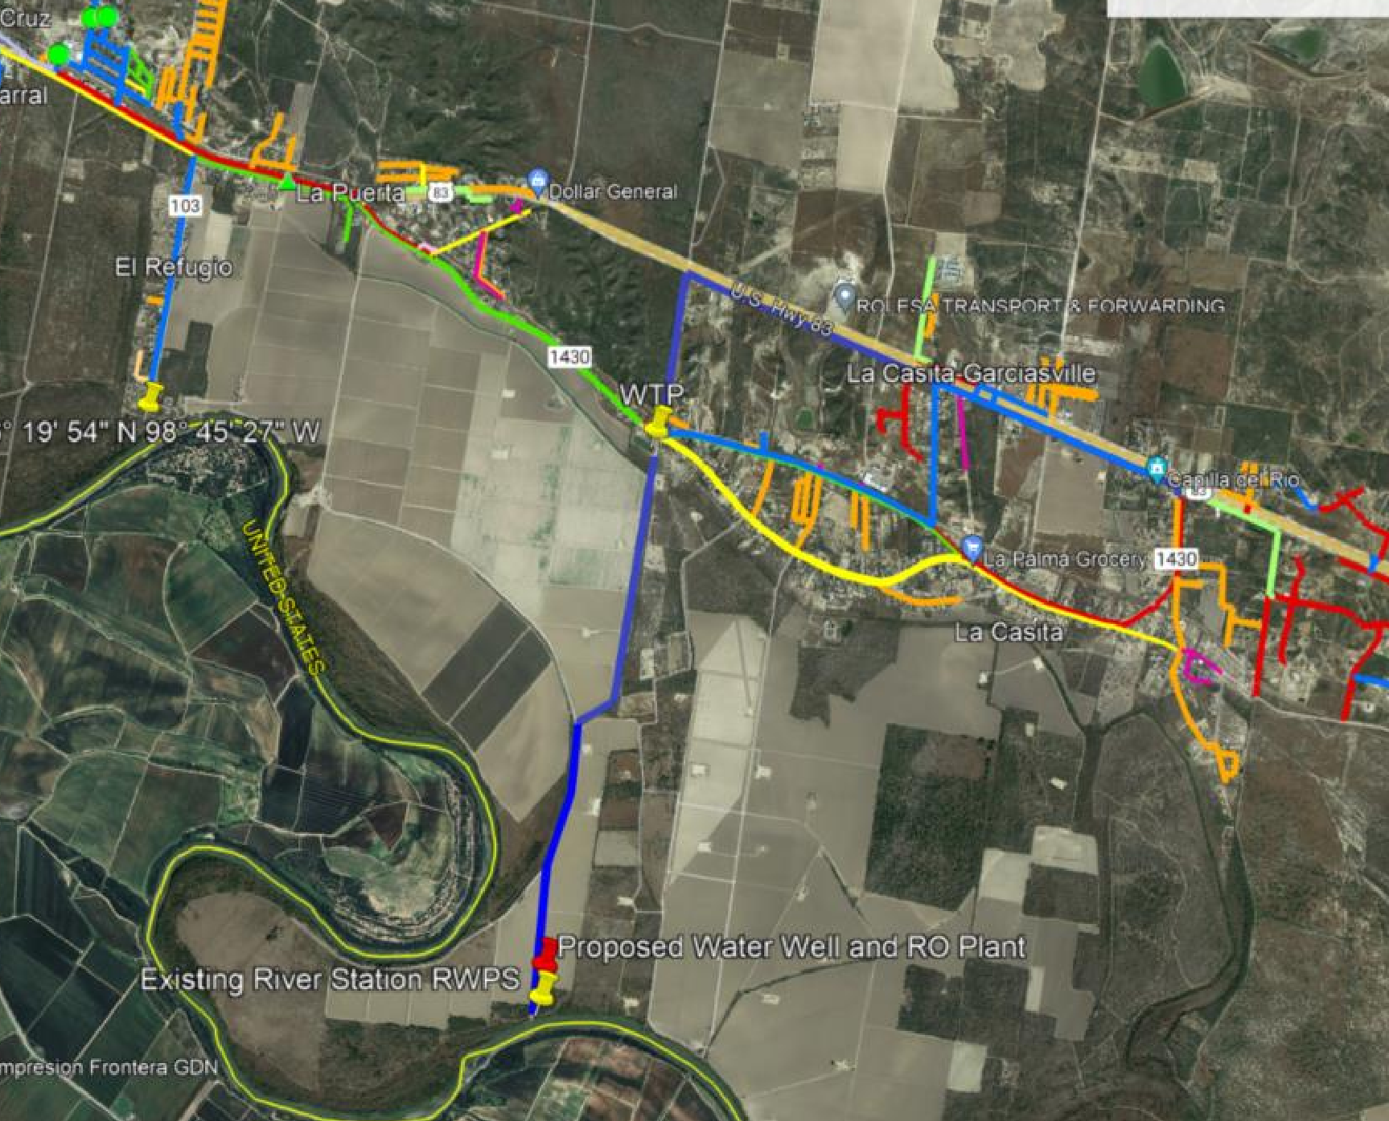
Union Water Supply Corporation received $9.4M in funding to address their need of domestic water supply
Drought Resiliency Improvements
Plan, design, and construct a groundwater well
Groundwater treatment plant
Notes:
6,909 residents

Slide 55
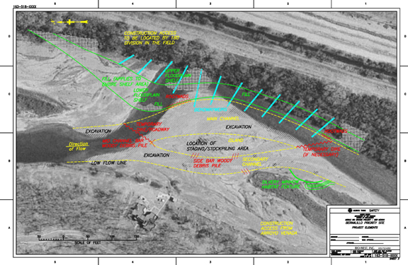
Applied Science Grants
Project Type 1
Project Type 2
Project Type 3
Projects to enhance modeling capabilities to improve water supply reliability and increase flexibility in water operations
Improve hydrologic models (groundwater)
Projects to improve or adapt forecasting tools and technologies to enhance management of water supplies
Develop or adapt forecasting tools to meet the needs of water managers
Adapt or improve existing forecasts to meet operational needs
Projects to improve access to and use of water resources data, or to develop new types of data to inform water management decisions
Improve data acquisition, data analysis and data delivery
Develop hydrologic databases or decision support tools

Slide 56
Key elements of the Applied Science Grants:
Request up to $400,000
Work must be completed within 2 years
50% Federal depending on the project type
Expect the funding opportunity will open summer 2024
Water districts, states, and municipalities in the western states
Funding available summer 2025
Notes:
Water Strategy Grants
- projects to conduct planning to support water supply and management solutions (e.g., domestic water supply projects for disadvantaged communities, water marketing, water conservation, drought resilience, and ecological resilience) (see Section C.4.1 – Water Strategy Grants)
Project Design Grants
- projects to conduct project-specific design for projects to improve water management or water supplies (see Section C.4.2)
Drought Contingency Plan
- proposals to develop a new or update an existing Drought Contingency Plan (see Section C.4.3)
- 50% cost share

Slide 57
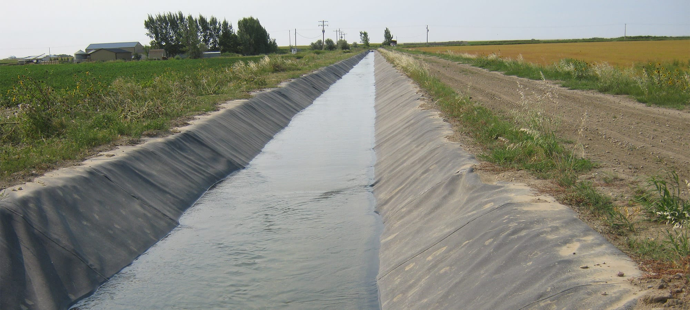
Small-Scale Water Efficiency Grant Program
Water Conservation Projects
Water Conservation Projects Cont’d
Renewable Energy Projects
Resulting in quantifiable and sustained water savings or improved water management
Canal Lining/Piping
Municipal Metering
Irrigation Flow Measurement
SCADA installation
Landscape Irrigation Measures (removing turf, installing smart irrigation controllers)
  Via rebates or direct-install programs
High-efficiency Indoor Appliances and Fixtures
Commercial Cooling Systems
Installing solar-electric, wind energy, or geothermal power systems
Replacing fossil fuel powered pups with renewable energy-based pumps

Slide 58
Key elements of the Small-Scale Water Efficiency Grant Program
Request up to $100k
Total project cost should be $225k or less
50% non-Federal cost share
Funding opportunity closes July 9, 2024
Water districts, states, and municipalities
Funding available March 2025
Notes:
Water Strategy Grants
- projects to conduct planning to support water supply and management solutions (e.g., domestic water supply projects for disadvantaged communities, water marketing, water conservation, drought resilience, and ecological resilience) (see Section C.4.1 – Water Strategy Grants)
Project Design Grants
- projects to conduct project-specific design for projects to improve water management or water supplies (see Section C.4.2)
Drought Contingency Plan
- proposals to develop a new or update an existing Drought Contingency Plan (see Section C.4.3)
- 50% cost share

Slide 59
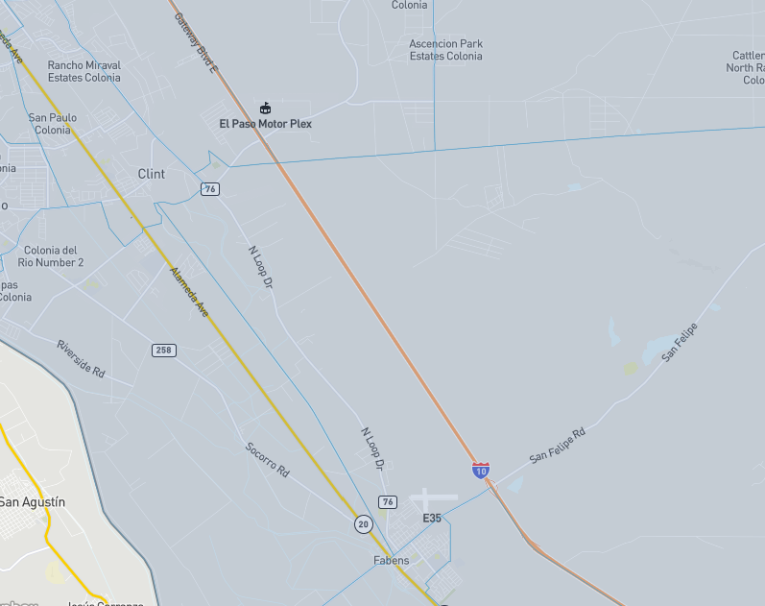
Drought Response Grant Program
Drought Resiliency Task D
Construction of domestic water supply projects for Tribes or disadvantaged communities that do not have reliable access to water supplies

Slide 60
However, the CWSRF has become increasingly competitive
Year | Funding Available | Maximum Funding Limit? | Number of PIFs Received | Number of Projects Invited
SFY 2020 | $525M | No | 102 | 57
SFY 2021 | $250M | Yes - $44M | 103 | 38
SFY 2022 | $250M | Yes - $44M | 130 | 21
SFY 2023 | $408M | No | 170 | 19
SFY 2024 | $460M | Yes - $59M | 159 | 28

Slide 61
Today we are going to focus on two options specific to funding wastewater projects
Agriculture Water Conservation Grants
Clean Water State Revolving Fund (CWSRF)
Economically Distressed Areas Program (EDAP)
FEMA/Flood Protection
Rural Water Assistance Fund
State Water Implementation Fund for Texas (SWIFT)
Texas Water Development Fund (DFund)
Agriculture Water Conservation Loan
Drinking Water State Revolving Fund (DWSRF)
Groundwater Conservation District Loan

Slide 62




Using an owner’s advisor helps alleviate the burden project funding puts directly on you.
Organization
Compliance
Experience
Notes:
Note from Yuliana:
I added three on here; organization, compliance, experience ( the points I am trying to make is that we need to stay on government schedule, comply with all requirements, and experience doing not only the applications but the work we are seeking funding for, somehow, I don’t want to just be a grant writer for them, want to be able to show we can do the work we are requesting funding for as well)

Slide 63

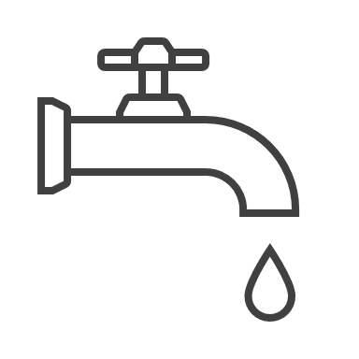


Over the last 10 years, we’ve completed:
250+
Wastewater Treatment
Plant Projects
220+
Water and Sewer Line
Projects
100+
Water Treatment Plant
Projects
50
Master Plan
Projects

Slide 64
Partnering with Garver means partnering with
A local team dedicated to helping you meet project funding goals
21 years of federal funding experience and creator of various funding programs
Experience in pursuing and securing funding and managing your federal/state agreements
Experience to execute and implement the project from beginning to end

