Slide 1
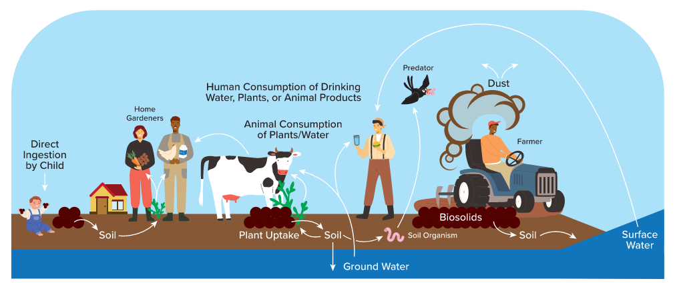
PFAS in Biosolids- What’s happening now?
February 28th, 2025
Laura Rodriguez-Gonzalez, PhD, ENV SP, PE
TACWA Meeting

Slide 2
This announcement comes on the heels of other PFAS regulatory developments
Final CERCLA designation for PFOA & PFOS
Draft Method for 40 PFAS in WW and biosolids (1633)
Proposed CERCLA designation for PFAS
Updated guidance on destroying and disposing of PFAS
Draft risk assessment for PFOS/PFOA in biosolids
Drinking water limits final
EPA Memo recommending NPDES permits require pretreatment and quarterly monitoring
Method 1633 Final
Draft human health ambient water quality criteria for PFAS
PFAS Strategic Roadmap
SUMMER
2021
FALL
2021
SPRING
2022
WINTER
2022
JAN.
2024
SPRING
2024
FALL
2024
JANUARY
2025
Notes:
PFAS Strategic Roadmap-announced risk assessment

Slide 3




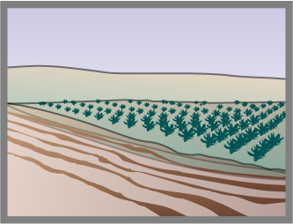



The draft risk assessment only evaluated a couple biosolids handling options
Governed under RCRA not CWA
Insufficient data
Land Application
Surface Disposal
Incineration
Landfill
Notes:
Check for updated version

Slide 4

A two-step approach was taken in this risk assessment
High End Deterministic Model
Assumed high starting concentrations for PFOA and PFOS
Assumed high consumption rates for every human exposure pathway
Found elevated risk for every exposure pathway
Central Tendency Deterministic Model
Assumed low starting concentrations for PFOA and PFOS
Assumed median exposure conditions
Found elevated risk for some exposure pathways
Monte Carlo Probabilistic Modeling
Would look at range of starting conditions and report the 95th percentile of risk distribution
NOT CONDUCTED because risk was already seen for median conditions

Slide 5
The model quantitatively analyzed land application and surface disposal while qualitatively analyzed incineration
Biosolids End Use | Application Rate | Number of Applications | Tilled? | Length of time person exposed to site | Conc. Of PFOA or PFOS
Land Application: Pasture | 10 DMT/ha | Once annually for 40 years | Not tilled (biosolids on top 2 cm of soil) | 10 years | 1 ppb
Land Application: Crop | 10 DMT/ha | Once annually for 40 years | Tilled (biosolids on top 20 cm of soil)
Reclamation: Pasture | 50 DMT/ha | One application only | Not tilled (biosolids on top 2 cm of soil)
Surface Disposal Site | Flow Rate of 4 x 10⁻⁶ m³/s | Disposal site operating for 50 years | NA
Notes:
DMT- dry metric ton per hectare

Slide 6
[these values were selected because they] represent a concentration that is lower than most sewage sludge generated in the U.S., including sewage sludge that represents only domestic sources…[and it’s] near the reporting limits expected in most major laboratories using EPA Method 1633 on sewage sludge”
A note about 1 ppb
EPA DRAFT RISK ASSESSMENT
Notes:
Why was the 1 ppb chosen?

Slide 7
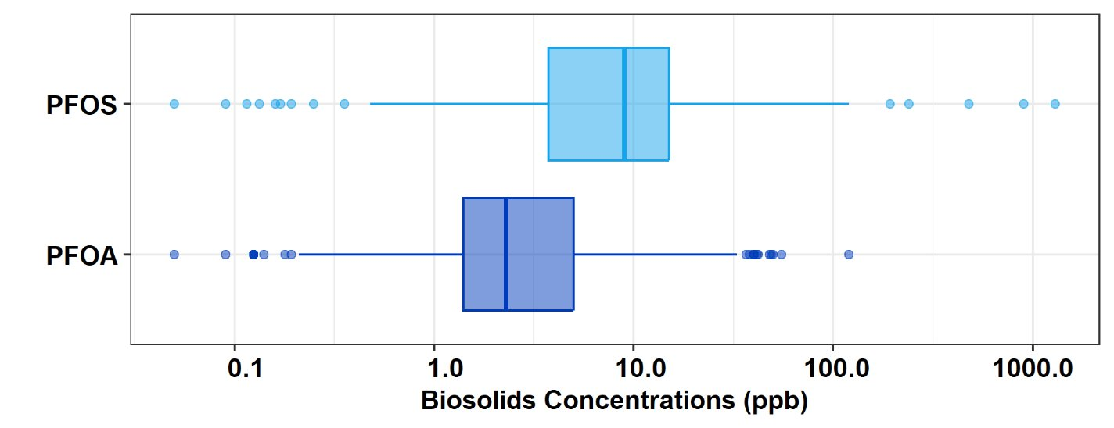
Probably True: 1 ppb would Be Lower Than Most Biosolids For PFOA & PFOS
Concentration included in EPA Draft Risk Assessment
Source: California Geotracker, 2024
Values < MDL assumed MDL/2
Notes:
Probably true- lower end of this concentrations

Slide 8
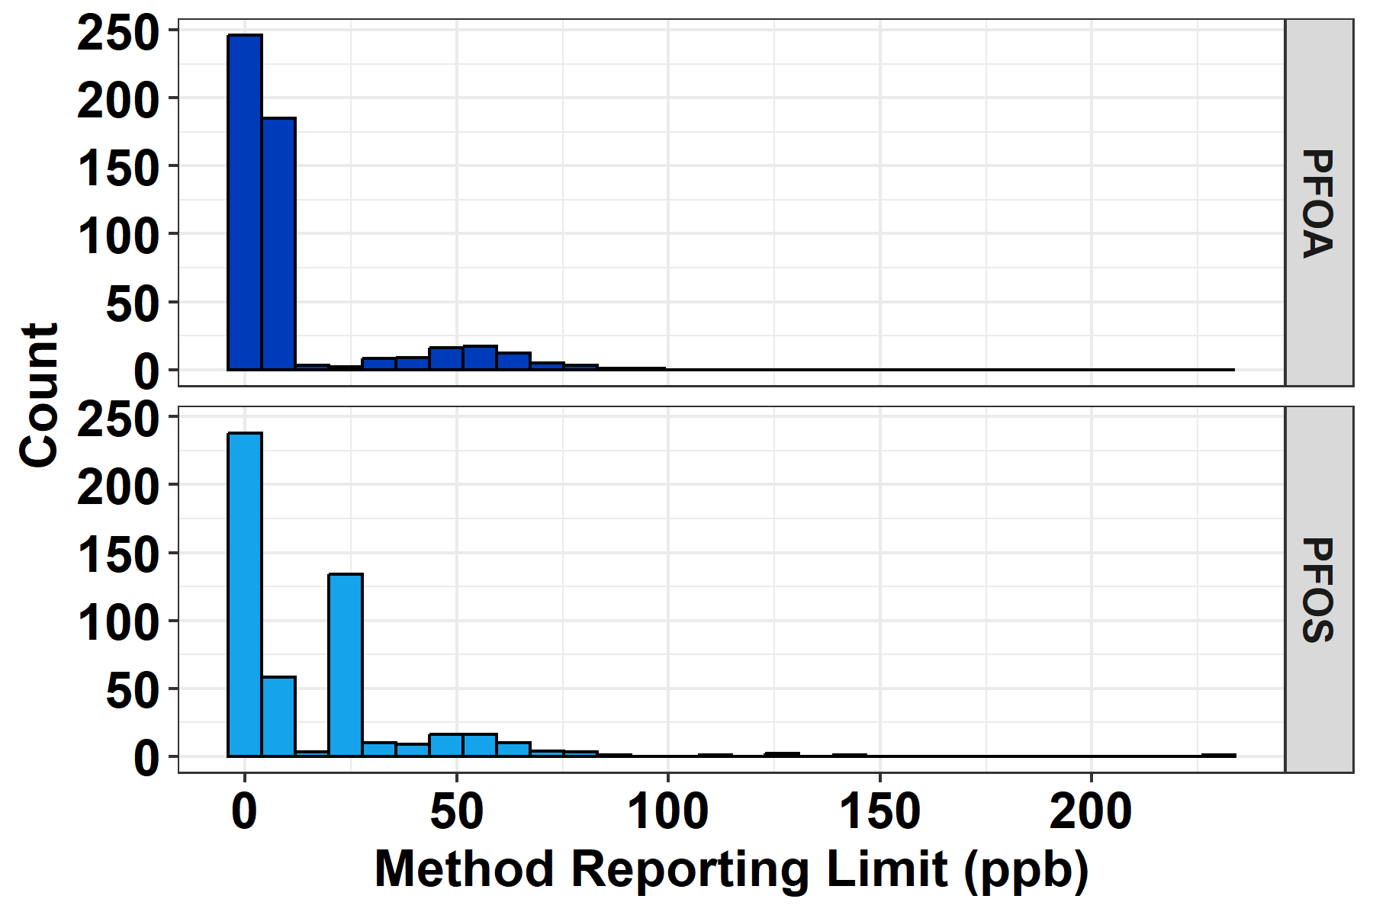
QUESTIONABLE: “Near reporting limits” doesn’t mean reliably quantifiable.
METHOD 1633 LOQS
CALIFORNIA GEOTRACKER BIOSOLIDS MRLs
Lab(s) | PFOA LOQ (ppb) | PFOS LOQ (ppb)
EPA Interlab Study (6 labs) | 1.6 – 2.0 | 1.6 – 2.0
Pace (TX) | 0.31 – 0.36 | 0.31 – 0.36
Eurofins (CO) | 0.36 – 21 | 0.36 - 21
Bureau Veritas (CO) | 1.2 | 1.2
Notes:
Is it near the reporting level? LOQ varies. MRL for the geotracker varied from 0-100. We may be able to report concentrations one order of degree higher than 1 ppb.

Slide 9
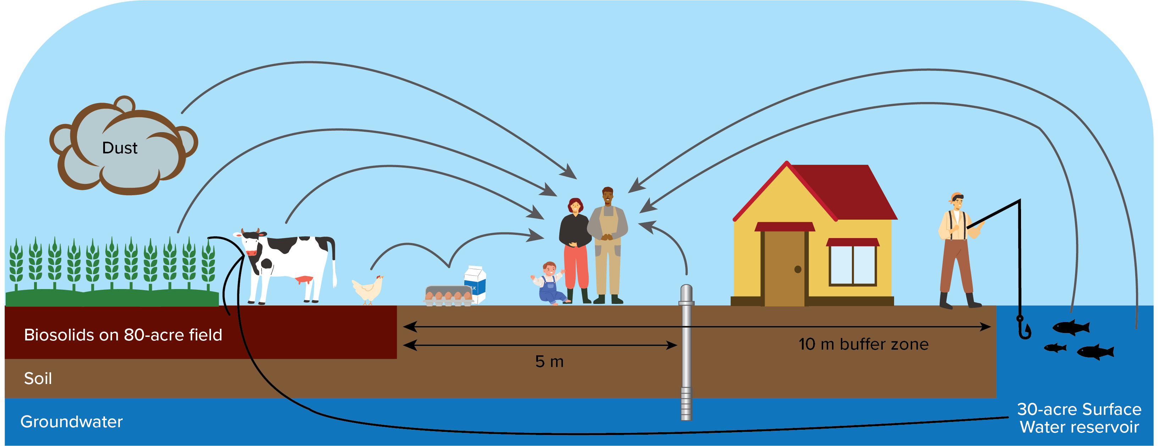
The assessment was intended to model a farm family
Land Application: Pasture or Crop Farm Scenario
Notes:
Question if it really models the moder farm family today. Model 18 exposure pathways, some shown. Ones not shown are pathways that end with a non-human-bird eats a worm that was in the biosolids dirt.

Slide 10


The assessment was intended to model a farm family
Surface Disposal
Notes:
Question if it really models the moder farm family today. Model 18 exposure pathways, some shown. Ones not shown are pathways that end with a non-human-bird eats a worm that was in the biosolids dirt.

Slide 11
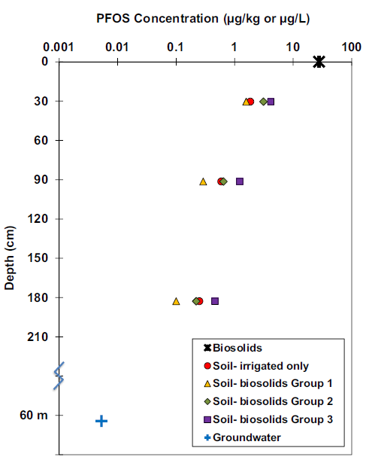

The model did not include the following…
Combined risk of exposure pathways or PFOA + PFOS
  Can scale results linearly for higher PFOA or PFOS concentrations in biosolids
Non-sewage sludge exposure to PFOA or PFOS
Background levels of PFOA or PFOS in the soil
Precursor transformation
Risk from inhalation or dermal contact
  Thus, did not assess risk to land application workers
I.L. Pepper, M.L. Brusseau, F.J. Prevatt et al. Science of the Total Environment 793 (2021) 148449
Notes:
From graph, even in virgin soil there may be PFAS
Not enough data for inhalation or dermal contact so did not model risk to the biosolids applicator

Slide 12
Draft Risk Assessment results indicate there is some risk
Risk threshold < 1 in a million
Risk threshold < 1
Notes:
Cancer Risk: number of expected excess lifetime cancer cases due to exposure
Risk threshold was < 1 in a million lifetime cancer risk
Hazard Quotient: ratio of potential exposure to level below which adverse noncancer effects are not expected
Risk threshold is < 1
Highest risk for each of the exposure pathways for each scenarios.

Slide 13
What this Draft Risk Assessment is NOT…
Final
A regulation
Recommendation for best disposal option
Risks for the average person or general population
No timeline given for next steps in the regulatory process.
Notes:
Don’t freak out. We have seen it coming sine 2021 and it just now released.
Does not quantify PFAs risk for incineration and does not consider the environmental benefits of the land application of biosolids and does not consider

Slide 14
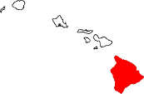
States are taking actions around PFAS in biosolids
Wisconsin – PFOA+PFOS
> 150 ppb – land application not allowed
>50 ppb – source control required and limited land application
> 20 ppb – implement source investigation and reduction efforts
< 20 ppb – no restrictions
Michigan – Tiered approach. PFOA or PFOS:
> 100 ppb – land application not allowed
>20 ppb – source control required and limited land application
< 20 ppb – no restrictions
PFOA+PFOS < 20 ppb “Exceptional Quality” eligible
Sampling and reporting requirements
Source control-based limits
Risk- or detection-based limits
Minnesota – Tiered approach. PFOA or PFOS
> 125 ppb – no land app​
51-124 ppb: source ID and limited land app​
21-50 ppb: track cumulative app rates​
<20 ppb: no restrictions
Proposed risk- or detection-based limits
Land application bans
Proposed land application bans
Maine – Ban on land app/biosolids due to PFAS concern.
Vermont – land app. requires soil and biosolids below:
3.4 ppb PFOS
1.6 ppb PFOA
0.84 ppb PFHpA
0.44 ppb PFNA
0.38 ppb PFHxS
Colorado --
PFAS monitoring in biosolids req’d; PFOS > 50 ppb requires source investigation.
Connecticut – Ban on biosolids that contain PFAS.
New York – Tiered approach. PFOA or PFOS
> 50 ppb – land application not allowed until < 20 ppb
> 20 ppb – 1 year to reduce to < 20 ppb
< 20 ppb – land app allowed
Texas – Proposed limits for land application:
PFOA < 0.9 ppb, PFOS < 5.1 ppb, limits for 14 other compounds
ppb = µg PFAS/kg biosolid
Maryland – Proposed ban on land application containing >1 ppb of PFOS/PFOA.
Updated February 2025. Not intended to be comprehensive due to ongoing changes.
Notes:
KT edits 2/17/2025
Oklahoma- proposed
Mississippi and Illinois- may propose bans***
Proposed OK ban: https://www.billtrack50.com/billdetail/1763470#:~:text=The%20legislation%20defines%20key%20terms,biosolids%20and%20sewage%2Dderived%20materials.

Slide 15





Utilities can take proactive steps while awaiting regulatory guidance on biosolids.
Know your data
POTW influent PFAS study – proposed
  Would require the 400 largest WRRFs to fill out a questionnaire about potential industrial sources of PFAS.
  200-300 WRRFs would then be required to sample influent, effluent, biosolids, and up to 10 industries.
  Method 1633, plus Method 1621 for aqueous samples
  One-time grab samples
Notes:
State level actions, lawsuits and maybe even farmers may not want to land apply biosolids.
Some time later this year the 400 largest utilities may be required to sample.

Slide 16
Utilities can take proactive steps while awaiting regulatory guidance on biosolids.
Know your data
Reduce significant sources
Notes:
State level actions, lawsuits and maybe even farmers may not want to land apply biosolids.
Some time later this year the 400 largest utilities may be required to sample.

Slide 17
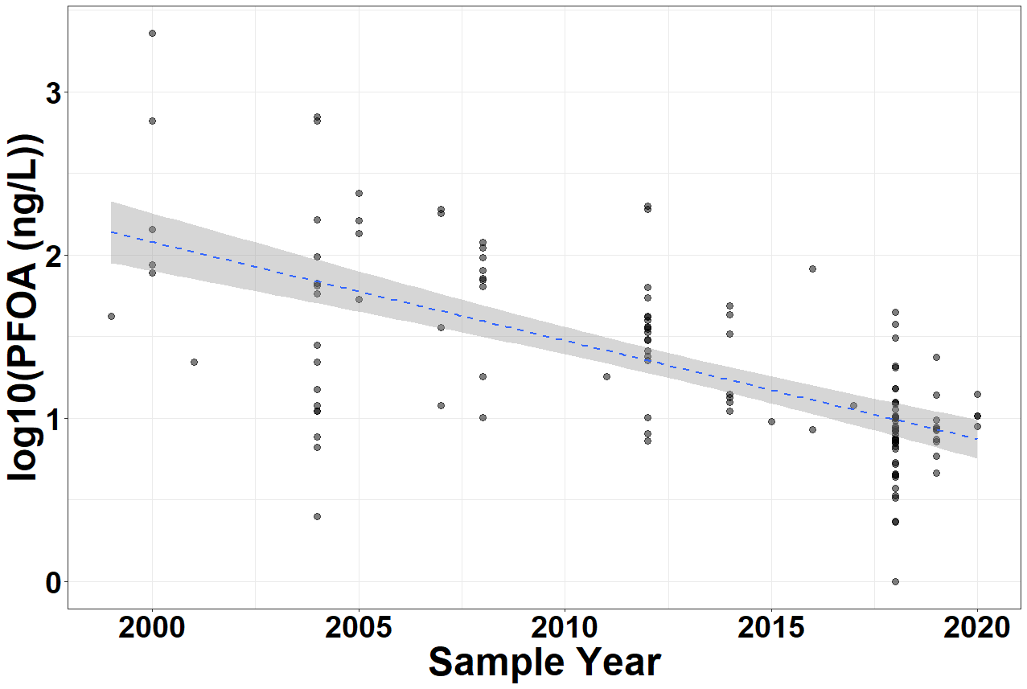
Source control and phase outs have led to decreased PFAS concentration in effluent and biosolids.
Voluntary Phase Out
Source: Thompson, K. A. et al. 2022. ACS ES&T Water, 2(5), 690–700.
Notes:
PFAS/PFOA levels have dropped with time in effluent and biosolids products.

Slide 18
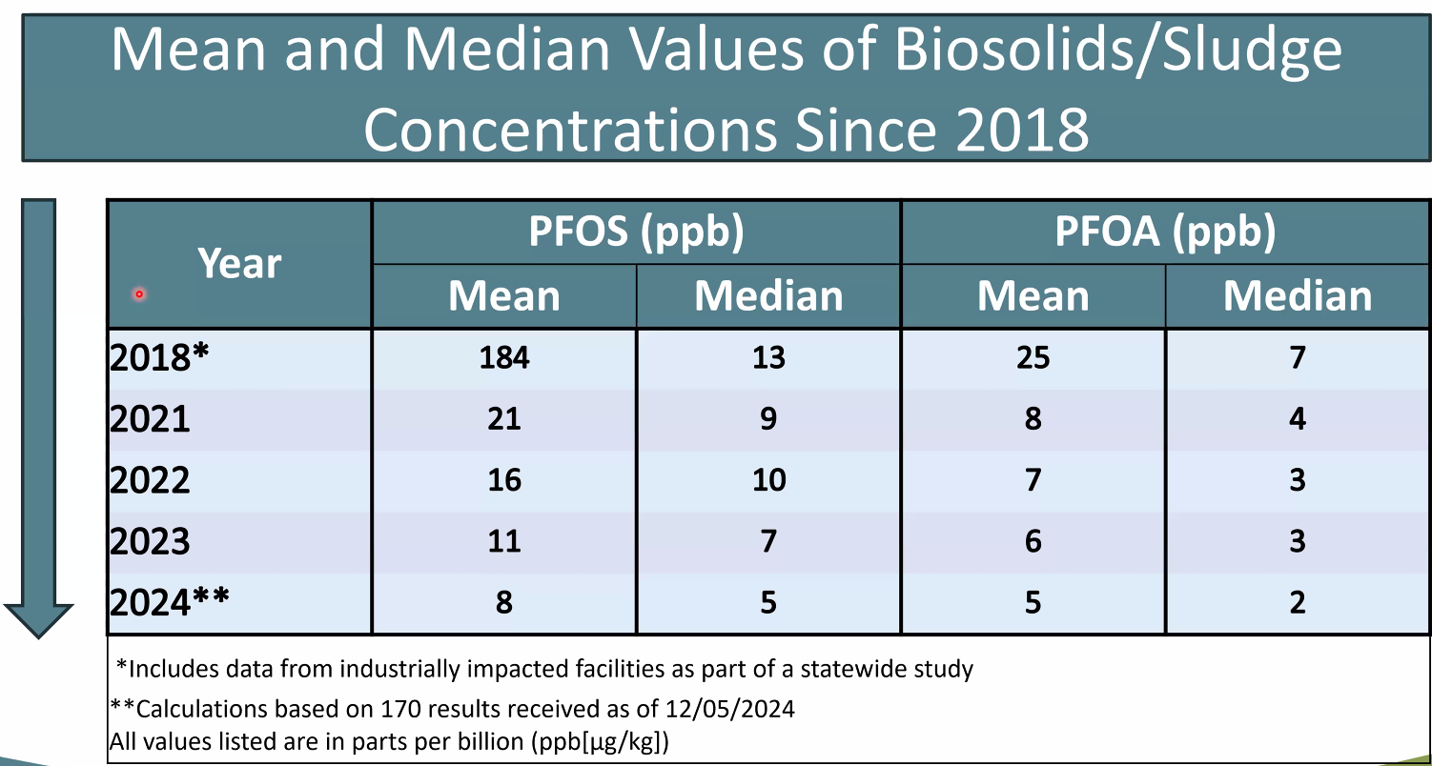
Source control and phase outs have led to decreased PFAS concentration in effluent and biosolids.
Source: EGLE, “Michigan’s Interim Strategy for Land Application of Biosolids Containing PFAS”, Conference Presentation 2024.
Notes:
PFAS/PFOA levels have dropped with time in effluent and biosolids products.

Slide 19

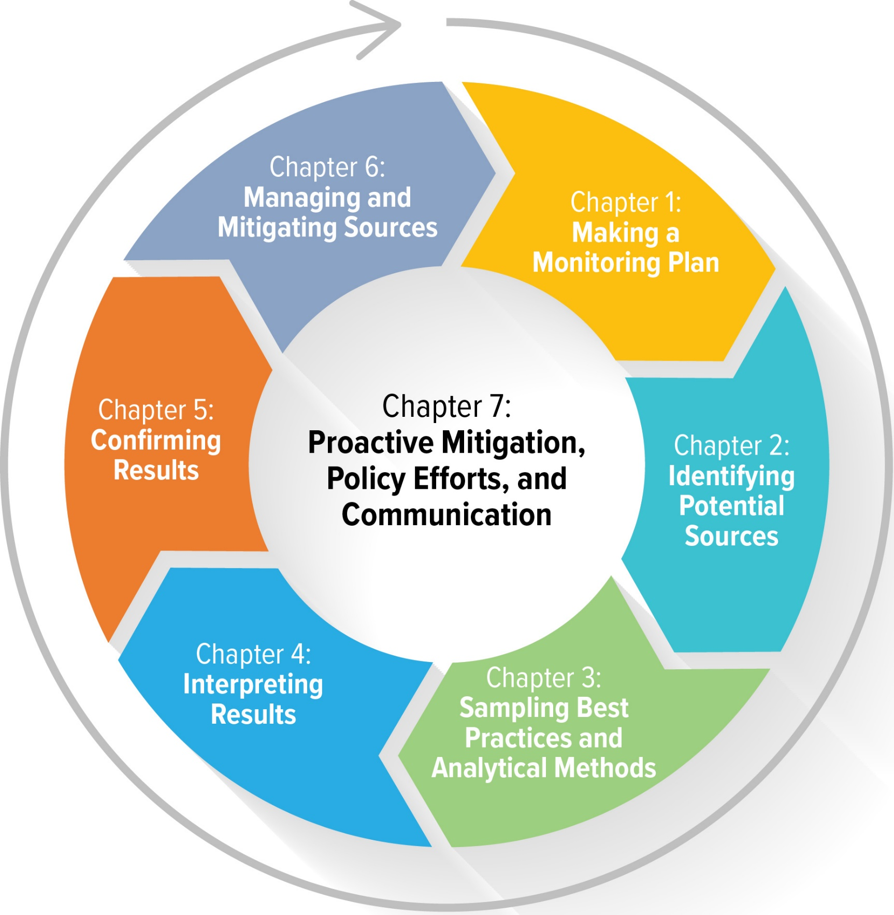







Source identification and control will help WRRFs understand PFAS industrial and domestic sources
WRF Project #5082: Investigation of Alternative Management Strategies to Prevent PFAS from Entering Drinking Water Supplies and Wastewater
Guidebook steps:
  Make a Monitoring Plan
  Identify Potential Sources
  Sample
  Interpret Results
  Confirm Results
  Mitigate Sources
  Communicate (Throughout)

Slide 20


Utilities can take proactive steps while awaiting regulatory guidance on biosolids.
Know your data
Reduce significant sources
Master plan strategically
Talk to your neighbors
Communicate proactively
Track/research/ test technologies
Notes:
State level actions, lawsuits and maybe even farmers may not want to land apply biosolids.
Some time later this year the 400 largest utilities may be required to sample.

Slide 21
In closing…
PFAS are detectable in biosolids
  Detection does not always mean significant source of exposure
Biosolids regulations are ever-evolving and vary significantly from state to state
  The EPA’s Draft Risk Management Assessment is not a regulation- Don’t Panic!
  State actions may come faster!
Source control is a key first approach to limiting PFAS emissions
Existing and newer biosolids treatment technologies show potential for PFAS removal, research and testing is on-going.

Slide 22

Thank you!
Questions?
Laura Rodriguez, PhD, PE | lrodriguez@carollo.com
Kyle Thompson, PhD, PE | kthompson@carollo.com

