Slide 1
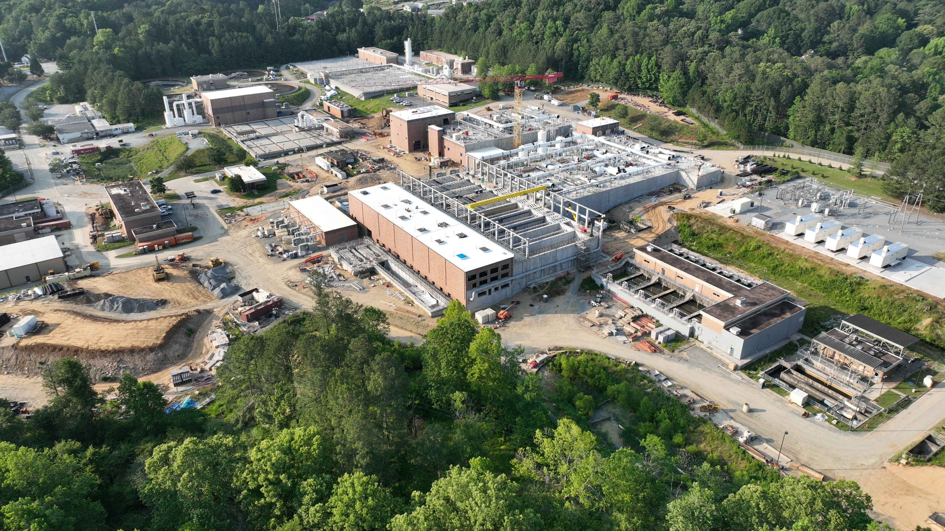
Process Intensification Opportunities in MBRs
Latest Trends and Results
Jose Jimenez, PhD, PE, BCEE, WEF Fellow
March 22nd, 2024

Slide 2
Agenda
Membrane Bioreactor | Energy Conservation | Densification + MBR | Peak Flow Management

Slide 3
Conventional Activated Sludge Process
IMLR
M
PE
SE
RAS
ANOXIC
AEROBIC
AEROBIC
SWING
WAS

Slide 4
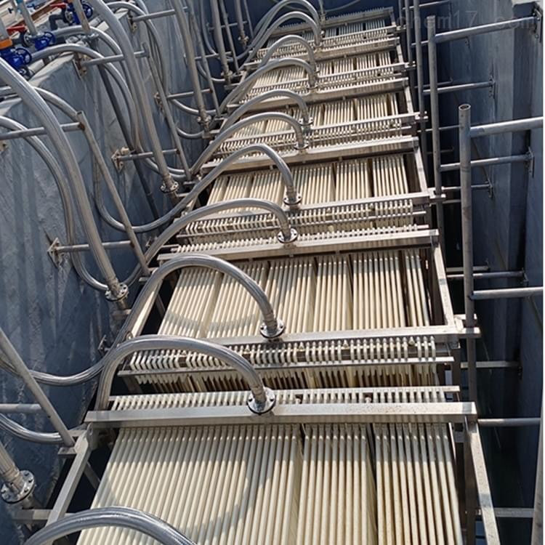
Choosing MBR over ASP
Higher water quality generated
its smaller footprint
Key disadvantages are the operational complexity and the cost
the capital (or investment) cost, CAPEX and
the operational cost, OPEX.

Slide 5
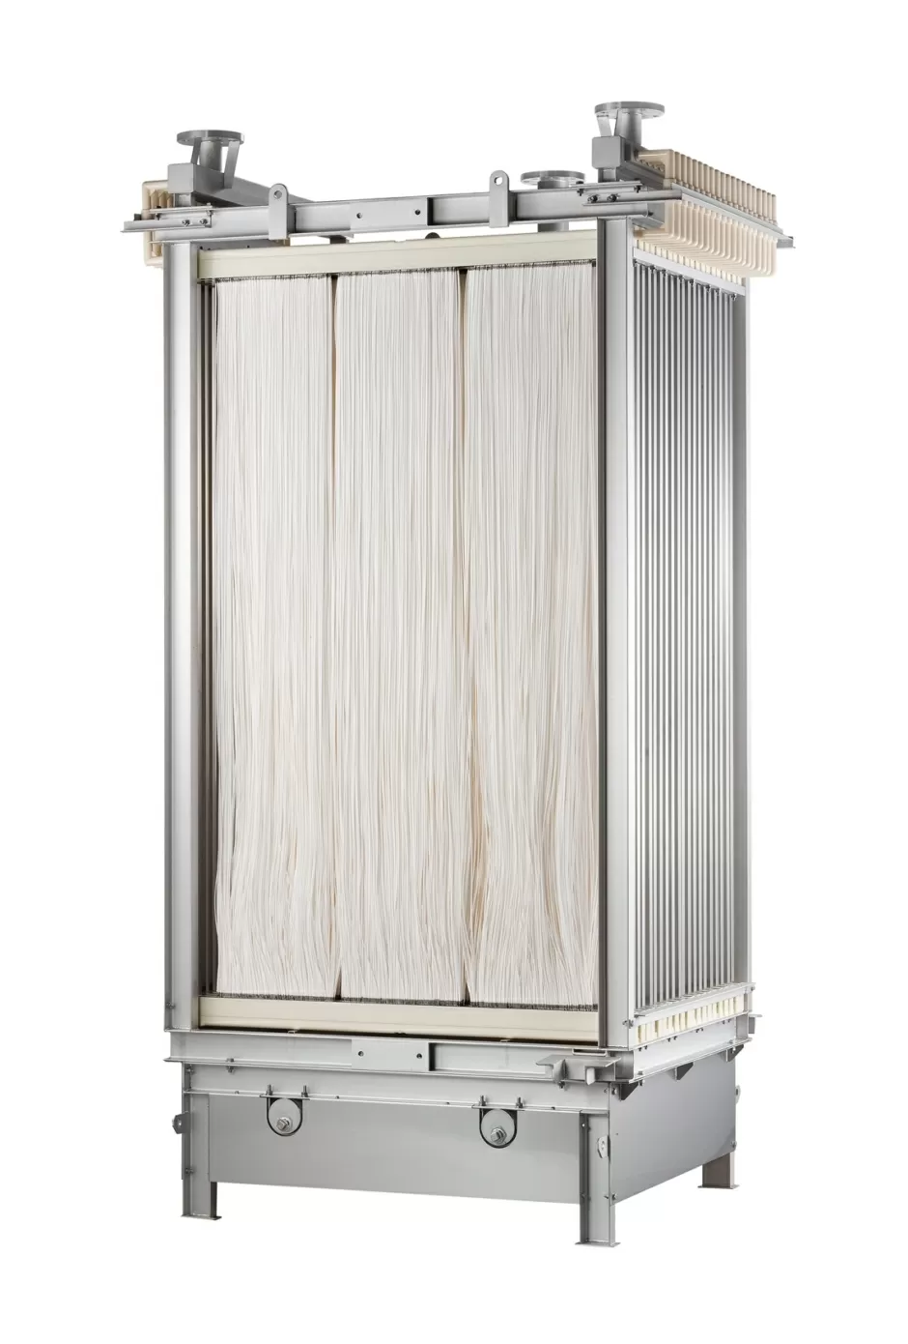
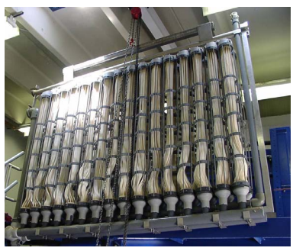
Membrane Bioreactor
Hollowfiber membrane
Flat-plate membrane
Dupont (Memcor) membrane

Slide 6
MBR Advantages MBR Disadvantages
Compact footprint
Requires fine screening of influent:
<3.0 mm flat sheet
<2.0 mm hollow fiber
Fully automated
Complete solids removal
High capital cost
Nutrient removal
High energy cost for air scour
High UVT values
Membrane maintenance and replacement
Simpler process
Microconstituent, pathogens and bacterial removal
Dissolved oxygen management and BNR

Slide 7
MBR Disadvantages
Requires fine screening of influent:
<3.0 mm flat sheet
<2.0 mm hollow fiber
High capital cost
High energy cost for air scour
Membrane maintenance and replacement
Dissolved oxygen management and BNR

Slide 8
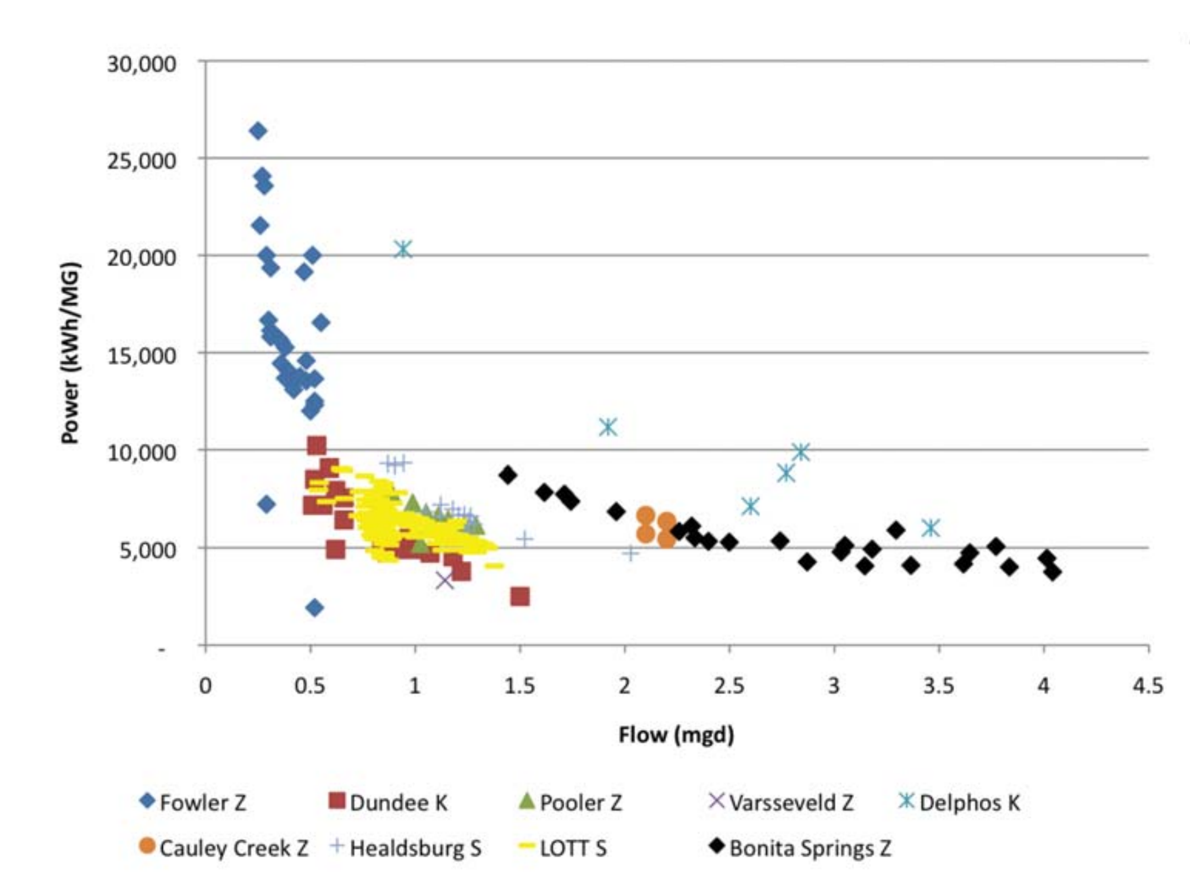
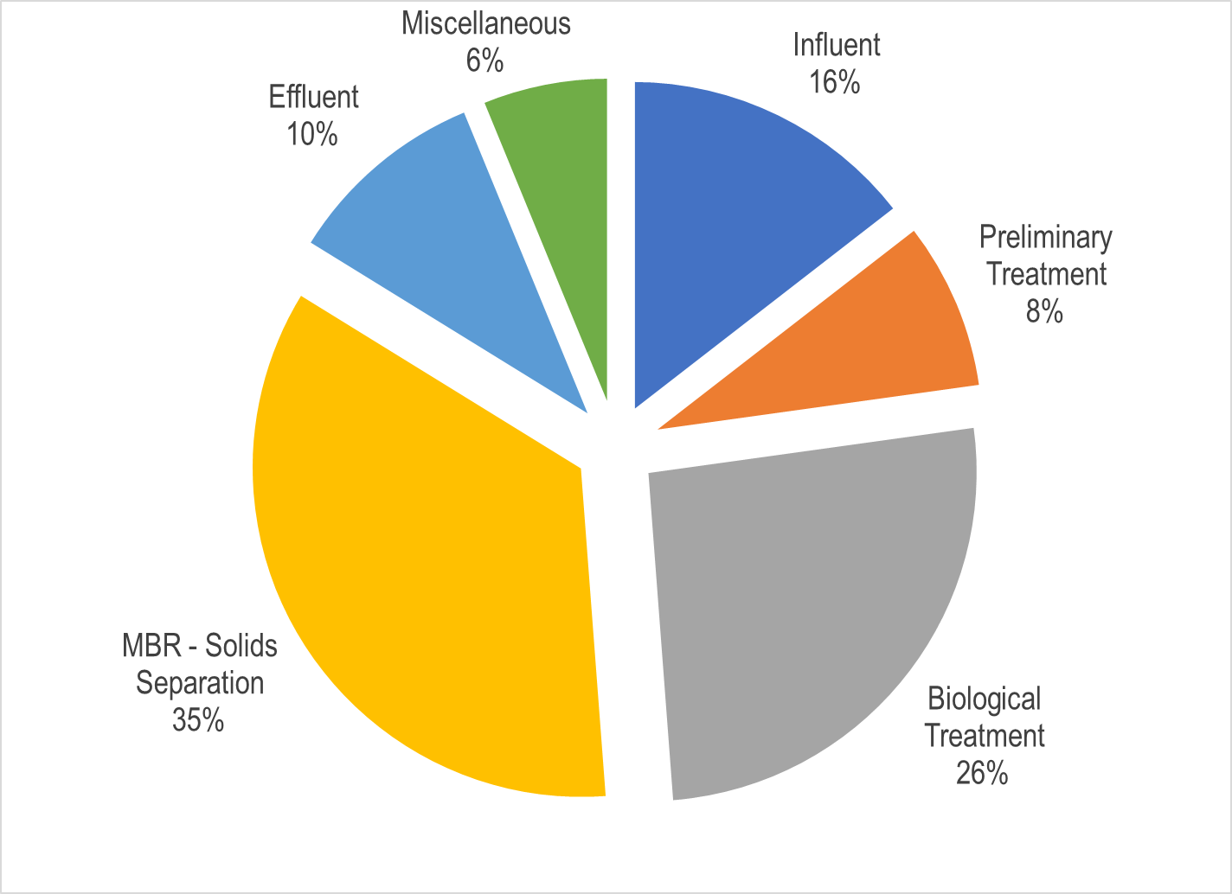
Energy Requirements in MBR
CAS – 1,500 – 3,000 kWh/MG
Pellegrin and Kinnear (2012)

Slide 9
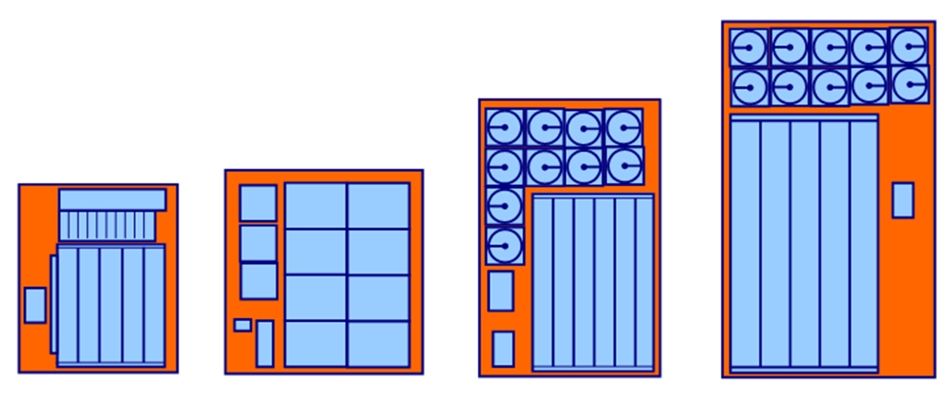
Benefits of MBRs
Reduced footprint
As low as 40% of conventional
High quality effluent
Low turbidity, BOD, TSS
Pathogen removal
Better trace organics removal
Tier 1 Pathogen Reduction Credits
 | WaterVal (Aus) | WRF 4997 (US)
Virus | 1.5 | 2.4
Bacteria | 4 | 4.5
Protozoa | 2 | 2.5
Ease of Operations
Fewer unit processes
Eliminates sludge settleability issues
Highly automated
Constructability
Modular expansion capability
Excellent for retrofits

Slide 10
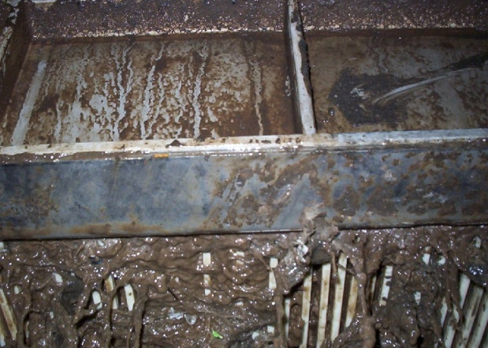
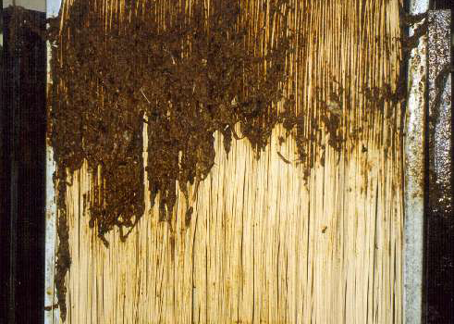
MBR Process Operations
“Sludged” Flat Sheet Cassette
“Sludged” Hollow Fiber Module
Air Scour
Highest energy usage of MBR operation
Trend toward lower air flow designs
RAS Circulation
4 to 6 times forward flow
Bioreactor/MBR MLSS of 0.6-0.8
Maintain MLSS in MBR
8-10 g/L long term
12-14 g/L short term
Chemical Cleaning
Maintenance cleaning
Chemical enhanced backwash
Recovery clean

Slide 11
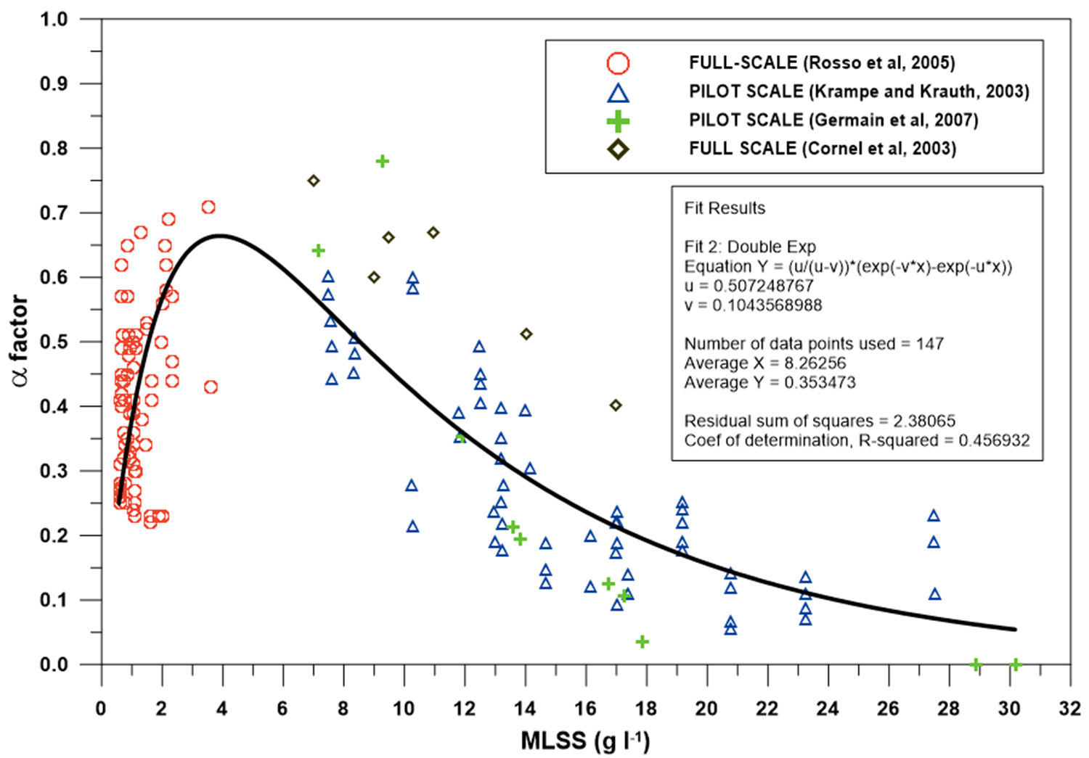
MBR – MLSS and Aeration

Slide 12
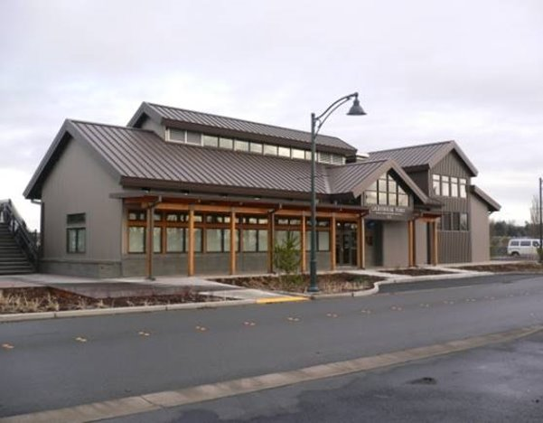
Process Considerations Pretreatment
Fine Screens
Best is 2mm round opening
No possibility of bypass
100% redundancy at peak flow
Fat, Oil and Grease: typ. <150mg/L
Flux rates
Function of ML suspended solids and temperature
30-day average typically 10-15 GPD/ft²
Up to 30 GPD/ft² for 2-4 hours
Lighthouse Point WWTP, Blaine WA – 1.5 MGD

Slide 13
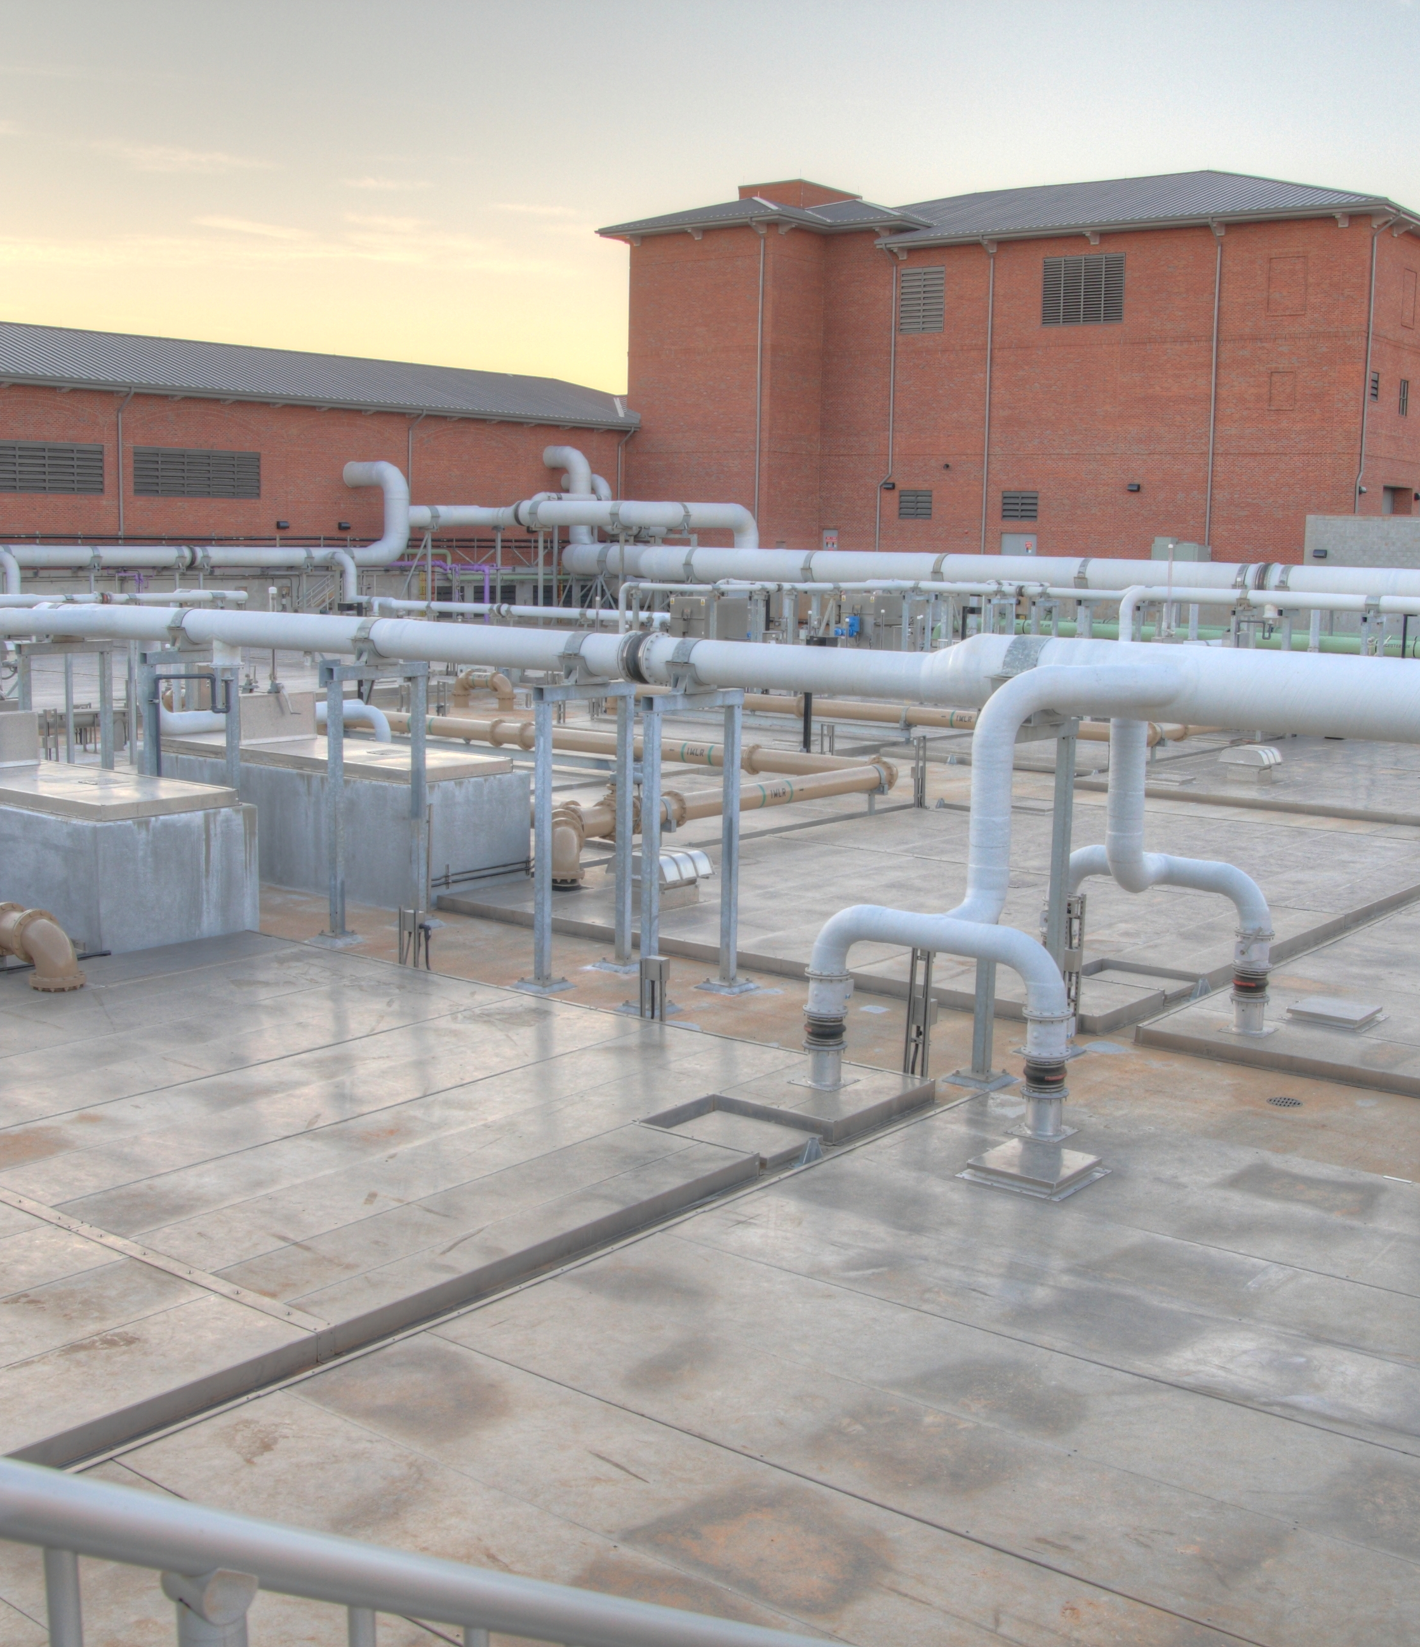
Process Considerations Biological Process
High SRT (>10 days typical)
Fully nitrifying conditions
Bioreactor MLSS typically 6,000-10,000mg/L
High MLSS = reduced OTR, esp. in fine bubble aeration
Filaments and bulking common, but not a concern as with clarifiers
Foam management

Slide 14
Aeration control technologies

Slide 15
Aeration Control Technologies for Biological Process Energy Reduction
Aeration controls such as ABAC or AvN™ can maintain DO conc. of 0.1 to < 1.0 mg/L.
Some low-DO ASP achieve limits-of-technology effluent water quality
Low-DO ASP require less energy and organic carbon than conventional aeration system (e.g., DO > 1.0 mg/L)

Slide 16
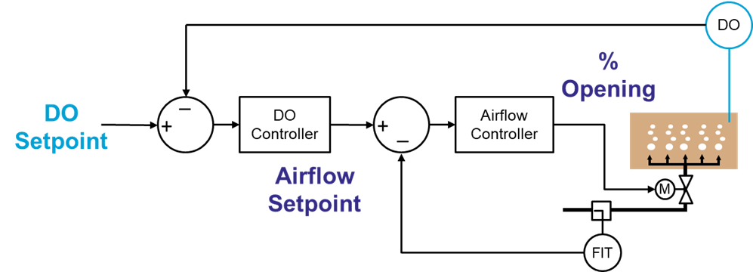
DO Cascade Control Loops
DO Setpoint Bands
Min = 1.0 mg-O₂/L
Max = 2.0 mg-O₂/L
Airflow Setpoint Bands
Min required for mixing
Max to protect diffusers

Slide 17
Ammonia Based Aeration Control (ABAC) Feedback ABAC
NH4/NOx
DO
%
Opening
_
_
NH4
Setpoint
+
PID
+
PID
+
PID
_
DO
Setpoint
Airflow
Setpoint
M
FIT
Target BNR Effluent
Aerobic Zone = 1-2 mg-N/L
DO Setpoint Bands
Min = 0.2 mg-O₂/L
Max = 2.5 mg-O₂/L
Airflow Setpoint Bands
Min required for mixing
Max to protect diffusers

Slide 18
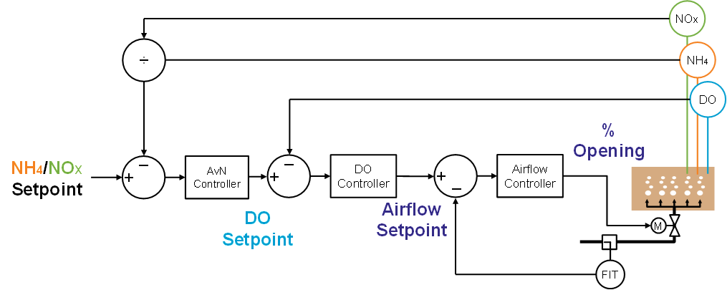
Ammonia versus NOx (AvN) Control
Target BNR Effluent
Aerobic Zone NH₄/NOx = target
DO Setpoint Bands
Min = 0.2 mg-O₂/L
Max = 2.5 mg-O₂/L
Airflow Setpoint Bands
Min required for mixing
Max to protect diffusers

Slide 19
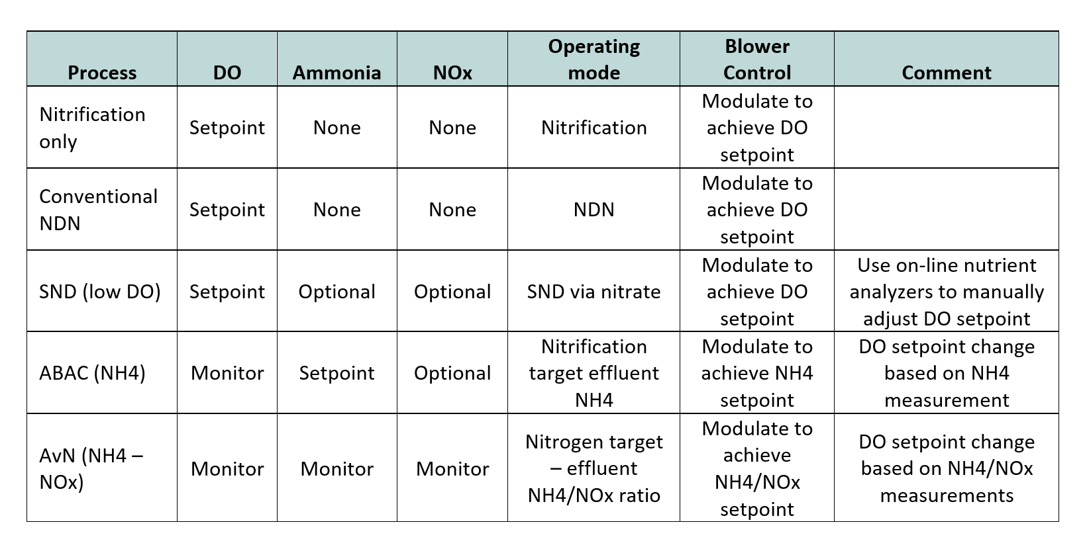
On-line Instrumentation for Nitrogen Removal

Slide 20
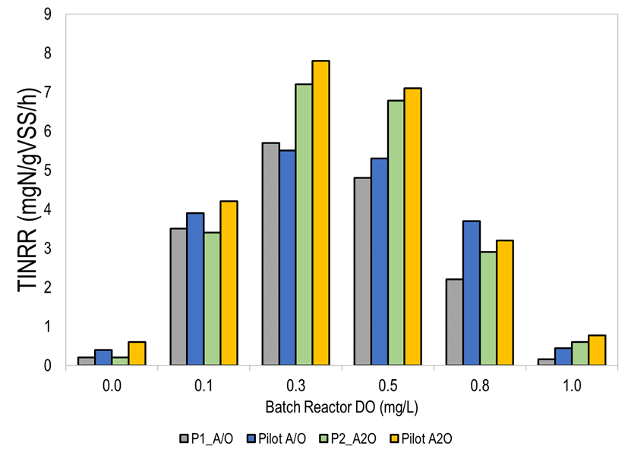
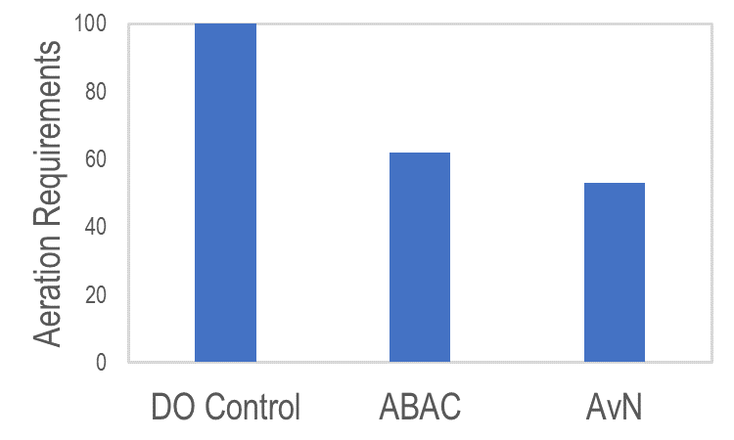
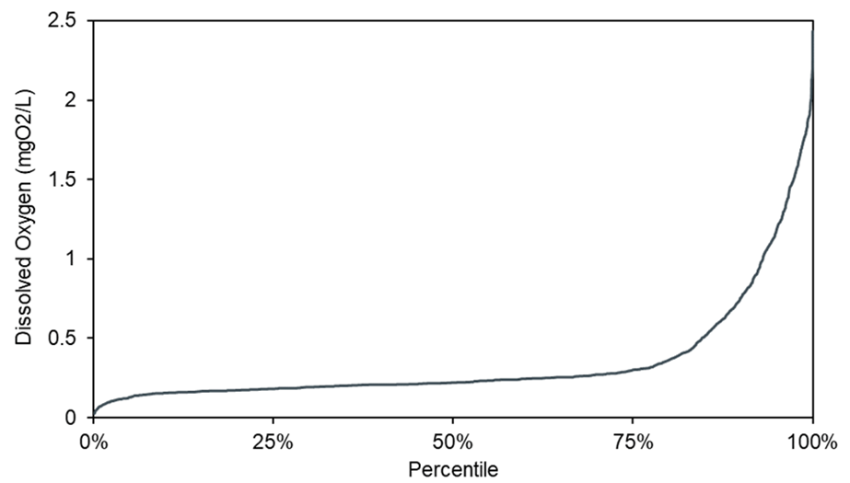
Energy Reduction Using Aeration Controls

Slide 21
MBR + Densified Activated Sludge

Slide 22
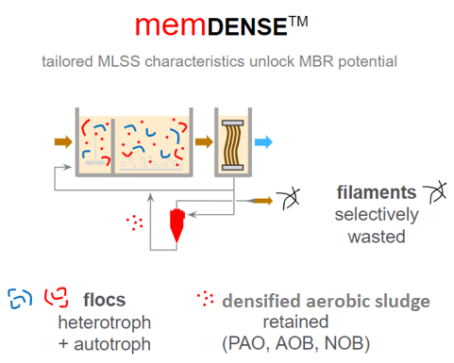
MBR + densification = memDENSE
Fundamentals
biology
Performance of membranes with MBR are limited by the characteristics of the mixed liquor
memDENSE allows controlling and stabilizing sludge characteristics (biological matrix)
wash out low value inventories
bio-accumulate high value inventories
membrane
lower cake layer resistance, lower super fine colloidal organics < 1.5 microns in Membrane Tank
Notes:
All disciplines that touch a water project (I&C, electrical, structural etc.)
Operator focused (CEO has operator licenses)
Owners Agent to Construction experience

Slide 23
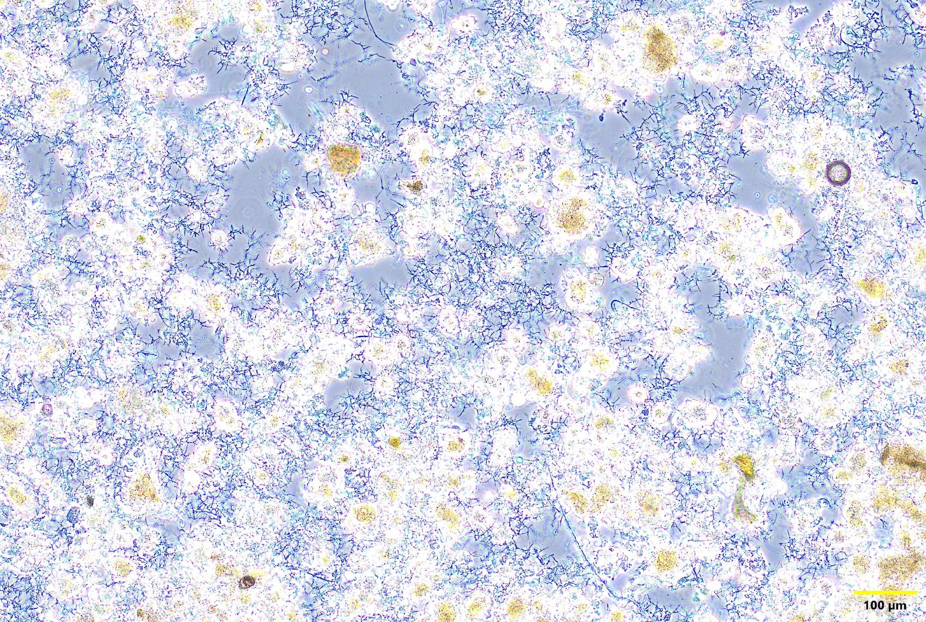
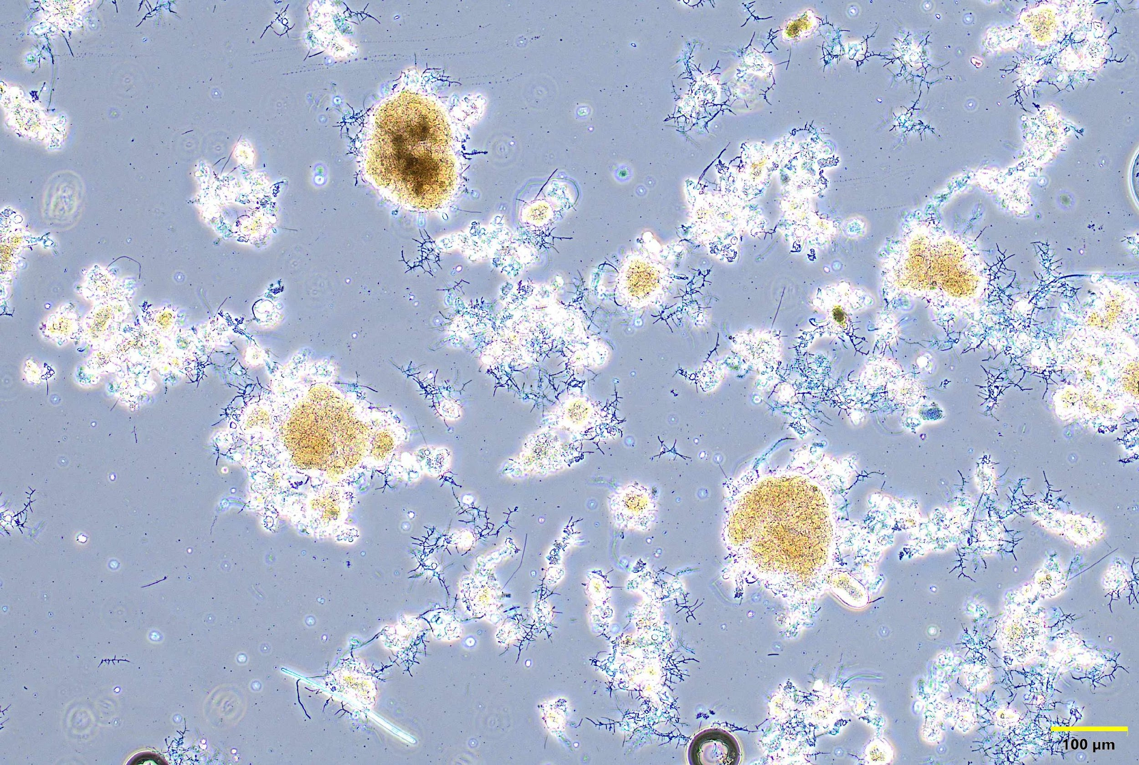
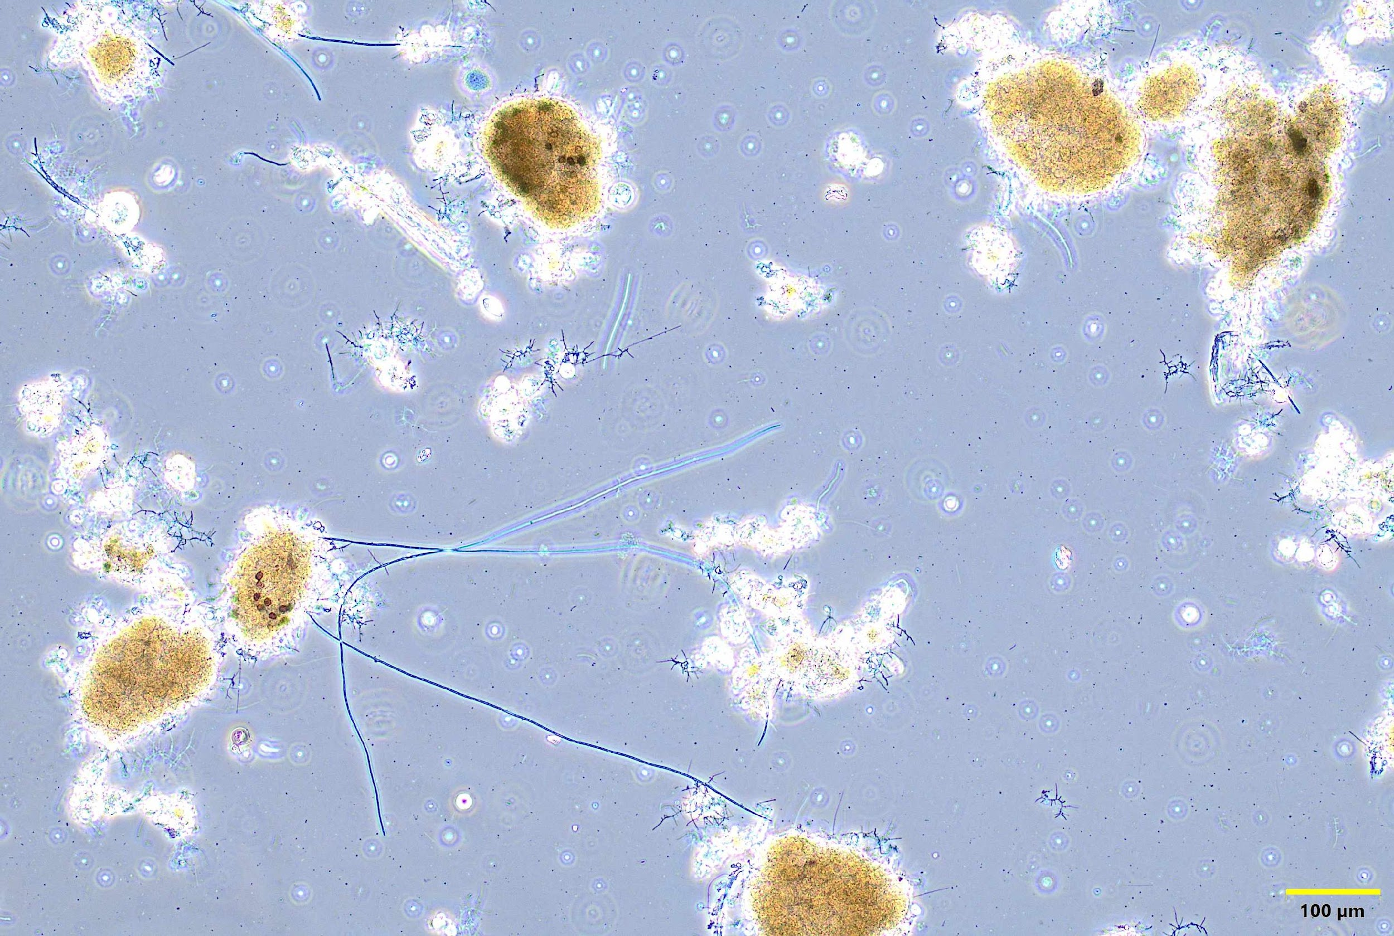
What does densification do? Separation of undesirable biomass
overflow
(OF)
excess biological sludge
(feed)
filaments
PAO
filaments
light & small flocs < 100 µm
pin & light flocs
large & dense flocs (AOB, NOB)
underflow
(UF)
dense flocs > 200 µm
PAOs (dark)
Nitrifiers (AOB, NOB)

Slide 24
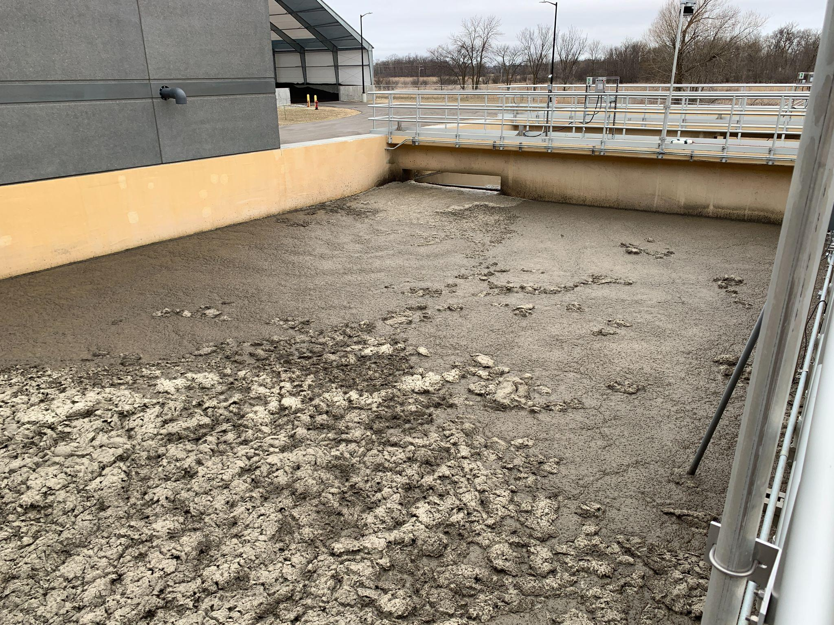
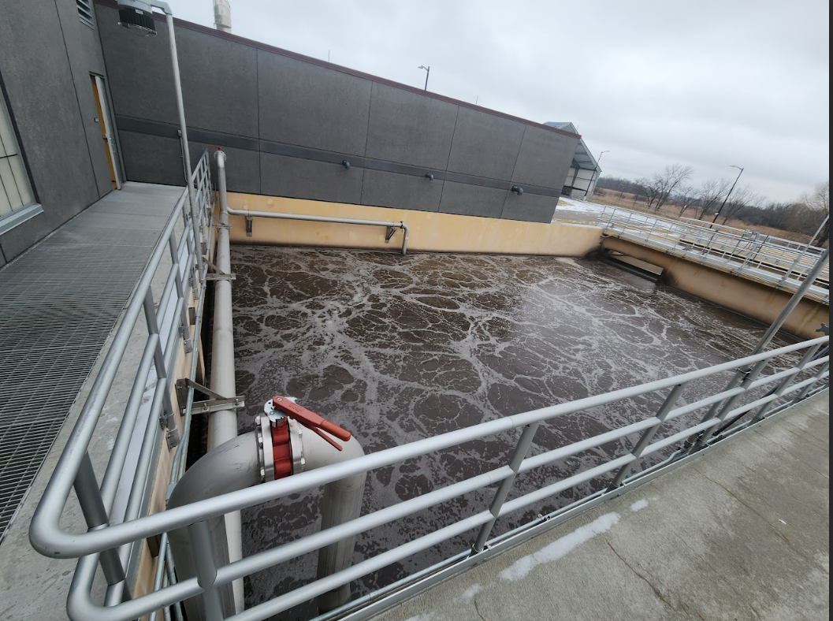
What does densification do? Improved and stabilized bio-process
Before
After memDENSE
Early steady-state

Slide 25
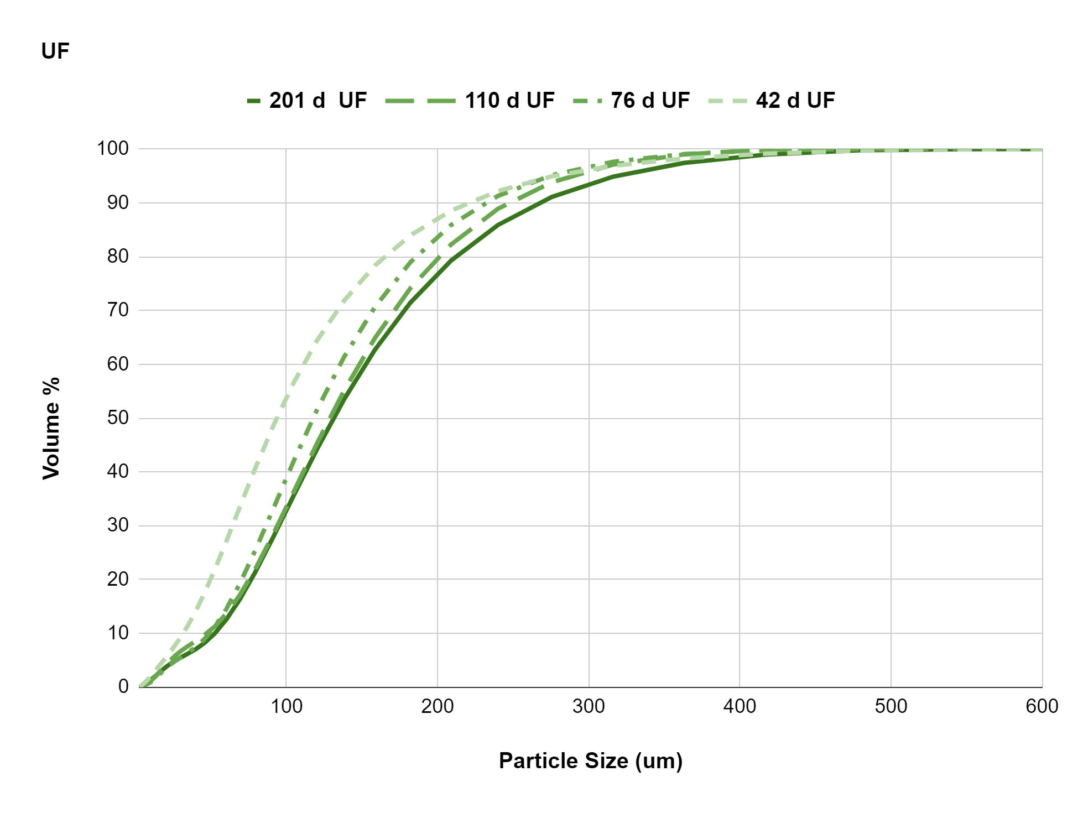
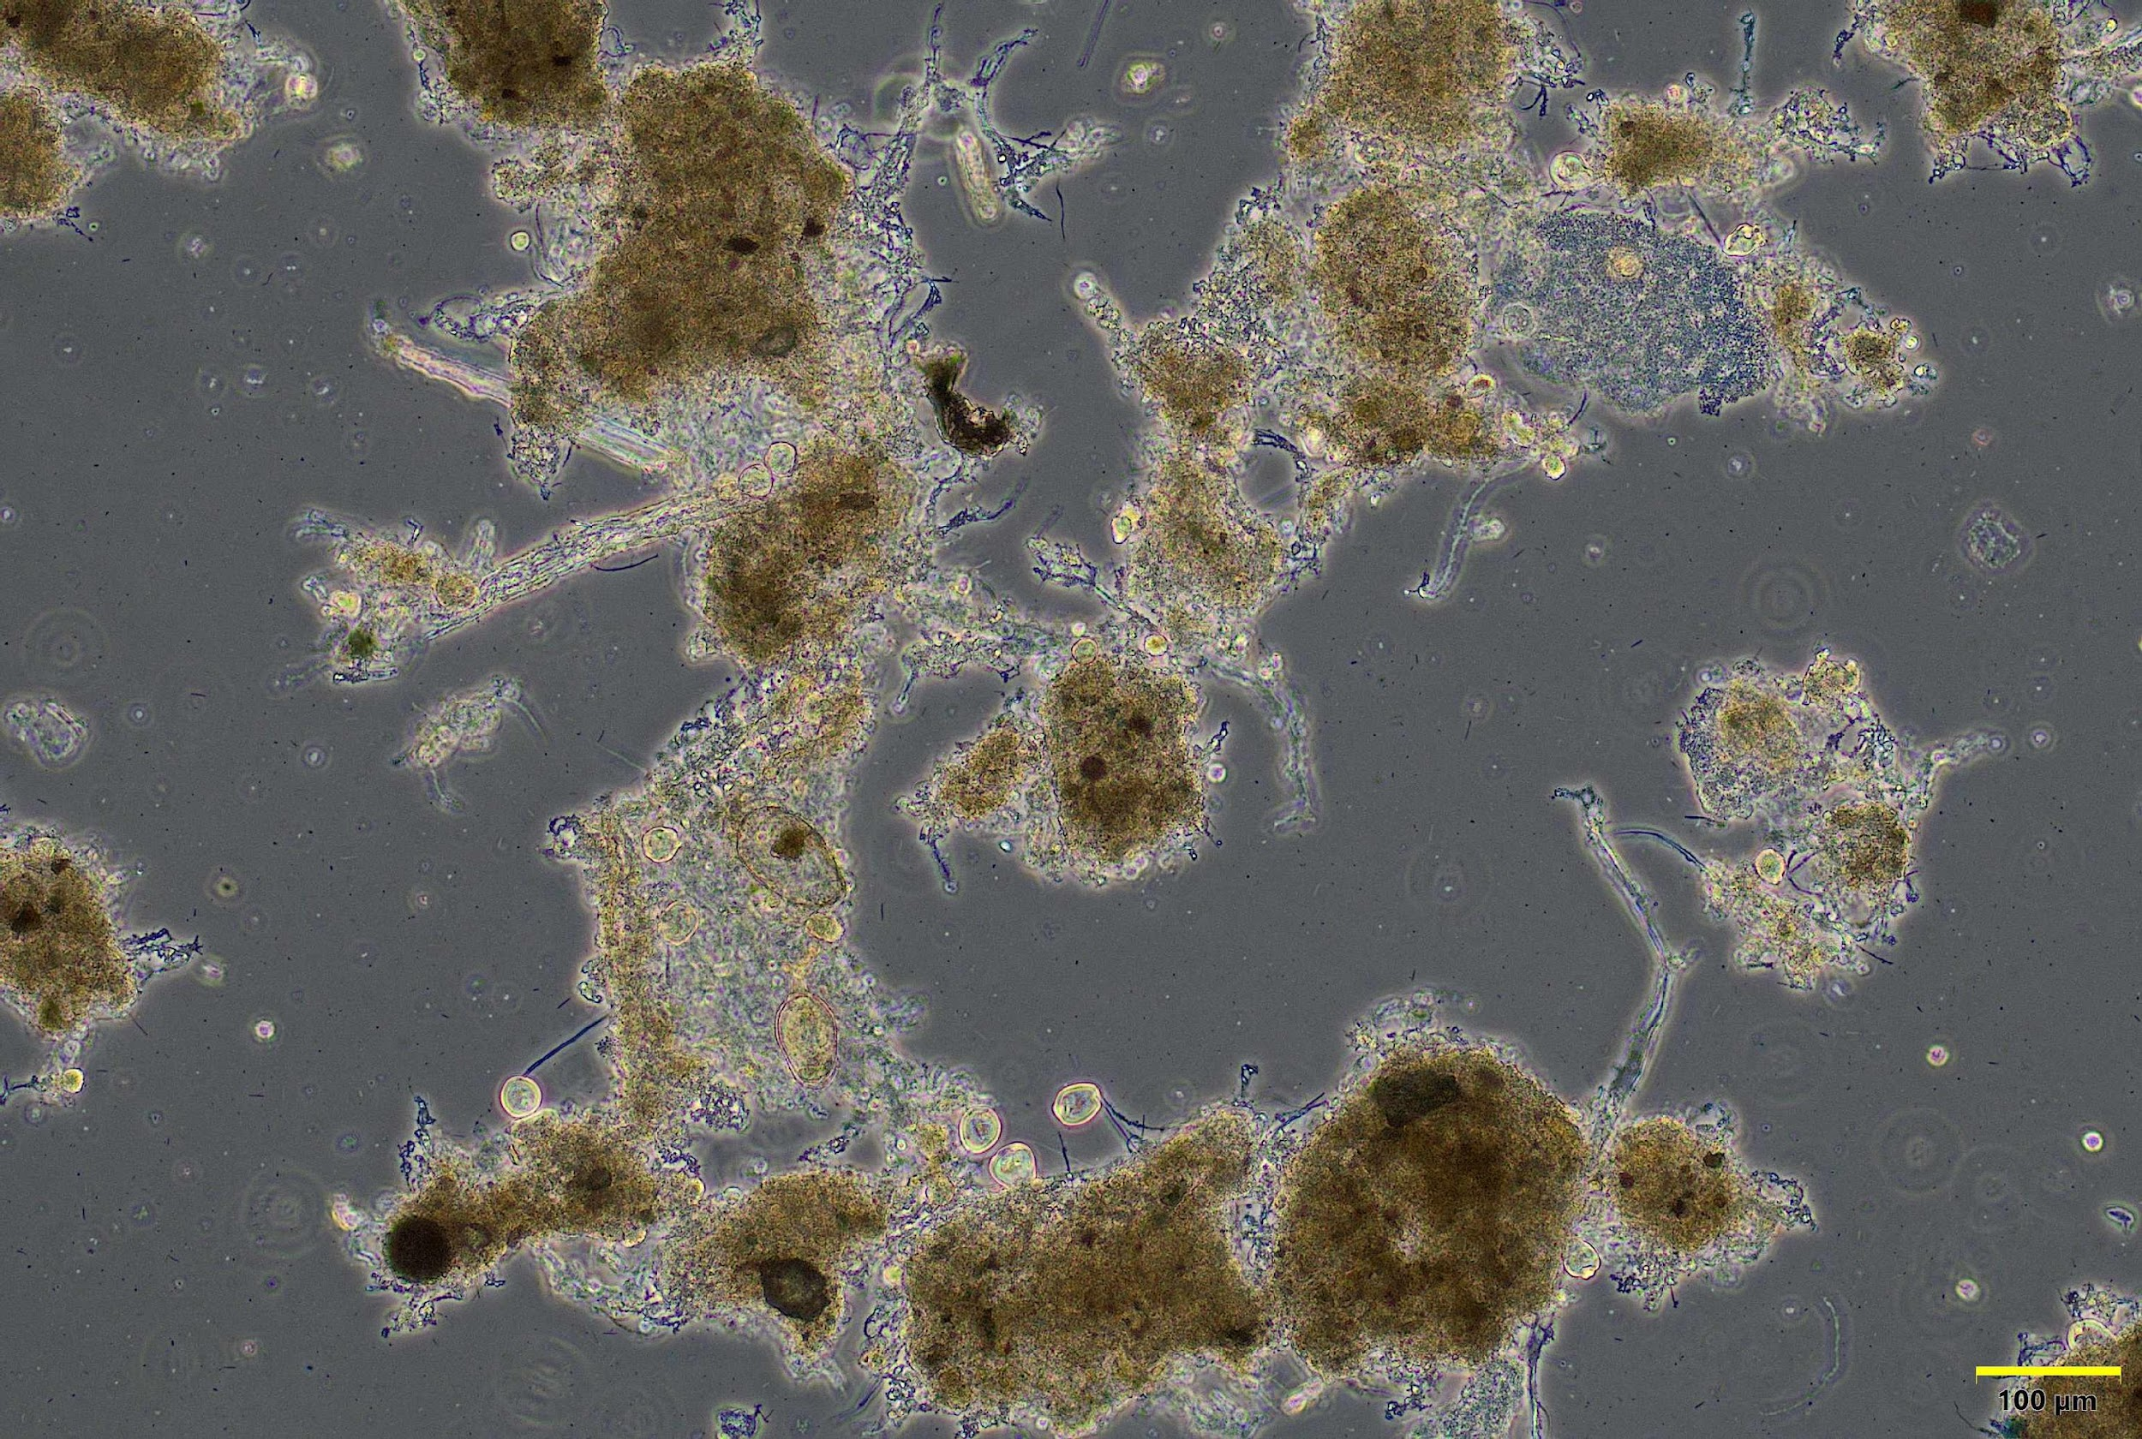
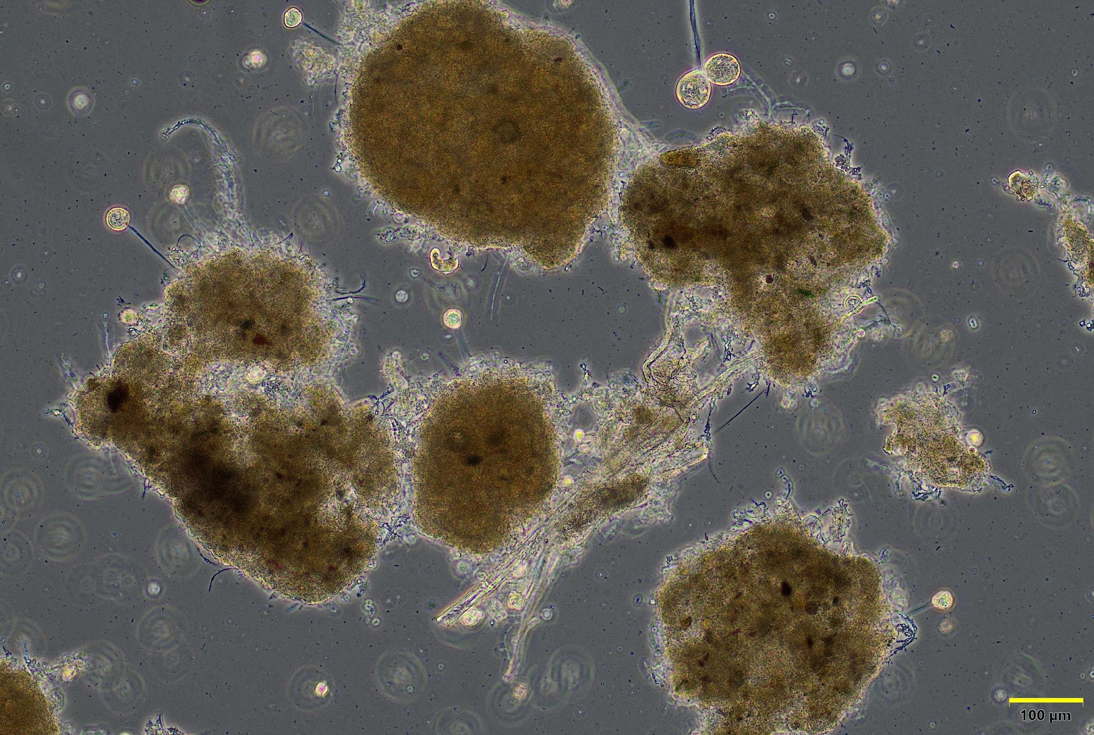
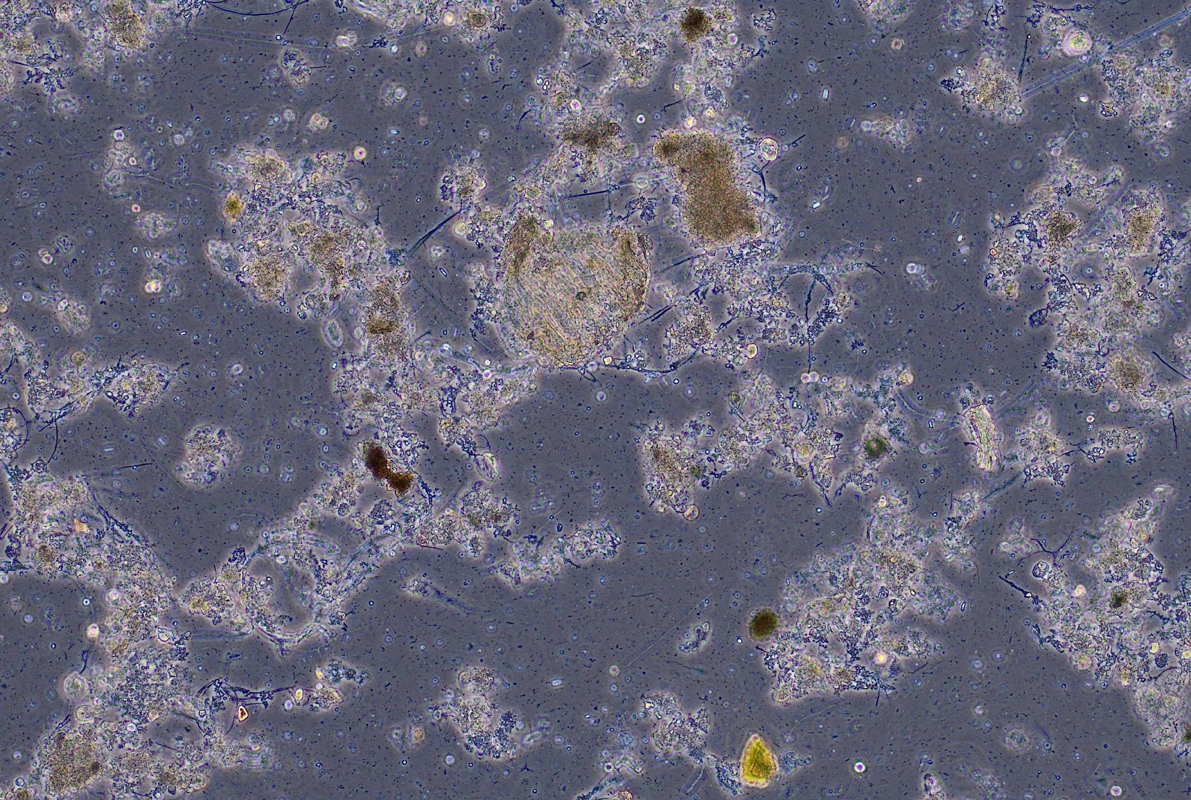
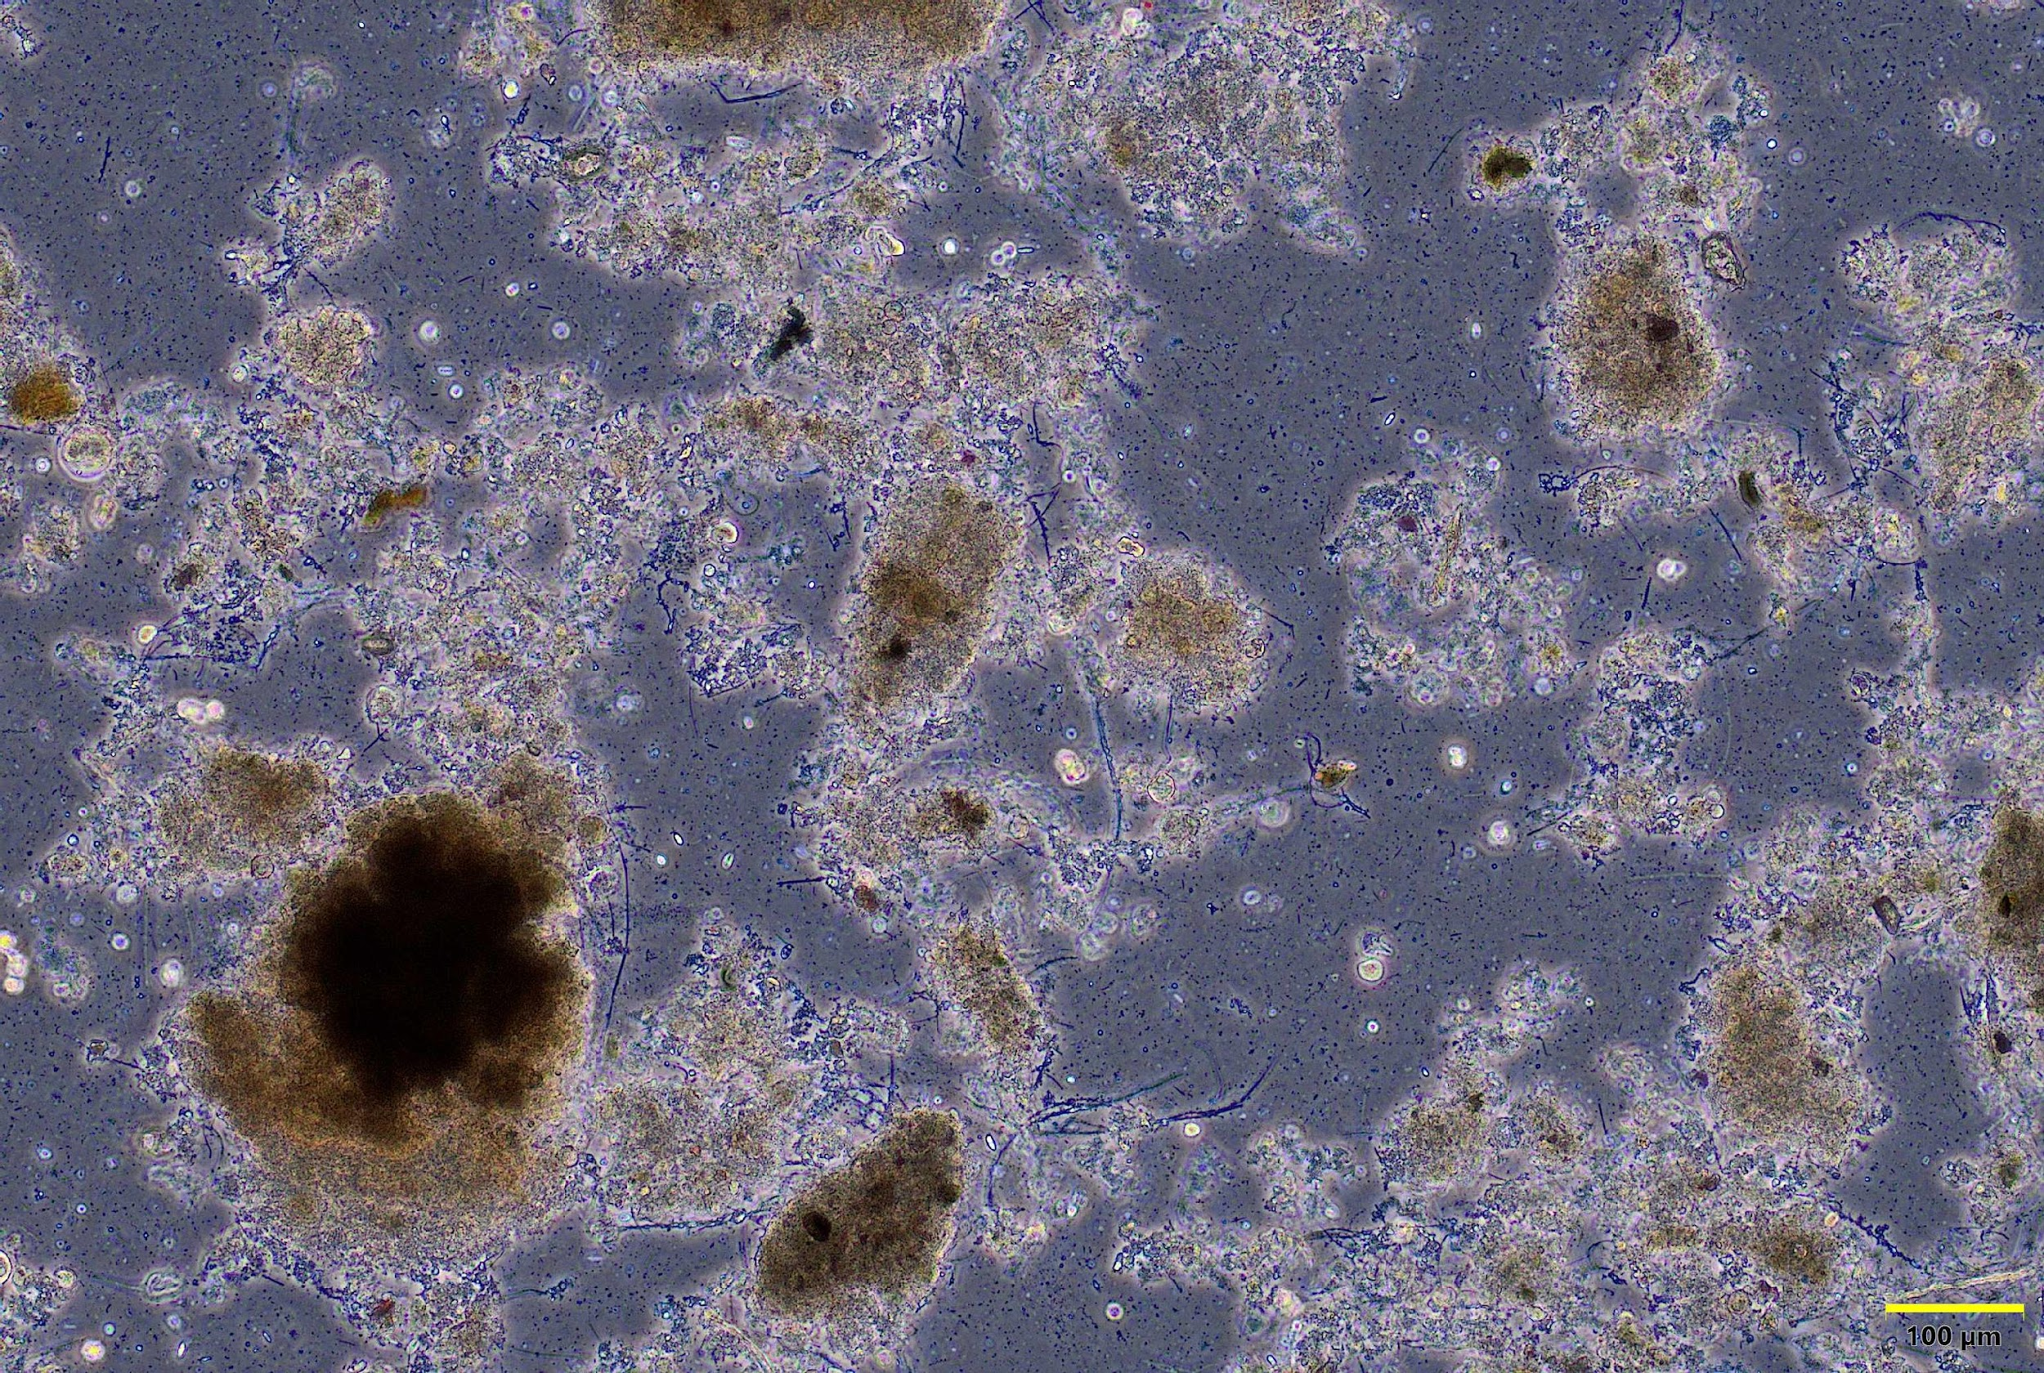
What does densification do? Particle size distribution
Startup Steady state
Overflow (WAS) Underflow
80th percentile particle size increase from 160µm to 210µm

Slide 26
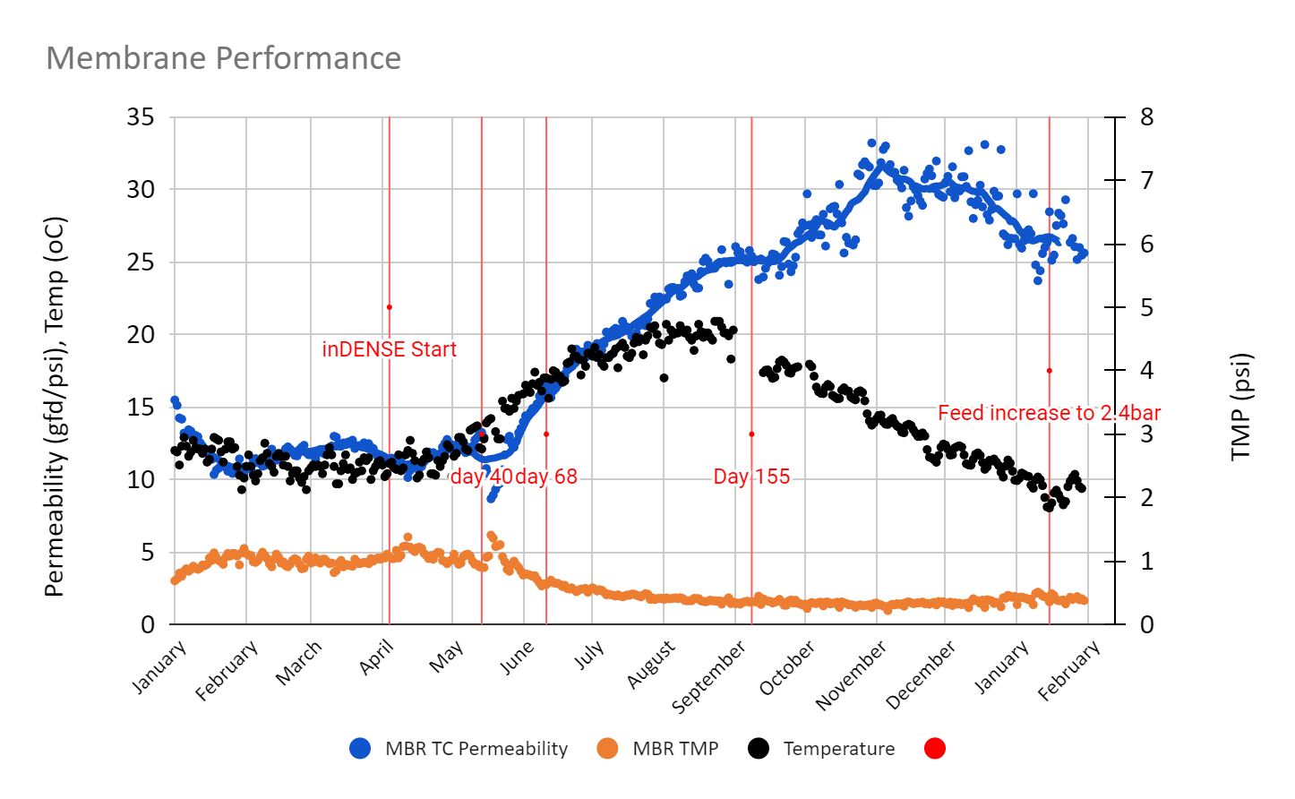
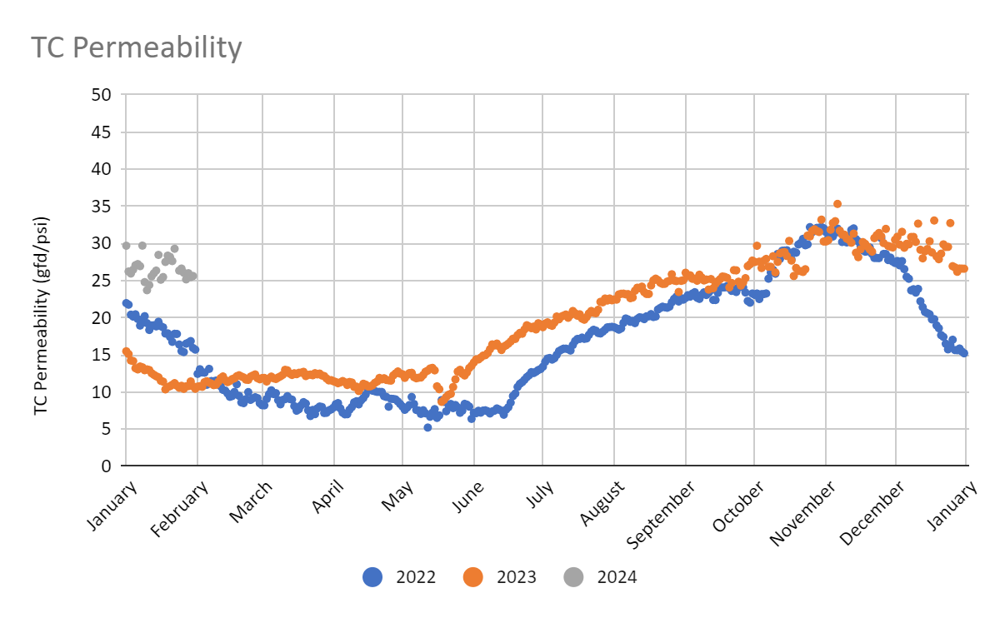
What does densification do? Densified MBR – effect on permeability
Maintained high permeability with temperature drop
Less recovery cleans
10-15 gfd/psi increase over pre densification

Slide 27
Peak flow management

Slide 28
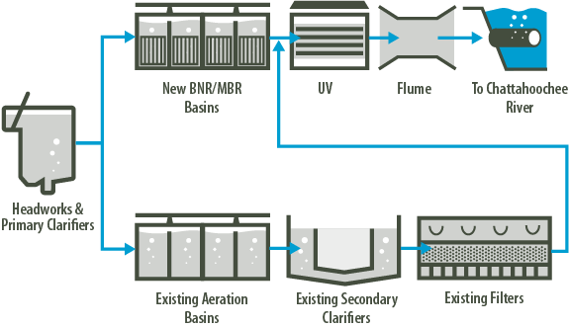
Process Analysis and Selection
VS
Single Train (Example)
Dual Train (Example)
FEATURES
Single, unified treatment train
MBR used for all flow
ADVANTAGES
Single unified biology
Less equipment to operate and maintain
No blending of different effluent qualities
Allows reuse of infrastructure
Allows for gravity discharge without need for effluent pump station
DISADVANTAGES
Potential for higher capital cost
Depending on approach selected, may not optimize use of existing plant infrastructure
FEATURES
Split treatment trains
MBR used for some flow, existing treatment for other flow
ADVANTAGES
Makes greatest use of existing plant infrastructure
DISADVANTAGES
Two separate biologies to maintain
More difficult and complex operations and maintenance
Brown and Caldwell
28

Slide 29
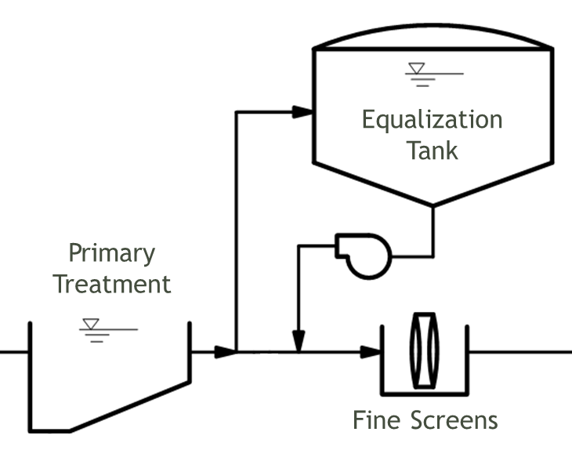
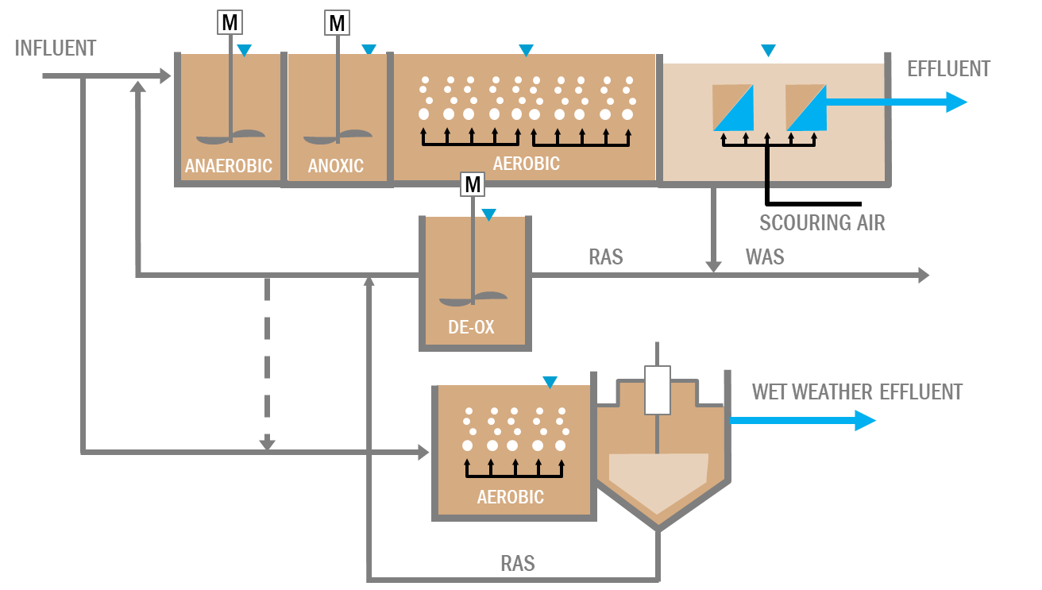
Wet Weather Management Opportunities
Equalization
In-line EQ in new process tanks
Retrofit existing secondary clarifiers
Separate WW Treatment
Brown and Caldwell
29

Slide 30
King County’s Brightwater WWTP Split Treatment
During Wet Weather Operations:
Primary clarifiers are converted to CEPT
Fe/polymer addition is activated
Portion of PE goes to MBR
Wet weather flow is bypassed and blended with MBR effluent before disinfection
Brown and Caldwell
30

Slide 31
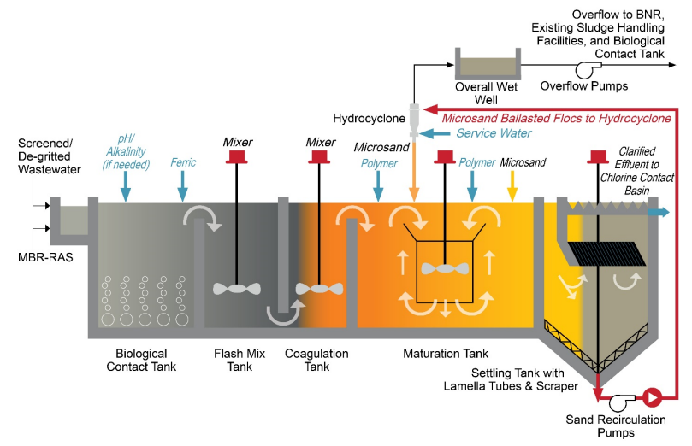
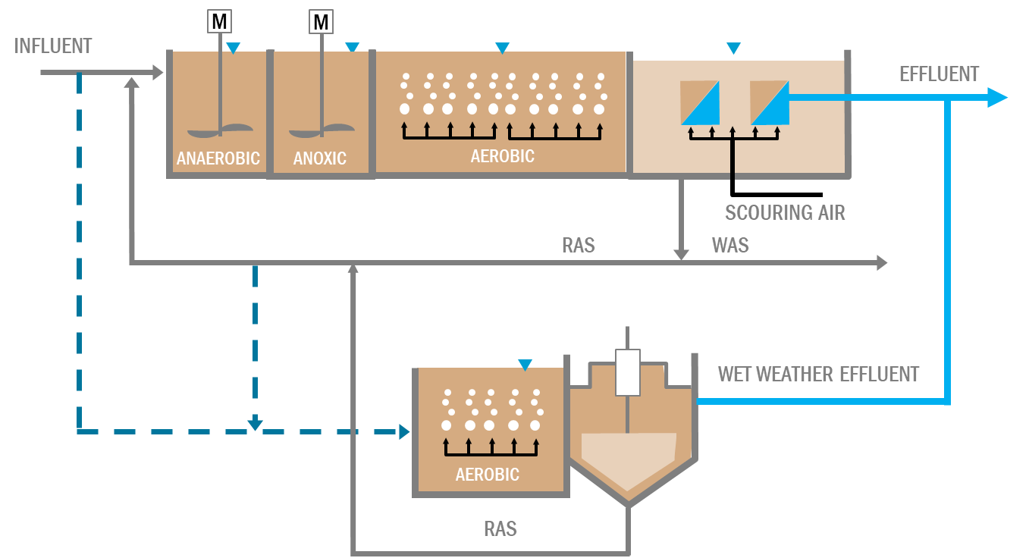
City of San Mateo, CA Nutrient Removal and Wet Weather Flow Management Upgrades
Use of Bio-Actiflo for treating wet weather flow was selected for the following reasons:
Proven technology and performance
When blended with MBR effluent, produces an effluent that meets current NPDES permit limits
Ease of operation
Quick startup
Small footprint
Brown and Caldwell
31

Slide 32
Thank you.
Questions?
Jose Jimenez, PhD, P.E., BCEE
Wastewater Innovation Leader jjimenez@brwncald.com

