Slide 1

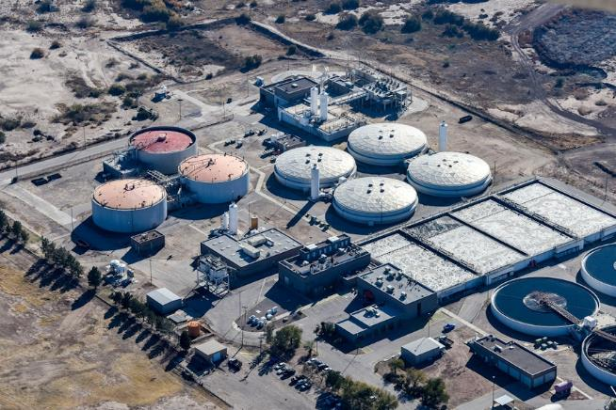
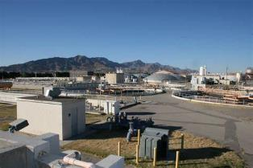
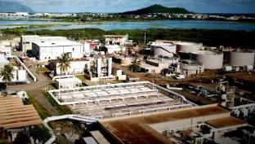
Advanced Operational Training: Elevating Standards to Meet Emerging Challenges
Lance Mason, Senior Operations Consultant
January 24, 2025

Slide 2
The Silver/Gray Tsunami –
Retirement of the Baby Boomer Generation of O&M Professionals
What the Silver/Gray Tsunami causes:
  Significant loss of institutional knowledge and memory of the operations, maintenance and management practices for increasingly sophisticated water and wastewater treatment facilities
What are some Issues?
What are some Solutions?

Slide 3
Issues
Retirement Age
  70% are reaching retirement age (60+)
  Over 50% will retire in the next decade
  Over 20% will retire within the next 3 years
Available Workforce
  Fewer people going into the O&M professions
  A Variety of Reasons for this include:
    Lack of pay for the work done
    Lack of recognition as a professional even though licensing is required
    Lack of training to learn the processes and keep up with the technology
    Lack of engagement in workplace
    Lack of opportunities to move into leadership
Huge loss of Institutional Knowledge
Not enough staff to do the work needed to serve the public well

Slide 4
Loss of institutional knowledge
AND
Not enough staff to replace retiring workers

Slide 5
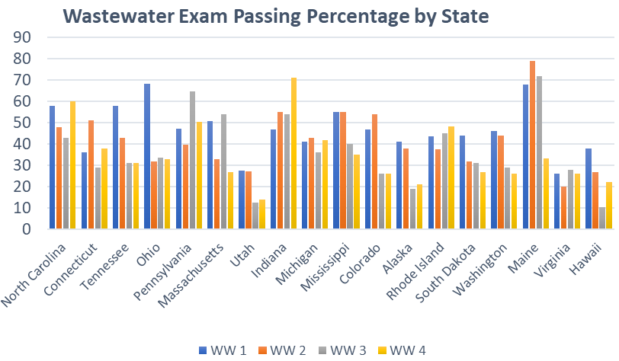
Wastewater Certification Passing Percentage by State
Avg. Pass Rate
47%
42%
37%
35%
Notes:
Understanding the organization from the top to bottom
How to recruit staff
How to engage & grow staff
develop process control requirements & take ownership
have them keep developing. Employee Skills Development? ---- should actually be more about how to pass the certification exam. CCH progression path is not necessarily the issue.
Basic Advancement path
Conceptual Progression
Skills Progression
How to retain staff

Slide 6
Wastewater Certification Passing Percentage by State*
State | WW 1 | WW 2 | WW 3 | WW 4 | Data Range
North Carolina | 58 | 48 | 43 | 60 | Historical
Connecticut | 36 | 51 | 29 | 38 | 2022
Tennessee | 58 | 43 | 31 | 31 | 2009 - 2022
Ohio | 68 | 32 | 34 | 33 | 2016 - 2022
Pennsylvania | 47 | 40 | 65 | 50 | 2020 - 2022
Massachusetts | 51 | 33 | 54 | 27 | 2019 - 2021
Utah | 28 | 27 | 13 | 14 | 2019 - 2022
Indiana | 47 | 55 | 54 | 71 | 2022
Michigan | 41 | 43 | 36 | 42 | 1974 - 2021
Mississippi | 55 | 55 | 40 | 35 | Verbal
Colorado | 47 | 54 | 26 | 26 | 2022
Alaska | 41 | 38 | 19 | 21 | 2018 - 2023
Rhode Island | 44 | 38 | 45 | 48 | 2018 - 2022
South Dakota | 44 | 32 | 31 | 27 | 2022
Washington | 46 | 44 | 29 | 26 | 2021 - 2022
Maine | 68 | 79 | 72 | 33 | 2019 - 2023
Virginia | 26 | 20 | 28 | 26 | 2022 - 2023
Hawaii | 38 | 27 | 11 | 22 | SFY 2023
*Per Each State’s Licensing Organization
Notes:
Understanding the organization from the top to bottom
How to recruit staff
How to engage & grow staff
develop process control requirements & take ownership
have them keep developing. Employee Skills Development? ---- should actually be more about how to pass the certification exam. CCH progression path is not necessarily the issue.
Basic Advancement path
Conceptual Progression
Skills Progression
How to retain staff

Slide 7
Training Program Goals
Basic level of understanding and confidence in Wastewater operations and process control
Basic level of understanding SCADA system, P&ID drawings, and discharge permits
Create a culture of communication, asking questions and accepting feedback
Develop good group dynamics for peer mentoring
Develop confidence in operational math calculations
Pass the certification exams and know how to prepare
Note: These goals are intended to be plant site specific and designed to cross train the staff at multiple facilities

Slide 8
What the Training Program is NOT
Training content solely based on passing certification exams
A classroom only style course
Training to merely satisfy CEU requirements for renewal or advancement of license
Course that is taught by one individual and/or one discipline in wastewater treatment
A math course that crams content into a consecutive 20-hour period
A training program that has a non-adaptable curriculum/schedule

Slide 9
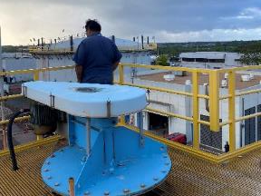
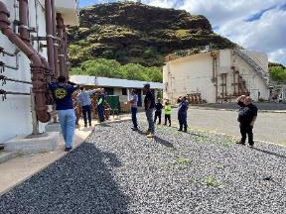
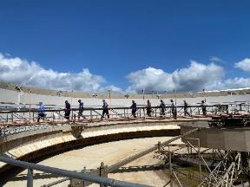
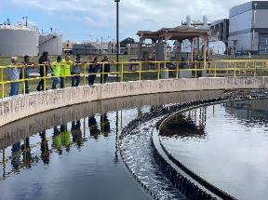
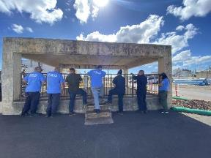
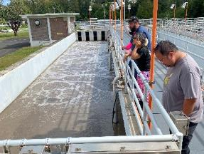
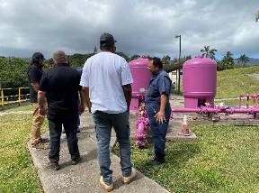
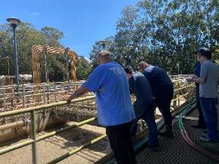
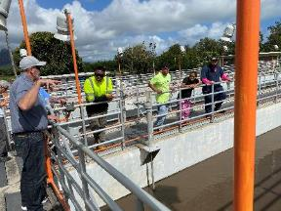
Experience at Different Sites - CCH
Through the program, students visited every CCH Treatment Plant on island.
Honouliuli WWTP
Sand Island WWTP
Kailua RWWTP
Waianae WWTP
Laie WRF
Wahiawa WWTP
Kahuku WWTP
Waimanalo WWTP

Slide 10
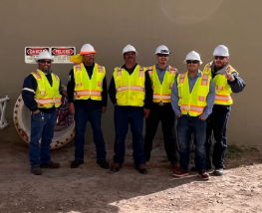
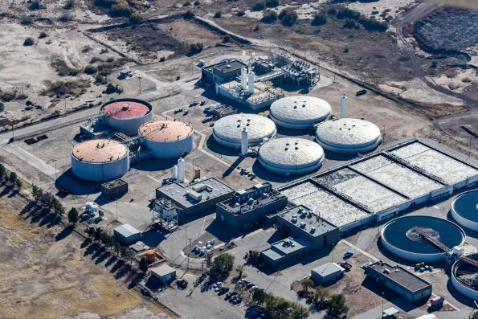
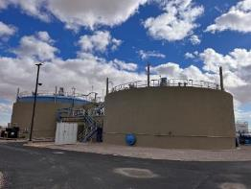
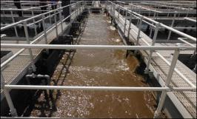
Experience at Different Sites - EPW
Through the program, students frequently visited each of the four wastewater treatment plants.

Slide 11
Conceptual Training Layout
 | MONDAY | TUESDAY | WEDNESDAY | THURSDAY | FRIDAY
Classroom Week | Class/Field | Class/Field | Class/Field | Class/Field | Assessment
Field Week | Week Prep | In the Field | In the Field | In the Field | Assessment
THEORY
CLASSROOM
ON-PAPER
DRAWINGS AND MANUALS
APPLICATION
SCADA/SCENARIOS
IN-THE-FIELD
ON THE JOB/REAL LIFE

Slide 12

City and County of Honolulu 13 Week Schedule Overview
WEEK | CONTENT | WEEK TYPE
1 | General Content, Safety, SOPs | Classroom Week
2 | Equipment Overview | Classroom Week
3 | Equipment | Field Week
4 | WW Characterization, Sampling, Preliminary & Primary Treatment | Classroom Week
5 | WW Characterization, Sampling, Preliminary & Primary Treatment | Field Week
6 | Secondary Treatment - Session 1 | Classroom Week
7 |  | Field Week
8 | Secondary Treatment/Laboratory- Session 2 | Classroom Week
9 |  | Field Week
10 | Disinfection/Advanced Treatment | Classroom Week
11 |  | Field Week
12 | Solids and Solids Handling | Classroom Week
13 |  | Field Week

Slide 13

El Paso Water Training Schedule
WEEK | CONTENT | WEEK TYPE
1 | Equipment Overview/Maintenance | Classroom Week
2 |  | Field Week
3 | Math Introduction, Wastewater Characterization/Water Chemistry | Classroom Week
4 |  | Field Week
5 |  | Field Week
6 | Plant Drawings, SCADA, and Permit Requirements, Preliminary & Primary Treatment | Classroom Week
7 |  | Field Week
8 |  | Field Week
9 | Secondary Treatment - Session 1 | Classroom Week
10 |  | Field Week
11 |  | Field Week
12 | Secondary Treatment / Laboratory- Session 2 | Classroom Week
13 |  | Field Week
14 |  | Field Week
15 | Disinfection / Advanced Treatment | Classroom Week
16 |  | Field Week
17 |  | Field Week
18 | Solids and Solids Handling | Classroom Week
19 |  | Field Week
20 |  | Field Week

Slide 14
Typical Training Layout
Classroom Week
Continual Assessment
Classroom Modules
Field Exposure
On-Demand
PowerPoint/Tablet Module trainings with integrated assessment
Self-tracked via software program
Real time metrics to adjust training needs on the spot
Mini trainings from guest speakers
On-the-job shadowing with the BC trainer
Equipment demos with the BC trainer
Practice maintenance-type work with the BC trainer
On-demand trainings for Operators to review content (Labs, Worksheets, Calculations)
P&ID drawings, Permits and Operations manual review
Classroom content and exams can be reviewed
Practice Exams available
Test prep type questions related to the classroom content
Surveys
Quizzes
Crossword Exercises
Math Exercises
End of Week Presentations

Slide 15
Typical Training Layout
Field Week
Field Packets
On-the-Job Field Work
Friday Assessment
Drawings and P&IDs
SCADA
Scavenger Hunt
ACEs
Discussion on OJT
Calculations
Crossword Puzzles
Coordinate closely with current operations to develop a list of duties to go through with new recruits for the week related to classroom training
Go through checklists/daily rounds of routine duties
Proficiency Testing
Create scenarios which require the operators to make decisions on what to do
Relating OJT with SCADA and Drawings
Could include decision making from lab work
Could include writing narratives

Slide 16
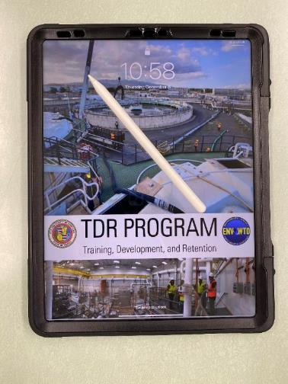
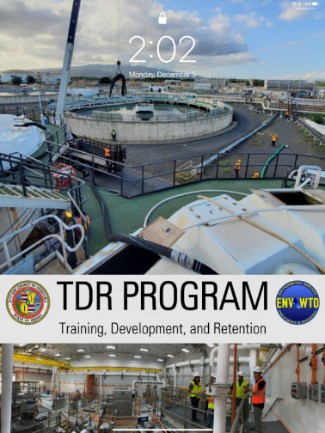
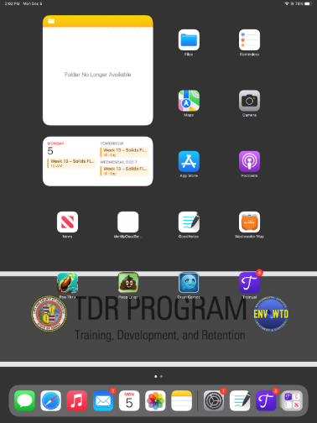
Field/Classroom Tablet

Slide 17
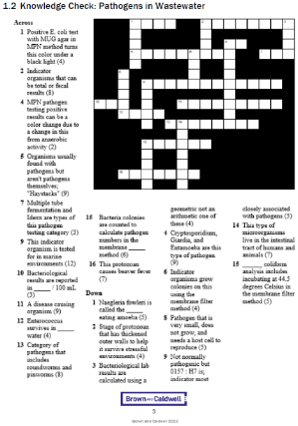
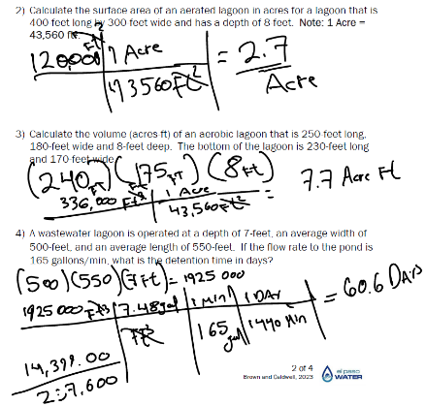

Session Activities for Field and Classroom
Notes:
GoodNotes was the note-taking application which we utilized.
As shown, individual file folders were created for trainees to download files to and keep track of their own materials. They were able to complete crosswords and math problems, as well as take pictures (not shown on this slide). There is no integrated calculator, however.
Another aspect of this program that was helpful is that the iPads could be connected to large displays via USB-C to HDMI ports. This meant that trainees could display their progress through problems on the iPad by simply connecting it, so there wasn’t a strict need for chalkboards or whiteboards.

Slide 18
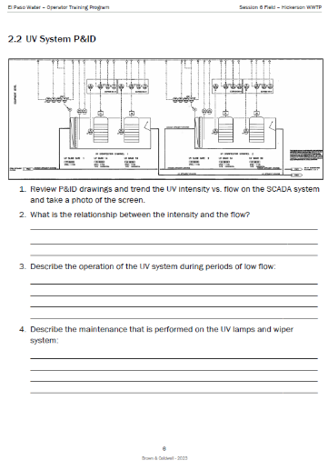
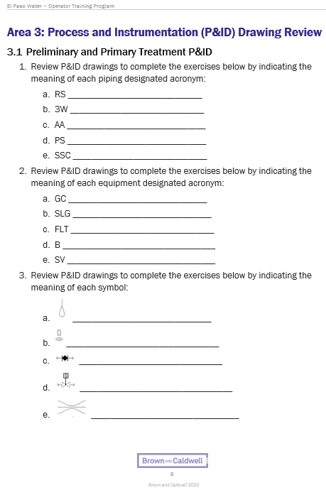
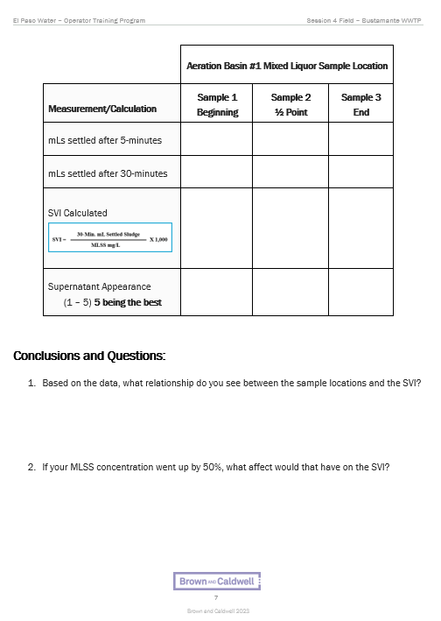
Session Activities for Field and Classroom (Continued)
Notes:
GoodNotes was the note-taking application which we utilized.
As shown, individual file folders were created for trainees to download files to and keep track of their own materials. They were able to complete crosswords and math problems, as well as take pictures (not shown on this slide). There is no integrated calculator, however.
Another aspect of this program that was helpful is that the iPads could be connected to large displays via USB-C to HDMI ports. This meant that trainees could display their progress through problems on the iPad by simply connecting it, so there wasn’t a strict need for chalkboards or whiteboards.

Slide 19
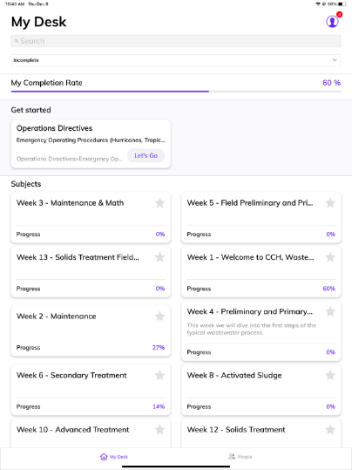
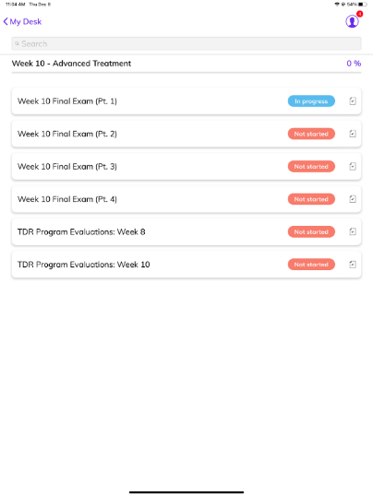
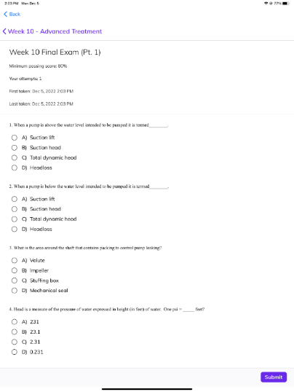
Collaborative Tracking Progress
Notes:
Trainual was the program we utilized in order to distribute quizzes to trainees, complete survey evaluations, and upload documents they were required to view.
In the case of quizzes, we were able to create multiple quizzes each week for trainees and Trainual was capable of grading each one immediately upon submissions. Results were emailed to necessary staff and reports could be accessed to track questions they got wrong and overall scoring.
For survey evaluations, the same principle applied.
And for documents, a benefit was that trainees were promptly to click through each page as prompted and had to mark documents as completed. This was important for documents they needed to review in accordance with city and county, like their directives.

Slide 20
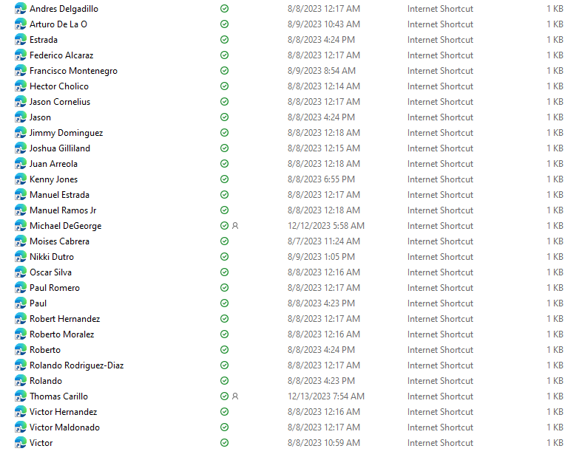
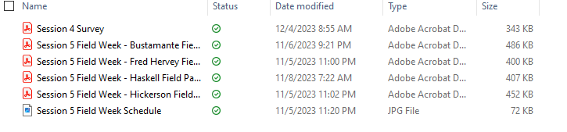
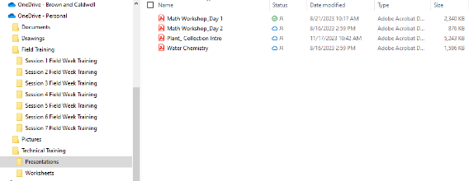
OneDrive Files
Notes:
iCloud Drive / Files
An important aspect of keeping the program up-to-date with on-the-go changes was that everything was connected online via iCloud, especially the files. iCloud files was an integral aspect of the program, utilized to upload files at a moments notice.
All of the trainee’s iPads were connected to the same iCloud, so they had instant access to any uploads and the ability to download this files from the cloud onto their individual iPads, particularly within GoodNotes, enabling editing for pictures and note-taking.

Slide 21
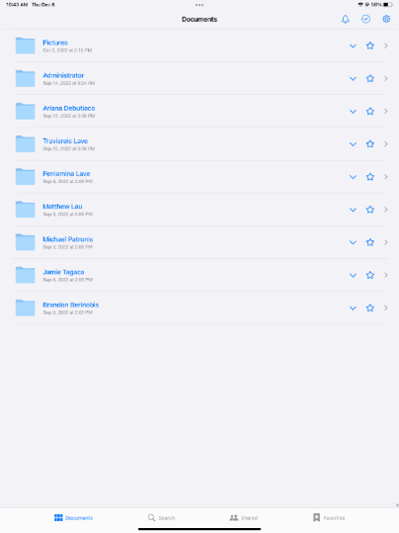
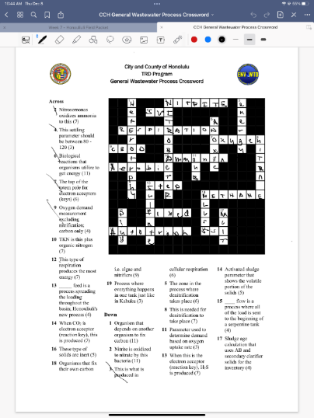
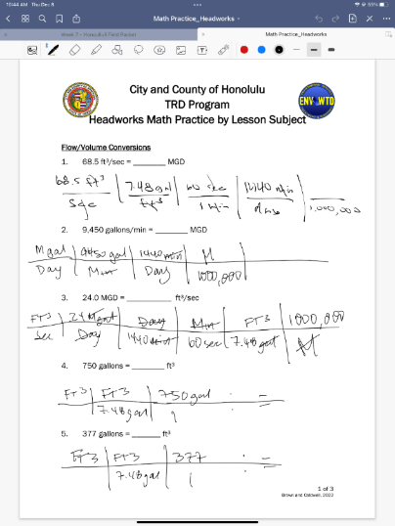
Tracking Software and Note Taking
Notes:
As shown, individual file folders were created for trainees to download files to and keep track of their own materials. They were able to complete crosswords and math problems, as well as take pictures (not shown on this slide). There is no integrated calculator, however.
Another aspect of this program that was helpful is that the iPads could be connected to large displays via USB-C to HDMI ports. This meant that trainees could display their progress through problems on the iPad by simply connecting it, so there wasn’t a strict need for chalkboards or whiteboards.

Slide 22
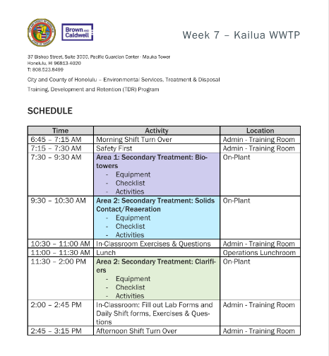
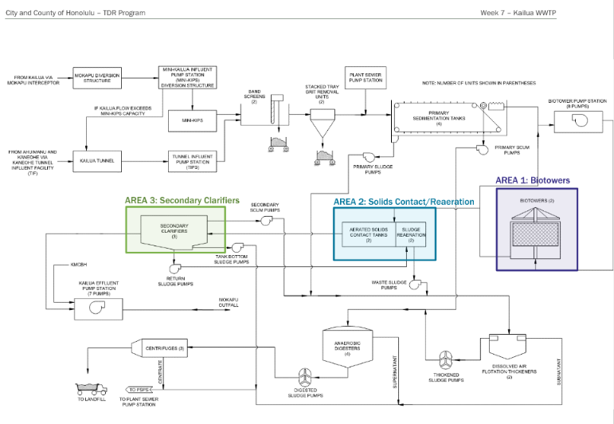
Field Packet Example
Notes:
An example of the field packet – field packets included an overall schedule, a map of areas that were “targeted” for each location, important or notable equipment for each location, checklists or equivalent of operators’ duties for each location, and activities.

Slide 23

ACE Field Activity
Assess the situation (What is the problem?)
Find the Cause (What is the root cause?)
Execute (What actions should we execute to mitigate and prevent recurrence?)
Exercises designed to follow the above steps which involves providing a written statement for each step. Idea being to promote problem solving skills and understanding of various process topics.

Slide 24
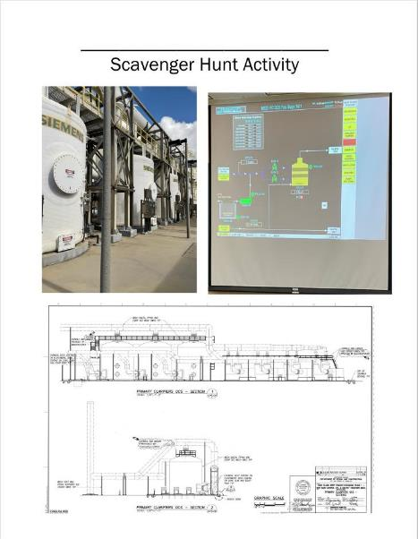
Activities – Scavenger Hunt
Student were given pieces of equipment to identify in the following subjects:
  SCADA
  Drawings (P&IDs)
  Onsite visual identification
Once equipment is identified a picture is taken and loaded on iPad.
This helped Operators understand the resources they have and to be able to find equipment in the field, on SCADA, and in the drawings!

Slide 25
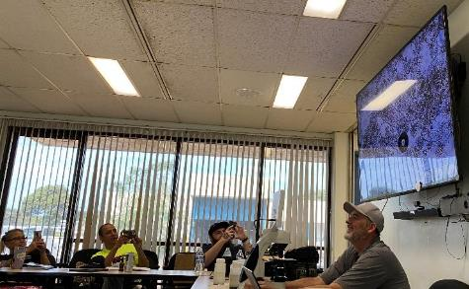
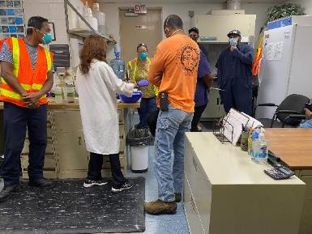
LESSONS LEARNED:
Classroom Week
Limit individual lectures to 1-hour
More field trips to backup lecture content
Math practice was surprisingly a hit
More in-class activities
“Lab exercises”
Crossword puzzles, quizzes, review questions
Presentations
Math practice
Re-assess time spent on process areas
Promote more vendor and/or guest lectures
Encourage frequent visits from existing staff to the classroom

Slide 26
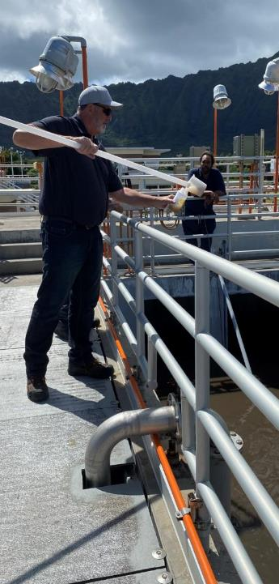
LESSONS LEARNED:
Field Week
Need more than a one-week period in between classroom sessions
Communication is important (example: maintenance PMs)
Access to “seasoned” operations staff was limited at times
Plants should have alternate trainers available and
pre-assigned
Field packet completion should be reviewed more closely by BC/Client Staff
Access to some field and process control equipment was limited at times
P&ID and SCADA training/exercises proved to be very beneficial

Slide 27
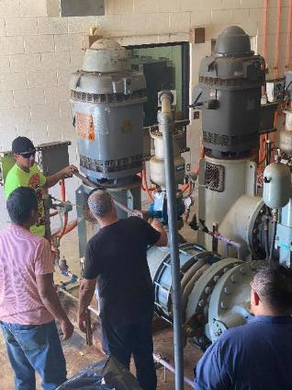
LESSONS LEARNED:
Overall
More participation by existing staff improves training success
Communication is important (example: field activities).
If the program is for brand new operators, consideration that probationary employees be exposed to plant staff as much as possible.
To prevent learning "burnout" classroom weeks should be broken up with field weeks and time doing normal operator duties.
Important to stress access to plant drawings, O&M manuals, SCADA, and plant data should be provided before the class starts.
The program started positive relationships and comradery that might never have been promoted without the cross training at different facilities
Most importantly…Be flexible! Things will change from original plan.

Slide 28
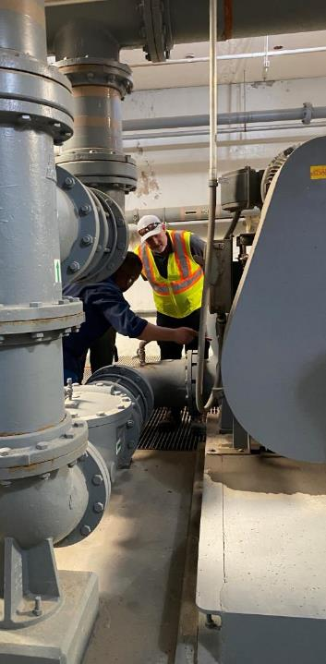
Questions You Need to Ask
Do we have the resources for field support trainers?
Will the current staff support/embrace the program?
What level of onsite presence/supervision do we need?
How will the hiring process effect start date?
Who will be your champions for this program?

Slide 29
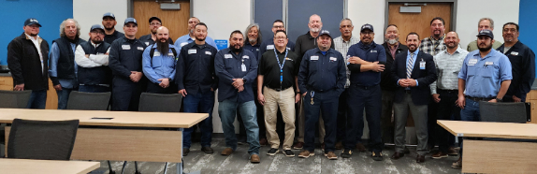
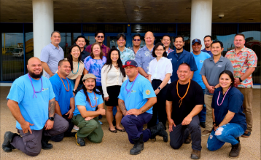

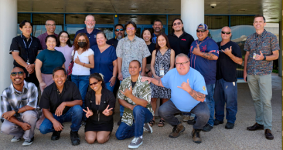
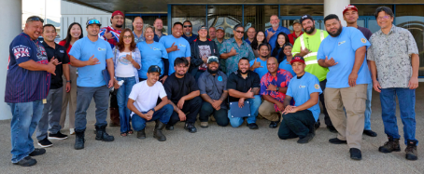
Lance Mason
Brown and Caldwell
Lmason@BrwnCald.com
602.296.9951

