Slide 1

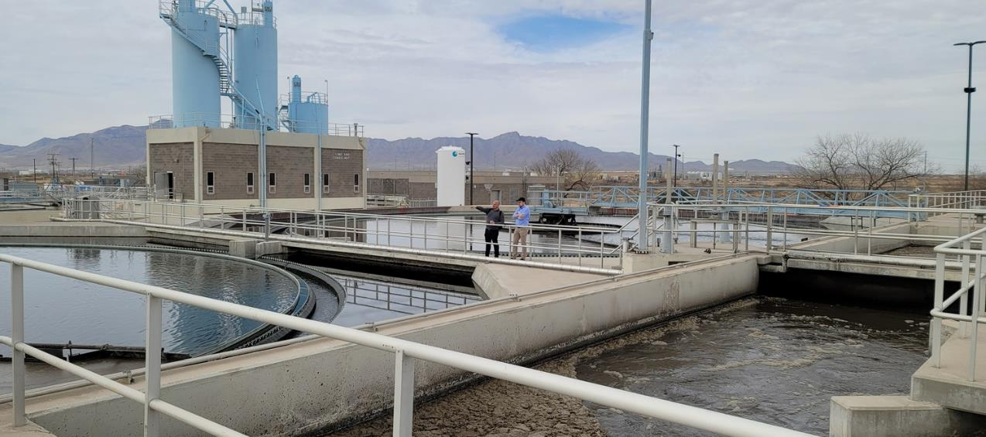



Fred Hervey WRP:
Post-Packaging of Improvements Save Time and Money
Tina Hanson, Garver
Ivan Hernandez, El Paso Water
Alonso Leyva, MGC

Slide 2
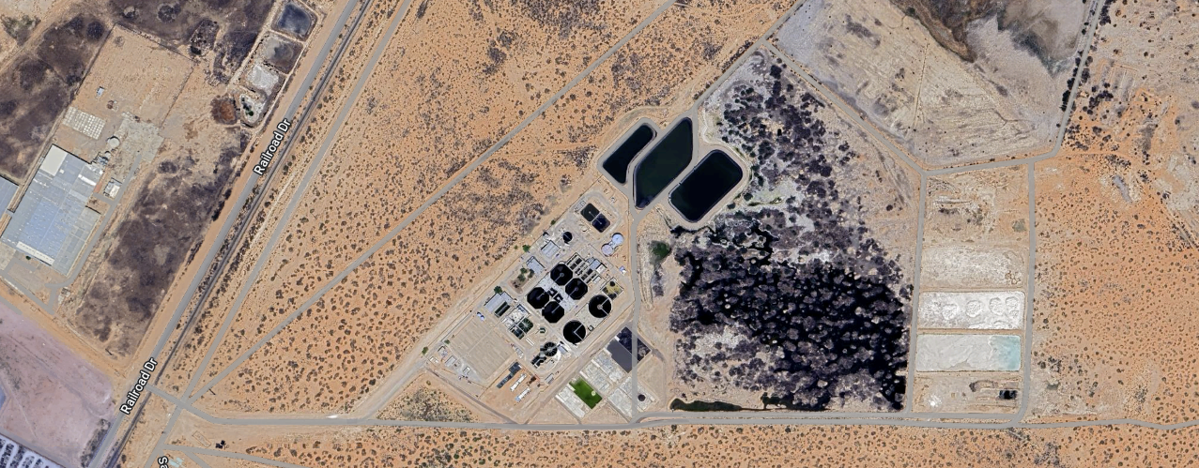
El Paso Water’s Fred Hervey Water Reclamation Plant is a critical part of the region’s water infrastructure, treating 12 million gallons of wastewater per day and since 1985 returning 12 billion gallons of water to the aquifer.
Notes:
This plant was one of the first in the nation to treat reclaimed water to drinking water standards. Since 1985, the plant has returned nearly 30 billion gallons of water to the aquifer.
1985
FH Various Improvements $75M
Plant overview/history of plant
Staff size?

Slide 3
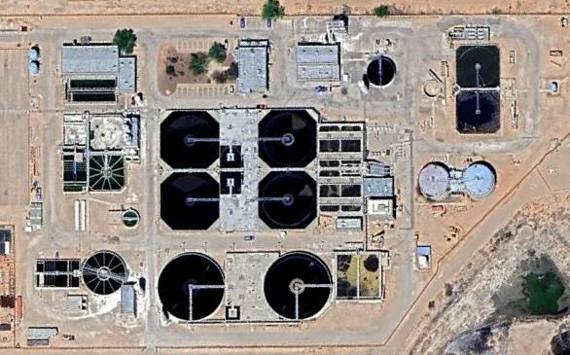
El Paso Water was faced with multiple improvement projects at one facility.
Garver
Headworks facility
Grit system
Odor control
Sluice gates
Denitrification facility
Media filtration replacement
GAC
Parkhill
Primary clarifiers
Lime reactors and recarbonation clarifier
Clarifier rehab
Freese & Nichols
Ozone

Slide 4
Over the next 25 minutes, we will discuss how the use of the CMAR delivery method saved both time and money.
CMAR Procurement
Design Coordination
Pre-Construction
Construction Progress

Slide 5

CMAR Procurement

Slide 6
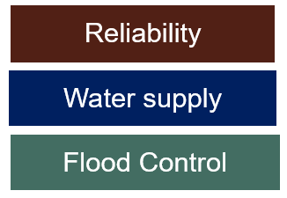
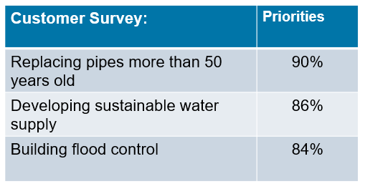
The scale of our CIP drove the need for efficient project delivery methods.
EPWater was not immune to the impact the global pandemic had on its CIP
The fiscal implications the pandemic created required slowing down the rate at which the CIP was delivered
Customer satisfaction outreach was crucial during this period of uncertainty to help us gage the needs for the utility
After the pandemic surge there was a need to “catch-up” on replacing aging infrastructure

Slide 7
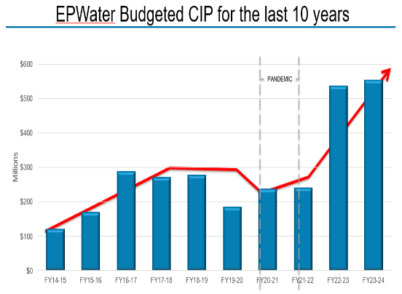
The scale of our CIP drove the need for efficient project delivery methods.
In FY2022 EPWater saw a 72% increase to the annual budget
  Over 90 projects identified (4x’s higher than the previous 5yr average)
EPWater was not the only agency “catching-up” – competing with other agencies for contractors
EPWater took a holistic approach to the issue and considered using alternative delivery to execute the CIP

Slide 8
Challenges created uncertainty, driving up costs.
Inflation
Market
Volatility
Labor Shortages
Challenges
Energy
Market
Uncertainty
Recruiting/
Retention
Supply
Chain

Slide 9
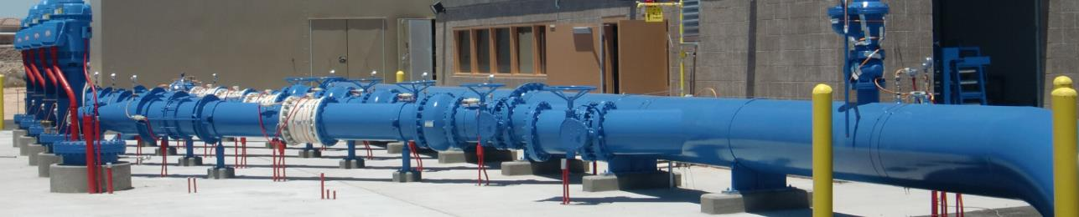
Early Execution Strategy: Low Bid Fast!
Accelerated execution of construction contracts
Early procurement (pre-purchase/owner furnished) critical material
Increase the awareness of the contracting community of upcoming EPWater work
Strategic creation of programs for certain types of projects to create “attractive” projects
Notes:
Public service board passed a resolution that would allow the President/CEO to award Low Bid projects under $6M. All in an effort to lock-in pricing during the volatile market and to get boots on the ground asap
With owner furnished equipment will reduce the overall delay on starting projects however there is the risk of finger-pointing if equipment fails
Because of all the work out for bid, contractors were “picking & choosing” what projects to bid on. We received on multiple occasions one-two bids on projects

Slide 10
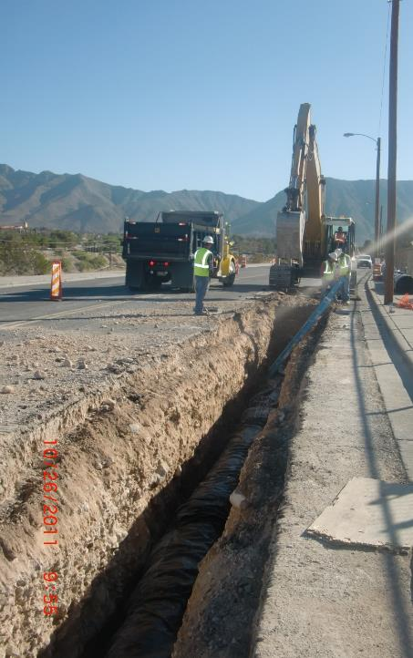



What went well:
What went well:
Doubled the number of projects advertised for bid (DBB & CSP).
Reduced the amount of time to enter into contracts
What didn’t:
Too many projects “out in the streets” at one time
Same bidders on our projects.
Awarding too many projects to single contractors
Lack of interest for some projects
  Contractors picking and choosing
  Competing with other regional agencies
What we learned:
Change to our CIP execution strategy was necessary
Embrace Alternative Delivery
Doubled the number of projects advertised for bid (DBB & CSP).
Reduced the amount of time to enter into contracts
What didn’t go well:
Too many projects “out in the streets” at one time
Same bidders on our projects.
Awarding too many projects to single contractors
Lack of interest for some projects
  Contractors picking and choosing
  Competing with other regional agencies
What we learned:
Change to our CIP execution strategy was necessary
Embrace Alternative Delivery

Slide 11
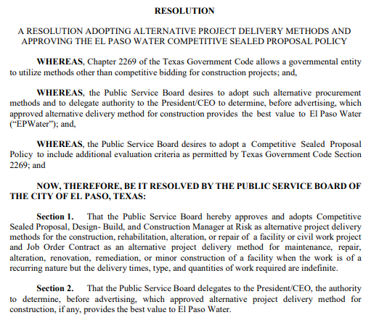
Background
Construction services are procured in accordance with Texas Gov’t Code Chapters 2252, 2253 and 2269
The majority of EPWater’s capital improvement projects are executed via the Competitive Sealed Bid (Low Bid) method
In May 2017, EPWater Public Service Board adopted the use of Alternative Project Delivery Methods
.

Slide 12





Embracing Alternative Delivery
There are six (6) construction delivery methods under Ch. 2269, Texas Gov’t Code.
Competitive Sealed Bid (traditional Low Bid)
Competitive Sealed Proposal
Construction Manager at Risk (CMAR)
Construction Manager Agent
Design Build
Job Order Contractproject.

Slide 13
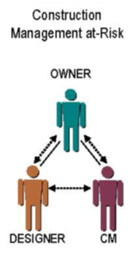
Why CMAR?
Provides innovative, cost-effective ways to accomplish work without sacrificing the owner’s needs
Early contractor involvement during design & develop a highly collaborative approach between all parties, preferably at 30% design
Proven advantages include:
  Earlier knowledge of costs
  Flexibility both to design modifications and schedule
  Quicker delivery
  Start-to-finish collaboration
  Flexibility to dictate phasing and sequencing

Slide 14
Why CMAR?
Early contractor involvement during design & develop a highly collaborative approach between all parties, preferably at 30% design
Owner contracts separately with Designer & Contractor (Loyalty!)
Need to accelerate the schedule
Ability to execute projects in multiple phases, including early procurement of long lead materials
Ability to dictate construction sequencing

Slide 15
Why CMAR?
Achieve better cost certainty and cost control
  Transparent “Open Book” procurement
  All trades are competitively procured, including those to be self-performed by the CMAR
Owner is not required to accept GMP and can opt-out if negotiations with CMAR are unsuccessful

Slide 16
Lessons Learned: Combining Similar Projects
Why it matters:
Combine multiple, small-scaled projects into a single program project
Reduces the number of projects to bid therefore reduced administrative work
Larger project will attract a larger pool of qualified contractors
Control over sequencing impacting system performance and cash-flows
Example:
  Fred Hervey WRP
    Combined 3 EORs.

Slide 17

This collaboration allowed El Paso Water to combine three design contracts into one CMAR construction contract.
Garver
Headworks facility
Grit system
Odor control
Sluice gates
Denitrification facility
Media filtration replacement
GAC
Parkhill
Primary clarifiers
Lime reactors and recarbonation clarifier
Clarifier rehab
Freese & Nichols
Ozone

Slide 18
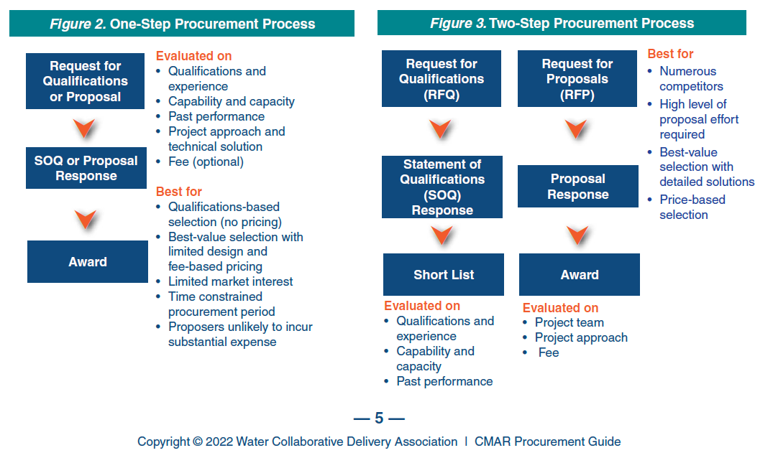
One-Step VS Two-Step

Slide 19











Construction Manager at Risk Project Delivery
PROCUREMENT
PRECONSTRUCTION
CONSTRUCTION
Owner Select Engineer & CMAR
Separate Contracts
Pre-Construction
Engineer
and CMAR Collaboration
Work Packages Procured
Competitively Bid
CMAR Proposes Guaranteed Maximum Price
Construction Begins

Slide 20









Construction Manager at Risk Project Delivery
Owner Select Engineer & CMAR
(separate contracts)
Pre-Construction (Engineer and CMAR Collaboration)
Work Packages Procured (competitively bid)
CMAR Proposes Guaranteed Maximum Price
Construction Begins
Procurement
Preconstruction
Construction
MAG – this is clients slide but if we could re-do it pls do.

Slide 21
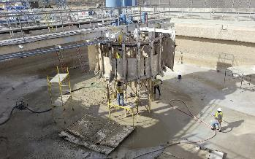
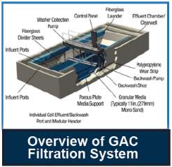
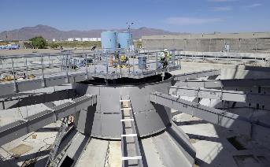
Project Schedule
January 2024
GMP1
Work Package
March 2025
GMP3 Work Package
June 2028
Construction Complete
June 2023
CMAR Pre-Construction
Services
May 2024
GMP2 Work Package
Notes:
Current Policy Adopted in 2011
Combined policy and procurement procedures
Amended June 11, 2015
Authorized the delegation of approval authority for Change Orders to VP Operations
* June 9, 2021 Purchasing & Contracts Policy introduced.
September 8, 2021 - Adopt New Purchasing and Contracts Policy.
Separate policy and procurement procedures manual
Resolution for the Competitive Sealed Proposal Policy.

Slide 22

Design Coordination

Slide 23
The three design consultants were 60 – 90% complete with design.
Garver
Headworks facility
Grit system
Odor control
Sluice gates
Denitrification facility
Media filtration replacement
GAC
Parkhill
Primary clarifiers
Lime reactors and recarbonation clarifier
Clarifier rehab
Freese & Nichols
Ozone

Slide 24
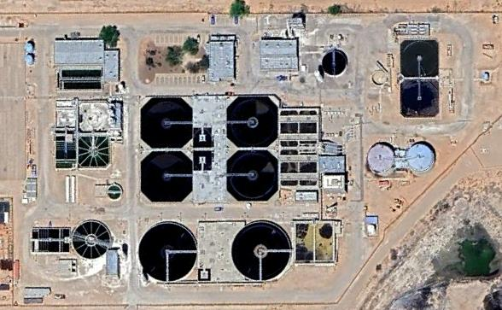
The design needed to be re-packaged into 3 GMP Packages to meet El Paso Water’s goals.
GMP1 (Garver, Parkhill)
Headworks facility
Grit system
Sluice gates
Lime reactors and recarbonation clarifier
Odor control
GMP2 (Garver, Freese & Nichols)
GAC
Ozone
Media filtration replacement
GMP3 (Garver, Parkhill)
Primary clarifiers
Clarifier rehab
Denitrification facility

Slide 25
But wait…. There is more!
Clearwell valve vault repairs
GMP1 (Garver, Parkhill)
Headworks facility
Grit system
Sluice gates
Lime reactors and recarbonation clarifier
Odor control
GMP2 (Garver, Freese & Nichols)
GAC
Ozone
Media filtration replacement
GMP3 (Garver, Parkhill, MMSE)
Primary clarifiers
Clarifier rehab
Denitrification facility
Clearwell valve vaults

Slide 26
But wait…. There is even more!
Equipment replacements are needed (Digester mixers, screenings washer/compactor conveyor)
GMP1 (Garver, Parkhill)
Headworks facility
Grit system
Sluice gates
Lime reactors and recarbonation clarifier
Odor control
GMP2 (Garver, Freese & Nichols)
GAC
Ozone
Media filtration replacement
GMP3 (Garver, Parkhill)
Primary clarifiers
Clarifier rehab
Denitrification facility
Clearwell valve vaults
Equipment replacements

Slide 27

Garver coordinated the CMAR services with each design team as the Owner’s Representative in Task Order 2.
TASK 1:
Project Management and
Administration
TASK 4:
Prepare Preliminary Construction Packaging and Implementation Plan
1
4
TASK 2:
CMAR Procurement
TASK 5:
Perform Design
Milestone Workshops
2
5
TASK 3:
Preconstruction Administration
TASK 6:
Review GMP
3
6

Slide 28




Collaboration between multiple Engineers of Record was key to project success.

Slide 29

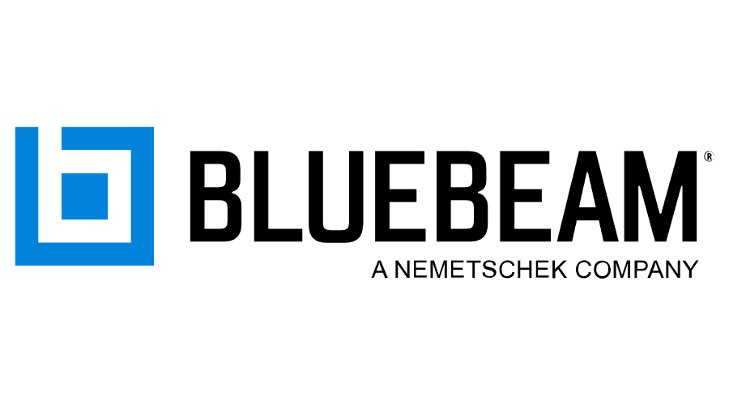
We used collaborative tools like SharePoint and BlueBeam to manage efficient design coordination.

Slide 30
Common technical specs: GMP 1

Slide 31
Common technical specs: GMP 2

Slide 32
Common technical specs: GMP 3

Slide 33
Successful coordination resulted in a unified design package ready for construction.

Slide 34

Pre-Construction

Slide 35
Risk Management
CMAR Partnerships Mitigated Risk – Professional Services Worth the Premium
Instant contractor feedback on constructability and equipment
Specific site investigations
Value Engineering
Agreed obligation to provide documentation
  Realistic schedule/sequencing, not engineered milestones
  Cost model
  RFI logs
  Project Risk Register with specific value allocation
  Procurement Plan with potential bid packages
Worked through limited CIP funds with multiple GMPs
Multiple CMARs working with and on top of each other

Slide 36
Pre-construction Schedule
CMAR team coordinating with Owner & Engineer
    EPW Fred Hervey Plant staff priorities and/or urgencies
    Take a decision on how many GMPs packages in the project
    Creating a Procurement Plan and update as design progresses
    Providing a cost model before advertisement
    Tentative schedule with long lead time items

Slide 37
Pre-Construction Tasks
Provide constructability feedback during design phase
CMAR team knowledge on industry costs
Negotiate with bidders and selection of most valuable cost proposal according to a specific criteria
      Price
      Experience
      Safety Performance
      Project Team & Approach
Goal: To have the most cost efficient design to avoid going over Owner’s budget and meet Engineer’s design intent

Slide 38
GMP Packages Logic
These are the reasons that decided to break this project into 3 GMPs
EPW Plant needs
EPW Annual Budget
Analyze construction sequencing

Slide 39
Three GMP Packages met EPW goals
GMP1 (Garver, Parkhill)
Headworks facility
Grit system
Sluice gates
Lime reactors and recarbonation clarifier
Odor control
GMP2 (Garver, Freese & Nichols)
GAC
Ozone
Media filtration replacement
GMP3 (Garver, Parkhill, MMSE)
Primary clarifiers
PACT clarifiers
Denitrification facility
Clearwell valve vaults

Slide 40

Construction Progress

Slide 41
GMP1 Progress & Status
General Contractor: RM Wright
Scope of Work: Rehabilitation of Reactor/Recarb Clarifiers, Slide Gates, Bar screens, Odor Control and Grit equipment.
NTP & Completion Dates: March 2024 & June 2026
Status: Installation of Reactor/Recarb Clarifiers, Coating, Gates & Bar screens
Challenges: Coordinate with multiple Engineers, adjust to plant needs and avoid affecting EPW operations

Slide 42
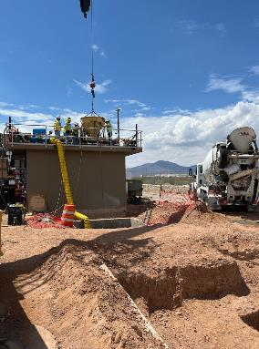
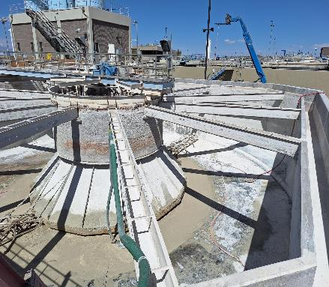
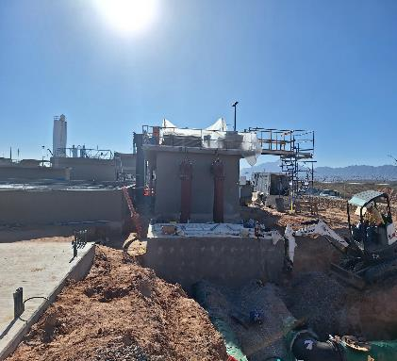
GMP1

Slide 43
GMP2 Progress & Status
General Contractor: MGC Contractors (Self-Performed)
Scope of Work: Rehabilitation of Ozone chambers, GAC basins and replacement of media filter system for a Diamond Cloth system
NTP & Completion Dates: July 2024 & March 2027
Status: Submittal/Material Procurement phase
Challenges: Coordinate with multiple Engineers, adjust to plant needs and avoid affecting EPW operations

Slide 44
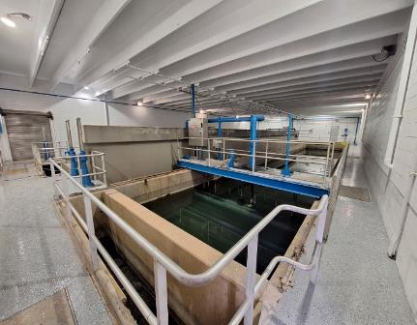
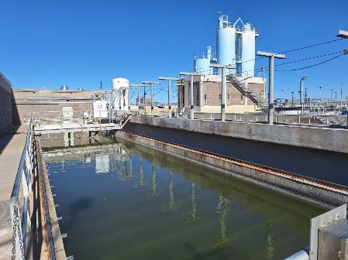
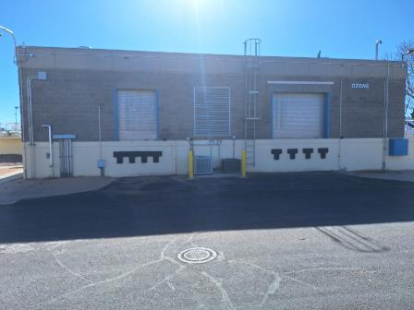
GMP2

Slide 45
The post-packaging of improvements through CMAR successfully streamlined the project, helping El Paso Water achieve its goals.
The collaborative efforts between El Paso Water, design teams & CMAR were instrumental in overcoming challenges and driving the success of the project.

