Slide 1
Total Dissolved Solids Study
Gregg Eckhardt, Senior Analyst
SAWS Treatment and
Production Operations
Meg Pierce-Walsh, Practice Leader Plummer Associates, Inc.
September 27, 2024

Slide 2
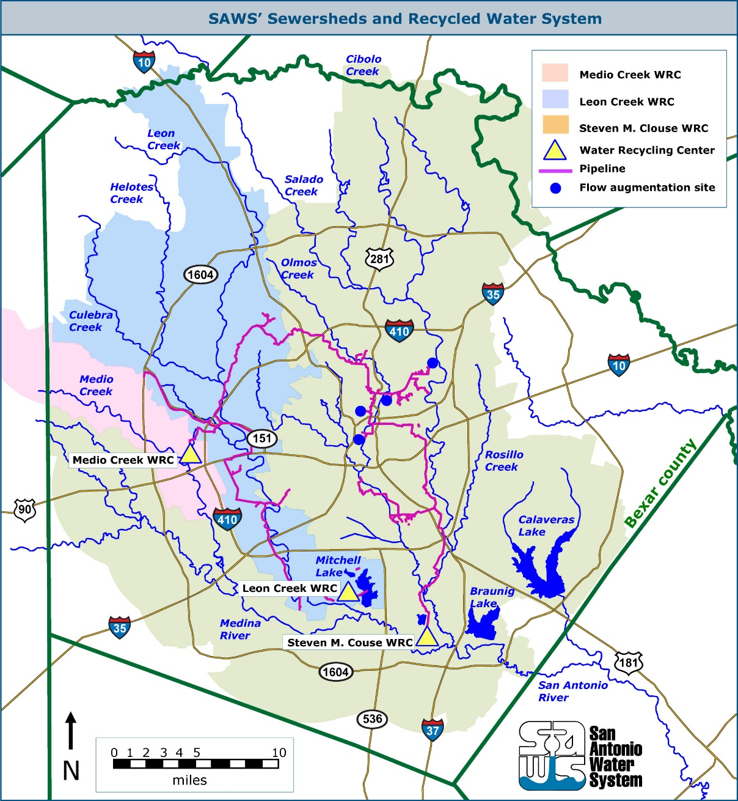
SAWS Water Recycling Centers
Three treatment facilities
6,042 miles of sewer mains
~ 100 SIUs
Primarily “very hard” groundwater
Nation’s largest direct reuse system
Discharges to effluent dominated stream

Slide 3
Effluent Total Dissolved Solids
200 – 400 mg/L
700 – 900 mg/L

Slide 4
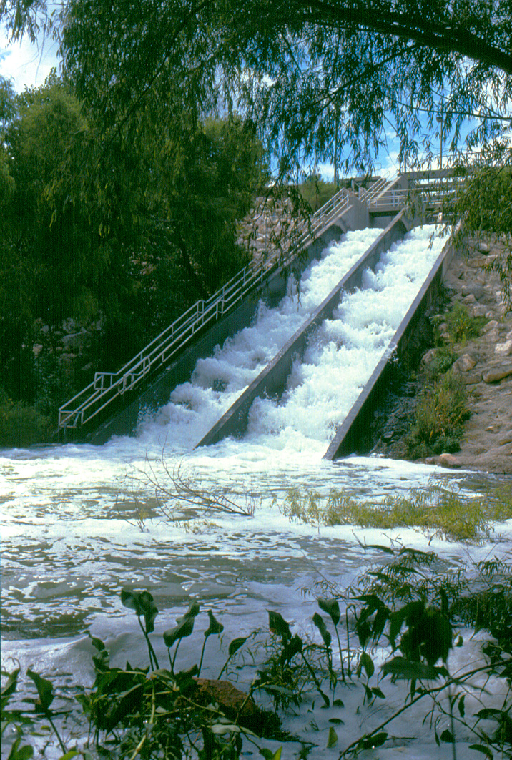
2019 Application for SMC Permit Renewal
Largest of the three plants
Permitted at 125 MGD
Has 6 permitted outfalls
One to Medina River at plant site
Five to Upper San Antonio River and Salado Creek
Streamflow augmentation discharges, water quality maintenance
SMC Outfall 001

Slide 5
SMC WRC Effluent Total Dissolved Solids
1997 to August 2024
Effluent TDS
Outfall 001
Stream Standard = 700 mg/L
mg/l

Slide 6
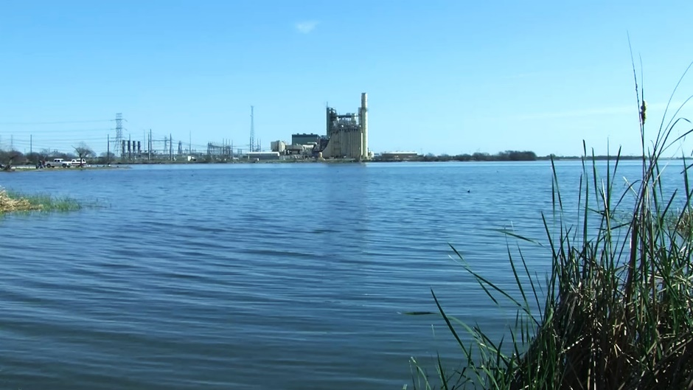
Flow Weighted Average Effluent TDS
1997 to August 2024
Flow Weighted Average Effluent TDS
CPSE Category B Standard = 700
mg/l

Slide 7
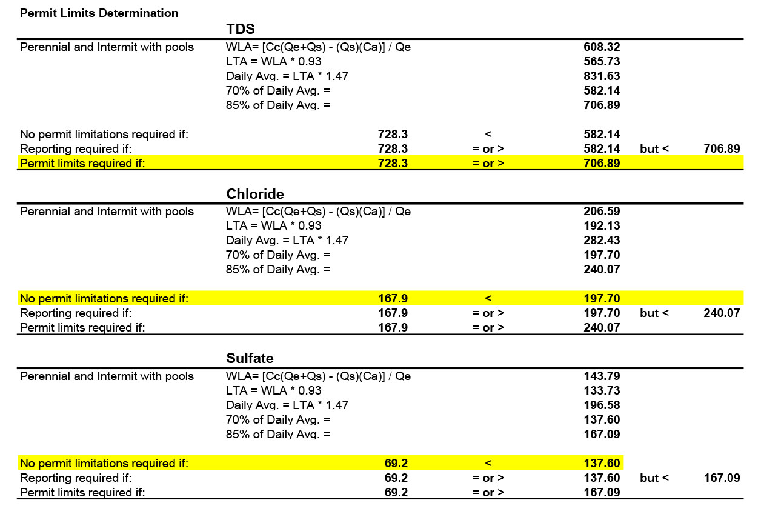
TCEQ Screening Calculations, Outfall 004
SMC Outfall 004

Slide 8
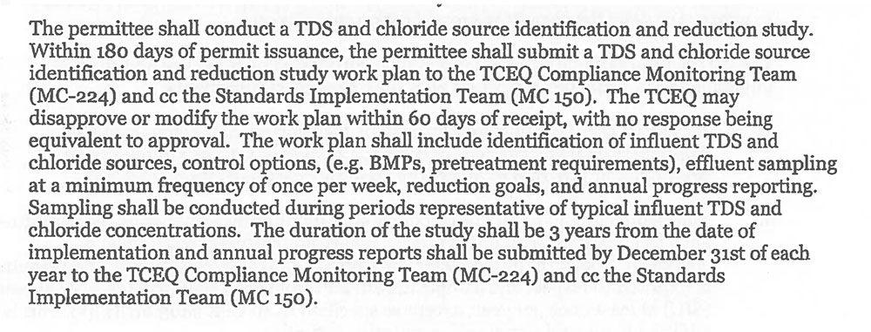
Renewed Permit Received June 20, 2019
Instead of permit limit, negotiations resulted in a requirement for a Source Identification and Reduction Study
SMC TPDES permit Special Condition 9

Slide 9
Study Requirements
Submit Work Plan to TCEQ for a 3-year study within 180 days
Identification of influent TDS and chloride sources
Control options (BMPs, pretreatment)
Effluent sampling
Reduction goals
Annual progress reporting

Slide 10
Project Solicitation Request – Professional Services
Expanded beyond SMC plant to entire service area
Collection & analysis of wastewater samples and flow data
Existing sources – residential, commercial and industrial
Determine loading (including using SAWS data)
Cost analysis – effective methods to reduce TDS
BMPs, pretreatment requirements, surcharge fees
Review potable water sources to calculate impact on loading
Water softeners impact on loadings
Prepare annual report each year and a final report

Slide 12
Work Plan Goals
Meet SMC WRC TPDES Permit Requirement
Understand TDS and chloride sources
Identify contribution by category/user:
Water supply
Industrial
Determine TDS and chloride concentrations upstream and downstream of WRC outfalls
Predict future TDS and chloride concentrations
Identify control options

Slide 13
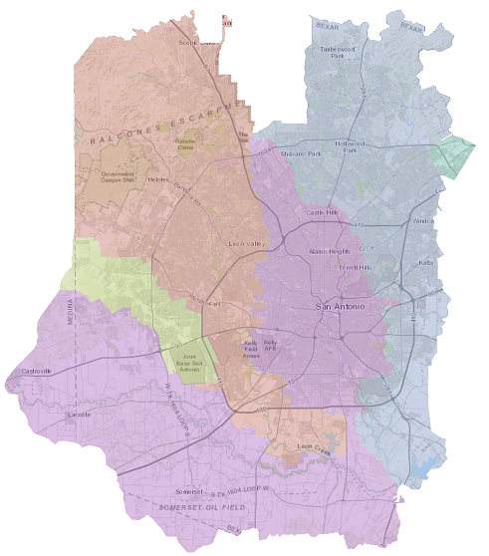
Work Plan Development

Slide 14
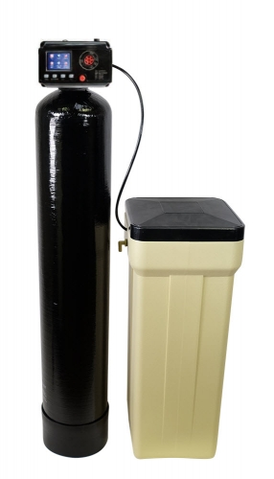
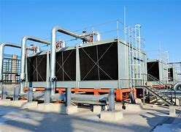
The Usual Suspects

Slide 15
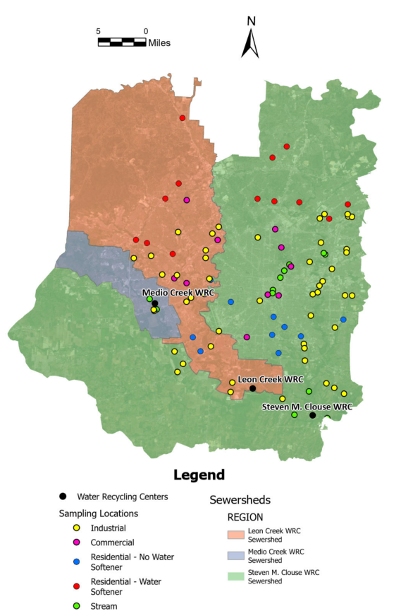
Sample Locations

Slide 16
Sample Location Breakdown
94 Total Sampling Locations

Slide 17
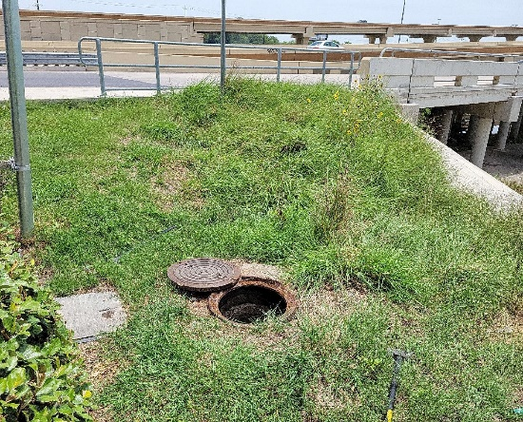
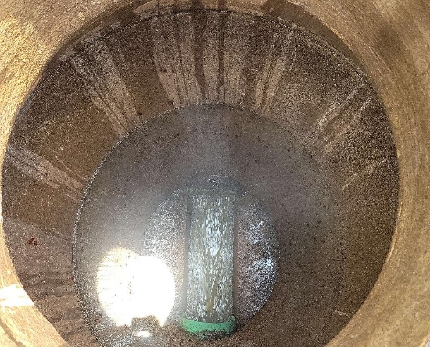
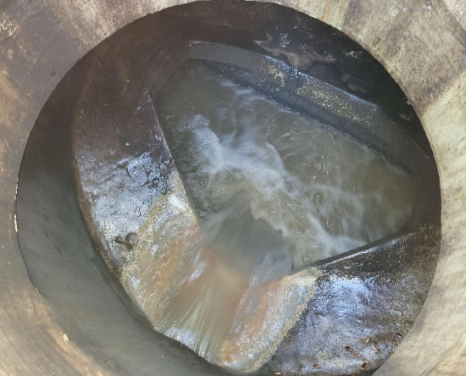
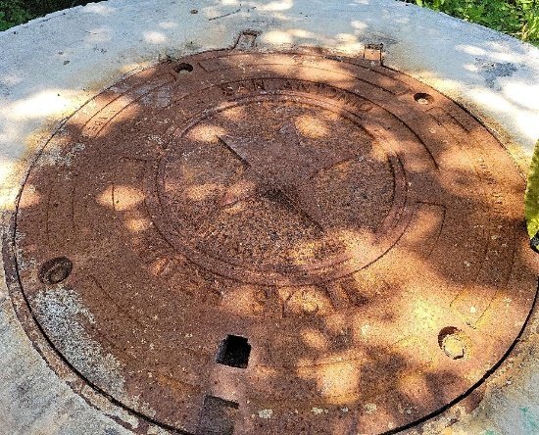
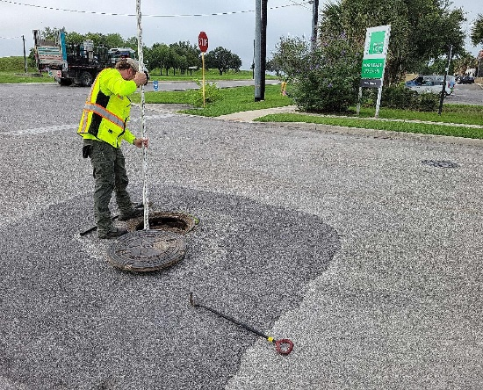
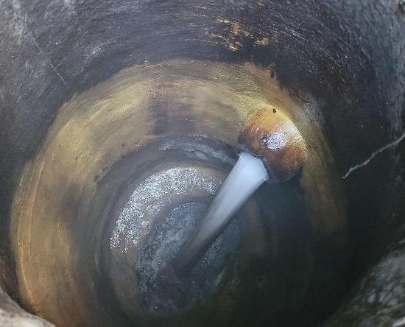
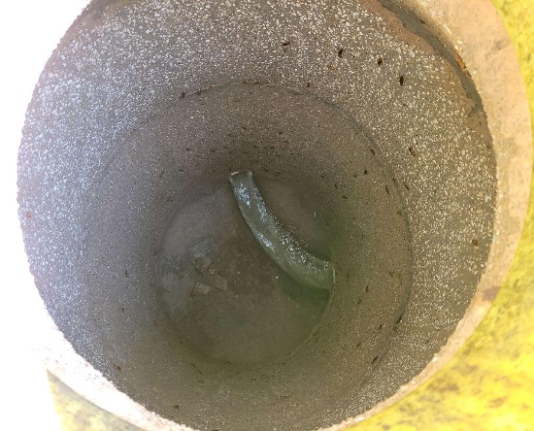
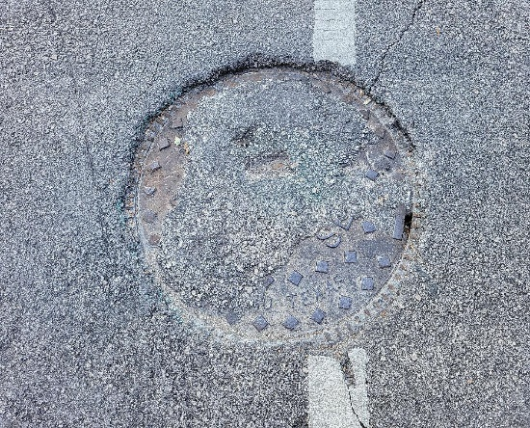
Issues in the Field

Slide 18
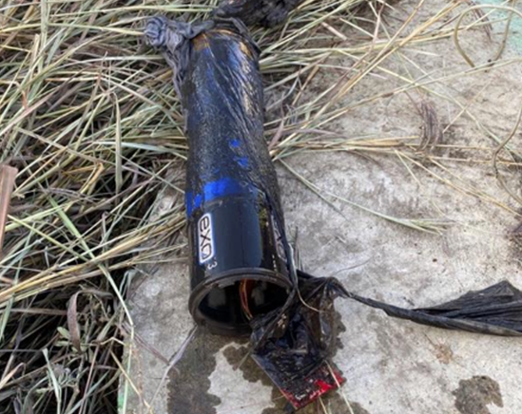
Issues in the Field
Damage Caused by Chemical Corrosion
Damage Caused by High Flow

Slide 19
Grab Sample Parameters
392 Total Grab Samples:
TDS,
total alkalinity,
specific conductivity,
chloride,
sulfate,
calcium,
magnesium,
manganese,
potassium, and
sodium.

Slide 20
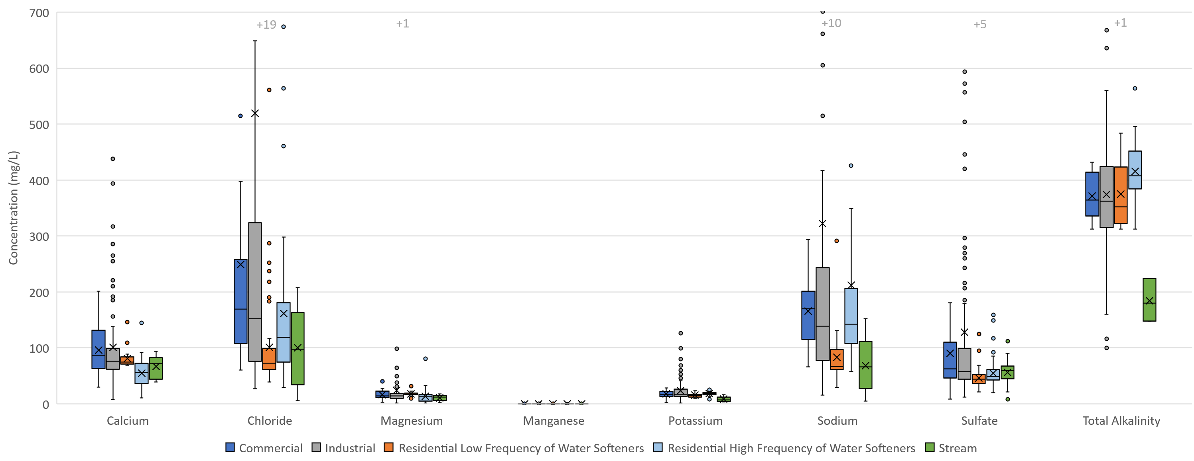
Mineral Composition

Slide 21
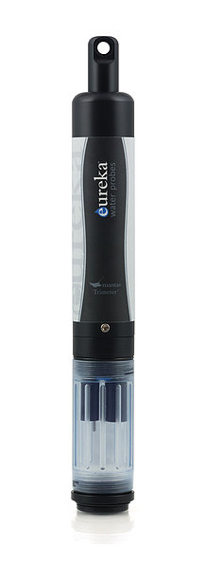
Continuous Sonde Measurements
Continuous conductivity
YSI EXO3 Multiparameter Sonde
Eureka Trimeter Multiprobe Sonde

Slide 22
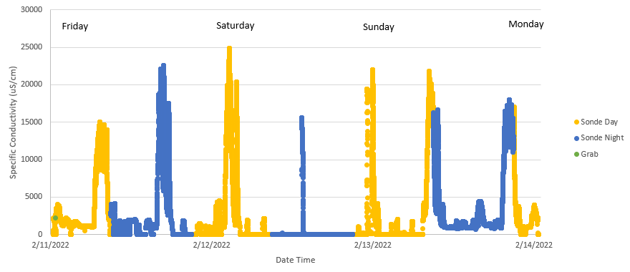
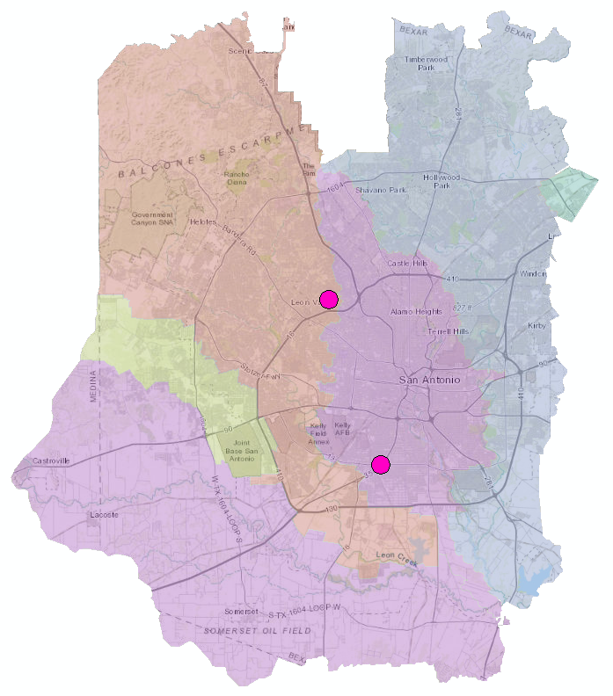
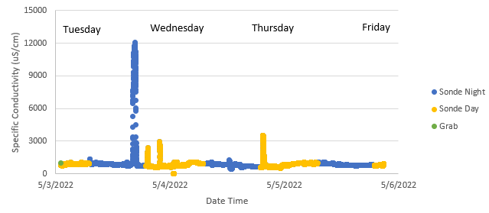
Continuous Data Examples – Commercial
C04: Hospital
C10: Commercial

Slide 23
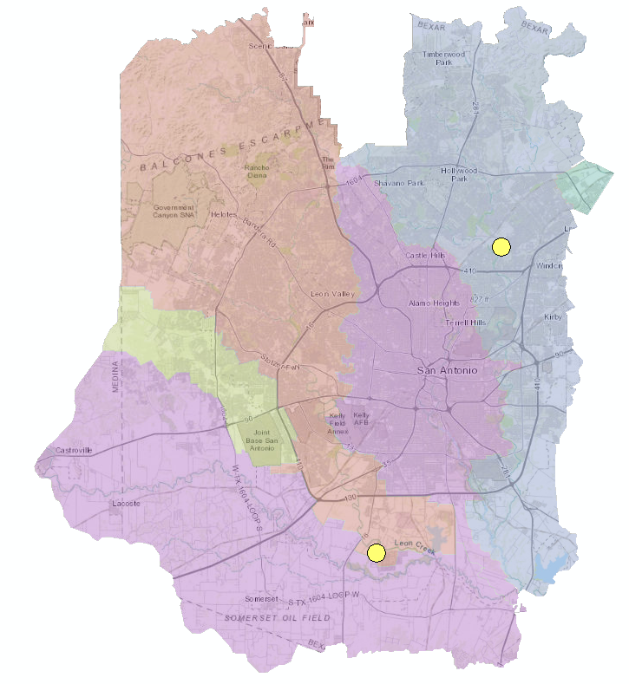
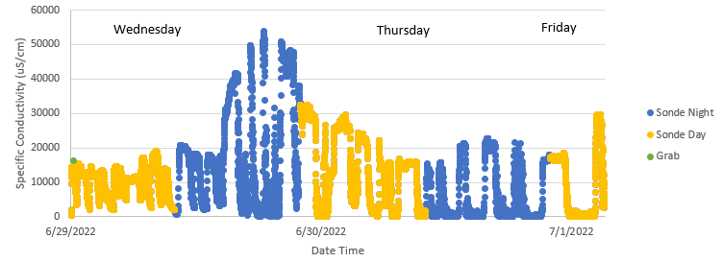
Continuous Data Examples – Industrial
I05
I06: Known Cooling Towers
I06
I05: Manufacturer
Notes:
Toyota – auto manufacturing

Slide 24
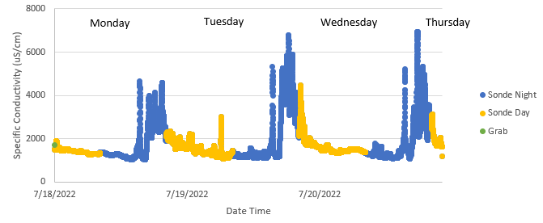
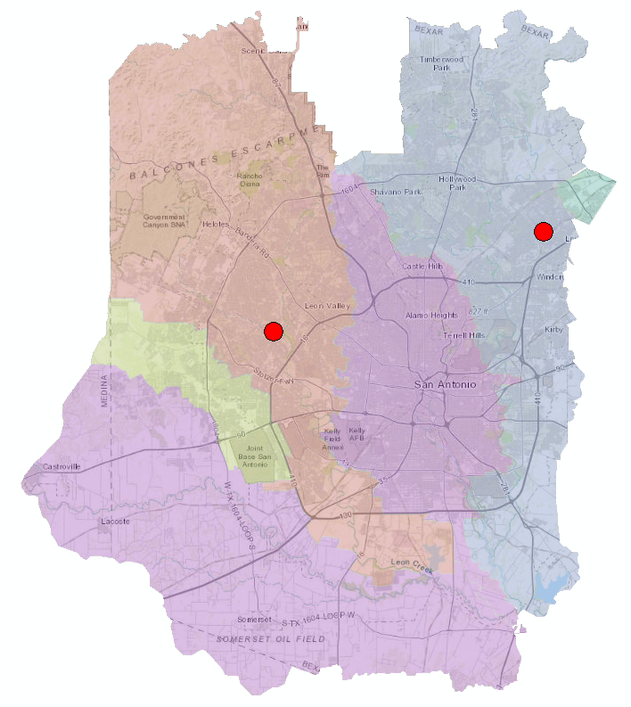
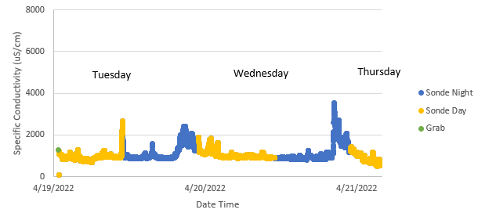
Continuous Data Examples – Residential w/Softeners
R02
R10
R02
R10
Notes:
Time of day, day of week

Slide 25
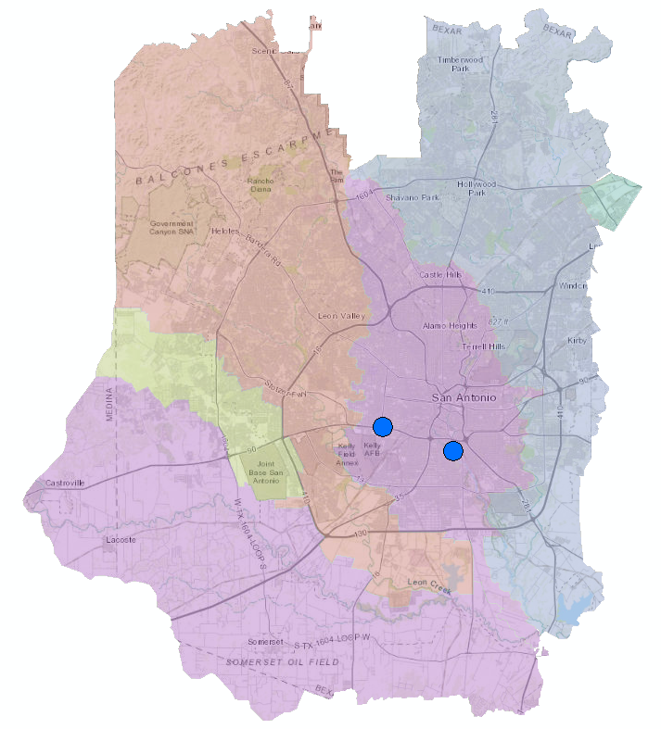
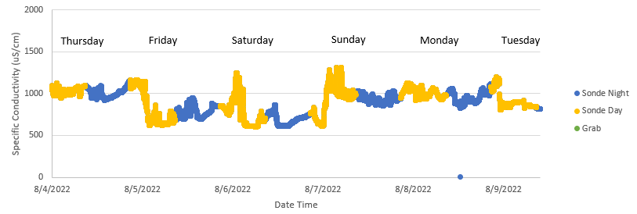
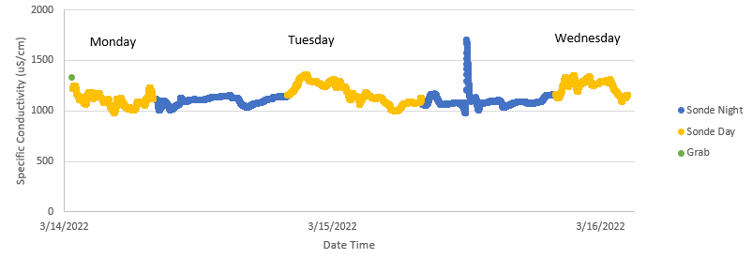
Continuous Data Examples – Residential w/o Softeners
N05
N02
N05
N02
Notes:
Spike may be a business, apartment complex, or other large capacity building. It may be a softener. May be able to use flume data.
Continue to better understand sewershed and if we need to explore further.

Slide 26
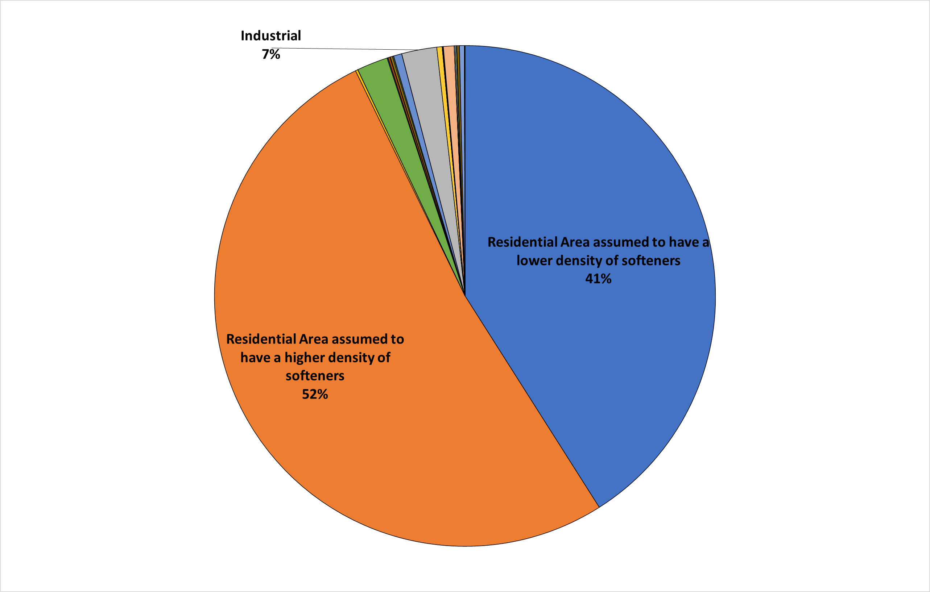
SMC Contribution Breakdown

Slide 27
Study Take Aways
Continuous data are valuable
Some manholes go dry – Plan flexibility
High concentrations do not always equal large loads
Nearly half of TDS load is from source water

Slide 28
Possible Control Options
Reduce residential TDS contributions
Rebate programs to replace inefficient water softener units
Public education programs
Training of water softener installers
Industrial dissolved salt discharge controls
TBLLs may not be practical if largest contributor is residential
Regulatory options:
Narrative restrictions
Numeric limits for target industries
Pretreatment options:
BMPs
Water conservation tools
Numeric thresholds for new/expanding industries

Slide 29
Total Dissolved Solids Study
Gregg Eckhardt, Senior Analyst
SAWS Treatment and
Production Operations
Meg Pierce-Walsh, Practice Leader
Plummer Associates, Inc.
September 27, 2024

