Slide 1
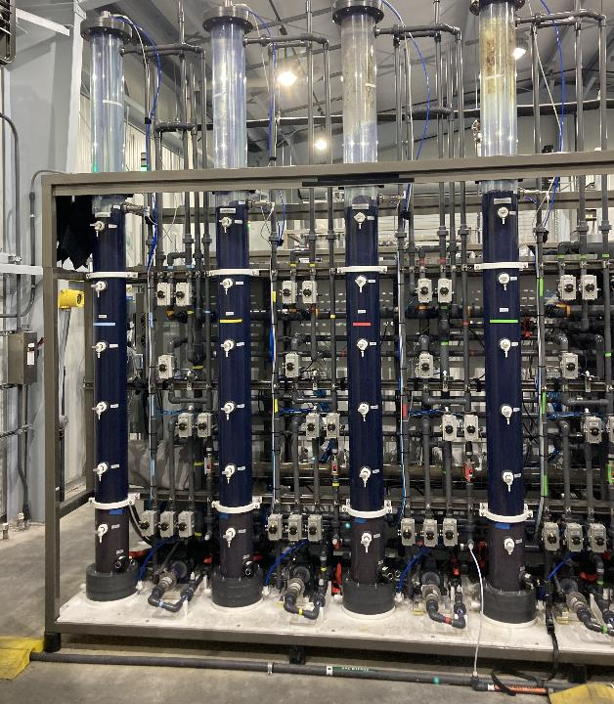

Using Carbon-Based Advanced Treatment (CBAT) to Implement "One Water" Initiatives
Chamindra Dassanayake (CD), PhD, PE
Wendell Khunjar, PhD, PE

Slide 2
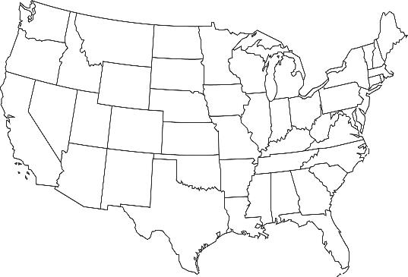
Presentation Outline
Treatment Drivers
Lessons from CBAT
The Future
Carbon Based Advanced Treatment 101
Full-scale CBAT installations
Pilot-scale CBAT investigations
UOSA
Aurora
SWIFT
Water Factory 21
Gwinnett County

Slide 3
Treatment Drivers

Slide 4
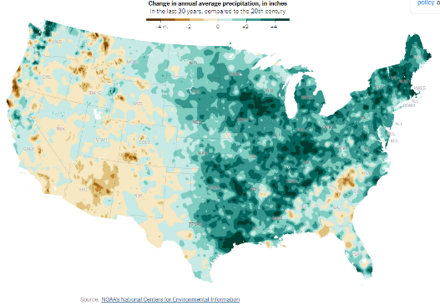
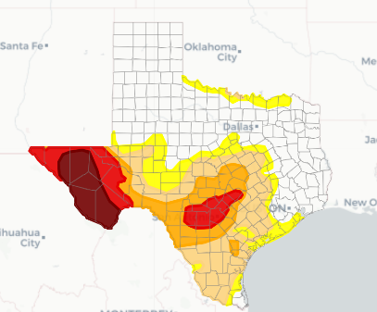
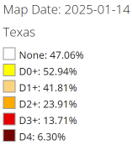
Unique Drivers Influence Movement toward Advanced Water Treatment
Drought
Cost of Production/Supply
Subsidence
Industrial/Alternative Demand
Environmental Discharge

Slide 5

Carbon Based Advanced Treatment
In 101 Seconds

Slide 6
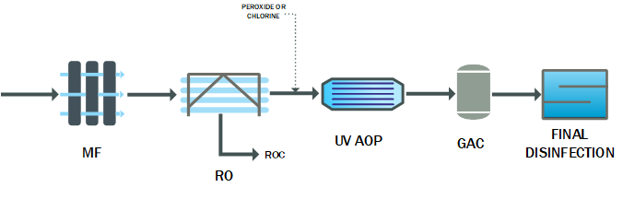
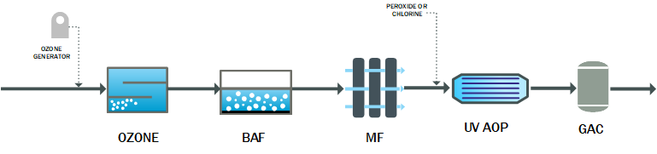
Historically, Two Main Paradigms for AWT
Chemical Barrier
Pathogen Barrier
Membrane-based
Carbon-based
Notes:
Removal of microbial and chemical constituents
Multi-barrier approach
Monitorable performance

Slide 7

Deciding Between Treatment Paradigms
Influent water quality
State Mandate for Treatment
Aquifer Compatibility
Distribution System Compatibility
TDS Reduction Needs
Concentrate/
Residual Management?
Resilience
mBAT
cBAT

Slide 8
Deciding Between Treatment Paradigms:
State Requirements, Site Specific Needs
Example: Pathogen Inactivation Log Reduction Values
 | California |  |  | Texas | Florida | Colorado
Reuse Type: | IPR (GW) | IPR (SW) | DPR | IPR or DPR | Draft DPR | DPR
Starting Point: | Raw WW |  |  | Treated WW | Raw WW | Treated WW
Enteric Viruses | 12-log | 8 to 9-log | 20-log | 8-log (min.) | 8 to 12-log | 8 to 12-log
Giardia | 10-log | 7 to 8-log | 14-log | 6-log (min.) | 6 to 10-log | 6 to 10-log
Cryptosporidium | 10-log | 8 to 9-log | 15-log | 5.5-log (min.) | 5.5 to 10-log | 5.5 to 10-log
CBAT
> 12
> 10
> 10
Additional state-specific requirements for number & type of chemical control barriers
Notes:
Highlight the TX column
Pull this down to the Franklin and GCDWR examples
Did not do microbial sampling at Franklin
Used CT approach
Show the CBAT removal potential relative to the TX
xBAT can also be footprint intensive with clarification

Slide 9
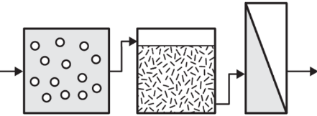
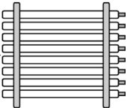
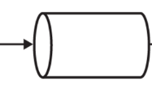

Deciding Between Treatment Paradigms
State Requirements, Site Specific Needs – HYBRID AWT
The California DPR approach to realize benefits from carbon-based in concert with membrane-based treatment trains
 | CA
Reuse Type: | DPR
Starting Point: | Raw WW
Enteric Viruses | 20-log
Giardia | 14-log
Cryptosporidium | 15-log
Secondary or Tertiary Effluent
Pure Water San Diego
Biologically
Active
Filtration
Ultraviolet Disinfection Advanced Oxidation
Ozone
Ultrafiltration
Reverse Osmosis
Potential Benefits
Improved RO permeate quality
Improved RO concentrate quality
Lower membrane costs
Notes:
Brine – main driver

Slide 10
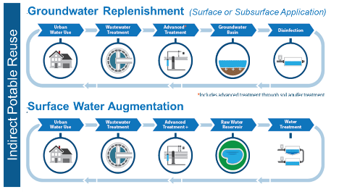
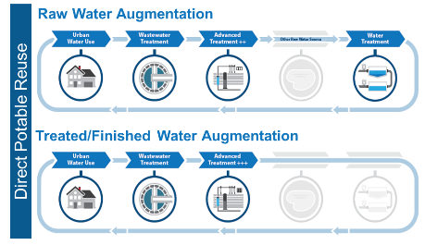
Deciding Between Treatment Paradigms: Flexibility!
For inland utilities, need treatment concepts that support multiple end use opportunities :
  Non-potable Reuse
  Groundwater Augmentation
  Surface Water Augmentation
  Raw Water Augmentation
Also minimize concentrate/residual disposal challenges
Carbon Based Advanced Treatment can be advantageous

Slide 11

Evaluating Outcomes from Multiple Perspectives
Consultant
Utility
Regulator
Public
What is the influent water quality, what are the effluent water quality targets, what are the risks, and what tools (processes) do I have to produce the desired water?
How do I balance water and wastewater needs, what option is the most cost-effective, and what option best supports the mission of the utility and our end users?
What option protects public health and the environment and how will the facility be permitted and monitored?
Where is my water coming from and do I trust my utility to reliably provide clean drinking water and effectively manage wastewater at an affordable price?
What are the risks; what are the barriers; how are the barriers monitored; and what happens if a barrier fails?
Hazard Assessment and Critical Control Points (HACCP)

Slide 12
CBAT Has An Established Track Record
Project | Year | Application | Capacity (mgd) | Scale | Status
National
Upper Occoquan Service Authority (UOSA), VA | 1978 | IPR | 53 | Full | Operational
Fred Hervey WRF, El Paso, TX | 1985 | IPR | 10 | Full | Operational
F. Wayne Hill WRC, Gwinnett County, GA | 2006 2016 | IPR DPR | 60 - | Full Pilot | Operational Study Completed
Hamby WRF, Abilene, TX | 2015 | IPR | 7 | Full | Operational
Rio Rancho, NM | 2017 | IPR | 1 | Full | Operational
PureAlta, Altamonte Springs, FL | 2017 | DPR | - | Pilot | Operational
Hampton Roads Sanitation District (HRSD) SWIFT, VA | 2018 2026 | IPR/DPR IPR | 1 16 | Demo Full | Operational Under Construction
Colorado Springs, CO | 2021 | DPR | - | Pilot | Completed
South Jordan, UT | 2022 | DPR | - | Pilot | Operational
Anne Arundel, MD | 2023 | IPR | - | Pilot | Operational
Clay County, FL | 2023 | DPR | - | Pilot | Under Construction
Polk County, FL | 2023 | DPR | - | Pilot | Operational
Franklin, TN | 2023 | PR | - | Pilot | Study Completed
Pure Water San Diego, CA | 2011 2025 | IPR IPR | 1 34 | Demo Full | Operational Design
International
Goreangab WRF, Windhoek, Namibia | 2002 | DPR | 5.5 | Full | Operational
Eastern Treatment Plant, Melbourne, Australia | 2013 | NPR | 92 | Full | Operational
Neugut WWTP, Dubendorf, Switzerland | 2018 | NPR | 15 | Full | Operational
Cape Town, South Africa | 2026 | DPR |  | Full | Design
CBAT configuration is adaptable
CBAT is a robust treatment platform that can be further enhanced
CBAT is not proprietary

Slide 13
Lessons from CBAT

Slide 14
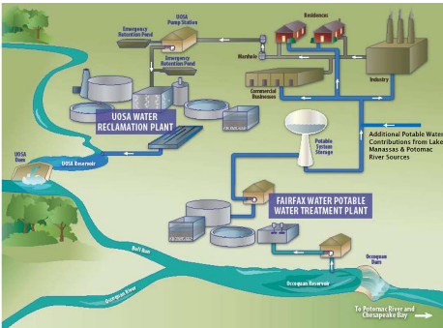
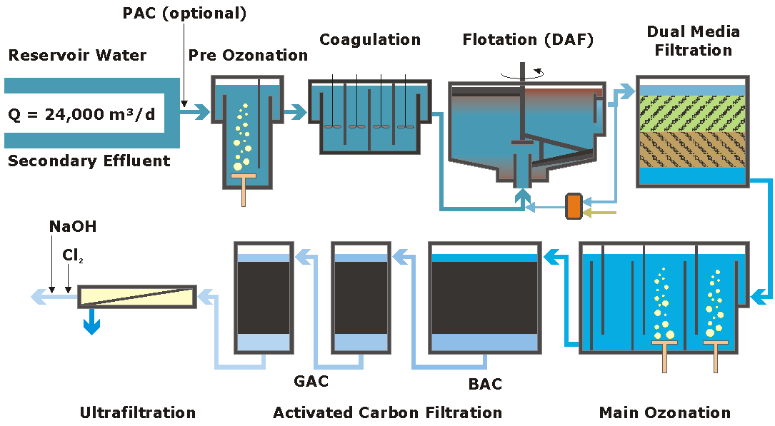
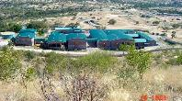
CBAT in Practice!
Windhoek, Namibia – Goreangab Water Reclamation Plant
Upper Occoquan Service Authority
Direct potable reuse since 1960s using CBAT
Upgraded in 2000
Surface water augmentation in practice since 1978
WW discharge limits set to improve reservoir health and downstream drinking water treatment

Slide 15
Case Studies
Gwinnett County, GA – F. Wayne Hill WRC

Slide 16
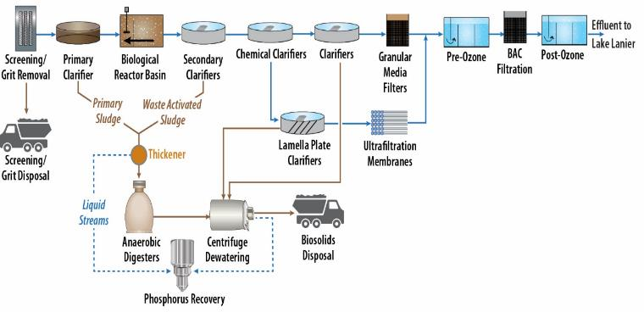
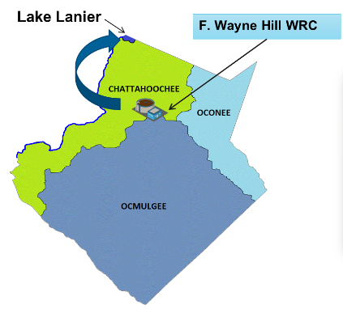
FWHWRC – CBAT for IPR
Added Ozone/BAC to meet stringent COD limits; now seeing IPR benefits with surface water augmentation of Lake Lanier
Process treatment train at the F. Wayne Hill Water Resources Center
Notes:
Piloted DPR – Gaya to send slides

Slide 17
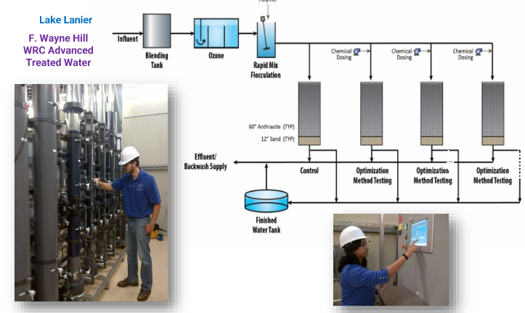
FWHWRC – CBAT and DPR
All blends: biological parameters were below detection
All blends: DBPs were low
15% FWHWRC Blend
50% FWHWRC Blendx
100% FWHWRC
Met ALL primary and secondary MCLs evaluated
Nitrate, Bromate, Color, Manganese, NDMA > MCL or action levels
Nitrate, Bromate, Cyanide > MCL levels
https://www.waterrf.org/research/projects/demonstration-high-quality-drinking-water-production-using-multi-stage-ozone
Courtesy GCDWR, Gaya Ram Mohan, Kati Bell

Slide 18
Case Studies
Franklin, TN

Slide 19

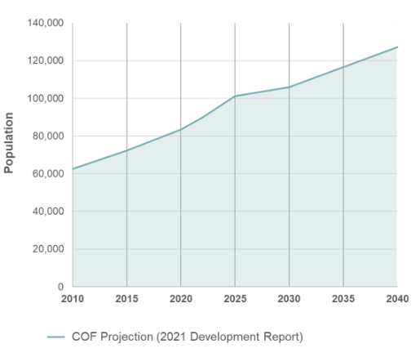


City of Franklin, TN - CBAT Considered to Meet Multiple Objectives and Potential End-Points
  Irrigation: Expand the use
  of reclaimed water for landscape and other irrigation
  Recreation: Use purified water to increase flows
  in the Harpeth River
  Augmentation: Use purified water to increase availability of source water to the Water Treatment Plant

Slide 20
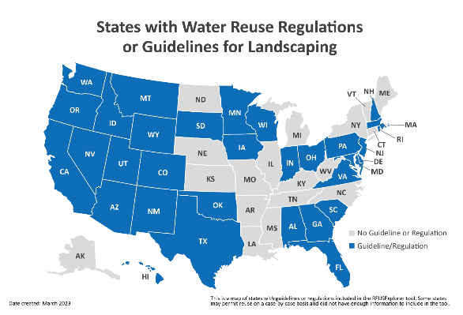
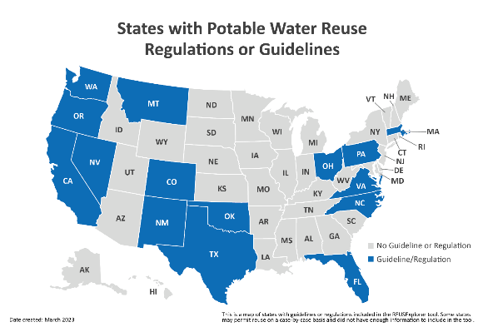
TN Did/Does Not Have Potable Reuse Guidelines
Reference: USEPA REUSExplorer

Slide 21
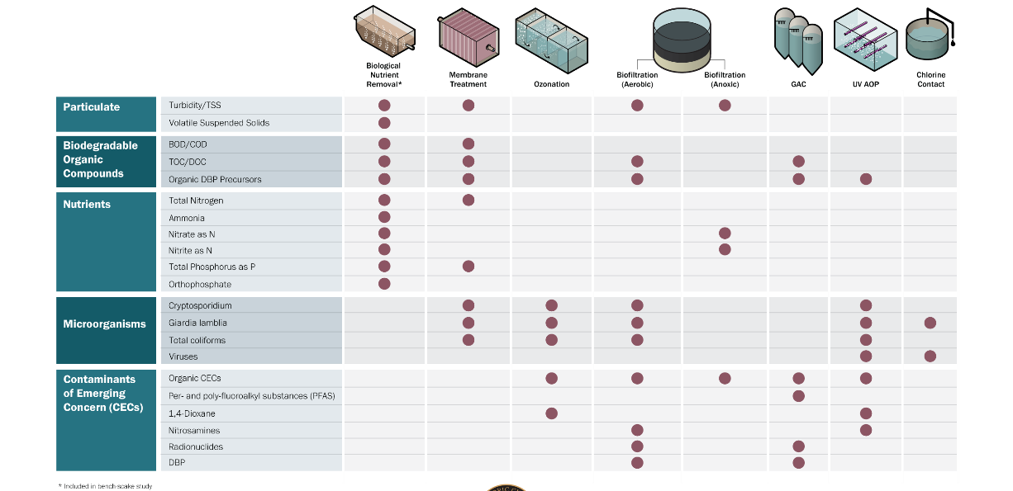
Long-Term CBAT Pilot Conducted to Support Permitting
Multi-barrier Treatment Approach

Slide 22
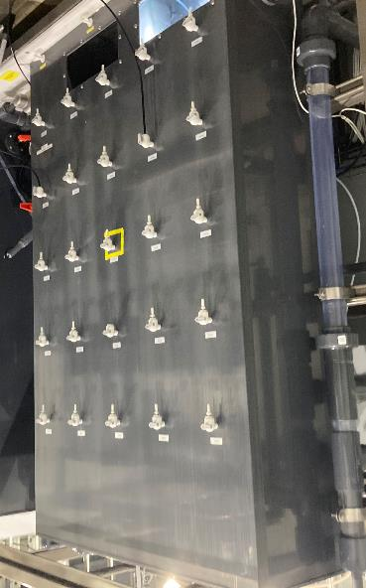
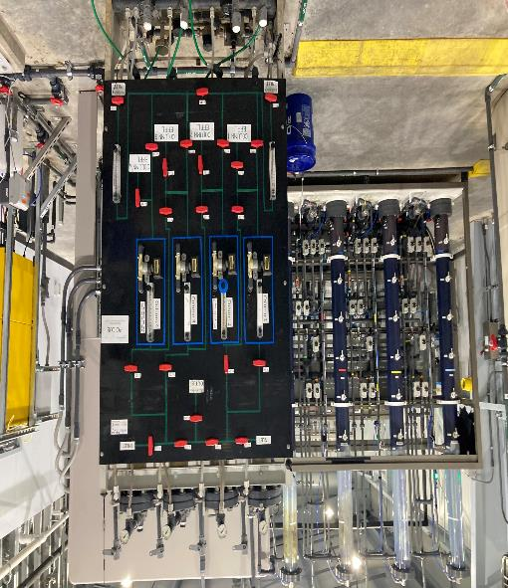
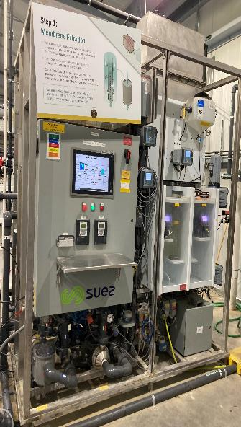
CBAT Pilot Pictures
Ozone Contactor
GAC
BAF
Tertiary Membranes

Slide 23
Bench Scale
Nutrient Removal
Ozone-BAC
Organics and Nutrients
GAC
CECs
UVAOP
CECs
N and P
TOC/DOC, TN
Organics Removal
Microbial Inactivation
Pilot Summary
Ozone
Ozone:TOC ratio contact time, CT, LRV
BAC
HLR, EBCT, Supplemental C dose, Feed DO, backwash criteria
GAC
EBCT, upstream water quality, bed volumes
UVAOP
UV dose, peroxide dose, upstream water quality
Lessons learned translate to design criteria for individual processes to meet treatment objectives.
AWT Process capable of producing high quality effluent:
TOC ≤ 3 mg/L
UVT > 94%
TSS < 1 mg/L
TN ≤ 2 mg/L
TP ≤ 2 mg/L
CECs - Met Target Log Reduction / MCLs
  > 97% reduction of PPCPs
Notes:
Algal bioassays – improved discharge water body quality
Highlight which of these aligned with TCDEQ requirements

Slide 24
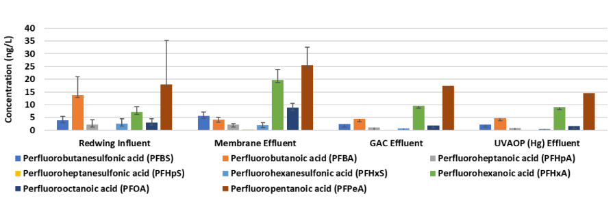
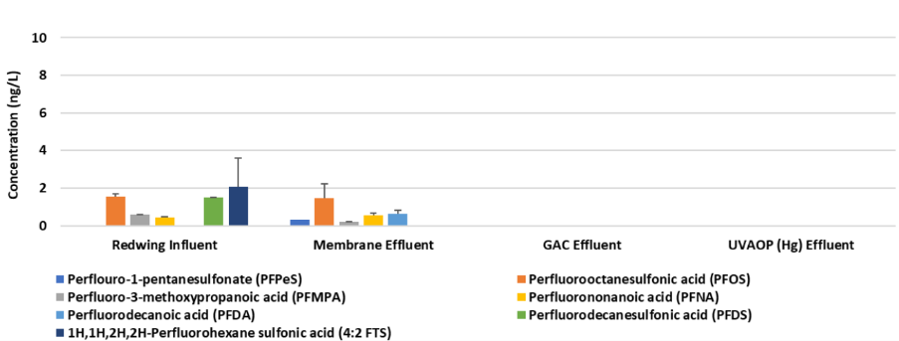
Pilot Summary
PFOA and PFOS removed to below 4 ng ng/L

Slide 25
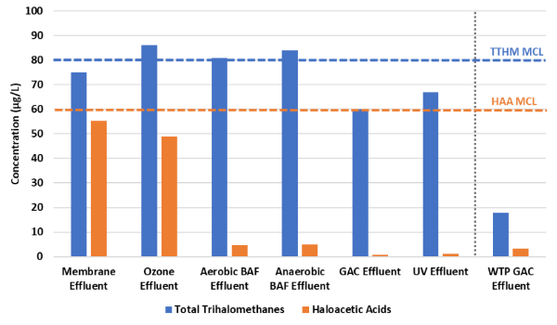
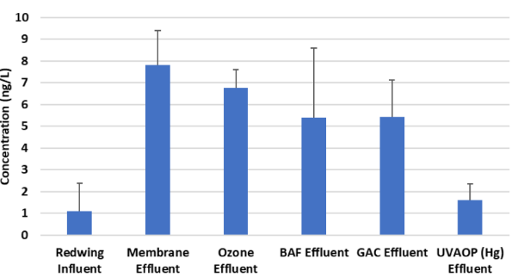
Pilot Summary
HAA and TTHM < MCLs
Nitrosamines removed to between 1 and 2 ug/L

Slide 26
Pilot Summary
HAA and TTHM < MCLs
Nitrosamines removed to between 1 and 2 ug/L

Slide 27
Summary and Future Considerations
Notes:
DPR paradigm

Slide 28
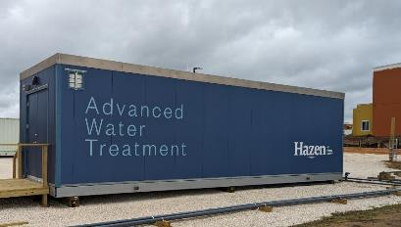
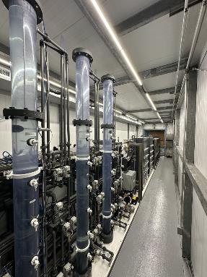
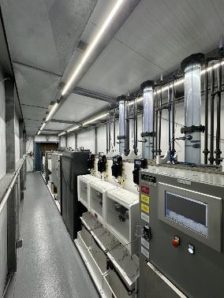
The Future of AWT is Bright!
CBAT has an established track record
CBAT configuration is adaptable
CBAT is a robust treatment platform that can be further enhanced
CBAT is not proprietary
  Diversity in mechanisms (oxidation, separation, adsorption) to accomplish log reductions of chemical and microbial contaminants
  Always room for improvement and refinement!
  Minimize bromate formation / ozone control and minimization of other regulated and unregulated DBPs
  Increase reduction of 1,4-dioxane
  Optimize pathogen LRVs
  Organics pre-treatment
  TDS
Notes:
CBAT is good base-case
Hybrid options can get us intensified benefits
Salt management options
40% cheaper → mBAT (FWH)
Potable reuse stds for TX – TCDEQ for Bustamante
Can meet requirements – need to pilot
Can address the salt piece – doesn’t generate ROC; however, weakness is no TDS reduction
Footprint also positive

Slide 29

Using Carbon-Based Advanced Treatment (CBAT) to Implement "One Water" Initiatives
Chamindra Dassanayake (CD), PhD, PE
cdassanayake@hazenandsawyer.com
Wendell Khunjar, PhD, PE
wkhunjar@hazenandsawyer.com
Gaya Ram Mohan
grammohan@hazenandsawyer.com

