Slide 1
TACWA – Advancing Operator Training/Customized Curriculum
Dawn R. Anderson, PE March 22, 2024

Slide 2
Agenda
Water/Wastewater Operations Workforce
Operator Licensing & Renewal Requirements
Training Solutions with Customized Curriculum
Operations Workforce Today
Focused Commitment on Training
Leadership Commitment in the Future
2

Slide 3
National Operator Statistics
110,000 Employed Water and Wastewater Operators
10,500 Projected Annual Openings, on Average for the Next Decade
Source: Bureau of Labor Statistics 2021
3

Slide 4
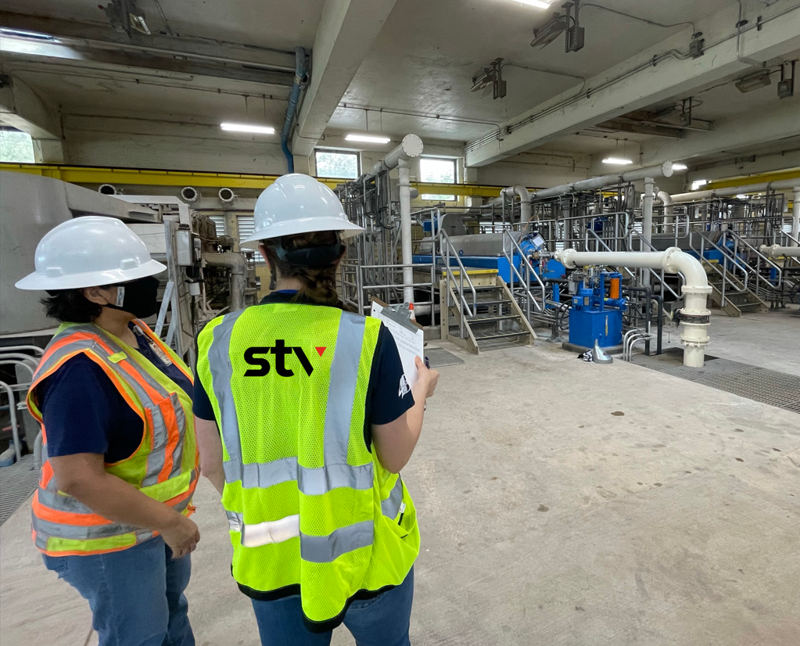
Texas Operator Statistics
TCEQ Reported the Past Decade
Decline in Water/Wastewater Licensed Operators
Increase in Texas Total Population
Increase in Texas Water Demand
Water/Wastewater Industry
Increase in Regulations
Increase in Advanced Treatment Process
Houston Advanced Research Center Survey
63% Respondents - Workforce Challenges
4

Slide 5
Operator Licensing – TCEQ Eligibility Requirements
Operator License Classification | Minimal Requirements (Hours) | Testing for Licenses
Class A Wastewater Operator | 5 Required Courses (100) + 1 Elective (20)* Must have a total of 160 hours of TCEQ Approved Training for Wastewater* 8-Years of Work Experience | Application Fee $111 Test Location: Austin Region or any TWUA Regional School
Class B Wastewater Operator | 4 Required Courses (80) + 1 Elective (20) 5-Years of Work Experience | Application Fee $111 Online Base Test at Acceptable Location
Class C Wastewater Operator | 2 Required Courses (40) + 1 Elective (20) 1-year of Work Experience | Application Fee $111 Online Base Test at Acceptable Location
Class D Wastewater Operator | 1 Required Course (20) No Work Experience Required | Application Fee $111 Online Base Test at Acceptable Location
5

Slide 6
Operator Licensing Renewal – TCEQ Requirements
All Wastewater Licenses
Valid for 3 Years
Class D Wastewater Licenses
Not Renewable (In most Cases)
30 CE Credits Required for Renewal
License Cannot be Renewed…
90 Days Prior to Expiration
30 Days After Expiration
6
Notes:
Online renewal, background check

Slide 7
Operator Training Approved by TCEQ & Resources
Training Providers
Annual Short-Schools
University of Texas at Arlington
Tarrant County College
Sponsored/Neighboring Utilities
Distance Learning Providers
Ken Kerri Courses
Online Providers
7
Notes:
Find and add some online provider logos

Slide 8
Operator Training Curriculum Expansion
TCEQ Regulatory Guidance – Approval of Training
Conferences/Trade Associations
Advanced Operator Training
Fats, Oils & Greases (FOG)
Nutrient Removal Module 1 – Basic with Chemical Nutrient Removal
Nutrient Removal Module 2 – Advanced with Biological Nutrient Removal
Wastewater Plant Simulator Workshop
Instrumentation & Controls 101
Electrical 101
Advanced Aeration Basin & Clarifier Training
8

Slide 9
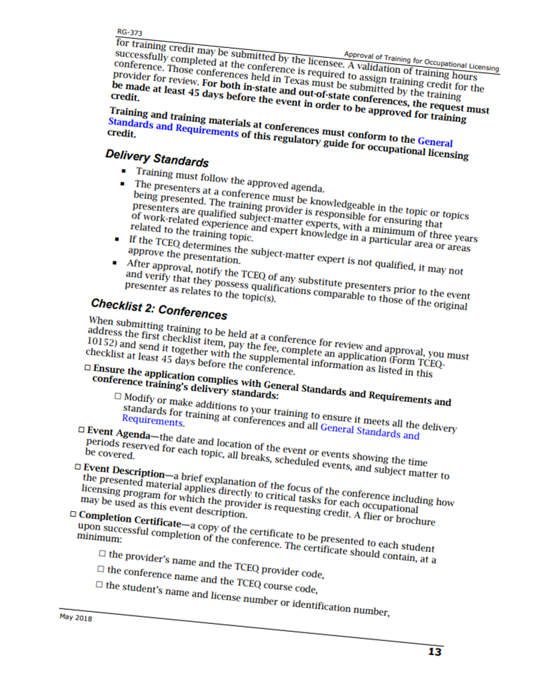
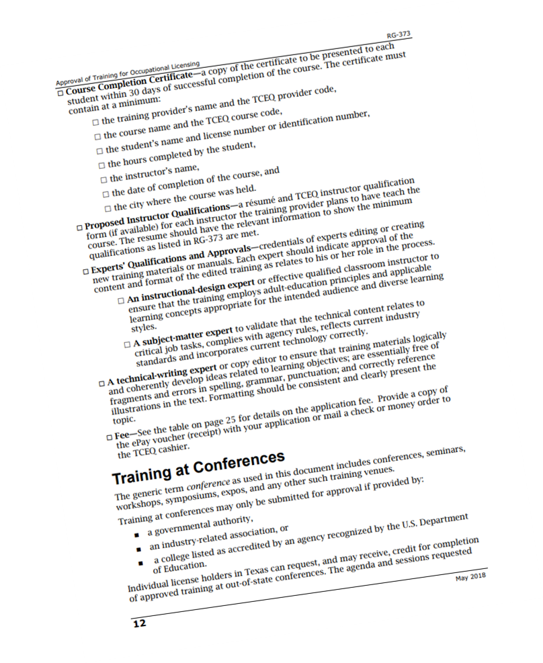
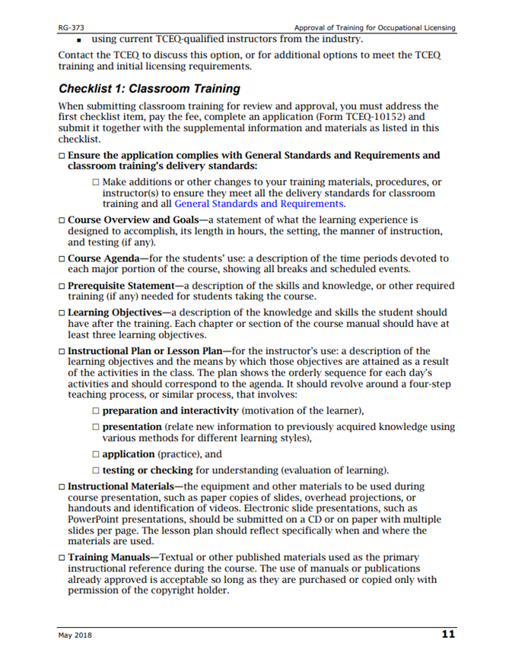
Operator Training – TCEQ Approval Process
Application Must Comply with General Standards, Requirements, and Delivery Standards
Provide TCEQ with the following:
Course Overview and Goals
Course Agenda
Prerequisite Statement
Learning Objectives
Instructional Plan
Instruction Material
Training Manuals
Proposed Instructor’s & Expert’s Resume
Technical-Writing Expert
Fee
Course Completion Certificate
Submitted by TCEQ Training Provider
9

Slide 10
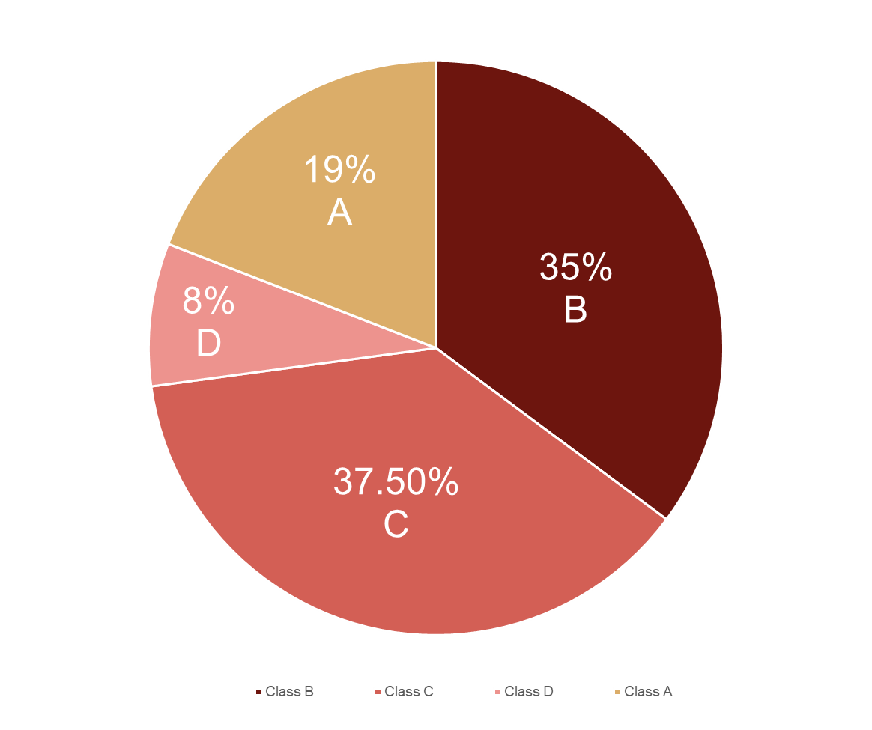
SAWS Operations Workforce
TCEQ Approved Training Provider
SAWS Wastewater Class Licensees*
Class A- 17 Employees
Class B- 31 Employees
Class C- 33 Employees
Class D- 7 Employees
Class A WW License Average Age - 54
Licensees Eligible for Retirement - 30
10

Slide 11
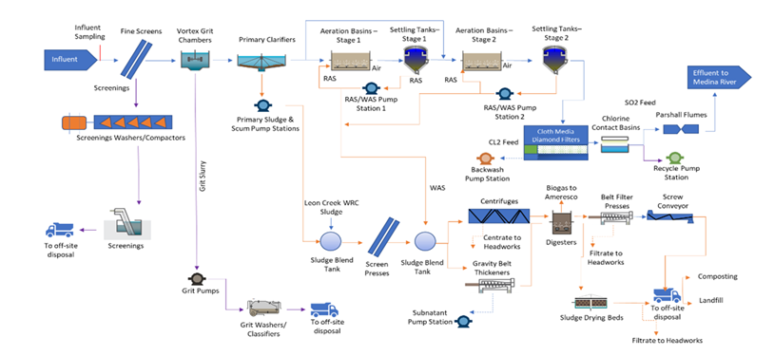
Advanced Operator Training Tailored for SAWS
Bridged the Gap for Knowledge Transfer
Provided Team Building Opportunities
Provided CE Renewal Credits for Operator Licenses
Provided Specific Equipment, Treatment, and Safety to SAWS Operators
Steven M. Clouse Water Recycling Center
11

Slide 12
SAWS Advanced Operator Training Courses
3 Operator Training Curriculums
Liquids Treatment
Solids Treatment
Disinfection
STV Provided
TCEQ Required Course Material
TCEQ Approved Trainers
Felipe Gutierrez, PE, PhD
Dawn Anderson, PE, Class A Operator
SAWS Operator Attendees Spanned
Operator Age Range
Experience & Class License
All SAWS Water Recycling Plants
12

Slide 13
SAWS Liquid Treatment Training Course
20 Hour Operator Training
SAWS System Overview, Collection System, & Discharge Permits Wastewater Characterization
Preliminary Treatment
Primary Treatment
Secondary Treatment
Filtration and Disinfection
Discharge Permits
 | Leon Creek WRC | SM Clouse WRC | Medio Creek WRC
Total Suspended Solids
Daily Average Concentration (mg/L) | 15 | 12 | 15
Daily Average Loading (lbs/day) | 5,755 | 12,510 | 2,002
7-day Average (mg/L) | 25 | 20 | 20
Daily Max (mg/L) | 40 | 40 | 30
Single Grab (mg/L) | 60 | 60 | 40
13

Slide 14
SAWS Solids Treatment Training Course
16 Hour Operator Training
Introduction to Solids Handling
Solids Conditioning
Thickening
Digestion
Dewatering
Sidestream Treatment
14

Slide 15
SAWS Disinfection Training Course
8 Hour Course
Purpose and Function
Indicator Organisms
Chlorine Disinfection
Theory of Operation
Equipment and O&M
Process Variables and Controls
Troubleshooting
Safety
UV Disinfection
Theory of Operation
Equipment and O&M
Process Variables and Controls
Troubleshooting
Safety
Data Collection, Sampling, and Analysis
15

Slide 16
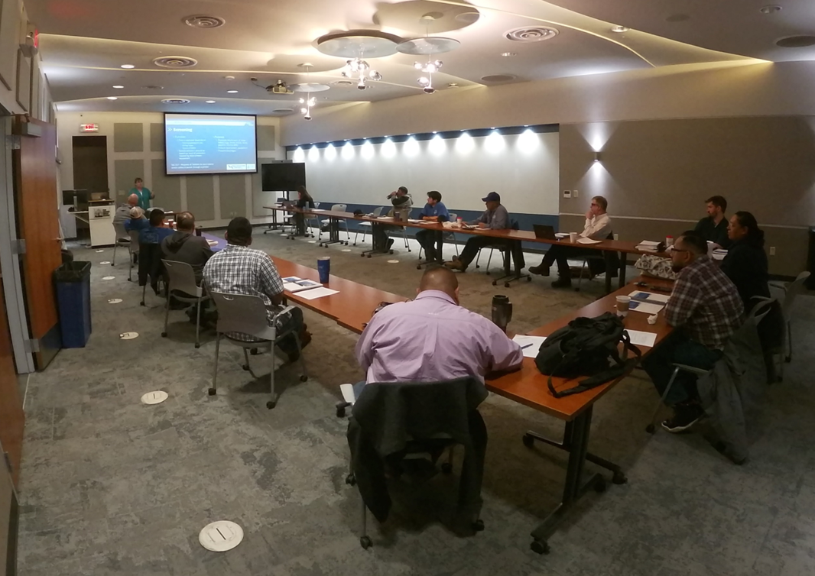
Customized Operator Training Benefits
TCEQ Operator Training Credit
Tailored Training Discussions
Operational Troubleshooting
Knowledge Transfer
Team Building
16

Slide 17
Summary
Operator Demand is Greater than the Declining Pool of Experienced Operators
Water/Wastewater Industry Knowledge Gap with Experienced Operators Retiring
Explore Training Solutions for Your System & Operator Needs
T
Your Commitment to Operator Workforce Training & Development is a Commitment in Our Future
17
17

Slide 18
Thank You!
Questions?
Dawn Anderson, PE
P: (214) 796-9956
E: Dawn.Anderson@stvinc.com

