Slide 1
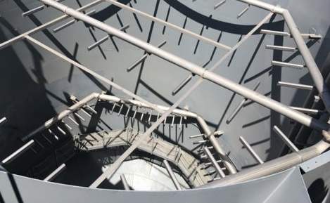
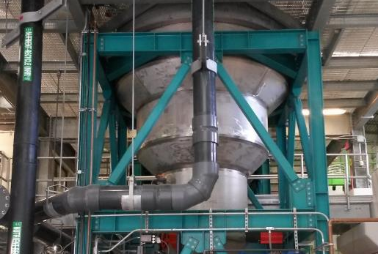
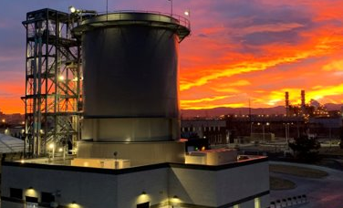
To Recover or Sequester? - Holistic Approaches to Managing Phosphorus (and Struvite) through Anaerobic Digestion
TEXAS ASSOCIATION OF CLEAN WATER AGENCIES
MARCH 22, 2024

Slide 2

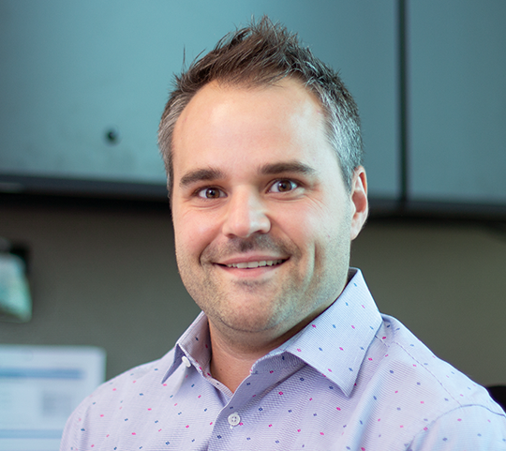
Introductions
Wendell Khunjar, PhD
Brandt Miller, PE
Director of Wastewater Innovation and Senior Process Specialist
With Hazen since 2012
Over 20 years of experience in all things water, including sidestream nutrient management and recovery projects (HRSD, Gwinnett County, Metro Water Recovery, etc.)
Principal investigator and technical advisor on 10+ WRF projects
Texas Wastewater Practice Leader
WEAT Municipal Resource Recovery & Design and Nutrient Committee Member
Over 16 years of experience including BNR design, process modeling, and operations support
Technical lead on over $650M in WRF design projects across Texas

Slide 3
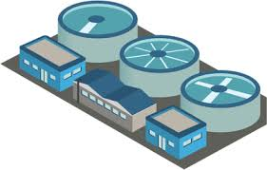
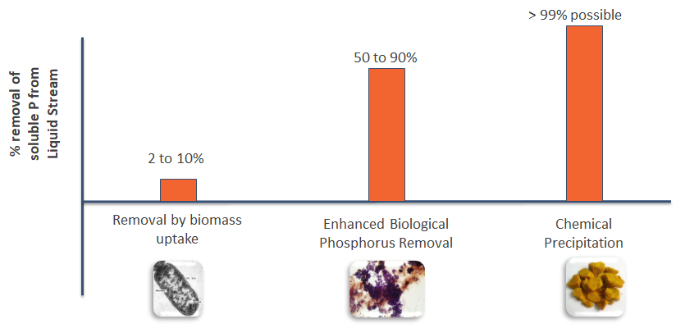
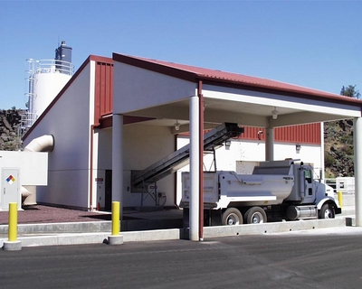
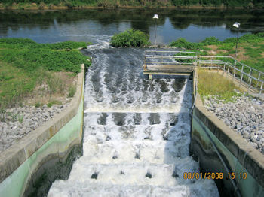
What is the Fate of Phosphorus at WRRFs?
Phosphorus
Recycle
Solids
Liquid Effluent
90+% of influent P can be present in the solids

Slide 4

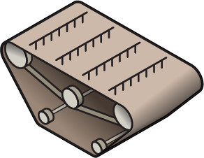

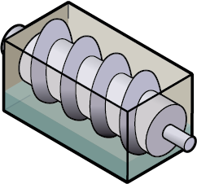

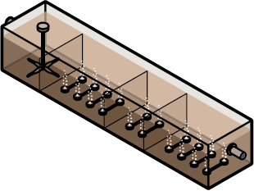
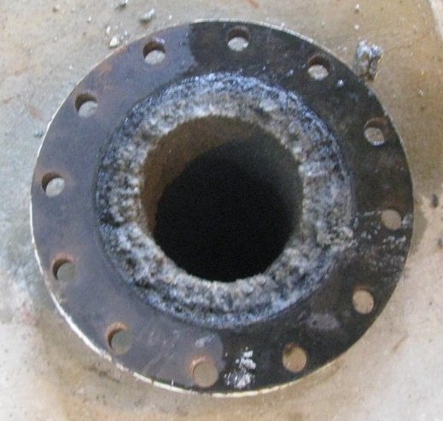

Managing Solids and Sidestream Nutrients is a Challenge
Primary and/or secondary treatment
Thickening
Stabilization
Dewatering
Residuals management
Solids stabilization can release a large amount of P (and N, Mg, Ca, Fe, etc.)
Nuisance precipitate formation
Challenges with effluent compliance
Increased labor, chemicals, etc.
Notes:
Slug loads in recycle

Slide 5
Solids and Sidestream Nutrient Characteristics Drive Precipitate Formation Potential
Precipitant
Type:
Chem P +
THP + AnD
EBPR +
THP + AnD
Struvite
(Mg + NH₃ + PO₄)
Chem P + AD/AeD**
EBPR + AnD/AeD**
Brushite
(Ca + PO₄)
Sidestream nitrogen content
Vivianite
(Fe + PO₄)
Chem P +
PAD**
EBPR +
PAD**
Chem P + HTNS
Biomass uptake + HTNS
EBPR + HTNS
EBPR – enhanced biological phosphorus removal
THP – thermal hydrolysis
AnD – anaerobic digestion
AeD – aerobic digestion
PAD - Post aerobic digestion
HTNS – holding tank and no stabilization
**NO₃
Sidestream phosphorus content
Notes:
Precipitate potential
Chemical is left side, ortho-p low

Slide 6
Several Strategies Exist for Navigating Challenges Associated with High Solids and Sidestream P
MANAGE
precipitate formation after it forms
SUPPRESS
precipitate formation by manipulating chemistry
MINIMIZE
precipitate formation by removing chemical constituent
INTENTIONAL
precipitate formation and facilitate removal
Dilution
Acid addition
Chemical addition
Nitrogen removal
Chemical precipitation
Sequestration
Recovery
Mechanical cleaning
These options do not reduce P or N recycle load
These options do reduce P and/or N recycle load
Notes:
Let it form, suppress it, minimize potential, intentionally form where you want it/can control it

Slide 7
Solids and Sidestream Phosphorous Sequestration and Recovery Options
Influent
Headworks
Primary Clarification
BNR
Secondary Clarification
Disinfection
Effluent
Septage
WAS release
WAS
Thickener
Anaerobic Digestion
SOLIDS STREAM (PRE-DEWATERING) OPTIONS
Thickener Filtrate
MagPrex
Nuresys*
EloVac
Nutrient Recovery Option
Struvite
Nutrient Recovery Option
Dewatering
Biosolids
Sequestration vs. Harvesting configurations
Dewatering Filtrate
Struvite
Chemical Precipitation
LIQUID STREAM (POST-DEWATERING) OPTIONS
Ostara
Paques
Nuresys*
Struvia
CalPrex

Slide 8
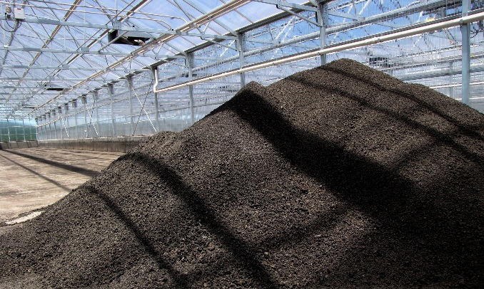
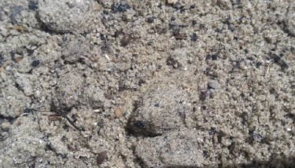
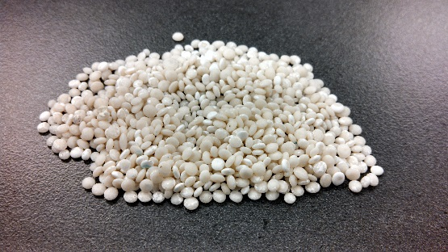
Sequestration vs. Recovery
Sequestration
Recovery
(from sludge)
Recovery
(from centrate)
Form precipitate and retain in the sludge
Form precipitate and extract from sludge
Form precipitate and extract from centrate/filtrate
Dominated by small crystals
Mix of small and large particles
Nucleation
Crystal Growth
Aggregation
Nucleation
Crystal Growth
Aggregation
Nucleation
Crystal Growth
Aggregation
Notes:
Nucleation – first step to form single crystal layer
Grow
Aggregate

Slide 9






Sequestration
Recovery
(from sludge)
Recovery
(from centrate)
Sidestream P load
Scaling potential reduction
Biosolids dewatering
Biosolids nutrient content reduction
Recovered product potential
Implementation Costs
Notes:
Scaling potential reduction

Slide 10



To Sequester or Recover?
Metro Water Recovery
Robert W. Hite Treatment Facility
Denver
Notes:
Our first case study involves a pre-dewatering phosphorus recovery system at the Robert W Hite Treatment Facility owned and operated by the Metro Wastewater Reclamation District.
We’ve partnered with the District and Stantec to plan, design, and construct a phosphorus recovery system at this facility.

Slide 11
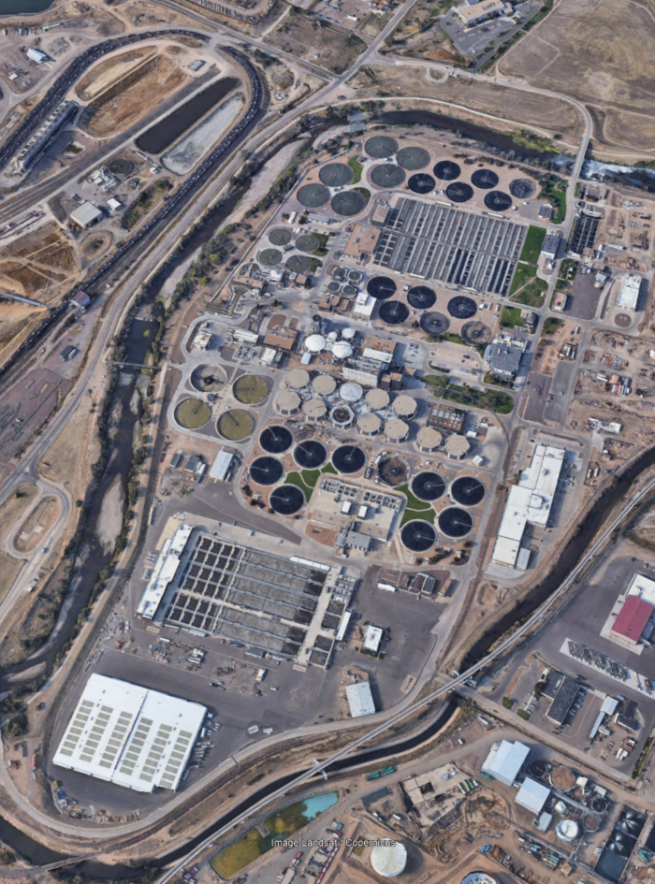
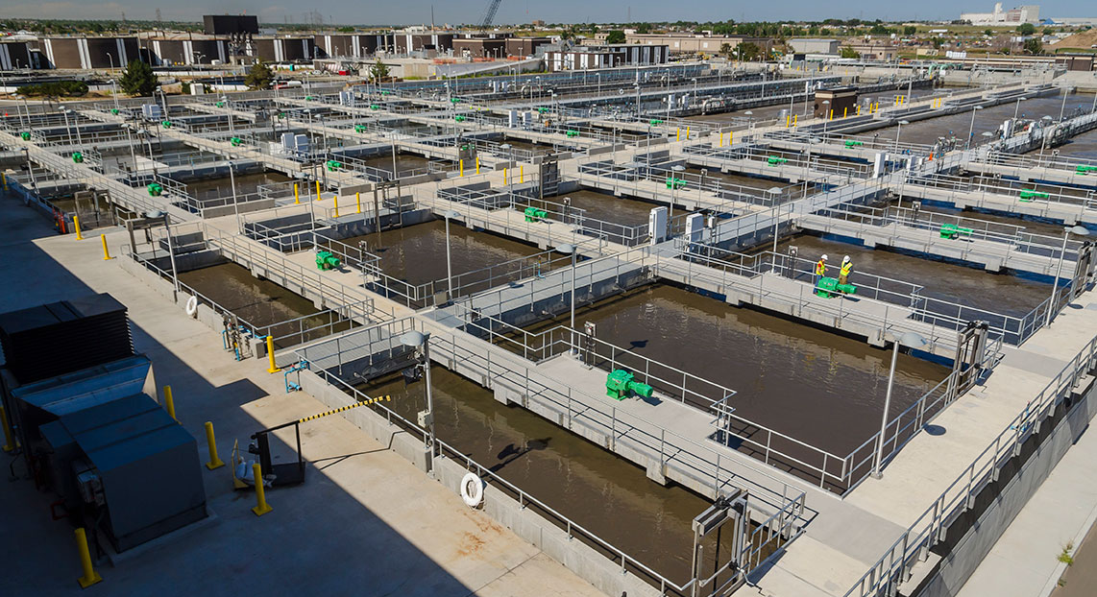
Robert W. Hite Treatment Facility (RWHTF)
220 mgd WRRF
Influent TP ~ 5 mg/L
Future Effluent TP Limits
Notes:
The Hite facility is a 220 mgd WRRF located in Denver
Influent TP averages 5 mg/L
Future effluent TP limits may be as stringent as 0.1 mg/L

Slide 12
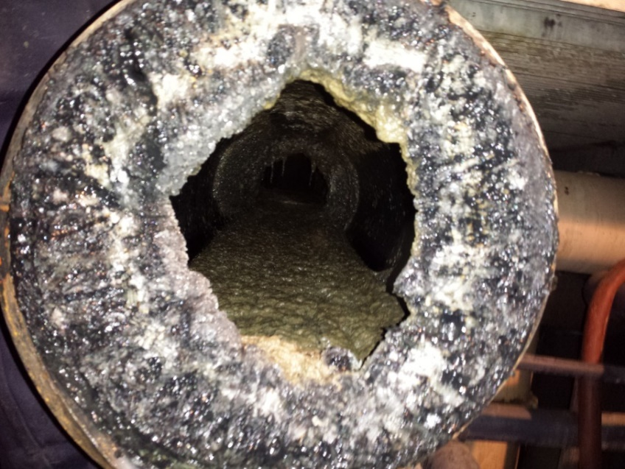
Combination of EBPR and AD Results in Significant Struvite Formation in Digester and Dewatering Complex
Sidestream represents
26% of Inf TP,
25% of Inf TKN
Primary Sludge
GVTs
GTE to NSEC SARs/SSEC
Digestion
SHT 3
SHT 2
Dewatering
CST
DMX
Return to NSEC CARRBs
Overflow
(ConWAS)
Return to SSEC CARRBs
Cake
Secondary Sludge
DAFT
Formation of up to 2,000+ lb P/day of nuisance precipitate
Underflow (DAFnate) to IPW

Slide 13
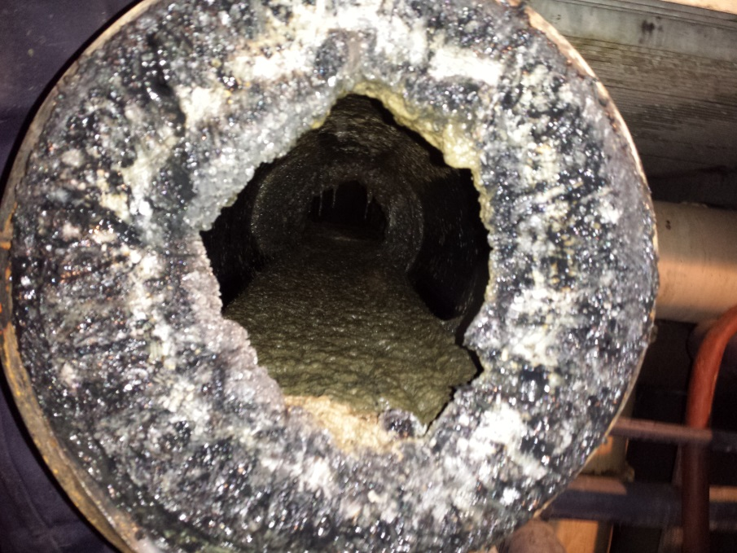
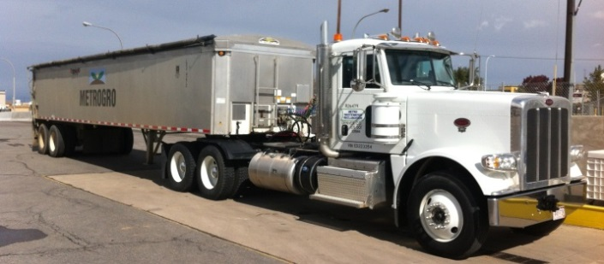
Multiple Drivers for Phosphorus Management
5 Measures for Success
Break the phosphorus recycle loop
Struvite-scale issues for O&M
Biosolids dewatering costs
Phosphorus loading on soils
Recovery of a finite resource
1 lb of phosphorus equates to 8 lbs of struvite
7,000 lbs of phosphorus enter the RWHTF each day!

Slide 14
Multiple Concepts Evaluated for RWHTF
PS
WAS
WAS Release
Thickener
Anaerobic Digestion
Recovery only
Ostara + WASSTRIP
CalPrex
Thickener Filtrate
Sequestration/ Recovery Option
Sequestration/Recovery
MagPrex
Nutrient Recovery Option
Dewatering
Return to main plant
Dewatering Filtrate
Biosolids

Slide 15
Sequestration/Recovery
MagPrex
MagPrex
Courtesy CNP

Slide 16
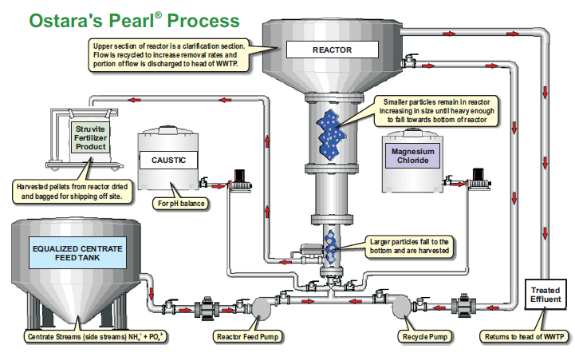


Recovery
WASSTRIP + Pearl
CalPrex
Release tank
Pre-dewatering
WAS
dWAS
Dewatering
CalPrex
Primary solids
Cake
Brushite

Slide 17
Evaluation Results
MagPrex
CalPrex
WASSTRIP + Ostara
Sidestream P load
470 lb/day
300 lb/day
650 lb/day
Scaling potential
1,900 lb/day
1,300 lb/day
1,000 lb/day
Polymer reduction
14 to 18%
Site-specific
piloting needed
5 to 10%
Cake %TS (increase)
3 to 5%
0 to 2%
Recovered product potential
410 lb/day
2,100 lb/day
1,900 lb/day
Implementation Costs
$11.8M
$16.9M
$21.8M

Slide 18
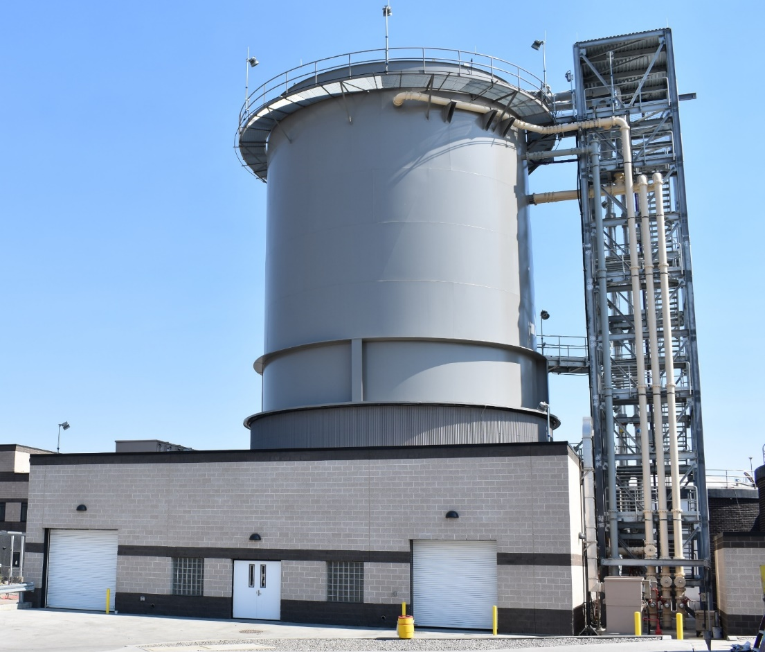
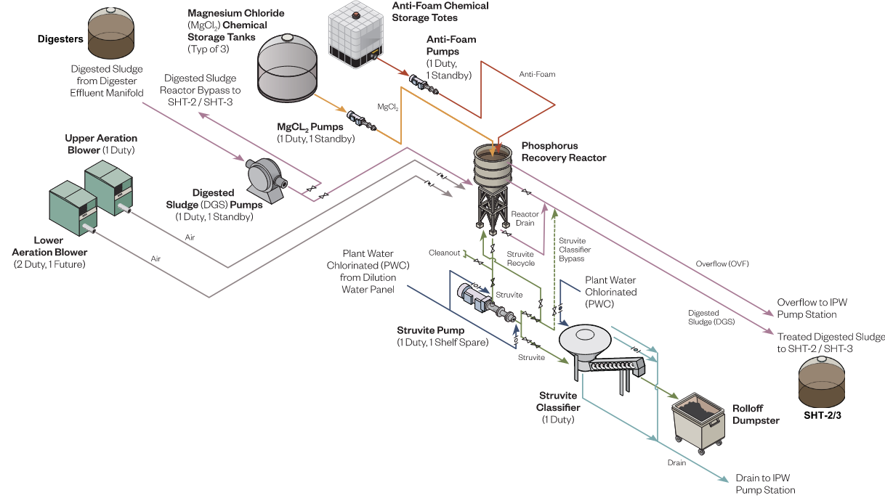
7 to 10 hour HRT
MagPrex Process Flow Diagram for RWHTF
Notes:
CNP’s MagPrex a relatively simple system that primarily requires Ortho-P and NH4 from digested sludge, magnesium addition, process aeration to raise the pH, and hydraulic residence time
In order to facilitate struvite formation:
Anaerobically digested sludge is pumped to the MagPrex reactor
Blowers are used for air stripping of carbon dioxide to increase the pH of the digested sludge since struvite forms more readily at higher pH
Magnesium chloride is dosed into the reactor since it’s the limiting nutrient for struvite formation
Anti-foam can be dosed to the top of the reactor to mitigate foaming if needed
Struvite settles in the reactor cone so it can be periodically removed using the struvite pump
There are three primary operating modes that determine where struvite removed from the reactor goes:
In Recovery Mode – Struvite flows to the struvite classifier where it’s washed and then discharged to a dumpster
In Recycle Mode – Struvite is recycled to the top of the reactor so fine crystals can grow larger to enhance struvite recovery
In Sequester Mode – Sequestered struvite is routed to a holding tank and onward to dewatering

Slide 19
Lessons Learned Since Commissioning
80+% oP reduction
20+% polymer demand reduction ($575K/year savings)
Minimal benefits on cake %TS at present

Slide 20
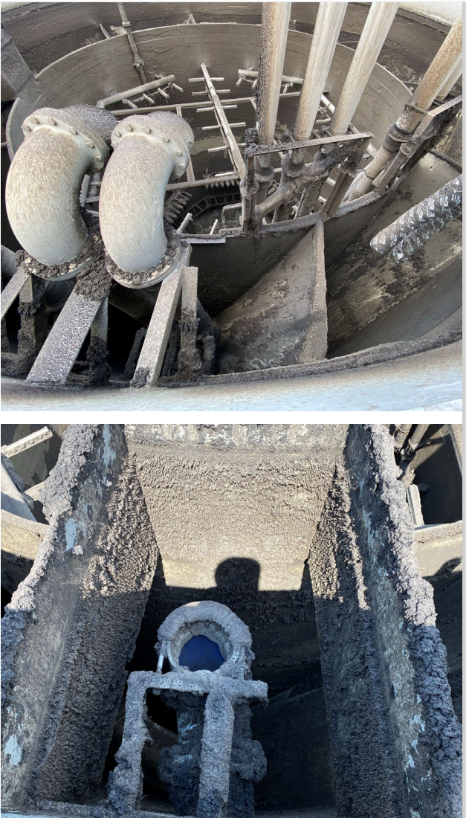
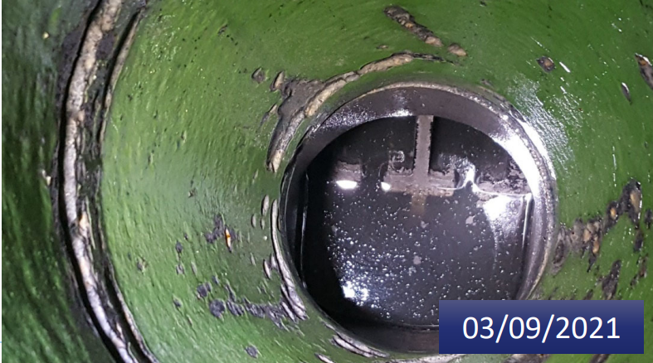
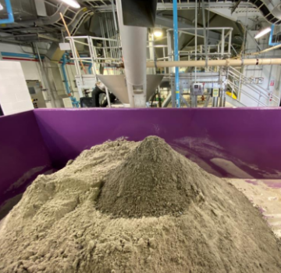
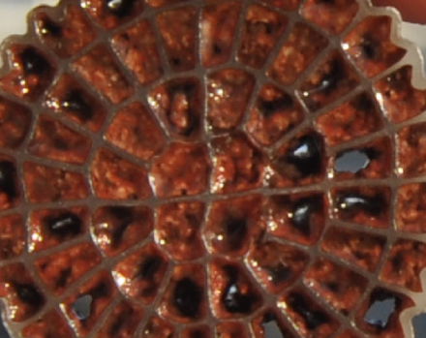
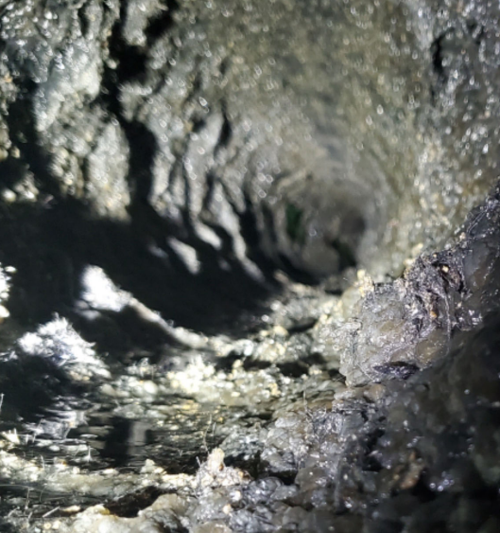
Lessons Learned Since Commissioning
Struvite capture lower than anticipated
Reactor cleaning is challenging
Nuisance precipitation decreased downstream reactors…
Alkalinity losses impact sidestream deammonification
…struvite still present in feedlines to reactors

Slide 21
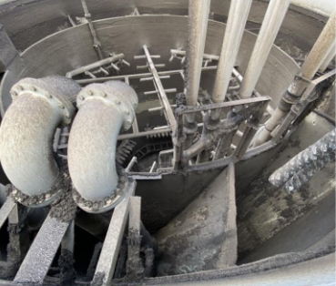
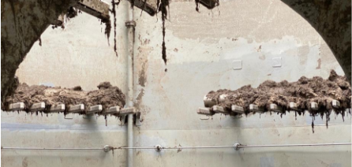
Design and Implementation Takeaways
Influent and Primary Sludge Screening important
Low-profile, vertically oriented diffusers are recommended
  Avoid Wide-band, horizontally oriented diffusers
Eliminate upper diffusers
  Metro turned off upper with no process impacts
Process control for aeration/alkalinity control if coupled with deammonification
Notes:
Complex scaffolding was erected between the reactor’s inner and outer shells and throughout the inside of the reactor to facilitate welding and coating as well as diffuser installation.
Upstream screening is critical to protecting AirPrex and reliable operation. Fine screening of influent wastewater and additional screening of primary sludge is recommended to prevent rags/wipes from accumulating inside the reactor as shown in attached photos. We understand influent wastewater is screened by coarse screens and 6 mm perforated plate screens. In addition, a strain press is suggested for primary sludge screening.
It appears the Haifa design includes low-profile, vertically oriented diffusers. Low-profile, vertically oriented diffusers like the ones shown in the attached photos are recommended. Wide-band, horizontally oriented diffusers are not recommended. At Metro, rags/wipes have accumulated on wide-band diffusers and some have broken off as shown in the attached photos.
It appears the Haifa design includes lower diffusers, but not upper diffusers. That configuration is preferable and upper diffusers are not recommended. Metro’s upper diffusers have proven problematic and were recently turned off without any negative process impacts. Some of the upper diffusers sheared off due to the combination of upward forces from the lower diffusers and downward forces from rags/wipes.

Slide 22


To Sequester or Recover?
Key to understand P, N, Mg and Ca balances at facility
Both options break recycling load effectively
Sequestration
?
Recovery
Process can be simpler
Can operate with or without exogenous chemical addition
Multiple options for sequestration
EloVac, MagPrex, Nuresys
Recovery most efficient from dewatering stream;
Lower recovery from sludge matrix
Need to balance oP conversion with pellet growth
Fines formation and capture important

Slide 23
Questions?
Wendell Khunjar, PhD PE
Brandt Miller, PE, PMP
wkhunjar@hazenandsawyer.com
703-267-2759
bmiller@hazenandsawyer.com
469-250-3784

Slide 24
To Recover or Sequester? - Holistic Approaches to Managing Phosphorus (and Struvite) through Anaerobic Digestion
TEXAS ASSOCIATION OF CLEAN WATER AGENCIES
MARCH 22, 2024

